Slide 1


ENRON EUROPE
Q2-2001
Plan Reforecast(CE2)
DRAFT
Prepared by FP&A

Slide 2
Index
Page
Summary PL
PL Analysis
Headcount/Org Chart
Expense Analysis
Allocations Analysis
Appendix
Detailed Expenses by Cost Centre Quarter to Date vs Reforecast 1
Detailed Expense by Cost Centre Full Year.

Slide 3
Summary PL
Highlights:
YTD
Forecast July to Dec.
Issues/Recommendations
Follow Up Points from Q1 Reforecast Meeting
Conclusion

Slide 4
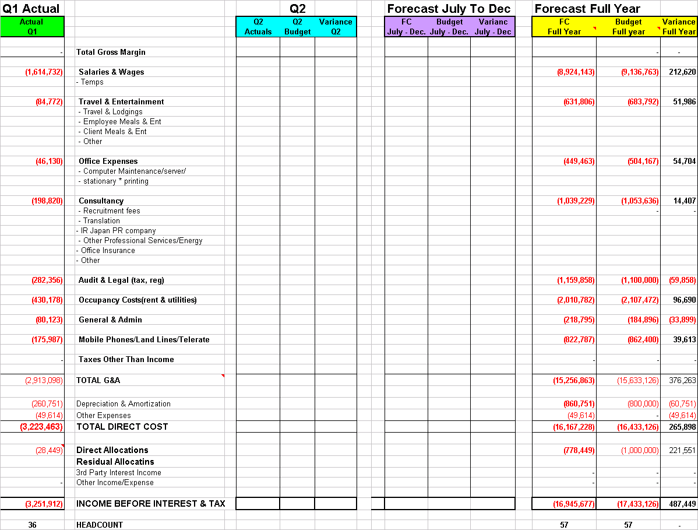
CE2 PL Analysis

Slide 5
Headcount Org Chart.
Org chart and/or detailed Headcount by name.

Slide 6
Expense Analysis
Detailed Expense Analysis by line to be completed.

Slide 7
Allocations

Slide 8
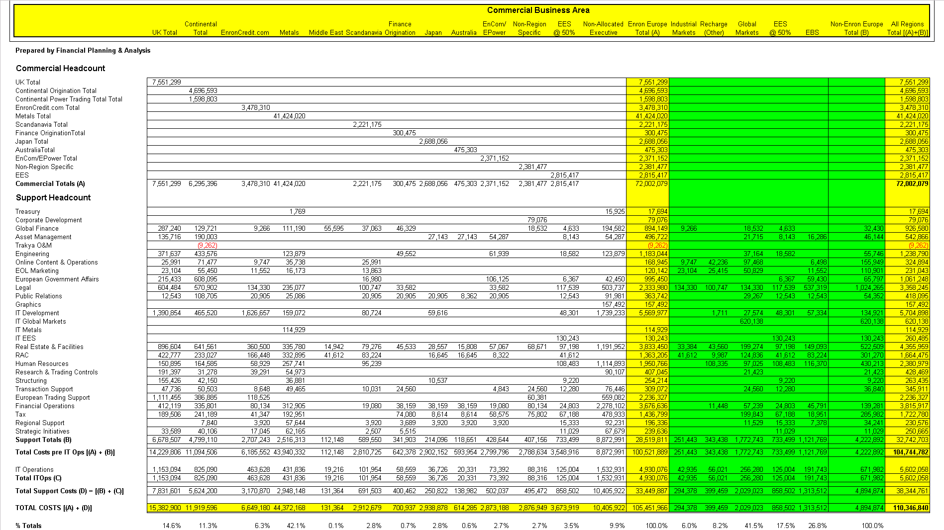
Allocations Analysis

Slide 9
APPENDICE

Slide 10
Detailed Expenses by Cost Centre Quarter to Date vs Reforecast 1

