Slide 1
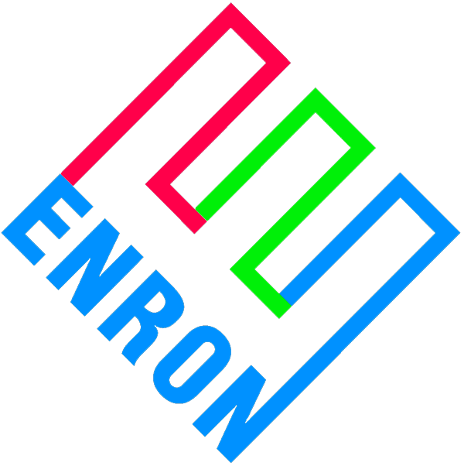
Merchant Plant Finance Price Risk Management Products
Entergy Wholesale Operations
March 30, 2000

Slide 2
Overview
Merchant generators face significant financial hurdles
Low credit ratings at project level
High coverage requirements
Low leverage ratios
Double leverage: parent and project sub
This is particularly true for mid-merit and peaking units
The financial community seems fixated on intrinsic value
Profits from energy sales dominate the analysis
Minimal consideration for extrinsic value (optionality)
Possible reasons for this include:
No familiarity with underlying commodity markets
Lack of conviction around modeled future price lines
Uncertainty with collateral valuations

Slide 3
Enron’s Perspective
Unlike other lenders, Enron can:
Manage the commodity price risk position
Take possession of and operate the collateral to our best commercial advantage
Be more creative with debtor restructurings
Enron can consider other commodity and geographic alternatives
Enron’s overall objective is to protect MTM earnings
This represents an obvious commercial opportunity for Enron to assist merchant generators to access lower cost of capital
Absorb some merchant price line risk
Step inside capital markets pricing
Concept is only valuable to merchant generators if we can accomplish an investment grade rating, or at a minimum higher leverage at project level

Slide 4
Basic Business Deal
Enron will enter into commodity price risk management contracts designed to provide a minimum amount of commodity revenues sufficient to meet at least 1.0x debt service
On a par amount of bonds Enron will specify
Our obligations must not be considered a guarantee of debt or hit Enron’s credit or balance sheet on any basis other than commodity price risk management contract
Payments under the contracts are in reality loans that must be repaid
Payments owed to Enron under any contract will be secured by a second mortgage
Subordinate only to senior bonds
Exercisable after fairly short cure period
Enron’s product is financial only
No physical delivery
Non-invasive on plant operations, marketing

Slide 5
Basic Business Deal
Enron’s product supports a financing in the 144a or public debt markets
Loan terms:
20 years
Par amount and amortization schedule to be determined by Enron (goal is 60% to 75% leverage)
No ABT
Equity sweep provisions comparable to industry standards
In essence, Enron has sold equity a put option on the project
Equity is incented to walk when asset value is less than debt outstanding
Enron’s product is really designed to bridge the time period until equity can go back to the capital markets on more favorable terms

Slide 6
Risk Allocation of Project
Enron takes merchant price risk. Lower than expected markets will likely bring pressure on Project’s ability to repay monies owed to Enron
Risks not covered by Enron
Risk Mitigant
Construction completion EPC contractor
Unit operation Operator and equity
Explosion, fire, etc Business interruption insurance
Unit availability Market based LD insurance
Most of the risks not covered by Enron are typically covered by other parties for merchant generators in the normal course of business

Slide 7
Flow Diagram
EPMI’s structure assures that
revenues > O&M and debt service
This puts Enron’s credit on merchant price line assumptions
Equity’s option to repay shortfalls are the same both pre & post Enron
Before, equity had to decide whether or not to default on debt. Now equity must decide whether or not to default on Enron
Enron assumes a credit position comparable to senior secured, but on more favorable terms to equity
Higher leverage
Longer term
No market windows
Net bp savings
$ Revenues
e-
ICAP
Other
Project
L.L.C.
Option, but not
obligation to
make up short-
fall in $
$ if necessary
EPMI
1. O&M
$ repayment
2. Debt Service
3. Equity

Slide 8
Example: $450/kW simple cycle peaker
Capital Markets
Rating: B- to BB+
IR (T=6%): T+350 to T+500
Leverage: <50%
Capital Structure:
Debt: $225/kW
Equity: $225/kW
Total: $450/kW
Debt Service: $28/kW-yr $31/kW-yr
PV10: $212/kW $235/kW
$ Benefits: Base Case ($23/kW)
Enron PRM
BBB- & Higher
T+150 to T+250
60% 75%
$270/kW $337/kW
$180/kW $113/kW
$450/kW $450/kW
$26/kW-yr $35/kW-yr
$221/kW $297/kW
+$36/kW +$27/kW

Slide 9
Equity Book Value vs. Debt Outstanding
Enron’s risk position is greatest in the middle years of the project’s life
Equity will likely refinance as soon as the capital markets offer more favorable terms than Enron’s deal

Slide 10
Enron’s Commercial Objectives
Structure puts Enron’s credit on the merchant price line
Achieve investment grade rating for project
Enron’s participation characterized as a PRM contract, not a guarantee of debt
Incent, but not obligate equity to make additional payments when required or lose plant
Short cure periods
Mortgage on asset
Incent, but not obligate equity to refinance, taking Enron out of credit support role

Slide 11
Next Steps
Confidentiality agreement; exclusivity
Identify Entergy’s candidate projects:
equipment, location, pro-forma costs
Research how the Project is currently financed
identify 3rd party security features
Enron to present structure & fee proposal
30 days
Investment bankers, rating agencies, marketing, closing
6 months

