Slide 1
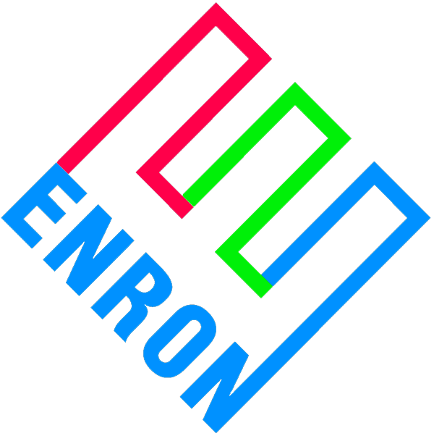
Merchant Plant Finance
Price Risk Management Products
Entergy Power
March 30, 2000

Slide 2
Overview
Merchant generators face significant financial hurdles
  Low credit ratings at project level
  High coverage requirements
  Low leverage ratios
This is particularly true for mid-merit and peaking units
The financial community seems fixated on intrinsic value
  Profits from energy sales dominate the analysis
  Minimal consideration for extrinsic value (optionality)
Possible reasons for this include:
  No familiarity with underlying commodity markets
  Lack of conviction around modeled future price lines
  Uncertainty with collateral valuations

Slide 3
Enron’s Perspective
Unlike other lenders, Enron can:
  Manage the commodity price risk position
  Take possession of and operate the collateral to our best commercial advantage
  Be more creative with debtor restructurings
    Enron can consider other commodity and geographic alternatives
    Enron’s overall objective is to protect MTM earnings
This represents an obvious commercial opportunity for Enron to assist merchant generators to access lower cost of capital
  Absorb some merchant price line risk
  Step inside capital markets pricing
Concept is only valuable to merchant generators if we can accomplish an investment grade rating, or at a minimum higher leverage at project level

Slide 4
Basic Business Deal
Enron will enter into commodity price risk management contracts designed to provide a minimum amount of commodity revenues sufficient to meet at least 1.0x debt service
  On a par amount of bonds Enron will specify
Our obligations must not be considered a guarantee of debt or hit Enron’s credit or balance sheet on any basis other then commodity price risk management contract
Payments under the contracts are in reality loans that must be repaid
Payments owed to Enron under any contract will be secured by a second mortgage
  Subordinate only to senior bonds
  Exercisable after fairly short cure period
Enron’s ultimate hammer over equity is the mortgage

Slide 5
Basic Business Deal
Enron’s product support a financing in the 144a or public debt markets
Loan terms:
  20 years
  Par amount and amortization schedule to be determined by Enron
  No ABT
  Equity sweep provisions comparable to industry standards
In essence, Enron has sold equity a put option of the project to Enron
  Equity is incented to walk when asset value is less than debt outstanding
Product concept is really designed to bridge the time period until equity can go back to the capital markets on more favorable terms

Slide 6
Risk Allocation of Project
Enron takes merchant price risk. Lower then expected markets will likely bring pressure on Projects ability to repay monies owed to Enron
Risks not covered by Enron
Risk Mitigant
  Construction completion EPC contractor
  Unit operation Operator and equity
  Explosion, fire, etc Business interruption insurance
  Unit availability Market based LD insurance
Most of the risks not covered by Enron are typically covered in the normal course of business for merchant generators

Slide 7
Flow Diagram
EPMI’s structure assures that
revenues > O&M and debt service
  This puts Enron’s credit on merchant price line assumptions
Equity’s option to repay shortfalls are the same both pre & post Enron
  Before, equity had to decide whether or not to default on debt. Now equity must decide whether or not to default on Enron
Enron assumes a credit position comparable to senior secured, but on more favorable terms to equity
  Higher leverage
  Longer term
  No market windows
  Net bp savings
$ Revenues
e-
ICAP
Other
Project
L.L.C.
Option, but not
obligation to
make up short-
fall in $
$ if necessary
EPMI
1. O&M
$ repayment
2. Debt Service
3. Equity

Slide 8
Example
Capital Markets
Rating: B- to BB+
IR (T=6%): T+350 to T+500
Leverage: <50%
Capital Structure:
Debt: $225/kW
Equity: $225/kW
Total: $450/kW
Debt Service: $28/kW-yr $31/kW-yr
PV10 $212/kW $235/kW
$ Benefits: Base Case ($23/kW)
Enron PRM
BBB- & Higher
T+150 to T+250
60% 75%
$270/kW $337/kW
$180/kW $113/kW
$450/kW $450/kW
$26/kW-yr $35/kW-yr
$221/kW $297/kW
+$36/kW +$27/kW

Slide 9
Equity Book Value vs. Debt Outstanding
ENA Risk Basis
Enron’s risk position is greatest in the middle years of the Project’s life
Equity will likely refinance as soon as the capital markets offer more favorable terms than Enron’s deal

Slide 10
Enron’s Commercial Objectives
Structure puts Enron’s credit on merchant price line risk
  Achieve investment grade rating for project
Enron’s participation characterized as a PRM contract, not a guarantee of debt
Incent, but not obligate equity to make additional payments when required or lose plant
  Short cure periods
  Mortgage on asset
Incent, but not obligate equity to refinance, taking Enron out of credit support role

Slide 11
Next Steps
Confidentiality agreement; exclusivity
Identify Entergy’s candidate projects:
  equipment, location, pro-forma costs
Research how the Project is currently financed
  identify 3rd party security features
Enron to present structure & fee proposal
  30 days
Investment bankers, rating agencies, marketing, closing
  6 months

