Slide 1

NAME OF SCHOOL
DATE
Opportunities with Enron

Slide 2


Slide 3
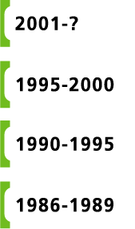
ENRON’S VISION
Become the World’s Leading Company
Become the World’s Leading Energy Company
Become the World’s First Natural Gas Major
Become the Premier Integrated Natural Gas Company in North America

Slide 4

THE WORLD’S MOST INNOVATIVE COMPANY
ENRON’S EVOLUTION
( Segmented by IBIT)

Slide 5
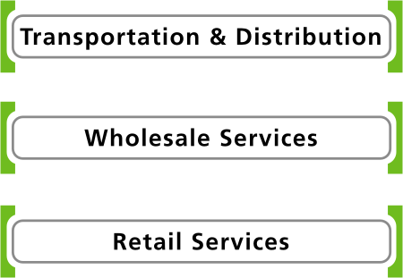
TODAY’S ENRON

Slide 6

TODAY’S ENRON
Natural Gas Transportation and Electric Distribution

Slide 7

STRONG COMPETITIVE POSITION IN ALL MARKETS SERVED
TRANSPORTATION & DISTRIBUTION
Northern Border Partners
(11%)
NORTHERN
3.1 Bcf/d Peak Capacity (Interstate Pipelines)
Operating at Full Capacity
Midstream Operations Recently Acquired
Northern Natural
Portland General
4.3 Bcf/d Peak Capacity
Extensive Supply and Flow Optionality
Operating at Full Capacity During Peak Demand
2,013 MW Generating Capacity
Low-Cost, Flexible Generation
Commodity Price Exposure Managed Through Rate Structure
NORTHERN NATURAL
PORTLAND GENERAL
Florida Gas
(50%)
1.7 Bcf/d Peak Capacity
Serves Rapidly Growing Market
200 MMcf/d Expansion Completed; 425 MMcf/d Underway
Transwestern
TRANSWESTERN
1.7 Bcf/d Peak Capacity
Serves Strong Gas Markets
150 MMcf/d California Capacity Expansion Announced
FLORIDA GAS

Slide 8

TODAY’S ENRON
Marketing and Delivery of Commodities Worldwide

Slide 9

WHOLESALE SERVICES
THE GLOBAL LEADER IN MERCHANT SERVICES
Enron Wholesale Services
Enron Americas
Enron Europe
Nord Pool
Helsinki
Oslo
Stockholm
Teesside
1,875 MW
Wilton
154 MW
Amsterdam
Hamburg
Moscow
Oxford
APX
EEX
Warsaw
IPE
London
Brussels
Nowa Sarzyna
116 MW
Frankfurt
Zurich
Milan
Madrid
Sarlux
551 MW
Marmara
478 MW
Arcos
1,200 MW
Global Markets
Crude & Products, Coal & Emissions, Weather, LNG
Industrial Markets
Pulp, Paper & Lumber, Metals, Steel
Broadband
Asset Operations Worldwide
Enron Net Works

Slide 10
THE MOST FLEXIBLE, RELIABLE AND VALUABLE ENERGY NETWORK
WHOLESALE SERVICES
>
Largest, Most Reliable Provider of Natural Gas and Power Worldwide
Unparalleled Physical and Contractual Assets and Market-Making Activities
Expanding Market Reach, Scalability, Information and Liquidity
Proven Risk Management Skills
Successful Application of Technology Increasing Leading Competitive Position
>
>
>
>

Slide 11
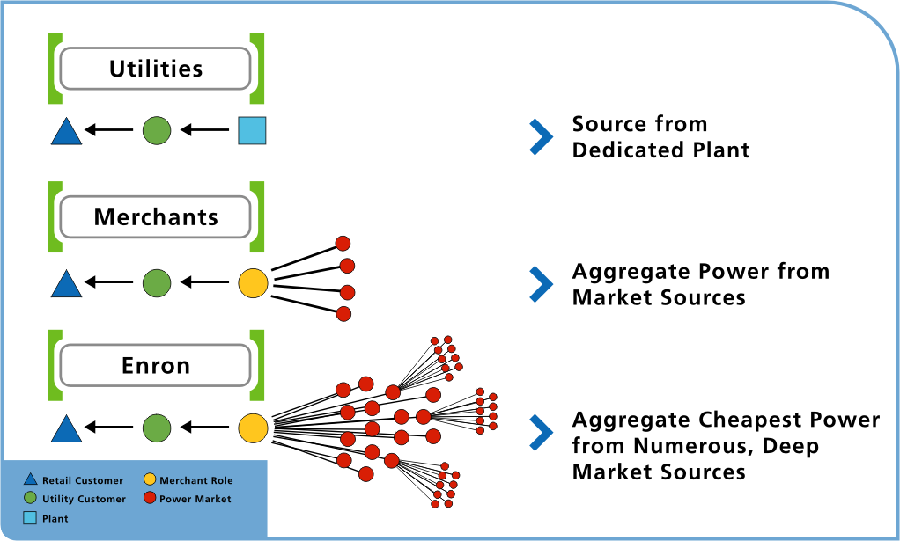
CONTRASTING BUSINESS APPROACH
WHOLESALE SERVICES
EXAMPLE: PROVIDING RELIABLE POWER SUPPLY

Slide 12

ENRON’S LEADING MARKET POSITION
WHOLESALE SERVICES

Slide 13
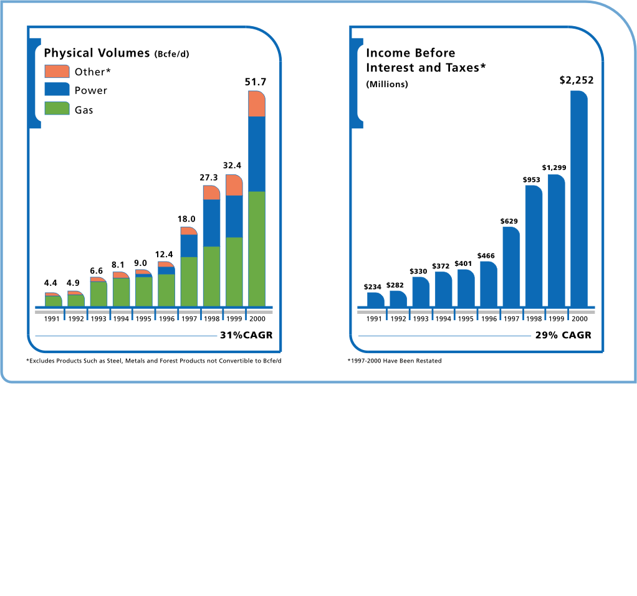
HIGH, LONG-TERM CORRELATION IN VOLUMES AND PROFITABILITY
WHOLESALE SERVICES
* Excludes Products Such as Steel, Metals and Forest Products not Convertible to Bcfe/d
* 1997-2000 Have Been Restated

Slide 14
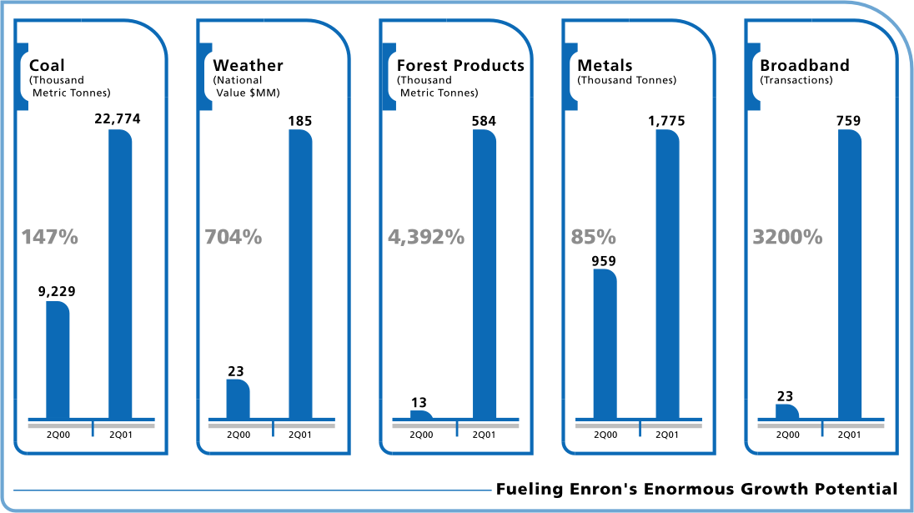

PROFITABILITY EXTENDING INTO NEW MARKETS
WHOLESALE SERVICES

Slide 15
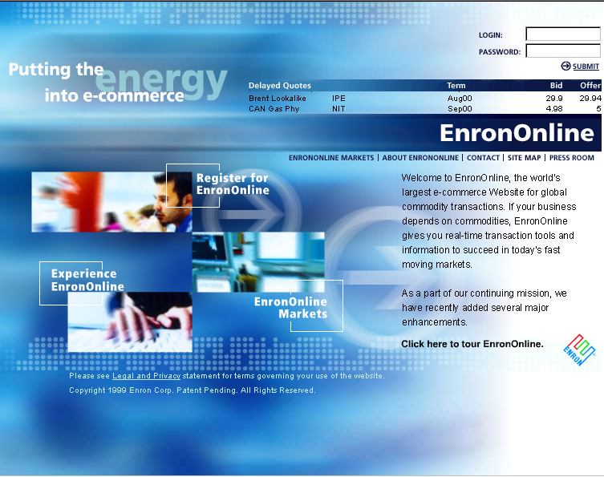
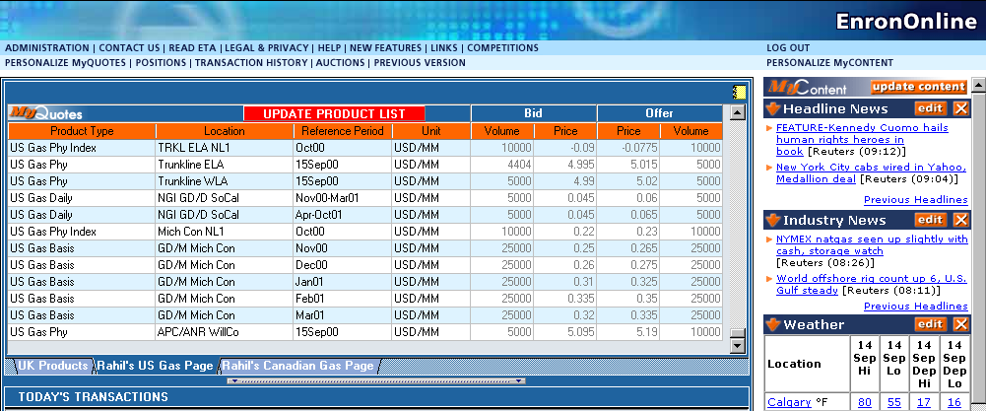
EnronOnline
WHOLESALE SERVICES
WORLD’S LARGEST WEB-BASED eCOMMERCE SITE
Since Inception (Late 1999)
>
1,360,000 Transactions
$780 Billion Gross Value
More than 1800 Products Offered
>
>

Slide 16
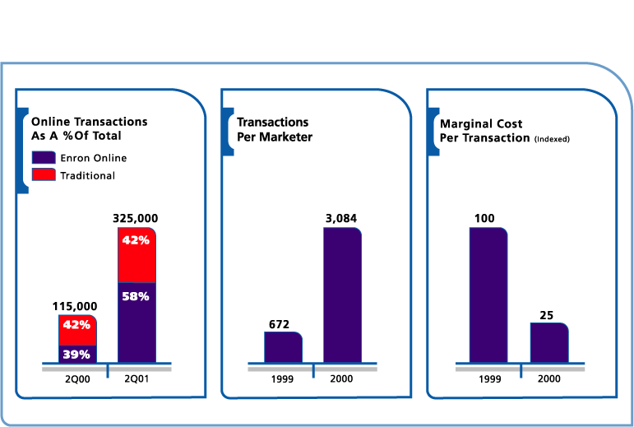
EFFICIENCY GAINS
WHOLESALE SERVICES
EnronOnline

Slide 17

TODAY’S ENRON
Energy Services for Commercial and Industrial Customers

Slide 18
RETAIL SERVICES
LEADER IN RETAIL ENERGY SERVICES IN NORTH AMERICA AND EUROPE
Enron Energy Services
>
Extending Enron’s Wholesale Expertise to New Retail Markets
Providing Comprehensive Energy and Facility Management Services Directly to End-Use Customers in the Commercial and Light Industrial Markets
Rapidly Reducing Customers’ Total Energy Costs
>
Enron Offices
HVAC Service
Facility Management
Energy System Design & Installation
Customer Sites
>

Slide 19















CUSTOMER SEGMENTS
RETAIL SERVICES
>$30 Million
Annual Energy Spend
$10 - 30 Million
Annual Energy Spend
<$10 Million
Annual Energy Spend
Comprehensive, Packaged Energy and Facilities Management
Gas, Power and Energy Management Services
Standardized Gas and Power Services
JCPenney
Enron Direct
USA Canada UK

Slide 20
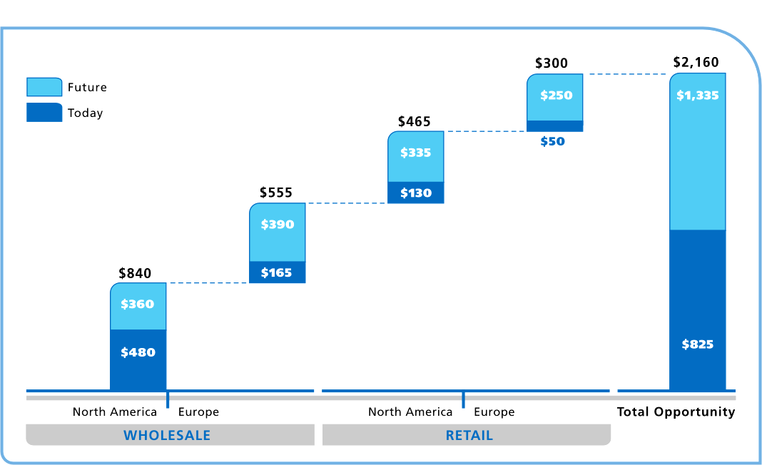
NORTH AMERICA AND EUROPE
ENRON’S MARKET OPPORTUNITIES

Slide 21
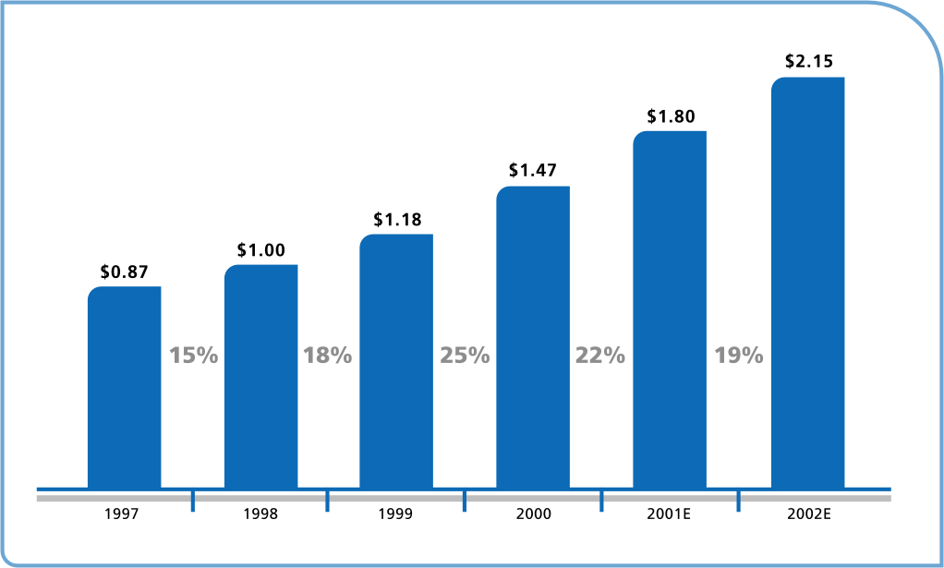
20% AVERAGE ANNUAL GROWTH RATE
ENRON’S EARNING GROWTH
Recurring Earnings Per Diluted Share

Slide 22
LOOSE-TIGHT CULTURE
LIFE AT ENRON
LOOSE
LOOSE
TIGHT
TIGHT
>
Organization
Creativity/New Business Ideas
Work Schedules
Work Environment
Dress Code/Floor Design
Movement of Talent
>
Financial Accounting
Risk Management
Performance Reviews
Legal Obligations
>
>
>
>
>
>
>

Slide 23


Slide 24
THE WORLD’S LEADING COMPANY. . .
LIFE AT ENRON
>
Strong Momentum in Enron’s Established Businesses
Successful New Businesses Extending Enron’s Enormous Growth Potential
Enron is Well-Positioned for Continued Strong, Long-Term Performance
Employees Recognized as a Key Contributor in Making Enron the World’s Leading Company
>
>
>

Slide 25


Slide 26

ENRON ANALYST ASSOCIATE PROGRAM

Slide 27
FOR THE DEVELOPMENT OF ENTRY-LEVEL PROFESSIONAL
Analyst Program
>
24-36 Months in Length
Rotational in Nature With 1 Year Assignment
Ability to Have Immediate Impact
Exposure to Enron’s Culture and Core Competencies
Opportunity to Gain New Knowledge and Acquire Additional Skills
Option to Return to School* or Receive Merit-based Promotion to 3rd Year Analyst After 24 Months
Option to Return to School* or Receive Merit-based Promotion to Associate After 36 Months
>
>
>
>
>
>
*Merit based educational assistance packages maybe available

Slide 28
CORNERSTONE FOR DEVELOPMENT OF ENRON’S COMMERCIAL TALENT
Associate Program
>
18-24 Month Program
Rotational in Nature With 6 Months Assignments
Immediate Responsibility and Impact
Exposure to Enron’s Core Competencies and Culture
Significant Networking Opportunities
Merit-Based Promotions to Manager After 18-24 Months
>
>
>
>
>

Slide 29

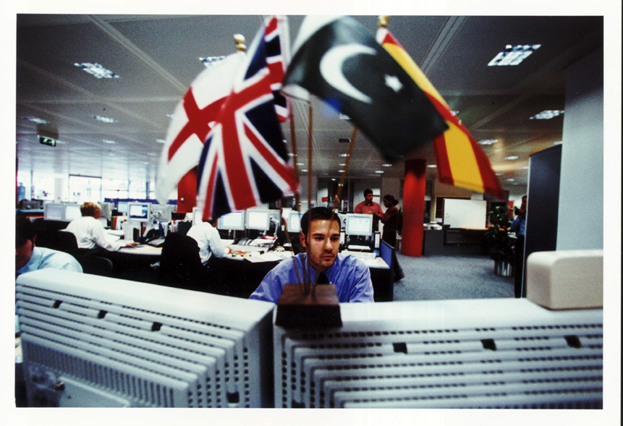
Enron On Campus

Slide 30


www.enron.com

