Slide 1

RESPECT
INTEGRITY
COMMUNICATION
EXCELLENCE

Slide 2
It’s Different Here
We ask “Why?”
We move fast. We provoke change.
We are a New Economy company.
Enron offers the innovation of a dot-com;
We have the stability of the FORTUNE 500;
We have the market acumen and transaction orientation of Wall Street.
Notes:
We ask “Why?”. We are not content to do things the way they have always been done.
We move fast. We provoke change.
We exemplify a New Economy company. We leverage returns with intellectual capital, not just assets. WE value our people. At Enron, every employee is a shareholder.

Slide 3

What People Are Saying About Us
“In less than a decade . . . Enron has emerged from its unlikely perch in the utility industry as a model for the new American workplace - every bit as much as the Silicon Valley start-ups that usually come to mind when the subject is entrepreneurship or innovation.”
SUNDAY, JUNE 27, 1999
Notes:
Work from slide.

Slide 4
Transportation
&
Distribution
Wholesale
Energy
Net Works
Retail
Energy
Broadband
Services
Natural Gas
Transportation
and Electric Distribution
Notes:
Organization Chart
Transportation and Distribution includes our regulated businesses. Enron’s history began with our gas pipeline network. Today, it is one of the largest, most innovative and cost effective systems in North America. The pipelines have been a significant contributor to the development of our North America wholesale energy network.
Wholesale Energy Operations and Services is our largest business. We have leading market positions worldwide in the deregulating energy markets. Our broad scale and extensive scope enables us to reliably deliver energy commodities and provide price-risk management and finance services to our customers at the lowest available cost.
Like we have done in our other businesses, we are extending our business model, intellectual capital and experience to other markets, such as metals and pulp and paper. We call this newest initiative Enron Net Works. In these markets, we will commoditize the products, provide expert physical logistics, price risk management and finance services, and apply eCommerce initiatives to accelerate transaction flow.
We transferred our Wholesale expertise to the new retail energy opportunity. Our Retail Energy business provides energy outsourcing nationwide directly to end-use customers in the commercial and light industrial markets. We are the only comprehensive nationwide provider of energy outsourcing services in North America. Like our wholesale business, its national scale and scope provide enormous operating advantages.
With Enron Broadband Services, we are extending our skills to the rapidly growing broadband market. We have modeled the business on the market-oriented, low asset approach of our very successful global energy business. We are exhibiting significant early success in this business.

Slide 5
Transportation
&
Distribution
Wholesale
Energy
Net Works
Retail
Energy
Broadband
Services
Marketing and
Delivery of Energy
Products Worldwide
Notes:
Organization Chart – Wholesale Energy
Enron has led the deregulation of the worldwide energy markets. The deregulating markets where we operate are growing at annual rates of 25-50%.
Before deregulation, the energy industry was very rigid. Utilities had to rely on dedicated assets and inflexible contract structures to meet their energy supply needs. With deregulation in place, Enron performs a valuable intermediary role – buying from those who are long energy and package it in the load profile and price structure needed by those who distribute or consume energy. In our role, we optimize the gas and power assets of all our customers.
In North America and Europe, Enron has well-established, extensive networks marketing and delivering commodities and offering a broad range of price risk management and finance services.
In the developing regions where we operate, we take an active role in shaping the evolving energy regulations and owning strategic assets to connect areas of supply to demand. We then target opportunities to provide merchant energy services similar to those in North America and Europe..
Business Model:
- We have a clear business model with a track record of success.
- We open markets.
- We package supplies and services to meet customers’ needs.
- We identify and manage risk.
- We use eCommerce to accelerate transaction flow.
- We replicate our business model to rapidly growing new markets.

Slide 6
Enron’s Wholesale Business
Natural Gas
Power
Largest and Most Reliable Provider of Gas and Power Worldwide
Coal
Crude
Products
Unparalleled Portfolio of Assets and Market-Making Ability Allows Enron to Uniquely “Package” Energy to Meet Specific Customer Needs
Emissions
Weather
Risk Management Expertise Provides Predictable Commodity Prices to Customers and Manages Enron‘s Exposure
Pulp and Paper
Metals
Merchant
Investments

Slide 7
COB
COB
Hub
Hub
Cinergy
Cinergy
Hub
Hub
Palo
Palo
Verde
Verde
Hub
Hub
Entergy
Entergy
Hub
Hub
Henry
Henry
Hub
Hub
Notes:
Enron’s Wholesale Energy Network
We have an unparalleled network of physical assets that enable us to reliably deliver natural gas and electricity anywhere in the U.S. on short notice. Our extensive scope, access to assets, liquidity and large capable commercial team provides us tremendous competitive advantage in sourcing supply at the lowest cost and offering our customers innovative higher value products and services.
Our network model involves:
- The use of physical assets in order to gain access to key logistics to deliver energy.
Accessing other’s assets via contractual commitments, which provide greater flexibility and require lower capital expenditure.
Creating extensive market-making capabilities and utilizing the market for intelligence on both price and availability.
All of our North American energy businesses are growing rapidly, as shown on the volume charts.
Our new eCommerce platform, EnronOnline, has also contributed significantly to our recent surge in market share.
Suggested business examples:
Trading and hedging, Peaker plants, Weather

Slide 8



Enron’s European Wholesale Network
U.K.
Volumes
(Bcfe/d - ytd
Nordic
Volumes
(Bcfe/d - ytd
5.6
Nord
Pool
Helsinki
1.8
2.7
Oslo
Stockholm
0.6
Teesside
1,875 MW
3Q99
3Q00
Wilton
154 MW
3Q99
3Q00
Offices
Energy Exchange
LNG Project Under Development
Energy Services
Energy Partnerships
Leased Capacity
Utility Services
Amsterdam
Hamburg
Oxford
APX
Warsaw
Moscow
IPE
EEX
Nowa Sarzyna
116 MW
London
Brussels
Frankfurt
Continental Europe
Volumes
(Bcfe/d - ytd
Zurich
Enron/Petrom JV
1.4
Milan
Budapest
Power Plants
In Operation
In Construction
Under Development
Bucharest
Mora la Nova
1,600 MW
Sarlux
551 MW
0.1
3Q99
3Q00
Energy Marketing
Activity
Madrid
Marmara
478 MW
Arcos
1,200 MW
Gas
Power
Coal
Note: Volumes Include Natural Gas and Power
Notes:
Enron’s European Wholesale Network
We have replicated our strong energy model to Europe.
We have over 2,500 employees in Europe.
We have a lead position if every market.
We are the largest gas and power marketer in the U.K.
We are the market maker on the NordPool.
We are the largest participant in cross-border activity on the Continent.
Each area is growing rapidly and contributing to Enron’s strong growth.

Slide 9
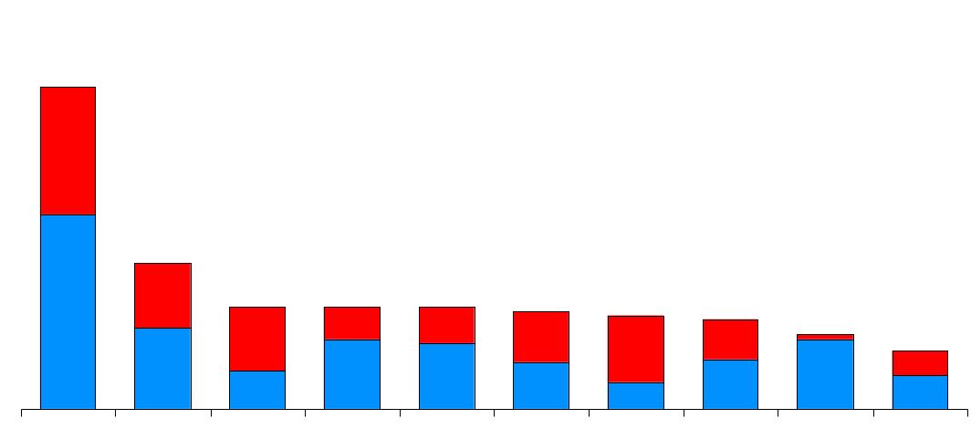
Enron’s Leading Market Position
Third Quarter 2000
(TBtue/d)
47.8
Power
Gas
21.7
15.2
15.2
15.2
14.5
13.8
13.3
11.0
8.6
Enron
Duke
PG&E
Aquila
Dynegy
Reliant
AEP
Southern
Coral
El Paso
Source: Gas Daily, Power Markets Week
Notes:
Leading Energy Marketers – Second Quarter
Enron commands a very strong first place ranking amongst other wholesale energy providers serving North America and Europe. Our volumes are almost 2 ½ times the next largest marketer. We believe we have distanced ourselves from the others and created an unparalleled and valuable strength in the marketplace.
Note: Volumes shown exclude Enron’s crude oil and liquids (5.0 Bcfe/d).

Slide 10
Transportation
&
Distribution
Wholesale
Energy
Net Works
Retail
Energy
Broadband
Services
Expansion Vehicle
for New Commodity
Market Penetration
Notes:
Organization Chart – Net Works
Enron Net Works is an exciting new growth engine for Enron.
Our eCommerce platform, Enron Online, is part of our Net Works business.

Slide 11
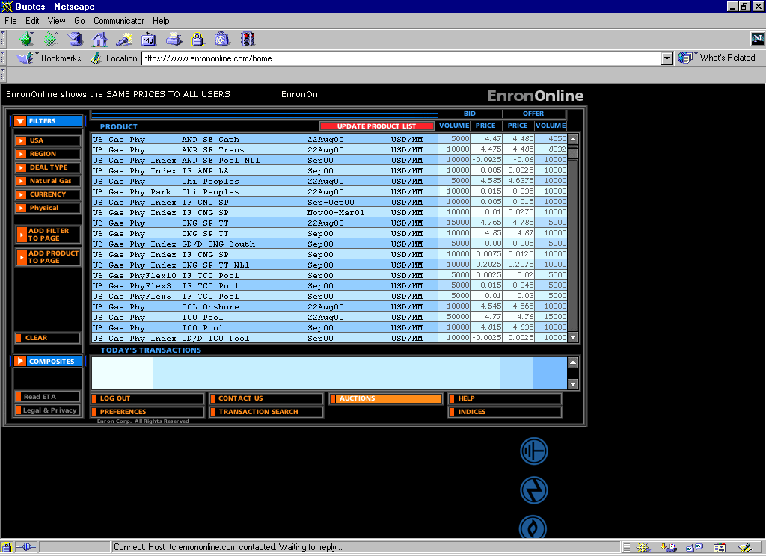
EnronOnline
Extending Enron’s Products to the Internet
Gross Transaction
Value
Through
12/22:
Transactions
540,000
$300 Billion
Currently Used for 60% of Enron’s transactions
Notes:
EnronOline – Extending Enron’s Products to the Internet
Enron was a B2B company before there was B2B, as our customers have always primarily been business customers. Our customers traditionally talked directly to Enron’s marketers to get transactions done.
With EnronOnline, customers can “click and transact” with Enron, choosing from over 1,000 energy and bandwidth products.
EnronOnLine was built in-house in 7 months. It was introduced in Nnovember of last year and is the only principal-based system in the energy industry.
EnronOnline has driven transactions to Enron, increasing our volumes and number of customers across our business.
Today, 60% of our Wholesale transactions are effected online.
We are the largest in the world in terms of eCommerce transactions. Since inception, we have conducted over $130 billion in total transaction value. That compares to Cisco and Intel levels of $9-10 billion and Amazon and eBay levels of $1-3 billion.
Again, we have tremendous growth in front of us as a result of our strong market positions and innovative approach to the marketplace.

Slide 12
Transportation
&
Distribution
Wholesale
Energy
Net Works
Retail
Energy
Broadband
Services
Energy Outsourcing
to Commercial and Industrial Customers
Notes:
Organizational Chart - Enron Energy Services
This business is relatively new, with its first full year of operations in 1997.
Enron’s retail business manages energy needs for end use customers, primarily in the commercial and light industrial market. We provide a long-term energy outsource product, which results in significant lower energy bills and stable gas and power prices for our customers.

Slide 13







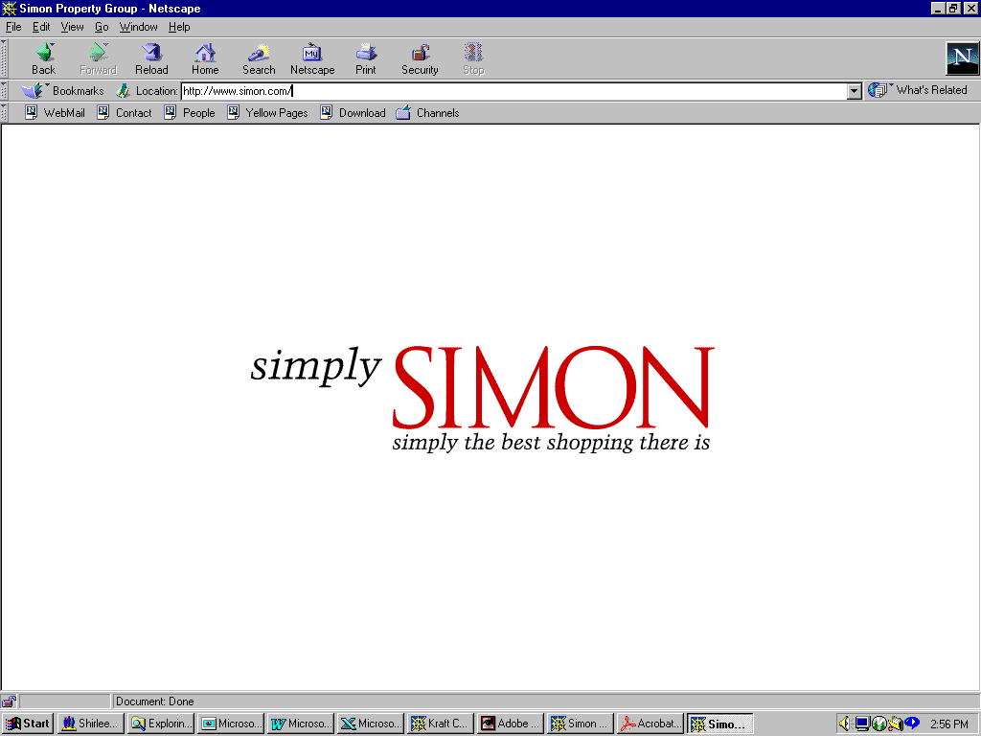






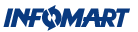






























Enron’s Retail Energy Customers
Manufacturing
High Technology
Hotels / REITs
QUEBECOR INC
Food Processing
Sports Venues
Financial Institutions
Public Sector/Institutions
Over $20 Billion of New Contracts Signed Since Inception
Notes:
$Enron’s Retail Energy Customers
We have many namebrand customers. Most of these customers have nationwide operations in the U.S. as well as Europe.
Our ability to provide integrated, nationwide energy services drives operational efficiencies and results in significant value to Enron.
Since late 1997, we have signed over $20 billion of new contracts.

Slide 14
Transportation
&
Distribution
Wholesale
Energy
Net Works
Retail
Energy
Broadband
Services
Bandwidth Management
and Broadband
Delivery Services
Notes:
Organizational Chart – Broadband Services
We have replicated our energy business model to the rapidly growing broadband market.

Slide 15
Enron Broadband Services
Enron
Intelligent
Network
Bandwidth
Intermediation
Deploy the Most Open, Efficient Network with Broad Connectivity
Content
Services
Be the World’s Largest Provider of Premium Broadband Delivery Services
Be the World’s
Largest Buyer and
Seller of Bandwidth
Fiber
Servers
Pooling Points
Network Control
Bandwidth Marketing & Trading
Comprehensive
Bandwidth
Management
Broadband Content Management & Delivery
Data Management
Services
Notes:
Enron Broadband Services
Our business has three major components:
We have a network, the Enron Intelligent Network. It is constructed of fiber but, unlike many communication networks, we will not own all of the fiber. Rather, just as we do in our energy businesses, we will own fiber when we neccesary to guarantee reliable delivery and we will source fiber contractually and through our marketing activities.
With the network in place, we have two major business segments: bandwidth intermediation and content services.
In bandwidth intermediation, we make markets in bandwidth, just like we do in energy. We buy and sell, offering comprehensive bandwidth management products.
With a low cost network in place, we also offer services to deliver high-speed data and content across the network. The recently announced contract with Blockbuster is a great example of our capabilities in this business.
We have made significant huge advancements in deploying the network and contracting for both bandwidth management and content delivery services. This business is off to a great start.

Slide 16
Bandwidth Intermediation
Vancouver
Calgary
Montreal
Seattle
Boise
Toronto
Boston
Portland
Detroit
New York
Amsterdam
Salt Lake City
Chicago
San Francisco
Denver
Philadelphia
London
San Jose
Frankfurt
Las Vegas
Washington D.C.
Paris
Los Angeles
Atlanta
Tokyo
Dallas
New Orleans
Houston
Miami
Over 100 Full-Time Professionals
55 Transactions Since Inception with 17 Counterparties
  Terms Up to 10 Years
  Fixed Price Commitments and Option Structures
  Over 75% Off-Network
Broad Product Offerings
  Protected Circuits
  Unprotected Circuits
  IP Transport
32 Bandwidth Products Quoted on EnronOnline

Slide 17










Enron and Blockbuster
20-Year Exclusive, Worldwide Agreement; Over $1 Billion Potential Contract Value for Enron
Enron Provides End-to-End Connectivity to Deliver Blockbuster’s Movie
Library via the EIN
  Enron Paid for Services Based on Number of Movies Rented
  New Broadband Distribution Agreements Enable DSL Delivery
  to the TV; Additional Partners and Cable Targeted
Service Introduced in Four U.S. Markets by December 2000
Significant Expansion Opportunities
Encoding
Storage
Bandwidth Management
Streaming Control
Content
Enron’s Intelligent Network
Enron’s Distribution Partners
Blockbuster’s
Customers

Slide 18
Accolades
“Most Innovative Company” 2000
“Most Innovative Company” 1999
“Most Innovative Company” 1998
“Most Innovative Company” 1997
“Most Innovative Company” 1996
“100 Best companies to work for” 2000
“100 Best companies to work for” 1999
— Fortune
— Fortune
Notes:
Accolades
We are innovative. Enron has been Fortune’s “most innovative” company for 5 years.
Enron is also a great place to work.. We have been one of Fortune’s 100 best companies to work for 2 years.

Slide 19
Total Return to Shareholders
Jan 1, 1990 to Jan 1, 2001
1600
1400
Enron Corp.
S&P 500
Pipeline Avg.
Utility Avg.
E&P Avg.
1415%
383.6%
545%
281%
216.8%
1200
1000
800
600
400
200
0
-200
Dec 90
Dec 91
Dec 92
Dec 93
Dec 94
Dec 95
Dec 96
Dec 97
Dec 98
Dec 99
Dec 00

Slide 20
What It’s Like to Work Here
Work Environment
- fast-paced
- intense
- unstructured
- team-oriented
Houston
- attractive cost of living
- 4th largest city in America
- #1 U.S. city for entrepreneurship & growth
Notes:
What It’s Like to Work Here
Work from slide.
Enron recognized that PEOPLE are our most valuable assets. Our success has been, and will be, driven by human capital and ideas.
We hoe you will look closely at Enron during your interview process. Thank you for this opportunity to present Enron.

Slide 21
Associate Program Overview
The Program
- 18-24 month program
- six-month assignments
- three-week orientation/training program
- promotion opportunities based on performance
Notes:
Associate Responsibilities
Understand accounting & finance concepts to manage modeling processes
Create complex financial or trading models
Complete analysis with little or no supervision
Identify new business opportunities
Find and implement solutions to business/team issues
Interact with clients and senior managers
Develop client relationships

Slide 22
Analyst Program Overview
The Program
- two-year developmental program
- one year rotations
- promotion opportunities based on performance
Training
- three-week orientation
- technical training (e.g. modeling, valuation,
derivatives, communication and work styles
Business School Loan Program

Slide 23
Tax Analyst Track
Undergraduate or Graduate-level degrees
The Tax Track
- 18-month developmental program
- six-month rotations
Training
- one-week orientation
- technical training
Promotional Opportunities
Notes:
As an Enron Tax Analyst, you will provide tax support to the various Enron business units. All rotations will be managed in the Tax Department - each a period of 6 months. Tax Analysts are responsible for and can specialize in the following areas:
External reporting of all tax regulated financial and regulatory requirements
Understanding and communicating of the tax impacts of proposed projects and products for assigned Enron lines of business
Working on researching and answering information request from government taxing authorities who are auditing Enron's various tax returns.
Detailed analysis, development, and successful implementation of the most advantageous foreign and domestic tax strategies for proposed transactions, acquisitions and divestitures
Interviews
Campus interviews consist of two 30-minute back-to-back interviews
Final round interviews will be conducted in Houston on a Thursday or Friday

Slide 24
Technologist Program Overview
The Program
- two year developmental program in technology roles
- two - one year rotations
- promotion opportunities based on performance
Training
- one month training and orientation
- continuous technical training
- continuous business/professional training
Coaching
- technology professional dedicated to mentor you

Slide 25
www.enron.com

Slide 26
Dates on Campus
Jan. 9 - Open Presentation
Jan. 24 - Pre-Interview Reception
Jan. 25 - First Round Interviews
on campus
Jan. 26 - Second Round Interviews
at Michigan Union

