Slide 1
Eletrobolt Project
Presentation to OPIC
March 1, 2001

Slide 2
Agenda
Day 1 - Thursday March 1, 2001 Time
I. INTRODUCTION (Ranabir Dutt) 9:00 - 9:10
II. PROJECT OVERVIEW (Brett Wiggs) 9:10 - 10:10
  A. ELETROBOLT ITS IMPORTANCE TO BRASIL
  B. ENRON’S ROLE AND DEVELOPMENTS IN BRASIL
  C. BUSINESS PLAN
    1. CONTRACT PERIOD
    2. MERCHANT PERIOD
III. FINANCIAL MODEL ASSUMPTIONS (Ricardo Szlejf) 10:10 - 10:45
Break 10:45 - 11:00
IV. ENGINEERING & TECHNICAL REVIEW (J. Ayers, Lee Johnson) 11:00 - 12:00
  A. TECHNOLOGY SELECTION
  B. O&M PLAN AND MAINTENANCE PROGRAM (Roberto Daniels)
Lunch 12:00 - 12:30

Slide 3
Agenda
Day 1 (cont’d) - Thursday March 1, 2001 Time
V. KEY CONTRACTS AND HIGHLIGHTS
  A. CONSORTIUM AGREEMENT (Brian Bradshaw) 12:30 - 1:30
  B. EPC (John Ayres) 1:30 - 2:30
    1. PERFORMANCE TESTING
    2. TRANSITION TO OPERATIONS
    3. SCHEDULE & MILESTONES
Break 2:30 - 2:45
  C. ECE & MAE CONTRACTS (Luis Maurer) 2:45 - 3:30
  D. SHARED FACILITIES (Luis Watanabe) 3:30 - 3:45
  E. GAS SUPPLY & CEG L.D. CONTRACT (Brian Bradshaw, Luis Watanabe) 3:45 - 4:15
VI. ENVIRONMENTAL & PERMITTING (Robert Moss) 4:15 - 5:15
Break 5:15 - 5:30
VII. DISCUSSION OF APRIL 1, 2001 SITE VISIT 5:30 - 6:30
DAY 2 – Friday March 2, 2001
I. DETAILED MODEL REVIEW (morning session with OPIC and Enron)
II. SEPARATE LEGAL DISCUSSION WITH OPIC

Slide 4
Project Overview

Slide 5
Description
Enron South America (“ESA”) has the opportunity to build capacity in a short power market through a commercial structure which minimizes downside risk while obtaining significant upside potential. Through this structure, ESA will build, own (with syndication of equity in future) and operate a 379MW (at site conditions) skid-mounted merchant power plant near Rio de Janeiro, Brazil.
  ESA Trading expects power prices and volatility to rise significantly between 2001 and 2004 as a result of rapidly increasing demand, stagnant capacity investment and falling reservoir levels.
  Petrobras, the largest energy company in Brazil, is providing a guaranteed capacity payment which will cover operating costs plus provide a return on and of capital.
  ESA will receive 75% of the market upside above the guaranteed capacity payment and natural gas cost. In exchange for the guaranteed capacity payment, Petrobras will receive 25% of the market upside. In addition, Petrobras will have the opportunity to sell significant quantities of natural gas to the project.
  Commercial Operations are scheduled to begin October 1, 2001, and the contract with Petrobras will be for a period of 5 years beginning at commercial operations.

Slide 6
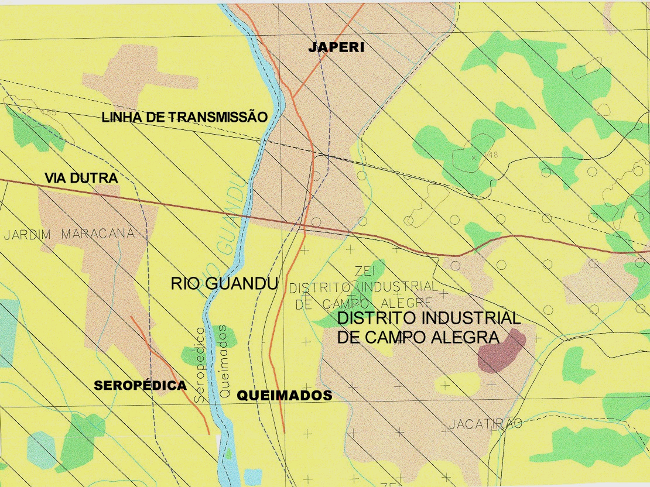
Project Location
Petrobras Main Pipeline - REVOL
TL 7 x 138kV
CEG Lateral
Project
Site
To SP
Highway
To Rio
Note: Project Site is approximately 1 million square meters.

Slide 7
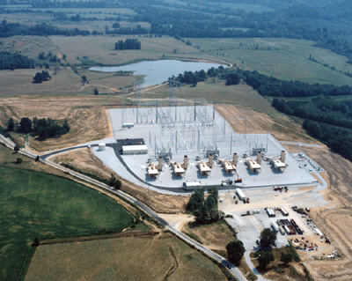
Example Project - Albany, New York

Slide 8
Power Market Overview
  Government-controlled for decades, the Brazilian power market is being gradually privatized. The Privatization process started 3 years ago and is expected to be completed by 2003.
  Most LDCs (with the notable exceptions of CEMIG and COPEL) have been privatized. The LDC segment, with the exception of Grupo Rede and VBC, is controlled by international investors (Iberdrola, Endesa, EDP, AES, Enron, Southern).
  Only 10% of the generating capacity in Brazil has been privatized to date.
  Investment in new generation capacity has significantly slowed as a result of lack of public funds and uncertainties regarding cost pass-through mechanisms for generators. The so-called Emergency Plan’s additions -17,000 MW of thermal capacity- will not be met on time.
  Transmission business is mainly controlled by state companies and tariffs are regulated. Significant investments coming from private investors are expected in the future to avoid transmission constraints.

Slide 9
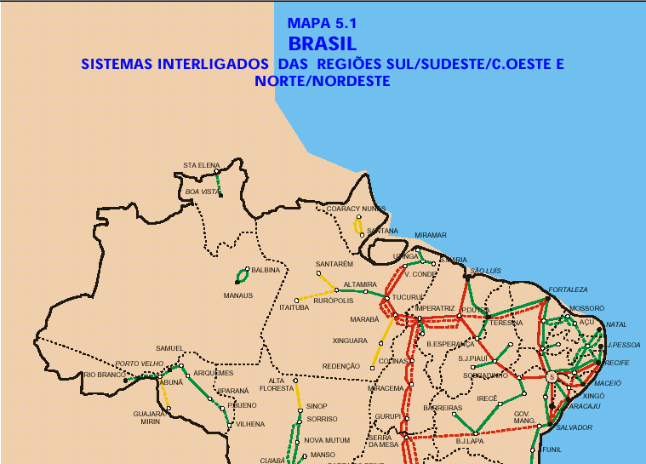
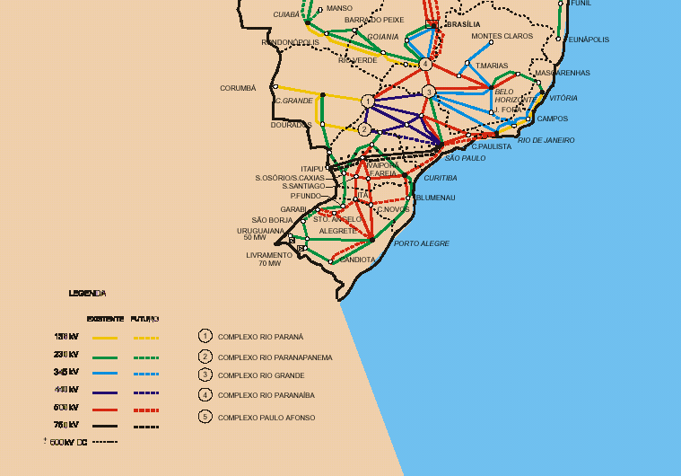
Power Infrastructure

Slide 10
Expected Demand vs. Capacity
Firm Energy
Will be delayed
New Thermal assets (*)
5%demand
growth
New hydro assets
Existing assets
(*) Additions of thermal capacity assume Emergency Plan in place according to governmental expectations

Slide 11
Spot Prices and VN
Historical Comparison
South East Spot Price
R$/MWh
VN price
Ranabir Note: How much capacity?

Slide 12
Power Opportunity
The Brazilian Power Market represents a very attractive opportunity for entering into a “long” position, given current expectations of high prices and volatility:
  Significant increases in demand (projected to be 5% to 6% per year).
  Public investment in new generation has been cancelled or postponed.
  Private investment in generation delayed due to uncertainty surrounding pass-through pricing rules.
  Hydro-intensive market (96% of electricity output) currently in a drought situation.

Slide 13
Natural Gas Overview
  Natural gas demand could grow at a 35-40% per annum over the next 5 years. The Emergency Program would demand about 63 mmcmd, but timing for its completion is significantly delayed
  17 gas distribution companies currently in operation, with 5 more coming online within the next 2 years
  25 companies have participated in the ANP’s rounds for exploration blocks. In addition, 33 joint ventures have been executed between Petrobras and local and international companies
  Domestic Proved Reserves of 8.2 tcf, enough to supply up to 31 mmcmd for the next 20 years. Additionally, Bolivian (18.3 tcf) and Argentine (24.4tcf) Proved Reserves comfortably guarantee supply of gas for the next 20 years.
LDCs forecasted demand
Regional “interconnected” Reserves
Will be delayed

Slide 14
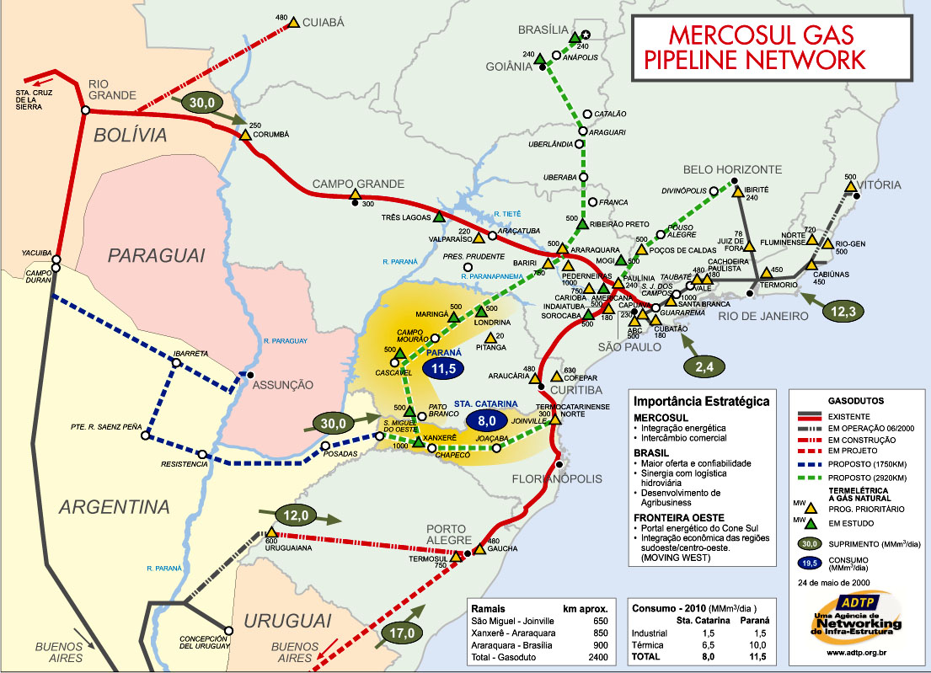
Gas Transportation Overview
  Bolivia to Brazil Pipeline to be fully loaded by 2004 (30 mmcmd)
  3 pipelines in-place or under-construction (50 mmcmd aggregate capacity in 5 years) to import gas from Bolivia and Argentina.

Slide 15
Natural Gas Opportunity
The deregulation in the Brazilian Gas Market is expected to continue and thus encourage new investments in the E&P and transportation sectors
  Petrobras, the dominant player in the national market, will be the partner in the project during the first 5 years of operation
  Many new players coming on line in the next 3-5 years
  Excess of supply created due to huge reserve increases and delays in the expected demand generated by the Emergency Program and other Brazilian demand.
A significant decrease in gas prices is expected starting in 2005/2006.

Slide 16
Eletrobolt Strategy
Nov. 01
Oct. 06
Oct. 11
Project Stage
Risks & returns
Power Market
Expected Conditions
Natural Gas Market
Expected Conditions
Generator Phase:
Capacity provider
Genco limited risk (Petrobras Corporate)
Limited Genco upside
Early phase - Rules in consolidation process
Increasing prices due to excess of demand
Petrobras ruling the market
High natural gas prices and no liquidity
Merchant Phase:
Energy & capacity provider
Merchant risk
Significant Genco upside
More mature market and increasing demand.
High prices and higher liquidity
Open and deregulated market
Significantly lower natural gas prices and higher liquidity
Through Eletrobolt, Enron intends to:
(i) capitalize on higher power prices expected for the next few years, benefiting from a structured, Petrobras risk, “floor” return on the investment
(ii) build up a solid “long” position in the highly attractive Brazilian Power Market, providing different products to the market once the Petrobras’ involvement expires

Slide 17
Project Competitive Advantages
  Speed of implementation and ability to quickly take advantage of market dynamics (severely short market).
  Gas prices decreasing in a deregulated market and over-supply scenario.
  Excellent project location within the electrical and gas systems.
  Flexible operating capabilities of the equipment permit value extraction from dispatch function and the arbitration between natural gas and power.
  Contractual structure with strongest energy company in the Brazilian market.
  Uncertainties in market may result in slower investment in new thermal generation.
  Significant project value after contract term.

Slide 18
Products for the Merchant Phase
  Merchant Energy Sales
  Deliveries to the Wholesale Market on a spot basis, benefiting from likely high prices
  Contracted Capacity and Energy to LDCs and industrials
  Contracts for short, medium and long terms, securing revenues for the project
  Back Up Energy & Capacity to other generators
  Specific contracts to cover market exposure for generators, providing additional secured revenues
  Derivative Products to market players
  Long position used to trade physical derivatives, such as swaps, puts, calls, collars, floors, etc.

Slide 19
Enron Assets in South America
Enron Projects in
South America
- 15,206 Km of pipelines in Brazil, Bolívia and Argentina
- 9 natural gas LDC’s and 1 power LDC with more than 2 million customers and a potential market of 60 million people.
- First IPP and first private pipeline in Brazil
- Pioneer in the trading of gas and power in Argentina and Brazil
Employees:
- Operating Companies: 4,805
- Enron South America: 136

Slide 20
Financial Model Assumptions

Slide 21
Base Case Assumptions
Assumption
Reference
Project Data:
Operations:

Slide 22
Base Case Assumptions
Revenues
Contract Period (2001 – 2006)
  Petrobras Floor price - Calculated SFE Allocation Payments equal to the Capacity and Energy Portions per the Consortium Agreement
  Dispatch at full available capacity: 100%
Merchant Period (2007 – 2011)
  Energy prices – represents the combination of the effects of supply and demand for long-term power through contracts and short-term power through the pool market, both escalated at US PPI ($38/MWH - $48/MWH)
  Fuel Prices – assumes a more open and competitive market than that of today’s market with fuel prices indexed to US PPI; ($1.50/ MMbtu commencing 2006)
  Dispatch: average of 60% for each year

Slide 23
Base Case Assumptions
Assumption
Reference
Power Prices - Consortium Agreement:
Power Prices - Merchant Period:

Slide 24
Base Case Assumptions
Assumption
Reference
Dispatch/Losses:

Slide 25
Base Case Assumptions
Assumption
Reference
Fuel Prices (Merchant Period):
T&D Charges:

Slide 26
Base Case Assumptions
Assumption
Reference
Depreciation:

Slide 27
Base Case Operating
Expenses Assumptions ($USM)
Reference: Enron Mobilization and O&M Estimate - Oct,2000

Slide 28
Tax Assumptions

Slide 29
Project Costs (US$MMs)
(1)

Slide 30
Base Case Financing Assumptions
Senior Debt Custom Amortization:
$140MM amortized mortgage style (2001 – 2006); semi-annually
$ 50MM amortized mortgage style (2006 – 2011); semi-annually
$190MM Total Senior Debt
Subordinated Debt Amortization:
$ 74MM amortized straight line over 5 to 6 years from COD
(Enron is investigating the use of off-balance sheet synthetic lease structures whereby Sponsor(s) will maintain the risks of ownership of the equity and sub-debt, while allowing other financial institutions to provide the off-balance sheet funding).

Slide 31
Expected Flow of Funds
Consortium Taxes, Admin costs
Taxes
SFE
Local R$ A/C
Trust operated w/ lien
#1
#2 SFE Allocation
Consortium
Local R$ A/C
Trust operated
No-lien
Operating Costs account
Maintenance Reserve
Petrobras
MAE
Other
O&M
Working Capital
Taxes
Reserves
SFE
Local US$ A/C
Trust operated w/ lien
#3 PB Pref. Allocation
#4 PB Cont. Allocation
Petrobras
#5 Market Allocation
O&M
Senior Debt Service
Sub-Debt/Equity
Petrobras
Operating Costs account
Debt Service account
Debt Service Reserve
Maintenance Reserve
Sub-debt account
Equity Account
ECE

Slide 32
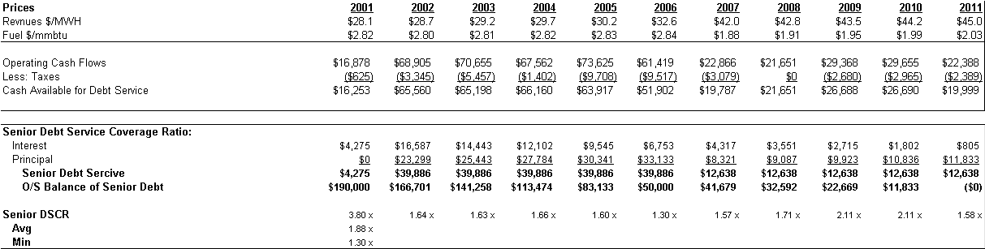
Base Case Projections
Note: 2006 coverage affected by accelerated maintenance reserve.

Slide 33
Engineering and Technical Review

Slide 34


Project Key Facts
GAS TURBINES ARE LM 6000’s FURNISHED BY GE
NEPCO IS THE EPC CONTRACTOR
PLANT OUTPUT TO THE LIGHT GRID = 379 MW
THE ELECTROBOLT SWITCHYARD TIES INTO 4 OF THE 7 LIGHT 138 Kv TRANSMISSION LINES NORTH OF THE SITE
SITE IS BEING RAISED 8 - 9 FEET DUE TO RIVER FLOODING
WATER REQUIREMENT FROM THE GUANDU RIVER IS 1,230 GPM
WATER DISCHARGE INTO THE GUANDU RIVER IS 250 GPM
MAIN STEP-UP TRANSFORMERS AND PLANT SWITCHYARD IS FURNISHED BY ABB

Slide 35
Project Key Facts (cont.)
TOTAL GAS CONSUMPTION IS 3.5 MMSCF/Hr
CEMS ON EACH LM 6000 STACK
RIVER WATER MONITORING SYSTEMS UPSTREAM OF PLANT DISCHARGE AND DOWNSTREAM OF PLANT INTAKE
SITE MOBILIZATION SCHEDULED TO BE MARCH 05, 2001
COD OF UNITS 1 THRU 4 IS SEPT. 15, 2001
COD OF UNITS 5 THRU 8 IS OCT. 15, 2001

Slide 36
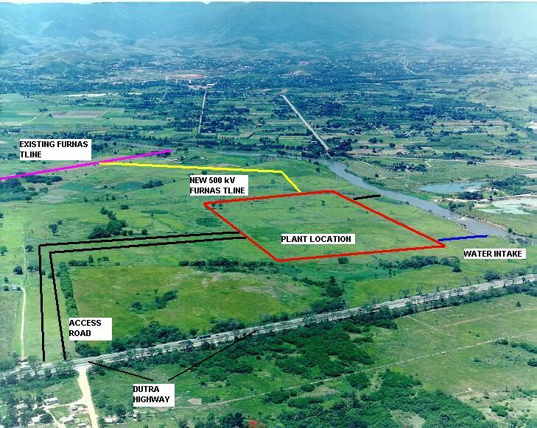
Arial View of Site
EXISTING LIGHT TRANMISSION LINES
7 – CIRCUITS – 138 Kv
WATER DISCHARGE
ELECTROBOLT SITE
GUANDU RIVER
CONFIDENTIAL - PRIVILEDGED BUSINESS INFORMATION

Slide 37
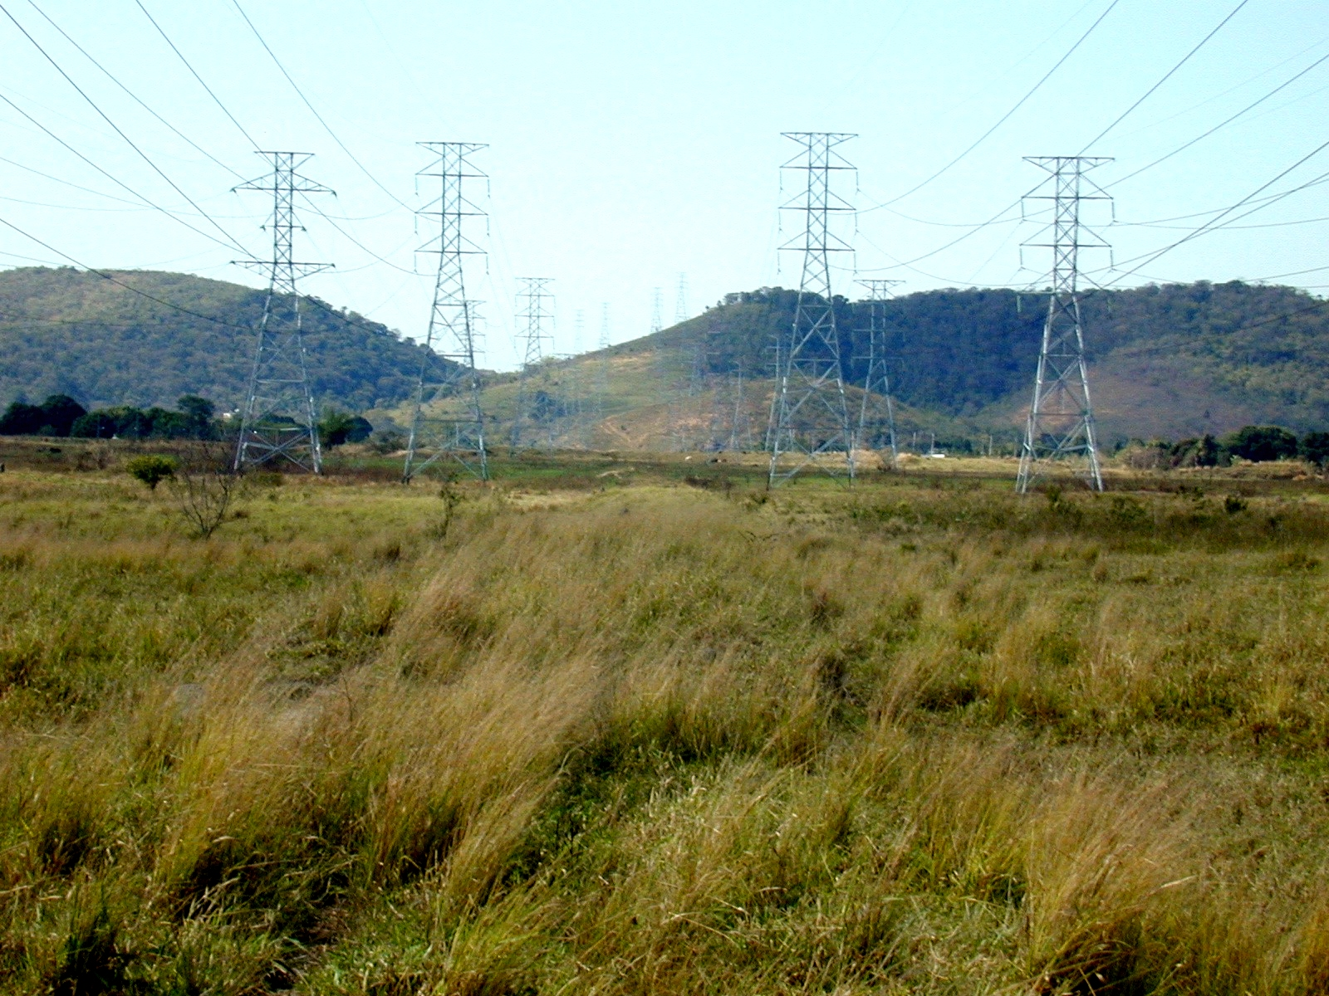
LIGHT Transmission Lines
CONFIDENTIAL - PRIVILEDGED BUSINESS INFORMATION

Slide 38

Scaled Site Map
CONFIDENTIAL - PRIVILEDGED BUSINESS INFORMATION

Slide 39
Scaled Site Map (Cont.)
CONFIDENTIAL - PRIVILEDGED BUSINESS INFORMATION

Slide 40
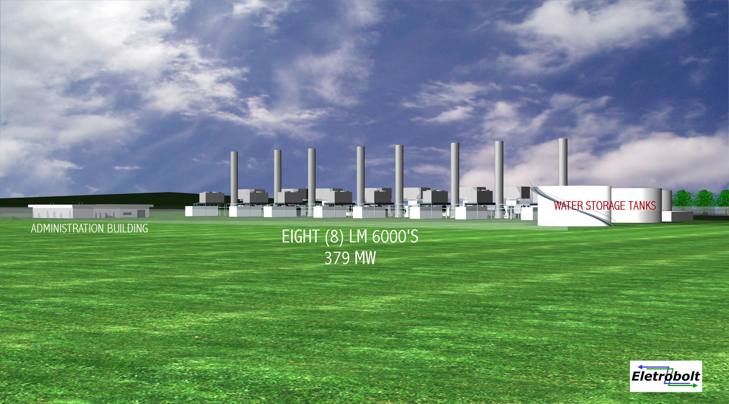
Project Site –
Digital Replication
CONFIDENTIAL - PRIVILEDGED BUSINESS INFORMATION

Slide 41
Project Scope
EIGHT (8) GE LM 6000’S IN SIMPLE CYCLE
LM 6000’S ARE ENHANCED SPRINT
TOTAL PLANT OUTPUT = 379 MW
GAS ONLY WITH NO BACK-UP FUEL
POWER TRANSMITTED OVER RIO LIGHT’S 138 Kv LINES
GAS SUPPLY FROM CEG

Slide 42
Project Scope (Cont.)
PROJECT SCOPE CONTINUED:
NOx, SPRINT INJECTION, & COOLING TOWER WATER SUPPLIED FROM THE GUANDU RIVER
DEMINERALIZED WATER GENERATED ON SITE
GAS COMPRESSORS ARE THREE (3) 50 % CAPACITY

Slide 43
GE Scope
EIGHT (8) COMPLETE LM 6000 ENHANCED SPRINT PACKAGES
GENERATORS ARE GE BRUSHLESS 13,800 VOLT, 60 Hz, 3,600 RPM, 60,000 KVA RATED @ 0.9 pf
2,200 TON CHILLERS FOR EACH LM 6000
PRE-FABRICATED CONTROL/ELECRICAL BUILDINGS FOR EACH PAIR OF LM 6000’S
ALL CONTROLS, PRE-FABRICATED BLDGS., COOLERS, ETC. FOR THE PLANT

Slide 44
GE Guarantees
EIGHT (8) UNIT GUARANTEES ARE
  47,750 Kw NET OF THEIR FURNISHED AUXILLIARY LOADS
  9,008 BTU/kWh (LHV)
  60 PPM Nox @ 15 % O₂
  15 PPM CO @ 15 % O₂

Slide 45
GE Liquidating Damages
POWER OUTPUT: ADJUSTED AVERAGE OF ALL EIGHT (8) MACHINES
  0 -2,270 kW = $250 / kW
  GREATER THAN 2,270 kW = $500 / Kw
HEAT RATE:
  $3,500 FOR EACH BTU/kWh (LHV) OVER 9,008 BTU/kWh
DELIVERY:
  DAYS LATE (1-15 =$10,000/DAY/UNIT), (16+ = $25,000/DAY/UNIT)
TAKEOVER:
  $25,000/DAY/UNIT

Slide 46
GE LD Caps & Warranties
MAXIMUM LIABILITY AMOUNT (MLA) = $125,225,400
  DELIVERY = 15% OF MLA
  POWER OUTPUT = 10 % OF MLA
  HEAT RATE = 10 % OF MLA
  TAKEOVER = 15 % OF MLA
MAXIMUM AGGREGATE = 30 % OF MLA
PRIMARY WARRANTY PERIOD IS ONE (1) YEAR FROM ACCEPTANCE OR COMMERCIAL OPERATION
  ON ITEMS REPLACED UNDER PRIMARY WARRANTY PERIOD, THEY WILL BE WARRANTED 12 MONTHS FROM MODIFICATION NOT TO EXCEED ONE (1) YEAR AFTER PRIMARY WARRANTY END.

Slide 47
Performance
COMPAIRISON OF GE PRO FORMA NUMBERS:
GE GUARANTEES - NEW & CLEAN PLANT PROFORMA DEGRADED
47,750 KW 47,398 KW
9,008 BTU/kWh (LHV) 9,237 BTU/kWh (LHV)

Slide 48
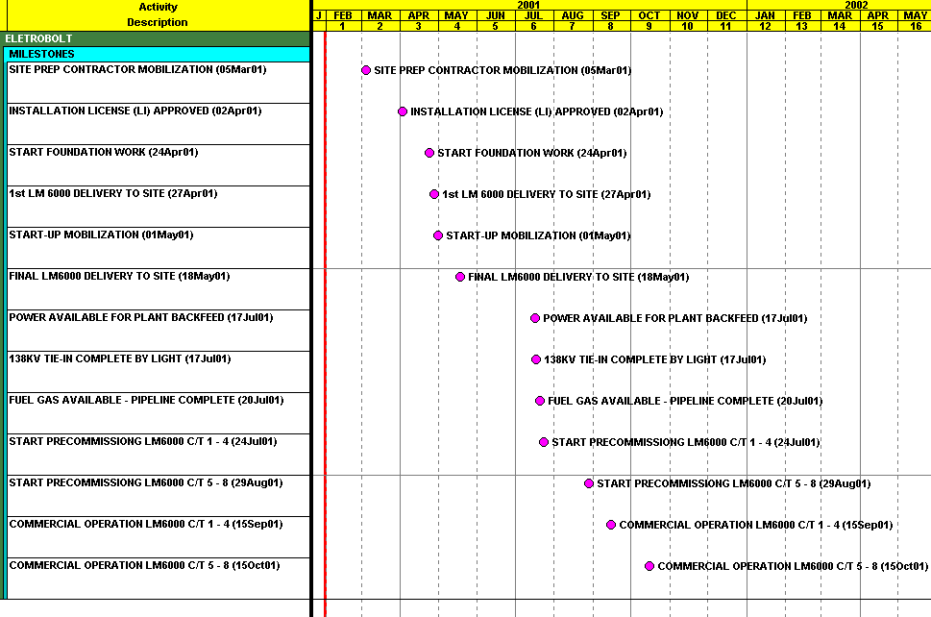
EPC Summary Schedule
CONFIDENTIAL - PRIVILEDGED BUSINESS INFORMATION

Slide 49
O&M Concept
Goals:
Attract and hire the best talent available
Implement a rigorous initial and ongoing training program in an effort to achieve a true Meritocracy
Establish self-sufficiency by ensuring the highest quality O&M team
Long term financial viability by balancing profit objectives with asset preservation, environmental compliance and personal safety
SFE will:
have a 38 full time employee staff with contracted third party labor
operate in shifts compliant with local, state, and Federal requirements to ensure continuous safe operation of the facility
have shift rotations to allow for continuous training and relief for scheduled vacations

Slide 50
Operator Training
Initial Training will be provided by a third party training organization whose sole responsibility will be to develop and execute a comprehensive documented training program delivered in Portuguese.
The result will be a qualification standard which will be used to objectively train and test employees
Training will consist of in class instruction and on-the-job training verified by rigorous testing and evaluation processes
Continuous Training and Evaluation will be provided to insure professional development and safe economic operation of the power plant
Safety training is the theme of SFE’s program

Slide 51
Manuals
The successful continuous operation of the power plant depends on the successful development and implementation of operating manuals which will include but not limited to the following:
  Administrative Program and Procedures Manual
  Operations and Maintenance Manual
  Personal Safety Procedures Manual
  Hazardous Materials Communication Program Manual
  Training Manual
  Water Chemistry Training Manual

Slide 52
Technical Programs
SFE will also ensure the successful continuous operation of the facility through the development and implementation of the following additional programs:
  Spare Parts Program
  Maintenance Program
  Material Management Program
  Resource and Outage Management Program
  Plant Betterment Program
  Security Program
  Hazardous Material Program
  Safety Program
  Records Management Program

Slide 53
Miscellaneous
SFE will:
take the lead in responding to any forced or emergency outage at the project
comply with all local, state and Federal permitting requirements and will establish a schedule to review our compliance
strive to maintain good relations with the local community through participation in local activities and meetings
establish and maintain communications and relationships with the various entities with which we will interface with such as contractors, customer, regulatory agencies, and the public.

Slide 54
Key Contracts and Highlights

Slide 55
Project Structure
Consortium Agreement
GasPetro*
Petrobras
ECE
Marketer
R$
FSA
R$
Btu
Btu
2. Fuel Pmt.
3. Market
Allocation
Contingency
Payment
3. Market
Allocation
Btu
GSA
SFE
Genco
ē
ECE/ Pmt. Agent
CEG
1. SFE
Allocation
R$
ē
Electricity
market
* Wholly owned affiliate of Petrobras

Slide 56
Brazilian Consortium
A Consortium is an unincorporated “joint venture” (similar to a partnership) that is registered with the registry of commerce in Brazil. The Consortium is not a legal entity, but a contractual arrangement among its members to regulate their rights and obligations. The characteristics of a Consortium are as follows:
  The Consortium will carry out its business under the name “Consorcio RioMerchant”
  The management of the Consortium is established in the Consortium Agreement
  (ECE) serves as the manager of the Consortium
  The Consortium does not have financial statements that are separate from its members (although pro-forma accounting is usually prepared to control the performance of the Consortium´s activities)
  The Consortium may have a tax identification number for control purposes, but it is not a separate taxable entity
  A Consortium cannot hold separate title to any assets. All the assets contributed by its members are held by all its members according to their respective interest in the Consortium. Although title is held by its members, they are dedicated to the Consortium

Slide 57
Consortium Agreement (CA)
Role of Petrobras
  Provide natural gas to the project
  Provide “contingent capital” to the Consortium
  Make certain capital contributions to the Consortium during events of Force Majeure/Political Force Majeure
Role of SFE (Genco)
  Acquire site
  Get all permits/approvals
  Develop, finance, construct, maintain and operate the plant
  Convey title of available contract capacity to Consortium
Role of ECE
  Market the electricity generated by SFE
  Perform the role as Payment Agent
  Represent the Consortium in the MAE

Slide 58
CA: Management
Management Committee consists of six members
Each Consortium Party will provide two members to the Management Committee
The Consortium Leader and Manager of the Consortium will be ECE
Objective of the Consortium is “to market the Capacity and the Net Electrical Output generated by the Merchant Project based on the contributions by each of the Parties”

Slide 59
CA: SFE Allocation
Every Calculation Period SFE will receive from the Payment Agent:
  Capacity Portion: designed to cover the fixed operating costs of the plant and provide a return on capital.
    Amount: i.e. R$30.41/kw-month
      90% of which is adjusted for US$/R$ exchange rate (anchored on July 3, 2000) and is escalated at US PPI starting July 2000 - designed to provide the return on capital.
      10% of which is in R$ and is escalated at the Brazilian inflation rate (IGP-M) starting July 2000 - designed to cover fixed operating costs.
      Capacity payment will be adjusted for actual availability achieved by the plant
  Energy: designed to cover the variable operating costs of the plant
    Amount: i.e. R$5.1528/MWh as of July 3, 2000
      88% of which is adjusted for the US $/R$ exchange rate (anchored on July 3, 2000) and is escalated at US PPI starting July 2000 - designed to cover variable US$ maintenance costs and chemical costs
      12% of which is in R$ and is escalated at the Brazilian inflation rate (IGP-M) starting July 2000 - designed to cover local O&M

Slide 60
CA: Distribution
All revenues are collected by the Payment Agent and distributed in accordance with the following:
  Consortium expenditures
    Consortium Taxes, Administrative Charges and Taxes
  Commissioning Delay Charges to SFE
  SFE Allocation
  Petrobras Preferred Allocation
    Payment for Gas consumed/distribution margin
  Recovery of Petrobras Contingency Contribution (if any) incurred during the immediately two preceding Calculation Periods
  Market Allocation

Slide 61
CA: Petrobras Payments
To the extent that the Payment Agent has insufficient funds from normal revenues to cover the SFE Allocation, Petrobras will contribute the shortfall to the Consortium for distribution to SFE.
Since the SFE Allocation is 90% indexed to the US$, Petrobras payment automatically covers the FX rate risk to the same extent.
Petrobras can recover any payment made as a “Petrobras Contingency Payment” from the Consortium over the period of the immediately succeeding two months to the extent that there is excess cash flows after the payment of SFE Allocation and the Petrobras Preferred Allocation.

Slide 62
CA: Other Allocations
Petrobras Preferred Allocation
  Payment of fuel at a rate of $2.475/MMBtu escalated as per PPI plus taxes. Fuel rate is capped at rate given to other IPPs
Market Allocation
  Any remaining funds will be distributed between Petrobras and ECE on a 1:3 ratio.

Slide 63
CA: Output and Availability
Availability is adjusted for
  Changes in capacity as a result of
    deviation from base conditions
    PFM, FM or Delivery Excuses (100% availability is assigned to SFE in these conditions)
SFE is allowed
  Scheduled Maintenance as per the manufacturers recommendations
  Unscheduled Maintenance, without penalty of 75 hours of capacity (i.e. 28,425 MWhrs/yr)
Excluding the above allowances, SFE has to provide an availability of 92%
  Thereafter, for every 1% of capacity shortfall, SFE is penalized 1.08% of capacity payment
Heat Rate
  SFE guarantees a heat rate of 10,213 Btu/kWh (HHV) @ base conditions
  Heat rate adjusted for:
    Capacity Dispatched
    Base conditions

Slide 64
CA: Duration
Term: Five years from the Start Date
Start Date: When the four unit pairs of turbines have completed start-up, testing and commissioning and is capable of delivering continuous energy

Slide 65
CA: Defaults
Non-payment by Defaulting Party not cured with 30 business days
Material Rep or Warranty is untrue and not cured within 30 days
Failure to perform covenants, which failure is not cured within 30 days (subject to 60 day limit if cure is being pursued)
Bankruptcy; filing for bankruptcy etc. (no cure period)
SFE Default: Failure of Merchant Plant to achieve Start Date by April 30, 2002 other than as a result of:
  FM or PFM
  Failure of Petrobras to deliver Natural Gas when nominated
Petrobras Default: Failure of Merchant Plant to achieve Start Date by April 30, 2002 as a result of non-delivery of natural gas, when nominated by SFE

Slide 66
CA: Termination Events
Event of Defaults
Other Events
  Failure of the Merchant Plant to achieve Start Date on or before Oct 31, 2002, as a result of FM
  Following the Start Date, the occurrence of a FM event in excess of 365 consecutive days

Slide 67
CA: Termination
Event of Defaults
If Petrobras is the Defaulting Party, Petrobras will pay SFE:
  SFE Termination Payment, plus
    equal to the PV of all future SFE Allocation plus any applicable Taxes during the remaining term of the CA discounted at 12%
  all Termination Costs
If SFE is the Defaulting Party, SFE will pay Petrobras:
  Petrobras Termination Payment
    revenues from future “forecasted sale of natural gas” at 10 cents/MMBtu, discounted back at 12% (equivalent of pipeline demand charge)
  all Termination Costs
If ECE is the Defaulting Party, ECE’s membership will be terminated and ECE will be substituted with another entity selected by SFE.

Slide 68
CA: Termination
Other Events
During the event of Force Majeure, Petrobras will be obligated to contribute to the Consortium the SFE Allocation for the lesser of:
  twelve consecutive months following the initiation of the event of FM, and
  duration of the event of FM
After 365 consecutive days of FM, either party may terminate the Consortium Agreement without further liability/recourse

Slide 69
CA: Consequences of PFM after Start Date
Petrobras will pay the SFE Allocation to the Consortium for the lesser of:
  the duration of the PFM, or
  12 consecutive months
If the PFM is not cured in the 365 consecutive days, SFE will terminate the agreement and:
  transfer the ownership in SFE to Petrobras free and clear of liens, debts etc for the payment by Petrobras of the “Book Value” within 30 days of the Termination Date, or
  transfer the project site plus all fixtures (other than the gas turbines and auxiliaries) to Petrobras
Book Value is the sum of
  net asset value, plus
  any debt or note payable, less
  any cash or dividends previously paid by SFE which were the direct result of payments of Petrobras Contingency Contribution

Slide 70
CA: Law and Dispute Resolution
Governing Law -- Brazilian Law
Dispute Resolution
  First step - try to resolve dispute by negotiations among executives within 30 days of dispute
  Second step - resolve dispute via arbitration under UNCITRAL Rules
    three arbitrators, one chosen by each party and the third chosen jointly by the arbitrators
    Enforcement of arbitrators award under the Inter-American Convention on International Commercial Arbitration (of Jan 30, 1975)
    Parties have waived right of appeals
Petrobras has Waived Sovereign Immunity

Slide 71
EPC Contract
The EPC contract provides for the supply of eight GE LM6000 Enhanced Sprint turbine generator packages together with associated auxiliary and ancillary equipment and all design, engineering, procurement and construction services required to build, start up, commission and test the power generation facility.
Performance, delivery and warranty obligations relating to the generation packages are provided separately by GE Packaged Power Inc. pursuant to the Agreement for the purchase of GE equipment dated December 22, 2000.
EPC Contract Price: $ [206,540,676]

Slide 72
NEPCO
NEPCO is the EPC contractor for the Project which will supply the eight General Electric LM 6000 Enhanced Sprint combustion turbine generator packages together with associated auxiliaries and ancillary equipment.
NEPCO is an ISO 9001 certified, full service engineering and construction company, based in Bothell, Washington, USA, with over 60 years of experience in the design, construction, operation, and maintenance of high efficiency, combustion turbine, simple and combined cycle, cogeneration plants, as well as conventional and waste fueled power generating facilities.

Slide 73
MAE Agreement
As an IPP with installed capacity > 50 MW, SFE is obligated to execute and is bound by a market contract called MAE Agreement (Law 9.648/98) when the plant is commissioned and ready to produce energy.
ECE is registered in the MAE as a marketer of energy.
The MAE Agreement, originally prepared and signed in August 1998, sets forth the basic rules on how the Wholesale Energy Market should operate.
Due to its nature (market contract), the completion of the MAE agreement is relatively simple, and may be accomplished in a matter of few weeks.
The execution of the MAE agreement has to occur, regardless of how the energy produced by SFE will be traded in the market.
The revenue will be defined for each settlement period, and will be based on the physical generation adjusted for transmission losses; those are defined from the metering point to the center of gravity of the Southern Sub-Market.

Slide 74
MAE Registration
SFE is obligated to be a MAE member and is obligated to register and have all contracted volumes settled by the MAE.
The strict interpretation of this regulatory mandate establishes that even pure capacity contracts should have associated volumes registered and settled by the MAE. The Consortium Agreement is similar to a capacity contract in that the capacity is transferred to ECE, who will represent the consortium in the MAE.
Registration is simply the monthly filing of volumes and counterparties for bilateral contracts with the MAE on an ex-post basis (after the contract month occurs). It does not include the filing of the actual agreement.
As per MAE rules, in case SFE does not register any contract volumes, it will have a financial credit, for every settlement period, based on its metered generation, scaled up/down at the center of gravity, multiplied by the prevailing spot price, for each settlement period.

Slide 75
Transmission and Distribution
SFE, as an IPP and owner of the physical assets, is obliged to sign connection and use of system contracts, depending on the voltage level at which it is connected
Since SFE is connected at voltage levels below 230 kV and not part of the Basic Grid, it has to sign connection (“CCD”) and use of distribution system (“CUSD”) contracts with the host utility (D/R) - Light
According to specific legal and regulatory provisions, SFE is also obliged to sign a Transmission Use of System Agreement (“CUST”) with the National System Operator (ONS)
SFE has established all the necessary contacts and developed all technical studies to support its connection at the specific location.
Regarding the CUSD, negotiations with Light are have occurred normally, and should be completed in a matter of weeks; some points need minor adjustments, such as shared liabilities in the case of system failure; no major obstacles envisioned;
Regarding the CCD, negotiations with Light have also been successful. The boundaries of the “shallow” connection are being defined.
Regarding the CUST, negotiations with ONS have occurred normally. Light made available technical studies prepared by CEPEL and it issued a document on February 12, 2001, agreeing and supporting the connection of SFE at that particular location in the grid.
All technical requirements have been clearly specified; No major problems or delays are envisioned to the successful completion of the physical works and signature of the contracts;

Slide 76
Shared Facilities Agreement
SFE will finance and construct certain facilities at the Site, including the river water intake and discharge structures, effluents discharge structure, site access roads, highway deceleration lane, drying sludge system, site perimeter fence for the entire Site and temporary wells for the utilization of water during construction.
To the extent Enron desires to utilize these common facilities for another project, the project may enter into a lease agreement with SFE for their use for an appropriate fee. SFE shall have sole responsibility for the operation and maintenance of the common facilities, including the timing of any shutdowns for maintenance or repair.

Slide 77
Gas Supply Agreement
For the term of the Consortium Agreement, Petrobras will enter into a gas supply agreement with CEG based upon the following terms, which will be on a “back-to-back” basis with the Fuel Supply Agreement between CEG and a Petrobras affiliate:
  The daily contract quantity, assuming a base load dispatch of the plant, is approximately 2.4 million cubic meters per day
  Petrobras will be responsible for all payments related to gas supply from the Petrobras Preferred Allocation, including the CEG margin of approximately $.15/MMbtu.
  The supply of natural gas will be interruptible, except that CEG will deliver natural gas on a “firm” basis for the period of time equal to the nomination of available capacity of the plant by ECE to the grid operator (ONS)
Prior to the termination of the Consortium Agreement, it is anticipated that SFE will independently enter into gas supply agreements appropriate for the market at the time in order to maintain the continuos supply of gas to the project.

Slide 78
Gas Supply Agreement (Cont)
The GSA will require quality and pressure specifications of natural gas that are consistent with the prudent operation of the plant.
The GSA will contain no take-or-pay, ship-or-pay, or deliver-or-pay provisions.
The GSA will be coterminous with the Consortium Agreement with ability to contract with open market after term.
The GSA will contain a provision that allows Petrobras to complete the pipeline if CEG has not substantially completed construction and testing of all necessary pipeline spurs and other facilities upstream of the delivery point in time to allow for the timely start-up and testing of the plant.

Slide 79
CEG
Companhia Distribuidora de Gás do Rio de Janeiro - CEG is a sociedade anônima responsible for natural gas distribution in the state of Rio de Janeiro.
The company was privatized in 1997, being acquired by an investment group led by Enron, with Gas Natural from Spain acting as the technical operator.
Enron is currently seeking to sell its share of the equity and may not be involved in CEG’s ownership in the long-term.

Slide 80
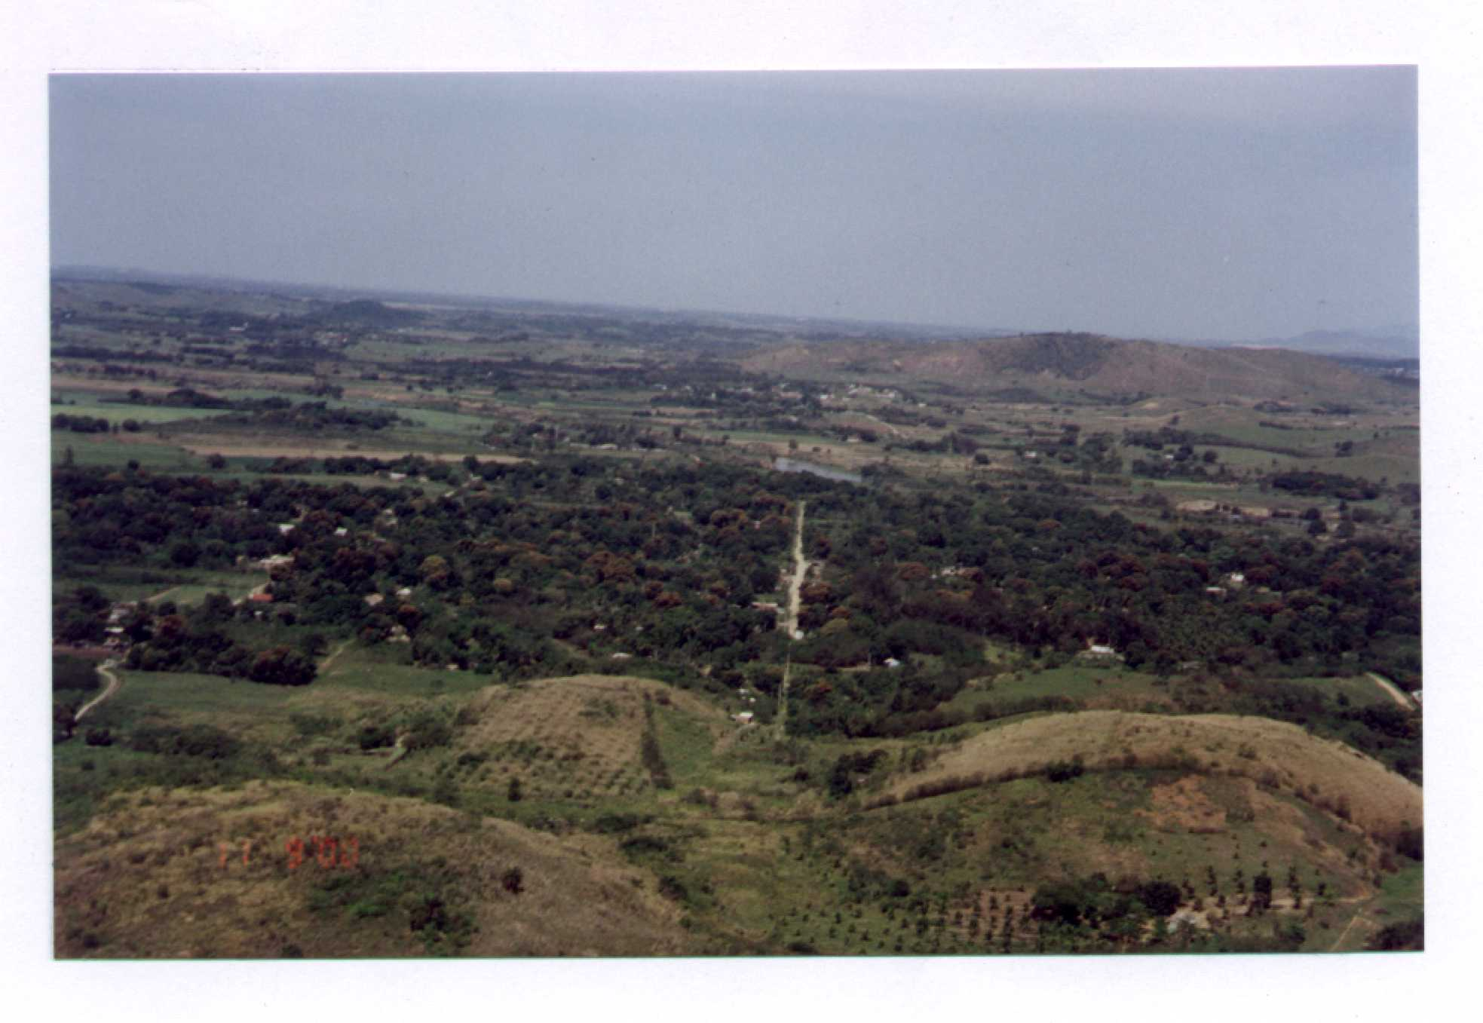
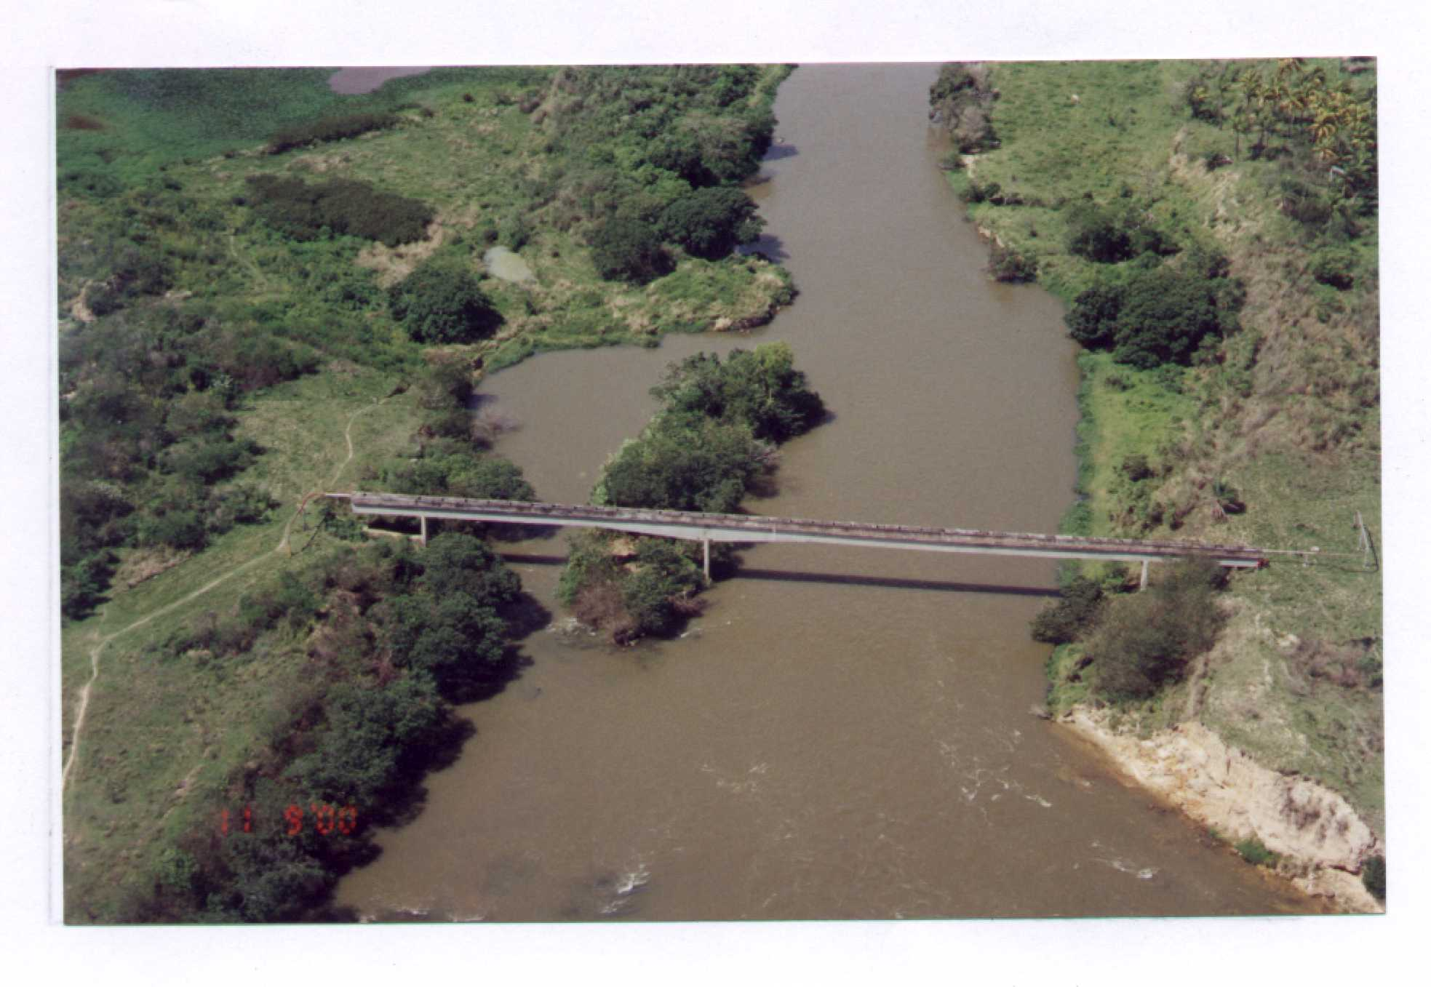
GSA - LD Contract
SFE has executed an agreement with CEG, by which CEG has already initiated development of the 14 km spur pipeline, prior to the execution of the GSA. The 14 km spur will be built primarily along an existing ROW owned by CEG. The Previous License for the pipeline was already issued with the Previous License for RioGen.

Slide 81
Environmental Considerations

Slide 82
EIA Report
The Environmental Impact Assessment (EIA) was developed by an independent consultant company (Mineral and Agrar) and properly registered at the Rio State Environmental Agency (FEEMA)
The environmental diagnosis and studies were developed in accordance with all guidelines established by valid Brazilian state, national and international environmental legislation.
The EIA was prepared to illustrate a Mitigation Program taking into account the preventive, corrective and compensatory nature of the actions to be taken, plus detail the environmental monitoring program.

Slide 83
Public Hearing Process
Environmental Impact Statement was delivered to FEEMA (Rio State Environmental Agency) on Oct. 23, 2000
Various project presentations were given to the community leaders throughout January
Environmental Public Hearing was held on February 16, 2001 in Seropédica - results very positive
Awaiting the final processing for the Previous License to be awarded - should be in March 2001

Slide 84
Permitting Status
Refer to detailed status report.

Slide 85
Environmental Enhancements
The turbines are equipped with water injection for NO_{x} abatement, a device that, associated to the characteristics of the natural gas provide an operation with low emission of atmospheric pollutants.
Environmental control procedures are incorporated by project design, such as air emissions control, liquid effluent treatment, solid waste disposal methods, noise abatement, etc. to meet or exceed applicable environmental standards.
The monitoring procedures proposed in the study are adequate to ensure proper environmental compliance and appropriate corrective measures.
The EIA has concluded that the project
is environmentally feasible

Slide 86
Brazilian Power and Gas Sector
Regulatory Status and Perspectives

Slide 87
Brazilian Regulation
ANP
ANEEL
Natural Gas
Electric DisCo
ECE
Free
Customers
Transportation
Spot Market
Gas LDCs
Distribution
SFE
State Regulation

Slide 88
Market Regulation
Major outlines of Definitive Market Rules:
  Spot price will be calculated by MAE and ONS. Generators, marketers and LDCs will be able to settle their positions against this price.
  Demand side management: Ability of the customers to re-sell unused energy (generated by voluntary load reduction) through the market.
  Capacity payment: In addition to marginal cost of power and embedded into the spot price, a capacity payment should be paid to all available, uncontracted capacity. However this point is one of few measures that are not approved yet by ANEEL. Therefore its implementation is likely to be postponed until 2002.

Slide 89
Implementation of the MAE
1998
1999
2000
2001
2002
Initial Plan Endorsed
by COEX
ASMAE
(As proposed by
Market Rules
Coopers &Lybrand)
Accounting + Settlement Systems
(
Jan 99)
Interim Metering
Revised MAE
Budget Figures
(Feb 99)
MAE Absortion of GCOI
Responsability Rules
Phase I
Phase II
(Repeal of MP1819)
End of Resolution 222
(Apr 99)
Extra Delays in Agreeing
Phase I
Phase II
w/ Definitive Market Rules
(Jul 99)
End of Resolution 222
Most Recent Estimates
Phase I.0 + Phase I.1
Phase II
(*)
(Sep 99)
End of Resolution 222
* Includes definitive metering

Slide 90
Major Regulatory Challenges for a Healthy Gas Industry
Introduction of effective competition.
  Need for multiple buyers and sellers.
  Open access on delivery infrastructure.
  “Open borders” for energy flows (natural gas and electricity).
Pricing signals in line with economic efficiency.
  Unbundling of commodity and fixed costs.
  Distance-based and interruptible tariffs are key (especially for thermal generation).
  Price mixing at the distribution (regulated) level not at the supply (competitive) level.
Clear signals need to be given that gas regulation will be market-driven and based on principles of economic efficiency.

Slide 91
What is happening at the MAE (Energy Wholesale Market)
Initial Contracts.- Rate-shock due was to be avoided by delaying and gradually allowing the “old-energy” contracts (best hydro - depreciated facilities) to eventually converge to the new energy prices (new plants) -- 1998-2005 transition
  Little trading liquidity until 2003 -2005 gets near.
  Free customers do not want to take the plunge and get exposed to higher marginal prices. Exceptions Tariff Cross-subsidies.
Temporary rules are in place (compromise) to trade the Initial Contracts - They are to be replaced by new rules (already agreed)
Delays (Impasse) between generators and consumers to agree to the new rules
  Agreement reached in Feb 00 - Targeted implementation in Sep 00.
  Due to Furnas legal challenges, submittal to Aneel approval delayed.
  Aneel has called for Public Hearings in July 00. Aneel may not approve the new agreement in its entirety. Delay to 2001 very likely
The Furnas legal challenge, and threats of counter legal challenges, has consumed the MAE leadership for months
  Confluence of Angra II delays (Claims of FM ) plus High Spot prices (Model-driven “Value of Water”) due to poor hydrology and no existing gas power options.

Slide 92
Barriers to a successful expansion of the Brazilian Power Supply
I) Getting full project commitments. Mitigation of current barriers
II) After getting started, challenges to achieve operation in the next 48 months (by 2003)
III) Convergence (or divergence) towards the vision of a competitive energy supply market.
(I) Mitigate
Current
Barriers
(II) Competition
for expansion
resources
(III) Competitive
energy supply
Markets
Uncertainties for power plant off-taker
Energy Price Cap Pass-trough (VN formula)
MAE/ONS Exposure
Gas Contract restrictions
Limited Turbines
  Plus ONS Limitations
Institutional resource Limitations
Time frame to present studies and obtain Licenses
Uncertainty on final regulatory environment
Delays in MAE implementation.
De-facto closed access to gas transportation facilities
Single entity domination of the gas-electricity convergence.
Concentration of market power.

Slide 93
Principal Barriers to
Classic Thermoelectric Projects
Capacity of Electric Distributors to sign a long-term PPAs
  Weak Financial Position – Regulatory Lag and Devaluation impact.- (EBIDAT Recovery ?)
  Separation of Distribution and Commercial Functions – Limited margins ?
  Progress to allow more free customers – size of the captive market?
Valor Normativo and Pass-through
  Level and indexation formula (One for all Brazil – does not reflect projects differences)
  Formula does not reflects the US$ obligations
  Mechanisms to harmonize gas indexation and other US$ obligations with electricity indexation (tracking account)

Slide 94
Principal Barriers to
Classic Thermoelectric Projects
Uncertainties due market in transition between the old system and the market system.
  Stability/Predictability of electric transition rules.
  Delays in the working of the MAE.
  Lack of liquidity in the MAE
  Opening of the gas market to competition (Convergence of gas and electricity)
MAE/ONS Exposure
  Influence of other projects on future transmission costs
  Influence of back-up costs.
  Frequency response requirements requested by ONS for gas turbines
Capacity of Free consumers/Marketers to sign long-term PPA
  Free customer not leaving until initial contracts are renegotiated and future more clear

Slide 95
Principal Barriers to
Classic Thermoelectric Projects
Competition for limited resources.
  Limited availability of turbines
  Human resource constraints in institutions to process simultaneous projects. (Banks, Regulators, Environmental Agencies) etc.
  Obtaining Financing in an uncertain regulatory environment
Legal/Institutional concerns with international project financing
  Dispute resolution- International Forum, Enforceability
  Central Bank rules for US$ account transfers.
Issues with Gas supply Contracts
  Requires more flexible TOP obligations – Hydro matching
  International Financing clauses
  Disputes with concessionaires and specific projects - Exclusivity.
  “Preferential pricing” for certain projects – Competition on the market
  Taxation – ICMS deferral to final consumer
  Central Bank- TOP payments for imported gas. – Economic dispatch different from dedicated supply

