Slide 1

Current Trends
Power Load Growth
Reduced Hydro
Change in Flows
Kemmerer
La Plata
Kingsgate

Slide 2
California SP15 Year on Year Generation

Slide 3
California NP15 Year on Year Generation

Slide 4
California SP15 Year on Year Load

Slide 5
California NP15 Year on Year Load

Slide 6
California Gas Consumption By Sector

Slide 7
San Juan Receipts Year on Year
Flows off TW & EPNG

Slide 8
Socal Sendouts Year on Year
Data for May-98 to Jul -98 is N/A

Slide 9
West Storage
Socal Storage - 105 Bcf
PG&E Storage - 96 Bcf
Wild Goose Storage - 17 Bcf
Clay Basin Storage - 56 Bcf
Jackson Prairie - 19 Bcf

Slide 10
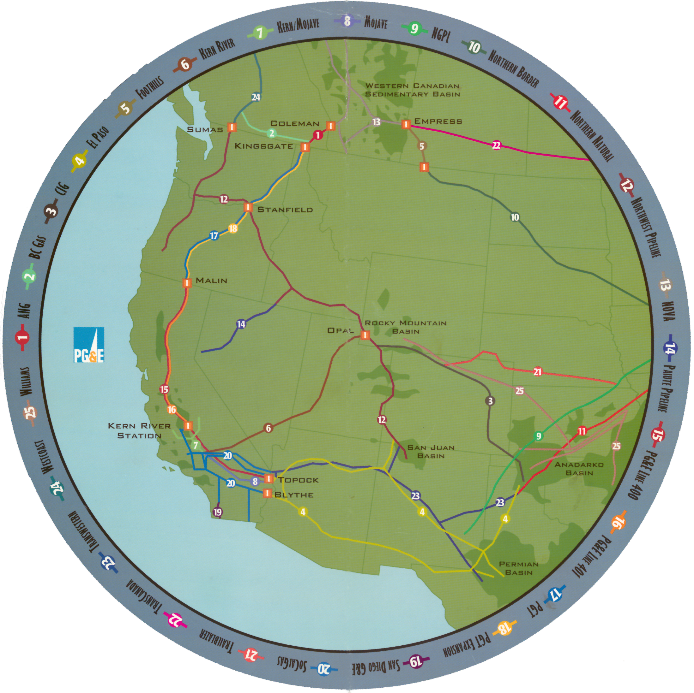

Slide 11
N & S Chehalis - 1Bcf/d
Idaho/Nevada - 0.275 Bcf/d
Colo/Utah - 1.1 Bcf/d
CA - 5 Bcf/d
EOCs -0. 5 Bcf/d

Slide 13
WSCC New Generation

Slide 14
WSCC New Generation - Gas Equivalent

