Slide 1

Current California Trends
California Storage
Ability to Deliver Gas to the California border
California Power
Load Shed
Energy Crisis

Slide 2
Increased Rockies Supply

Slide 3
California SP15 Year on Year Generation

Slide 4
California NP15 Year on Year Generation

Slide 5
California SP15 Year on Year Load
*ZP26 included SP15 from 2/00-11/00

Slide 6
California NP15 Year on Year Load

Slide 7
California Gas Consumption By Sector

Slide 8
San Juan Receipts Year on Year
Flows off TW & EPNG

Slide 9
Socal Sendouts Year on Year
Data for May-98 to Jul -98 is N/A

Slide 10
West Storage

Slide 11
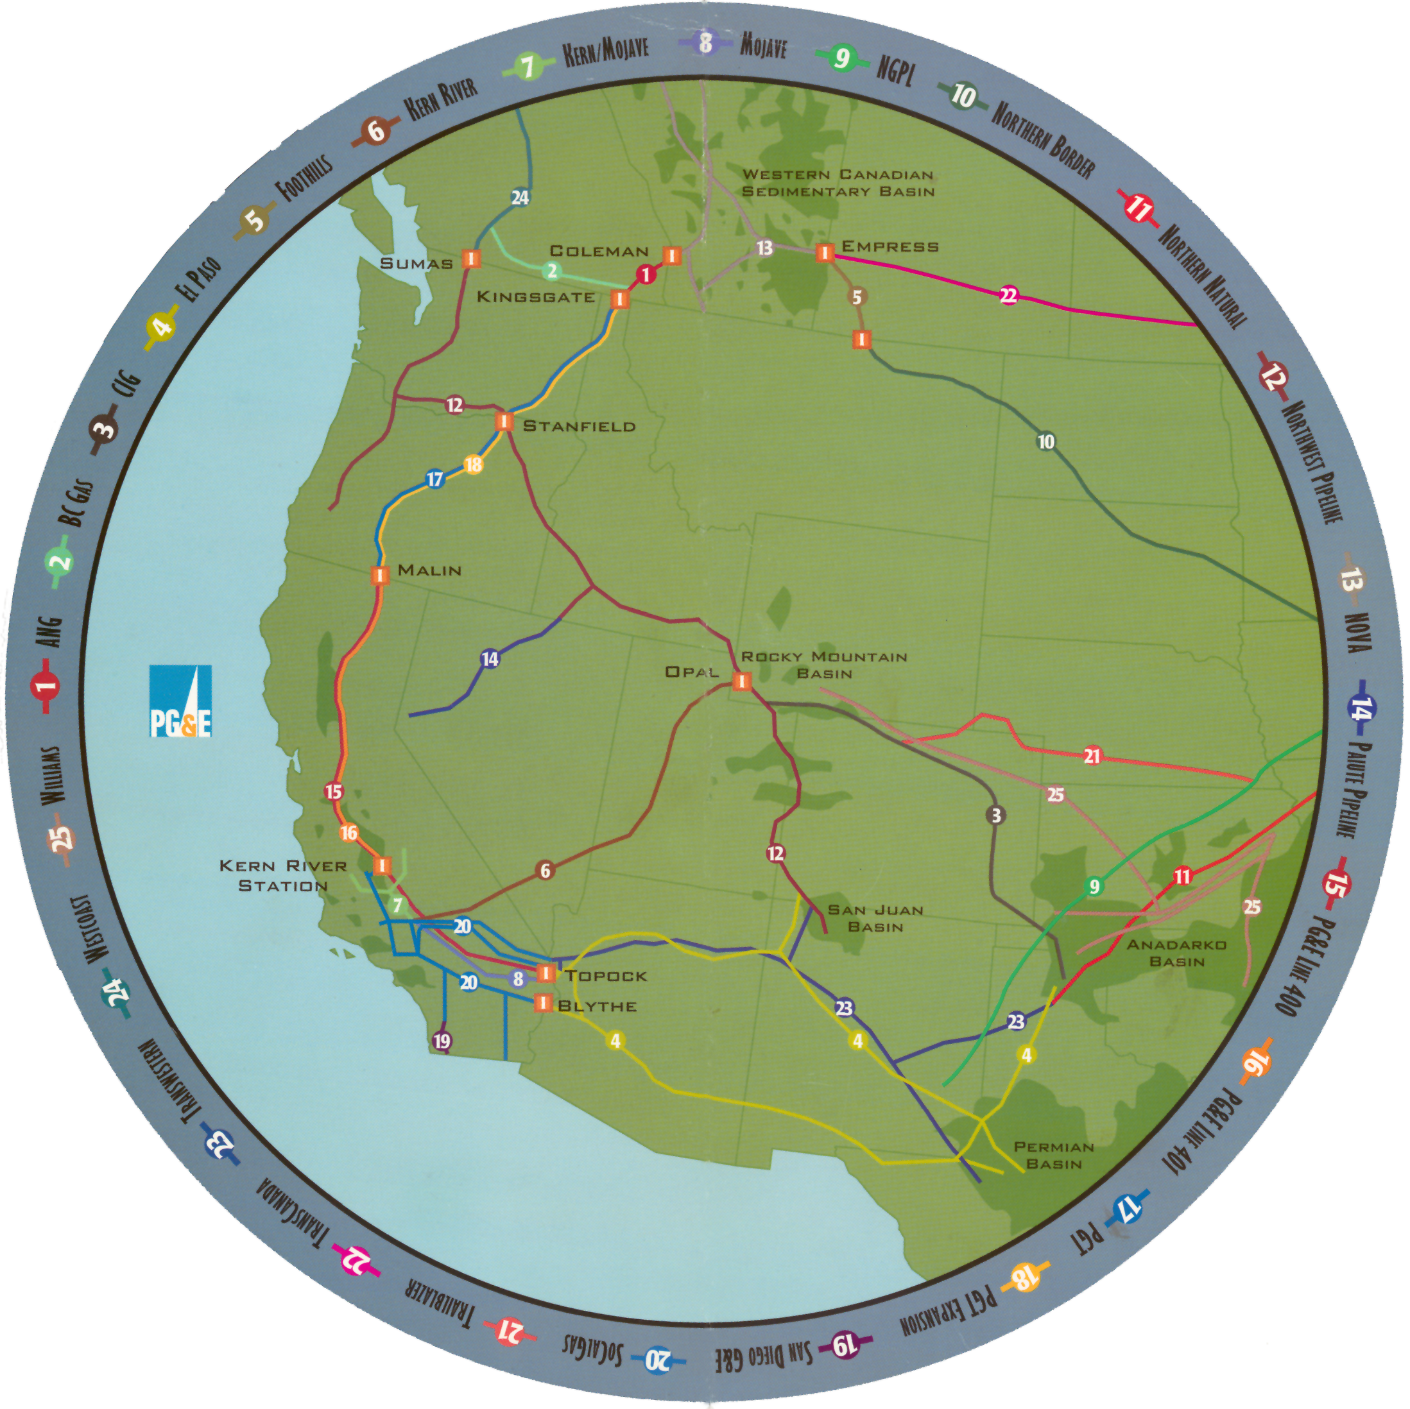

Slide 12
N & S Chehalis - 1.4 Bcf/d
Idaho/Nevada - 0.400 Bcf/d
Colo/Utah - 1.7 Bcf/d
CA - 7+ Bcf/d
EOCs 1.1 Bcf/d

Slide 14
WSCC New Generation

Slide 15
WSCC New Generation - Gas Equivalent

Slide 16
Pipeline Capacity/Expansion- Southwest
Southern Trails
Q4 2001
120,000 Mcf/d
San Juan to Southern California
Kern River Expansion
May 2002
124,000 Mcf/d
Rockies to Southern California
All-American Pipeline
Q2 2001
100,000 Mcf/d
West Texas to Southern California (no new incremental supply)
Northern Baja
Jan. 2003
400,000 Mcf/d
Pull Gas away from Socal into Mexico

Slide 18
Pipeline Expansion/Capacity- Rockies
Coastal Connection
Q4 2003
500,000 Dth/d
Rockies to Mid-continent
Colorado Interstate Gas Expansion
Sept. 2001
85,000 Dth/d
Tap into Raton Basin, stays in Rockies
Trailblazer Expansion
Dec. 2002
150,000 Dth/d
Rockies to Mid-continent
Medicine Bow
Nov. 2001
2 Bcf/d, 0.5 Bcf/d sold firm
Gas from Medicine Bow to Cheyenne Hub
Western Frontier
Nov. 2003
540,000 Dth/d
Cheyenne Hub to Mid-continent

