Slide 1

Project Summer
Confidential
O:\Corpdev\NorthAmerica\Conner\ENA Corpdev\Project Alpha\Presentation

Slide 2
Rationale - Equity Returns
Return on capital of subject entities as a whole is lower than that of ENE
Need to revise taking out the 20% equity interest

Slide 3
Deal Description
Transaction
$6.08 billion cash sale for 80%of Enron’s equity interests in:
  Substantially all non-European international operations (including Turkey)
  Enron Gas Exploration and Production
  Enron Wind
Purchaser is a Middle and Far East private investor group led by Dr. Amin Badr El-Din
Enron retains 20%of combined entities
  Has option to exit after after IPO or after 5 years through a put right for the then-current book value
  Has Board representation - One for EI and four for a/b
Employees
  All current employees in subject businesses are to go with the sale
  Purchaser is to be responsible for all severance and other related benefits
  Enron to pay pro-rata bonuses for employees for 2000
  Enron to provide $150MM to purchaser to be used as a pool to be used for employee retainage, severance, or for other employee benefit items
  Mutual no hire provision
Enron to pay up to $75MM for fees relating to transferring subject businesses
Purchaser has right to exclude Turkey businesses from transaction
  Purchaser performs due diligence after signing

Slide 4
Deal Description
Obligations of Enron
Purchaser has limited rights to use the Enron name
Provide transition services for up to 2 years
Keep existing Enron guarantees in place for up to 5 years
Between signing and closing, Enron is to provide capital to subject businesses based upon an agreed upon budget
Obligations of the Purchaser
Secure purchase with L/C

Slide 5
Operations Included In Sale
All Businesses
  South America
  Enron Wind
  Enron Gas Exploration and Production
  Middle East
  Turkey
  CALME
  India
Partial Businesses
  Asia, Pacific, Australia, and China
    Excludes trading operations in Japan and Australia
    Excludes Hainan project
Detailed List is shown in Appendix

Slide 6
Transaction Overview
ENE
$
Purchaser
Effective
80% ownership
interest in
EI Companies
To be revised
EI
A
B
C
Has transfer issues.
Does not have transfer issues.
Enron distributes its equity interests in subject companies into three holding companies
Equity interests with contractual or regulatory transfer restrictions will be placed in either A or B
Because of restrictions, Enron must retain a level of direct ownership
Enron equity interests with no transfer restrictions are to be placed in C
Enron sells effectively 80% of interests in A,B, and C to Mint

Slide 7
Pro Forma Ownership
Eagle
Mint
X
(100% - X)
EI
51% Voting
& Economic
49% Voting
& Economic
100% Voting
& Economic
B
49% Voting
99.9% Economic
C
51% Voting
0.01% Economic
A
Enron, through its ownership in A, B, and EI, has 20% economic interest in the aggregate group (A,B,C)
Purchaser has an 80% interest in the aggregate group through EI ownership
As transfer restrictions are eliminated, A/B interests will be transferred to C
There will be an adjustment to Enron interests in EI to reflect transfers, performance, and equity infusions
Enron has no obligation to provide capital infusions
  If it does not participate, ownership interests will be diluted

Slide 8
Timing
Deal Timing
  Signing of definitive agreements the week of August 14th
  Signing of other ancillary agreements to occur between sign and closing
  Closing expected within 60-90 days of signing

Slide 9
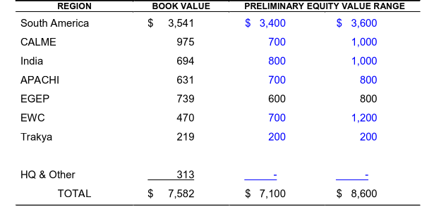
Valuation
Sale price within valuation range
Rationale for sale at end of valuation range
  Opportunity to sell all businesses at once
  It would take substantial time to sell each business unit separately
    REGIONAL VALUATION BREAKDOWN
    (Dollars in Millions)

Slide 10
Gain/Loss and Cash from Transaction
Slight book loss, but mitigated by liquidity
Substantial cash proceeds after expenses and repurchases
Why no bonus

Slide 11
Pro Forma Financial Impact
Divestiture is expected to be accretive to earnings
Assumes 100% of proceeds used to reduce debt

Slide 12
Appendix

Slide 13
Contract Summary
Purchase price adjustment
  Enron cash-in/cash-out to those operations since 3/31
  Agreed upon net income adjustment to capture earnings between 3/31 and closing
  Adjustment maintains Enron book basis in subject companies
Purchaser has limited rights to use the Enron name
  South America, Africa, Middle East, Caribbean, Central America, India - 5 years
  Asia (excluding Japan and Australia) - 3 years
  EE&CC and Wind - 6 months
Transfer Issues
  Pre-Closing - Purchaser directs activity, but involves Enron in such activities
  Post-Closing - Purchaser directs activities and is at risk for transfers within the new organization structure
  Once Enron places its equity ownership in the required holding companies, the risk lies with the purchaser Cost Sharing
Representations and Warranties of Enron
  Representations and warranties are qualified by knowledge of Enron senior management, but not EI senior management
  Capped at $XXMM, with a term of XX
Exit Mechanism
  Enron can participate in an IPO, or can request that the purchaser complete an IPO on the Subject companies after 5 years
  If the purchaser declines, purchaser is required to purchase Enron’s interest at book value
Human Resource Issues
  Companies have mutual no-hire agreement
  Analyst/Associates are to remain Enron employees, but are excluded from the no-hire provision
Enron guarantees must remain in place
  Current outstanding Enron guarantees related to subject businesses are $

Slide 14
Operations for Sale

