Slide 1
February 26-27, 2001
Mexico Meeting
E-nhancing Mexico’s Economic Growth
Dr. Kenneth Lay
Chairman
Enron Corp.
E-Impact
Plenary Session
February 27, 2001
Notes:
Introduction Statement
THIRTY SECONDS
00:00:30

Slide 2
Mexico/U.S. Trade Status
Trade Volume in 2000
Average Growth: 1993-99
($US billion)
(Percentage)
400
20
300
15
200
10
100
5
0
0
China
UK
Korea
Mexico
China
Korea
UK
Taiwan
Japan
Canada
Mexico
Japan
Taiwan
France
Germany
Canada
France
Germany
Singapore
Singapore
Source: US Census Bureau
Notes:
Mexico became the second largest U.S. trading partner in just 5 years second only to Canada. The trade volume between Mexico and the U.S. has tripled since the implementation of NAFTA in January of 1994.
Since then Mexico has signed Free trade Agreements with Chile, Israel, The European Union, and several Central American nations (Guatemala, El Salvador… to be updated)
Mexico is currently negotiating a free trade agreement with The Mercosur Countries (Argentina, Brasil, Paraguay and Uruguay) and a preferred trade status with Japan. Mexico is also an active member of the APEC.
All these treaties, the economic reform that has and is been carried out, and Mexico’s privileged geographic situation make this country one of the most open economies in the world and ensure it a huge economic potential through trade.
However, in a globalized world economy, countries have to strengthen their competitive advantages every day by enhancing their productivity. While education and production technology are the foundations of productivity, implementing them is a medium to long term effort.
On the other hand, information technologies can enhance productivity at the margin in the short term and are essential for a continued level of competitiveness for countries with an export oriented economy.
What can e-commerce do for Mexico? A lot. The fundamental question today is : How can Mexico take full advantage of these technologies?
ONE MINUTE
00:01:30

Slide 3
Mexico’s Fixed Telephony Infrastructure
Telephone Lines in Service
(Millions)
12.3
10.9
9.9
8.8
8.8
9.2
8.5
7.6
6.7
6.0
5.3
1990
1991
1992
1993
1994
1995
1996
1997
1998
1999
2000
Source: COFETEL
Notes:
In the last 10 years, Mexico has more than doubled the number of telephone lines in service, bringing the total to 12.3 million lines. The 1990-1999 Compounded Annual Growth Rate was 8.8%. Since the infrastructure is virtually new, a surprising 96% of Mexico’s telephone lines are digital.
Nevertheless, telephone density is still rather low at close to 13 lines per each 100 inhabitants. Demand for new fixed lines has become stagnant due mainly to a huge growth in the demand for Mobile telephony which by the end of 2000 had roughly the same number of operating lines than fixed telephony.
This obviously has an impact on Internet penetration.
Despite the aforementioned data,...
Mexico is the second largest telecommunications market for the United States after Canada. In 1998, 424 million telephone calls were originated in the United States and 239 million in Mexico. The market has grown steadily at an 18% CAGR for the last 13 years. In terms of private line service, Mexico came third after Canada and Japan during 1998. In that year, US Carriers had 28,368 64k equivalent private lines installed and working in the country.
All this activity represented total retained revenues for US carriers of $1.1 billion dollars, while Telmex received $1.3 billion. Traffic revenues have increased at a [20%]% CARG for the last 13 years, mainly as result of significant volume increments. 50% of revenues are business related.

Slide 4
Internet Users in Mexico
(Thousands)
1,613
1,011
846
740
478
239
240
298
299
167
142
154
166
141
14
31
33
69
10
29
48
84
3
5
‘95
‘96
‘97
‘98
‘99
‘00
‘95
‘96
‘97
‘98
‘99
‘00
‘95
‘96
‘97
‘98
‘99
‘00
‘95
‘96
‘97
‘98
‘99
‘00
Government
Education
Home
Business
Source: COFETEL
Notes:
Added to a relatively low telephone density, to a low home computer penetration and to high connection costs, internet usage in Mexico is limited, with an estimated 3 million users, representing 24% of the telephone users in Mexico and only 3% of the total population.
Nowadays, the large cross-border telecomm business activity which I have referred to is focused on traditional services. This, in our opinion, represents an opportunity to companies providing IP based value-added services (like EBS), in both sides of the border. Services such as streaming media, bandwidth trading, Virtual Private Networks and specially Voice Over IP packet transport could represent a significant business opportunity for EBS. (check confidentiality with EBS’s JAAB)
Additionally, regulatory arrangements currently in place have made the cost associated with telecommunications services in Mexico expensive vis a vis other nations. This situation places cost as the main concern for businesses, even above quality, when discussing LD and other telecommunications services. As a result, solutions that offer cost savings are clearly of interest to business customers.

Slide 5
Integrating E-commerce in Trade
National
International
Promote national
B2B utilization to
optimize supply chain
Enable international
B2B access and
solutions for more
Mexican companies
B2B
Implement security and
fulfillment policies for
increased trust in B2C
Continue home computer
promotion
Enable international
B2C access and
solutions for more
Mexican companies
B2C
Notes:
Due to the structure of the Internet access in Mexico. The country should concentrate heavily on B2B and on International B2C.
International B2B
Mexican corporations should be able to buy and sell efficiently through the internet to and from their international business partners. Mexican companies should increase the use of the internet as a distribution channel of their goods and services to the international business community.
More and more of their international transactions should take place through this channel every year. It will cut their costs and more importantly it will increase their business volumes.
Credit, security, quality of service standards, and standardized contracts are key factors that Mexican corporations should solve towards these objectives.
International B2C
Mexican companies should seek to sell retail worldwide through the internet.
Trust and security are key. You will gain this through excellent fulfillment and quality of service.
National B2B
In order to increase efficiency, reduce costs and grow business, Mexican corporations should promote and increase the use of B2B in every segment of the supply chain. This is an area where great opportunities exist. If Mexican companies are competitive now imagine what they could do with the incorporation of the latest B2B technologies to their supply chain.
National B2C
Due to the characteristics of the economy, the limited penetration of internet and computers at home B2C will take some time to develop in Mexico.
Excellent fulfillment, enabling off the phone credit card payment and increased home computer penetration are key to success in this field.
Mexican companies have done an excellent job at offering options by which many households have been able to acquire PC equipment.

Slide 6
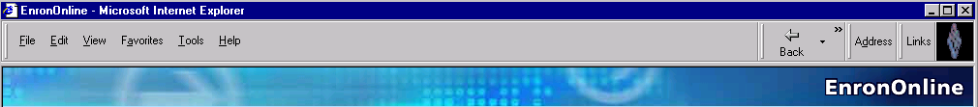
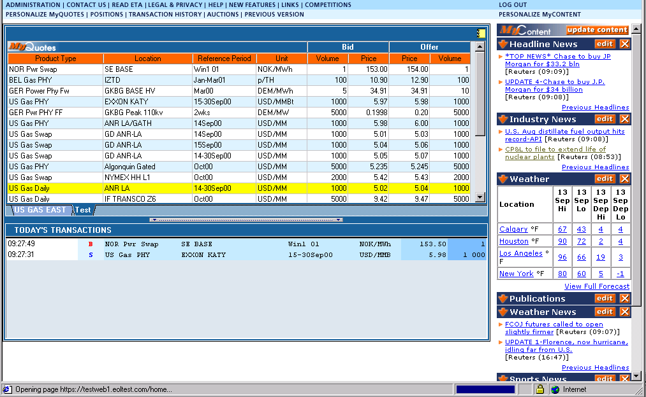
EnronOnline
Instantaneous Market Making
Daily Transaction Growth
6000
5000
4000
3000
2000
1000
0
11/29/99
12/10/99
12/21/99
01/01/00
01/12/00
01/23/00
02/03/00
02/14/00
02/25/00
03/07/00
03/18/00
03/29/00
04/09/00
04/20/00
05/01/00
05/12/00
05/23/00
06/03/00
06/14/00
06/25/00
07/06/00
07/17/00
07/28/00
08/08/00
08/19/00
08/30/00
09/10/00
09/21/00
10/02/00
10/13/00
10/24/00
11/04/00
11/15/00
11/26/00
12/07/00
1999
2000
2001
Natural gas - electricity - oil - coal - emissions - weather - plastics - paper - lumber - metals - steel - broadband

Slide 7
EnronOnline Efficiency Gains
Transactions Per
Market Maker
Marginal Cost
Per Transaction
(Indexed)
3,084
100
672
25
1999
2000
1999
2000

Slide 8
Current Opportunities
Reform regulation to incite new infrastructure
Commoditize broadband
Harmonize tax policies
Educate through internet use
Notes:
Broadband as a commodity
Ensure competitive environment to achieve low cost broadband capacity by guaranteeing open undiscriminated access to optic fiber infrastructure, to last mile connections and to Point Of Presence sites.
Allow for capacity trading through marketers that do not have to own fiber infrastructure
Tax Homologation
Education through the internet.

