Slide 1
Newest approaches to Industrial/Commercial Power Quality
Alex McEachern
Power Standards Lab
(510) 658-9600
www.PowerStandards.com
www.Alex.McEachern.com Silicon Valley Manufacturing Group – 8 August 2001

Slide 2
Power Quality in Silicon Valley
Traditional approaches to power quality at high tech industrial/commercial facilities
Why they don’t work
One new approach
Very low cost, or free
One future approach…
www.Alex.McEachern.com Silicon Valley Manufacturing Group – 8 August 2001

Slide 3
Traditional approaches
Tradition #1: Overkill
Clean up everything, everywhere
Big UPS/generator
Individual UPS / filters
Why it doesn’t work
Expensive – unrequired coverage
Possibly unreliable
Raises source impedance
Doesn’t solve the problem
www.Alex.McEachern.com Silicon Valley Manufacturing Group – 8 August 2001

Slide 4
Traditional approaches
Tradition #2: Passive
Wait for a problem, then monitor, then solve
Pray for a repeat of the problem (!)
Actual problem vs. power quality problem
Cold beer and hot showers
Why it doesn’t work
Management doesn’t see you do anything
Doctor / softball bat analogy
Doesn’t solve the problem
www.Alex.McEachern.com Silicon Valley Manufacturing Group – 8 August 2001

Slide 5
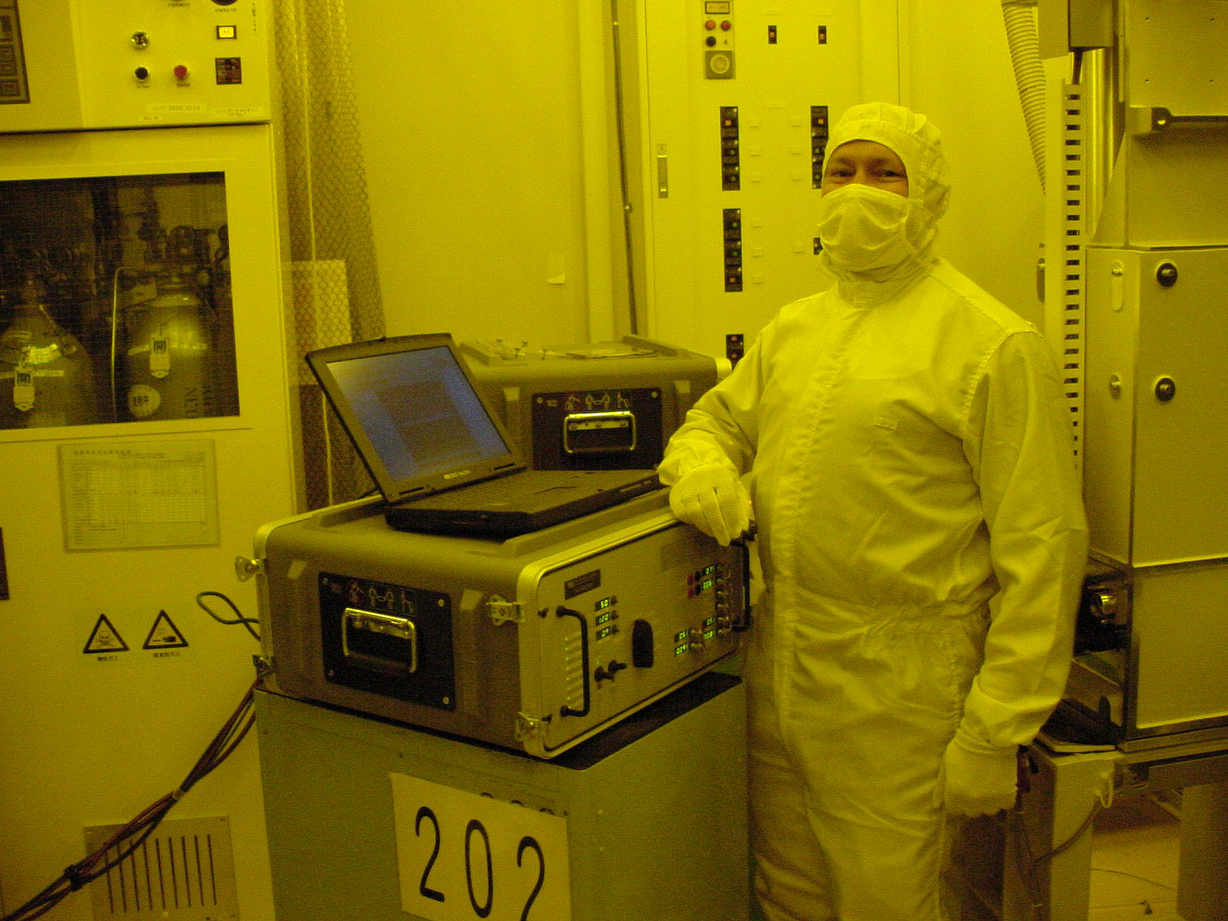
New approach
Power Standards Lab provides
bad quality power.
www.Alex.McEachern.com Silicon Valley Manufacturing Group – 8 August 2001

Slide 6

What if cars were built like this?
“Requires road that
is +/- 10% smooth.”
www.Alex.McEachern.com Silicon Valley Manufacturing Group – 8 August 2001

Slide 7
The basic idea:
Power quality is a compatibility issue between
the electric power system and the sensitive load.
To solve the problem, improve either one.
www.Alex.McEachern.com Silicon Valley Manufacturing Group – 8 August 2001

Slide 8
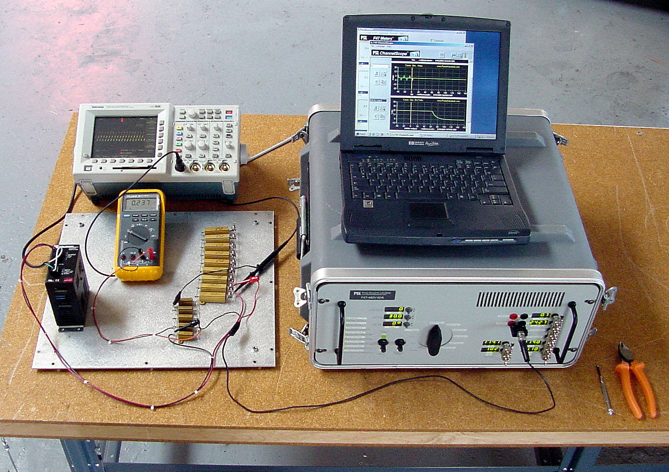
Solve power quality problems by testing and improving the loads.
Cheap or free improvement
Fundamentally sound
Active, not passive
New standard in semiconductor
business: SEMI F47
www.Alex.McEachern.com Silicon Valley Manufacturing Group – 8 August 2001

Slide 9
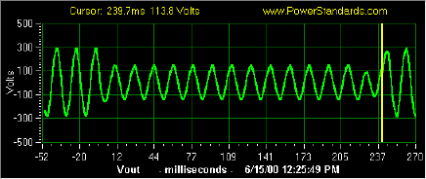
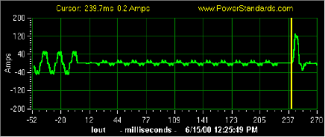
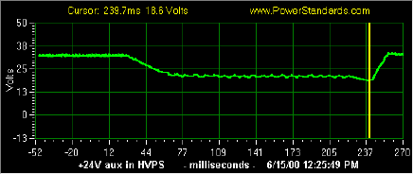
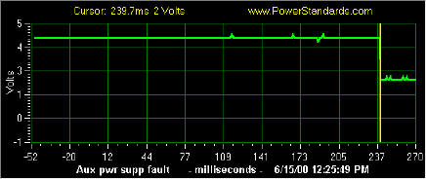
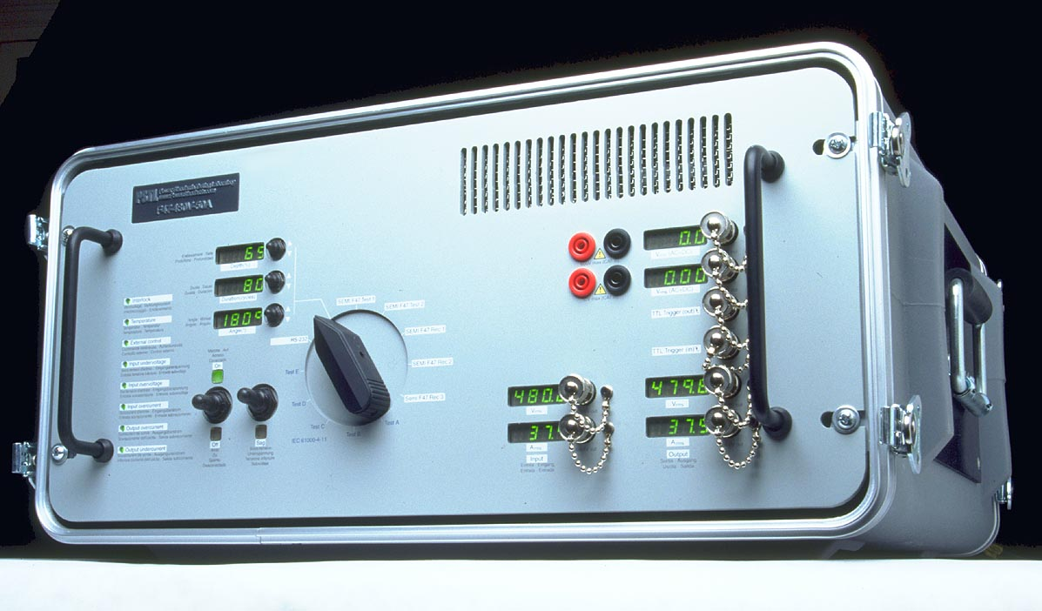
Typical on-site tests when you suspect a power quality problem
Voltage sags – various depths
and durations – 50% 200ms
High frequency impulses:
up to 6kV, up to 5kA
Test equipment: sag generators,
impulse generators, couplers,
data acquisition
www.Alex.McEachern.com Silicon Valley Manufacturing Group – 8 August 2001

Slide 10
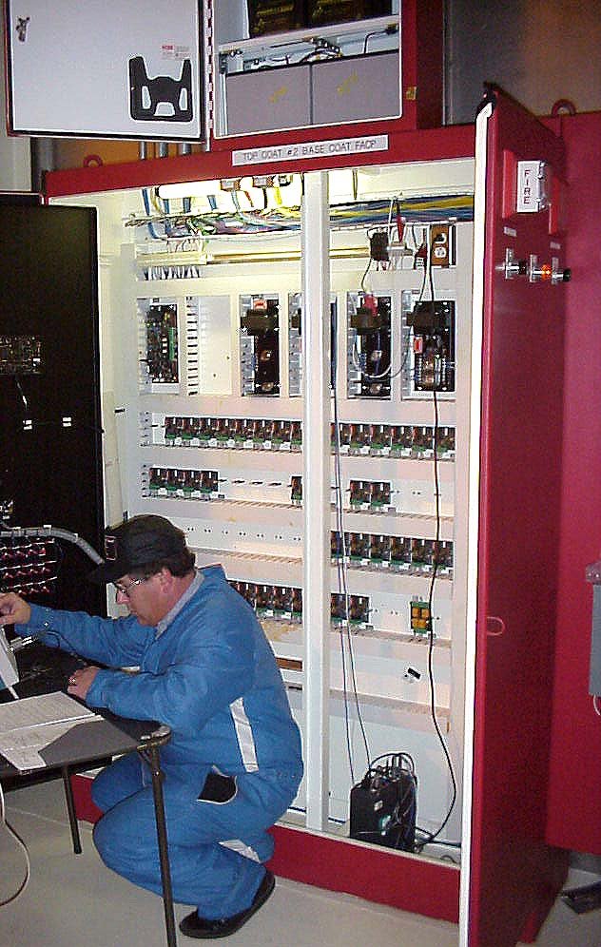
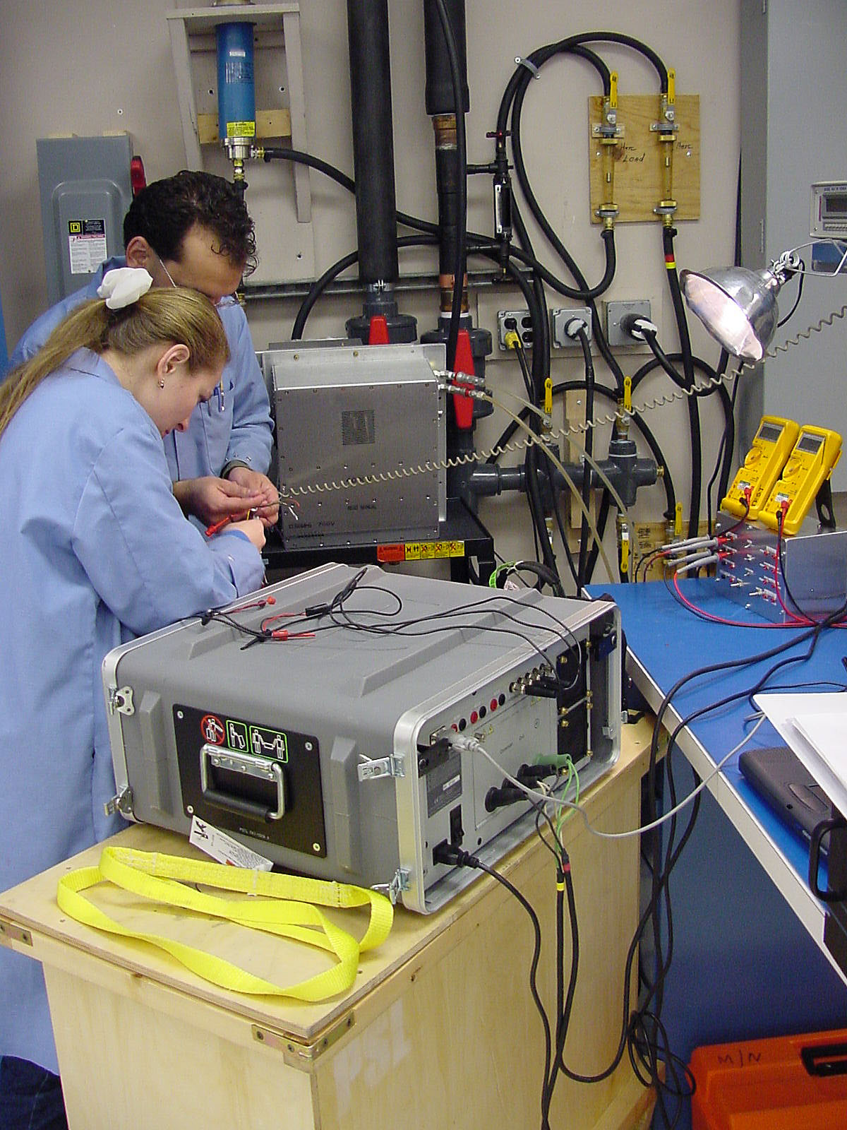
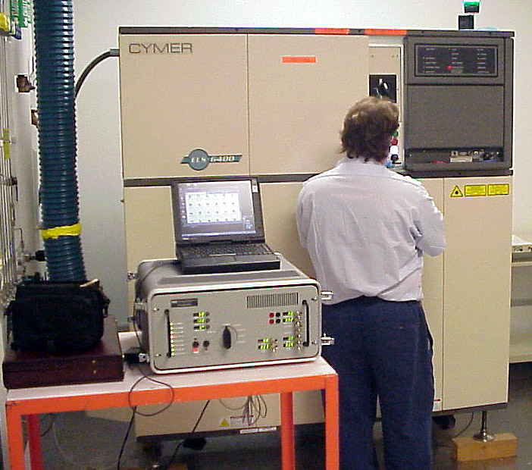
Examples of this approach
Laser manufacturing
Electronic assembly
Automobile plant
www.Alex.McEachern.com Silicon Valley Manufacturing Group – 8 August 2001

Slide 11
SEMI F47 – a new standard
Requires manufacturing equipment
to tolerate three specific voltage sags
Solves 90%+ of the PQ problems
SEMI F42 is the test standard
Other standards starting to follow
(IEC 61000-4-11, 61000-6-2, NEMA…)
www.Alex.McEachern.com Silicon Valley Manufacturing Group – 8 August 2001

Slide 12
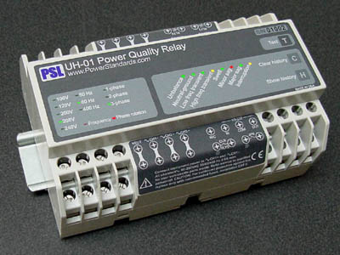
A future approach to power quality
Doubt is a basic issue in power quality
“Power-quality-aware” loads
Full 3-phase power quality monitoring
built-in – sags, swells, impulses,
frequency, phase rotation, loss,
neutral-ground, waveforms
www.Alex.McEachern.com Silicon Valley Manufacturing Group – 8 August 2001

Slide 13
Recommendations
Add on-site testing using bad quality power
to your arsenal.
2. Consider specifying SEMI F47 on major
purchases.
3. Watch for power-quality-aware systems
in the future.
www.Alex.McEachern.com Silicon Valley Manufacturing Group – 8 August 2001

Slide 14
Newest approaches to Industrial/Commercial Power Quality
Alex McEachern
Power Standards Lab
(510) 658-9600
www.PowerStandards.com
www.Alex.McEachern.com Silicon Valley Manufacturing Group – 8 August 2001

