Slide 1


Slide 2
Restructuring US Energy Market and Implications for the Future of Energy Trading: Practitioner’s Perspective
Vincent Kaminski
ENRON CORP.
HOUSTON, May 9, 2000

Slide 3
Outline
Energy markets: differences and similarities
The power trading company of the future
The importance of physical assets
The challenge of energy contract valuation
The impact of Internet on energy trading

Slide 4
ENERGY MARKETS: DIFFERENCES AND SIMILARITIES

Slide 5
Why Power Markets Are Different
Most markets are the result of spontaneous economic and social development
Power markets are man-made, a product of social experimentation, carried out under the pressure of economic and social forces
The process of market design and implementation may be messy and convoluted
The task of market design is complicated by the very complex nature of the power industry
  The integrated generation and transmission grid is a very complicated system that requires instantaneous synchronization and coordination
  The industry was traditionally based on cooperative behavior that is replaced by competition in the context of the rules developed through a political process

Slide 6
Why Power Markets Are Different
The uncertainty regarding the political developments slows down the development of power markets, especially the forward markets
The rules may be sometimes revised to a significant extent creating regulatory uncertainty
Important lessons regarding the implications of different solutions can be learned from other countries
One has to understand the impact of man-made rules on the dynamics of market prices
Rules created by humans can be circumvented by the humans. The potential for strategic behavior in bidding into the power pools.
  Example: England and Wales Power Pool – the dynamics of the capacity payment

Slide 7
Why Power Markets Are Different
The power markets are likely to be quite imperfect for a long time
The sources of imperfections
  The power market is, to a large extent, the market for surplus power
  The demand side is insulated from the price signals in most power markets
  Different sectors of the power industry are deregulating at a different pace and in inconsistent ways
    Example: transmission markets vs. generation markets
The technology of the power markets (lack of storage) induces exceptional levels of price volatility that may be amplified through regulatory errors

Slide 8
THE ENERGY TRADING COMPANY OF THE FUTURE

Slide 9
BTU Marketing
Emergence of companies marketing multiple groups of energy commodities and related services
Concept of one stop energy shopping
The trend to BTU marketing is likely to accelerate and blur distinctions between different segments of the industry through
  internal growth
  strategic alliances
  mergers

Slide 10
BTU Marketing
A necessary condition: marketing of the entire spectrum of energy commodities
However, multiple product lines don’t automatically create a true BTU marketer. Example: a gas liquids producer is not necessarily a BTU marketer.
Additional features:
  cross market transactions involving multiple distinct products
  additional financial and non-financial services which make inter-market transactions possible
  transactions involve transformation of one commodity into another through financial/physical activities

Slide 11
Inter-Market Arbitrage
Exploitation of market price differences resulting from:
  transportation bottlenecks
  inventory shortages
  structural demand/supply shifts
Example: high gas prices in the winter of 1995/1996 created opportunities for power and natural gas markets arbitrage
Marketers exploit differences between market price ratios and technological transformation rates
Example: Gas tolling. Generation owner receives natural gas in return for electricity.

Slide 12
THE IMPORTANCE OF PHYSICAL ASSETS

Slide 13
The Importance of Physical Assets
Energy trading cannot be separated from the physical side of the business
  Even in the most liquid market, certain percentage of trades goes into delivery
  Physical energy commodities have to be produced, stored, delivered to the end-user
  The transportation/transmission system is of paramount importance
Trading activity revolves to a large extent around the needs to protect the economic performance of fixed assets (refineries, natural gas and oil storage facilities, power plants)

Slide 14
The Importance of Physical Assets
However , trading activity allows to create virtual physical assets through a combination of financial transactions
  Examples:
    Virtual storage
    Virtual power plants
    Virtual transmission
The assets will be increasingly valued by looking at them as portfolios of options
In many cases, risks of option positions in illiquid markets will be managed through mirror options embedded in physical assets

Slide 15
THE CHALLENGE OF VALUATION MODELS

Slide 16
Option Pricing
Major challenges
  Complicated payoff structures
  Non-traditional price processes
  In many case ability of delta hedging is limited or nonexistent
Current models: most commercially available approaches represent mechanical implementations of solutions borrowed from the financial markets
Examples to follow

Slide 17
Option Pricing
The market for electricity options is dormant/under an oxygen tent
Price spikes of 1998 effectively shut down the market for electricity derivatives
Call options continue to be written by the generators
  treated as covered calls
  cash flow enhancement is the main incentive

Slide 18
Hedging
In many cases it is impossible to create a replicating portfolio
  no intra-month forward markets (or insufficient liquidity)
  it is not feasible to delta hedge with physical gas
  balance of-the-month contract: imperfect as a hedge, low liquidity
Risk mitigation strategies are used
  portfolio approach
  physical positions in the underlying commodity
  storage

Slide 19
Modeling Price Process
Energy prices have split personality (Dragana Pilipovic)
  Traditional modeling tools (Geometric Brownian Motion) may apply to the long-term forward prices
  As we get closer to the delivery month, the price dynamics changes
  Gapping behavior of the spot prices and the front of the forward curve
  Limited liquidity and backward bending supply curves

Slide 20
Modeling Price Process
Traditional answers to modeling problems seem not to perform well
  Mean reversion
    seasonality of the mean level
    different rate of mean reversion for positive and negative deviations from the mean
  Jump-diffusion processes
    asymmetric jumps with a positive bias
    one can speak rather about floor-reversion

Slide 21
Modeling Price Process
The academics and industry researchers address the problems of
  complicated contract structures
  non-conventional price processes
The issue of limited ability to hedge has not been fully recognized
  transaction cost approach
  perception of a temporary nature of the problem (market growing pains)

Slide 22
THE IMPACT OF THE INTERNET

Slide 23
The Communications Revolution
“A new communications technology (…) that allowed people to
communicate almost instantly across great distances, in effect
shrinking the world faster and further than ever before. A world-
wide communications network whose cables spanned
continents and oceans, it revolutionized business practice,
gave rise to new forms of crime, and inundated its users with
a deluge of information. Romances blossomed over its wires.
Secret codes were devised by some users and cracked by
others. The benefits of the network were relentlessly hyped by
its advocates and dismissed by the skeptics. Governments and
regulators tried and failed to control the new medium.”

Slide 24
The Communications Revolution
“A new communications technology (…) that allowed people to
communicate almost instantly across great distances, in effect
shrinking the world faster and further than ever before. A world-
wide communications network whose cables spanned
continents and oceans, it revolutionized business practice,
gave rise to new forms of crime, and inundated its users with
a deluge of information. Romances blossomed over its wires.
Secret codes were devised by some users and cracked by
others. The benefits of the network were relentlessly hyped by
its advocates and dismissed by the skeptics. Governments and
regulators tried and failed to control the new medium.”
TOM STANDAGE, “The Victorian Internet”

Slide 25
The Impact of the Internet: A Digression
The closest analogy in history: the Mother of all Networks or the Victorian Internet: THE TELEGRAPH
Explosive growth after technical viability of the concept was proved
The invention supported in its first stage of development by the government, fully implemented by private investors
The economic and social impact of the telegraph was immediately recognized by everybody. The long-term consequences of the telegraph were completely unexpected and took decades to identify.
An example
  The telegraph reduced by about 50% capital requirements of the railway system, significantly accelerating late 19th century economic growth

Slide 26
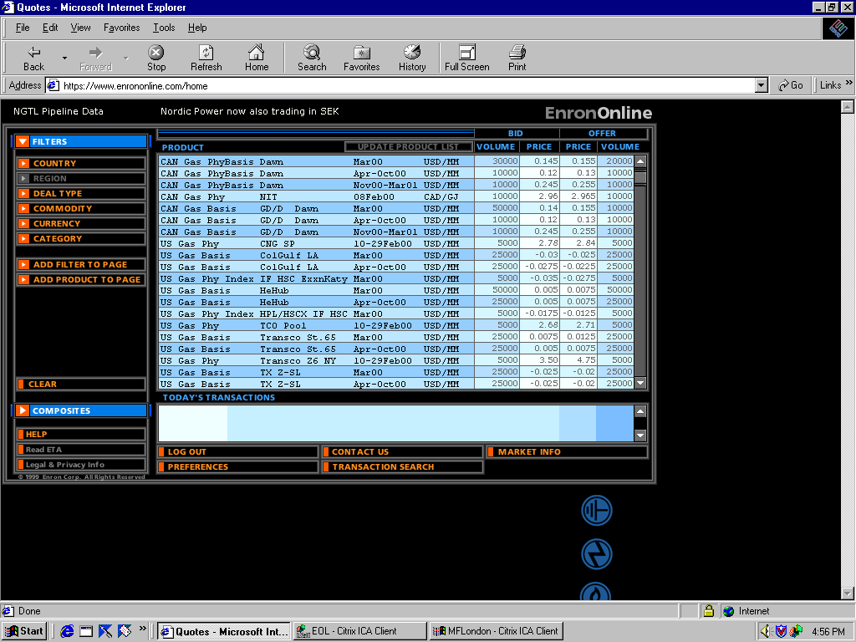
EnronOnline
Extending Enron’s Products to the Internet
Free, Reliable Transaction System with Enron as Principal
Fully Integrated into Enron’s
Established Risk Management
and Logistic Processes
Utilizing Site to Offer Energy-Related Auction Capabilities
Expands Enron’s Information Base and Market Knowledge
“Tried and Tested” Platform for Expanding Enron’s
eCommerce Activity

Slide 28
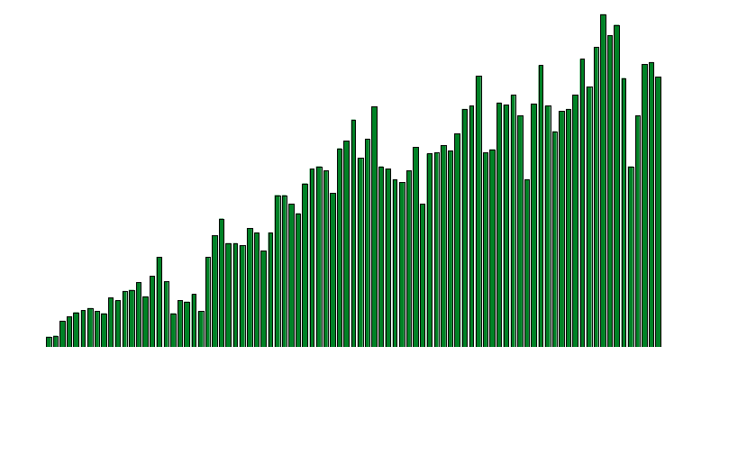
EnronOnline
Daily Transactions
Gross Notional
Value
Transactions
To Date: 70,000 $27 Billion
March: 28,000 $11 Billion

Slide 29
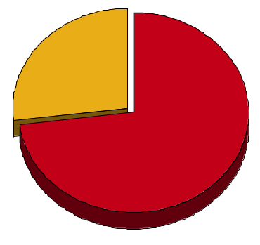
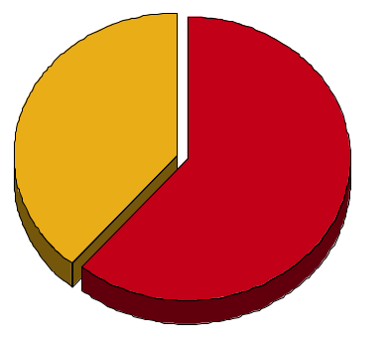
EnronOnline Versus Traditional Channels*
First Quarter 2000
Volume
Transactions
27%
39%
73%
61%
EnronOnline
Traditional
*Estimate

Slide 30
Rapidly Increasing Utilization of EnronOnline*
(Transactions)
100%
100%
100%
100%
45%
33%
39%
25%
Dec
1999
Jan
2000
Feb
2000
Mar
2000
EnronOnline
Traditional
*Estimate

Slide 31
Enron’s Wholesale Energy Network
North America
COB
COB
Hub
Hub
Cinergy
Cinergy
Hub
Hub
Palo
Palo
Verde
Verde
Hub
Hub
Entergy
Entergy
Hub
Hub
Henry
Henry
Hub
Hub

Slide 32
The Impact of On-line Trading
The introduction of Internet based trading platforms will revolutionize energy trading
  Reduction of profit margins
  Increased market transparency
  Reduction of trading margins will make economies of scale imperative accelerating the trend towards consolidation of the industry
On-line trading will accelerate the trend towards BTU marketing
Internet will change the ways corporations are managed
  More flexible and open management structures
  Employees will evolve into intra-preneurs

Slide 33

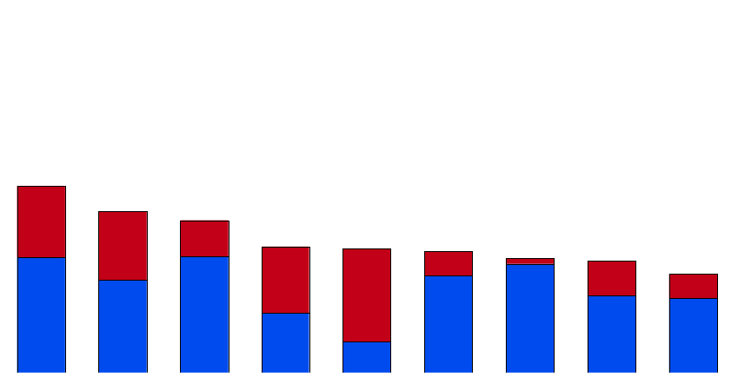
Enron’s Leading North American Market Position
1Q 2000 versus Full Year 1999
(TBtue/d)
32.4
24.4
16.9
14.6
13.8
11.4
11.2
11.0
10.3
10.1
8.9
1999
1Q00
Aquila
PG&E
Duke
Southern
AEP
Dynegy
Coral
Reliant
El Paso
Enron
Gas
Power
Source: Gas Daily, Power Markets Week (February 2000), Natural Gas Week (March 2000), Enron Analysis

Slide 34


Network Connectivity
_{Europe}
_{Asia}
Fiber
Servers
Markets
Pooling Points
Unlimited, Real-Time Bandwidth Access with
End-to-End Control

