Slide 1
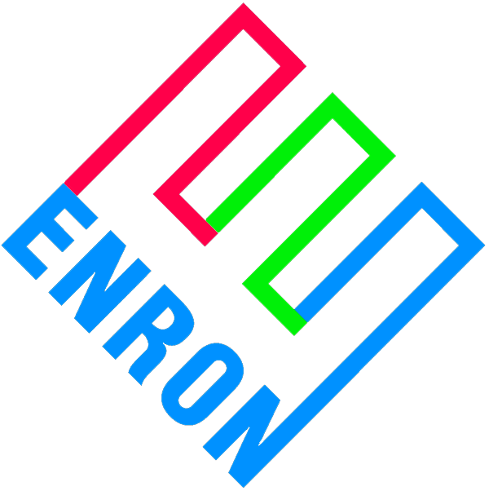
Merchant Plant Funding Assistance Product
Potential Roles for Bank Participation
February 2000

Slide 2
Preface
Merchant generators face significant financial hurdles
  Low credit ratings
  High coverage requirements
  Low leverage ratios
This is particularly true for mid-merit and peaking units
The financial community seems fixated on intrinsic value
  Profits from energy sales dominate the analysis
  Minimal consideration for extrinsic value (optionality)
Possible reasons for this include:
  No familiarity with underlying commodity markets
  Lack of conviction around modeled future price lines
  Uncertainty with collateral valuations

Slide 3
Enron’s Perspective
Unlike other lenders, Enron can:
  Manage the commodity price risk position
  Take possession of and operate the collateral to our best commercial advantage
  Be more creative with debtor restructurings
This represents an obvious commercial opportunity for Enron to earn fees assisting merchant generators to access lower cost of capital
  Absorb some merchant price line risk
Concept is only valuable to merchant generators if we can accomplish an investment grade rating or at a minimum higher leverage at project level

Slide 4
Basic Business Deal
Enron will enter into commodity price risk management contracts designed to provide a minimum amount of commodity revenues sufficient to meet at least 1.0x debt service
  On a par amount of bonds we will specify in advance
Payments owed Enron under any contract will be secured by a second mortgage
  Subordinate only to senior bonds
  Exercisable after fairly short cure period
Enron’s ultimate hammer over equity is the mortgage
In essence, Enron has sold equity a put-right of the project to Enron

Slide 5
Contract Features
The two contracts require performance regardless of the operable status of the power plant
The two contracts are not linked to each other as to performance
Each of the two contracts can be terminated due to non-performance
Payments required under the two contracts will exactly offset each other
The two contracts are non-invasive on plant operations
  Financial only, no physical elements
  No effect on dispatch of plant, no consumption of environmental permit capacity, or influence on the marketing of capacity, energy and ancillary services

Slide 6
Basic Price Risk Management Contracts
EPMI
Financial - Buy Contract
$ Fixed
Project
$ Formula e-
Revenues:
Energy, capacity, ancillaries
Insurance proceeds, LD pmts. And all other
EPMI
Financial - Sell Contract
$ Formula e-
$ Fixed
Financial contracts:
Formula floating The positive difference, if any, between a market based index and a strike price = fuel price * heat rate + VOM.

Slide 7
Basic Credit Structure
Revenues
$ Fixed = D/S
O & M
EPMI
Fin - Buy
$ formula e-
D/S
EPMI
Fin - Sell
$ Fixed
Fin - Sell
$ formula e-
Equity
Credit Contribution is from inserting contracts on either
side of D/S in the flow of funds
Expected result is an investment grade rating

Slide 8
Basic Deal Structure
$ Proceeds
$ Proceeds
Bondholders
Trustee
e-
LLC
$ D/S
Reimbursement
Agreement
$ Fixed
e-
e-
$ Fixed
EPMI
Fin. Buy
EPMI
Fin Sell
ENRON
Baa2/BBB+
guarantee
guarantee
EPMI Financial Buy directly with trustee to make bankrupt remote
EPMI Financial Sell with LLC
Reimbursement Agreement covers monies owed to Enron under either agreement

Slide 9
Expanded Deal Structure with
Enron as Project Lender
$ Proj.-Loan
20-year
$ Funding
Loan
20-year
LLC/
Trustee
Enron
SPV
Capital/Bank
Markets
BBB+/Baa2
Ins. Co. rating
$ D/S
$ D/S
Fin Buy
e-
Fin Sell
Fixed
Fixed
5-year
Wrap
e-
EPMI
Insurance
Co.
Potential for credit duration mismatch between project loan and 5-year insurance company wraps
The insurance wrap will likely evergreen every five years
Funding loan must accommodate springing credit change

Slide 10
Example: Simple Cycle Plant Costing $500/kW
$500 Equity risk basis
Equity cost: $500/kW
Represents equity risk basis
ENA loan: $375/kW
Outstanding balance represents Enron’s risk basis
Amortization schedule

Slide 11
Predicting the psychology of equity
Enron has sold equity a put on the underlying project
Enron’s security features, restrictive covenants, mortgage
incents equity to refinance ASAP
As soon as equity can achieve
higher leverage/term than outstanding
Enron loan, equity will refinance
Highly unlikely that equity
will exercise put early
in its life…equity has too
much invested.
At very least, equity will refinance
when residual value is in excess of
par amount of bonds outstanding

Slide 12
Potential Bank Roles
Sell Enron a put of bonds purchased to control bankruptcy and the collateral process
Extend funding loan to Enron SPV with springing interest rate and credit features

Slide 13
Event Map leading to Put of bonds
$ Proceeds
$ Proceeds
Senior
Bondholders
Trustee
e-
LLC
$ D/S
Reimbursement
Agreement
EPMI buys
bonds
$ Fixed
e-
e-
$ Fixed
EPMI
Fin. Buy
EPMI
Fin Sell
EPMI puts
bonds
Bank
ENRON
Baa2/BBB+
guarantee
guarantee
1. LLC defaults under EPMI Finance Sell
2. EPMI terminates Financial Sell
  Causes MTM to be owned EPMI
  Creates 2nd secured obligation under reimbursement agreement
3. Project LLC goes into bankruptcy
4. EPMI buys Sr. bonds to control process
5. EPMI takes control of asset through bankruptcy
6. EPMI puts bonds to bank
  Restructuring opportunity
  Reactivates mortgage

Slide 14
Credit and interest will spring to Enron levels if insurance securing debt doesn’t evergreen
%
Credit
Spread
ENE 15-year
ENE 10-year
ENE 5-year
Insurance supported
credit spread
Initial
Insurance
Period
Evergreen
Insurance
Period
Evergreen
Insurance
Period
Evergreen
Insurance
Period
Closing 5 10 15 20 years
The springing rates will be set and known at closing
The springing options will occur 3-times over life of the debt

