Slide 1
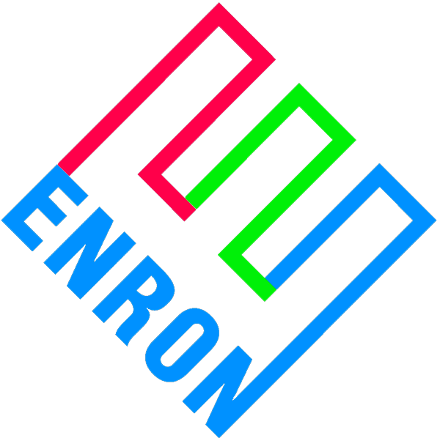
Merchant Plant Finance
Price Risk Management Products
April 11, 2000

Slide 2
Basic Concept
Debt capital markets are over-pricing merchant market risk
This represents an opportunity for ENA to step inside the capital markets and capture commodity positions and basis points
  Merchant price line risk at ENA curves
Enron’s risk basis is as a secured lender
In essence, ENA sold to equity the right to put the plant to ENA at debt levels
  Put strike price equal to outstanding debt
  Exercise of put means equity will write-off their entire investment
To accomplish objectives, ENA will enter into commodity price risk management contracts to eliminate merchant price line risk to debt

Slide 3
Basic Price Risk Management Contracts
EPMI
Financial - Buy Contract
$ Fixed = D/S
Project
315 MW
7 x LM6000, SS
$550/kW to build
$375/kW leverage
$ Formula e-
EPMI
Financial - Sell Contract
$ Formula e-
$ Fixed = D/S
$ Formula e- The positive difference, if any, between a market based index and a strike price = fuel price * heat rate + VOM.

Slide 4
Contract Features
The two contracts require performance regardless of the operable status of the power plant
The two contracts are not linked to each other as to performance
Payments required under the two contracts will exactly offset each other
Each of the two contracts can be terminated due to non-performance
The two contracts are non-invasive on plant operations
  Financial only, no physical elements
  No effect on dispatch of plant, no consumption of environmental permit capacity, or influence on the marketing of capacity, energy and ancillary services

Slide 5
TECO/Mosbacher Delmarva Peaker
Basic Credit Structure
Revenues
Bulk Power Mkts.
e-
ICAP
Ancillaries
$ Fixed = D/S
O & M
EPMI
Fin - Buy
$ formula e-
D/S
Bondholders
EPMI
Fin - Sell
$ Fixed = D/S
Fin - Sell
$ formula e-
Equity
Credit Contribution is from inserting contracts on either
side of D/S in the flow of funds
Expected result: BBB- / Baa3 minimum

Slide 6
TECO/Mosbacher Delmarva Project
Basic Contract Structure
Trustee
e-
LLC
Reimbursement
Agreement
$ Fixed
e-
e-
$ Fixed
EPMI
Fin. Buy
EPMI
Fin Sell
ENRON
Baa2/BBB+
guarantee
guarantee
EPMI Financial Buy directly with trustee to make bankrupt remote
EPMI Financial Sell with LLC
Reimbursement Agreement covers monies owed to Enron under either agreement
Bankruptcy treatment of e- revenues from Financial Sell through LLC?

Slide 7
Expanded Delmarva Structure with Financing
LLC
$ Neg. Loan (“NL”)
SPV
$ funding loan (“FL”)
Capital Mkts
$ NL D/S
$ FL D/S
F
e
F
e
FB
FS
ENE Bermuda
Guarantee of $ Neg. Loan
Because we’ve engineered all defaults in to the FB demand, charge, Ins. Co. “B” is comfortable insuring NL D/S.
The capital markets extends funding loan based off insured cash flows. A much easier sell.
Basically, we sell LLC credit enhanced with EPMI contracts to only one institutional entity (I.e. Ins. Co. “B”).
F
FB
FS
Ins. Co. “B”
e
F
e
EPMI
Re-insurance, if necessary
Insurance policy to mitigate risk
Ins. Co. “A”
Enron Re
Re-insurance reflecting deductible and co-pay

Slide 8
Equity Book Value vs. Debt Outstanding
Equity write-down
ENA Risk Basis
* Equity write down from bankruptcy

Slide 9
Predicting the Behavior of Equity
Equity write-down
ENA Risk Basis
B. Greater risk will be in the
middle years of the project
A
B
C
A. Highly unlikely that equity will
put plant early in its life
C. Equity is incented to refinance
at the first opportunity taking
ENA out of the deal
Worst case scenario: ENA owns project at debt levels

