Slide 1
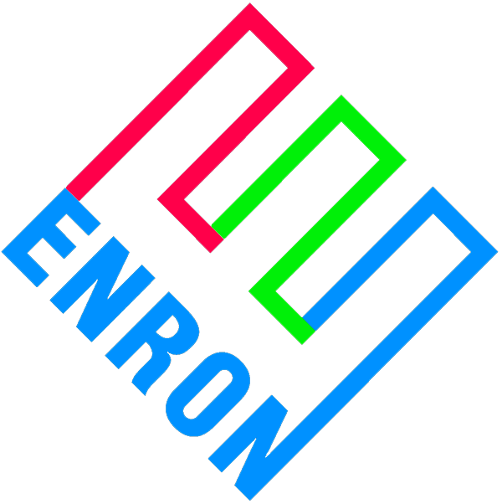
Enron Commodity Price Risk Management Product (E-CPM)
In Support of Merchant Generation
March 13, 2000

Slide 2
Basic Concept
Debt capital markets are over-pricing merchant market risk
This represents an opportunity for ENA to step inside the capital markets and capture commodity positions and basis points
Merchant price line risk at ENA curves
Enron’s risk basis is as a secured lender
In essence, ENA sold to equity the right to put the plant to ENA at debt levels
Put strike price equal to outstanding debt
Exercise of put means equity will write-off their entire investment
To accomplish objectives, ENA will enter into commodity price risk management contracts to eliminate merchant price line risk to debt

Slide 3
Basic Price Risk Management Contracts
EPMI
Financial - Buy Contract
$ Fixed
Project
$ Formula e-
EPMI
Financial - Sell Contract
$ Formula e-
$ Fixed
$ Formula e- The positive difference, if any, between a market based index and a strike price = fuel price * heat rate + VOM.

Slide 4
Teco/Mosbacher Delmarva Peaker
315 MW, 7x LM6000’s, oil-fired peaker in Eastern PJM
ENA earns fees and 50 MW call option
$ MM
$24.2 call option value*
5.8 ENA fee
$30.0 revenues
-20.8 put option premium*
$ 9.2 net income
* At ENA mid curves
Put option premium compensates Enron for selling a put of the Project to equity

Slide 5
TECO/Mosbacher Delmarva Peaker Basic Credit Structure
Revenues
$ Demand = D/S
O & M
EPMI
Fin - Buy
$ formula e-
D/S
Project flow of
funds
EPMI
Fin - Sell
$ Demand
Fin - Sell
$ formula e-
Equity
Credit Contribution is from inserting contracts on either
side of D/S in the flow of funds
Expected result: BBB- / Baa3 minimum

Slide 6
Equity Book Value vs. Debt Outstanding
Equity write-down
ENA Risk Basis
* Equity write down from bankruptcy

Slide 7
Predicting the Behavior of Equity
Equity write-down
ENA Risk Basis
B. Greater risk will be in the
middle years of the project
A
C
B
A. Highly unlikely that equity will
put plant early in its life
C. Equity is incented to refinance
at the first opportunity taking
ENA out of the deal
Worst case scenario: ENA owns project at debt levels

