Slide 1
EnronOnline Phase III Overview
November 12, 2001

Slide 2
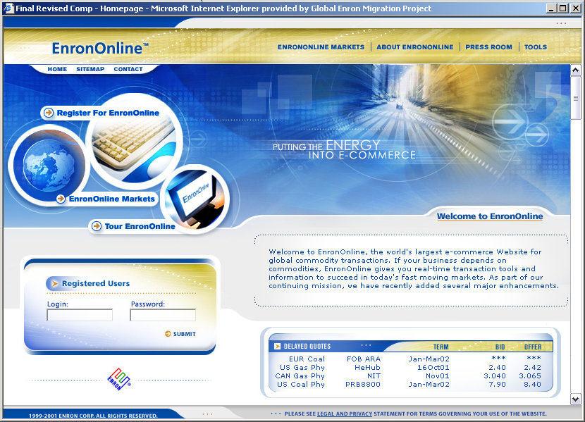
EnronOnline Home Page

Slide 3
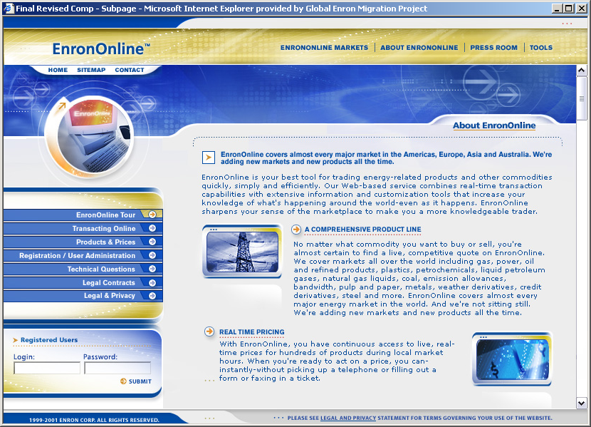
EnronOnline Garden Page

Slide 4
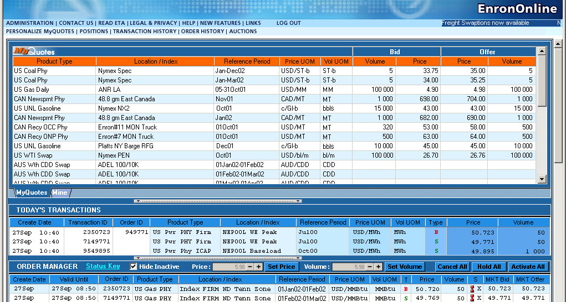
Expanded Quotes Screen
| MyCONTENT
MyContent: removed from right side of screen; will be accessed via link
MyQuotes: add fields for Price and Volume Units of Measurement
Today’s Transactions: add fields for Transaction ID, Order ID, Price unit, Volume unit
Order Manager: renamed from Today’s Orders; see add’l changes next slide
N.B. – new color scheme from home page will be reflected in the Quotes screen and other secure pages

Slide 5
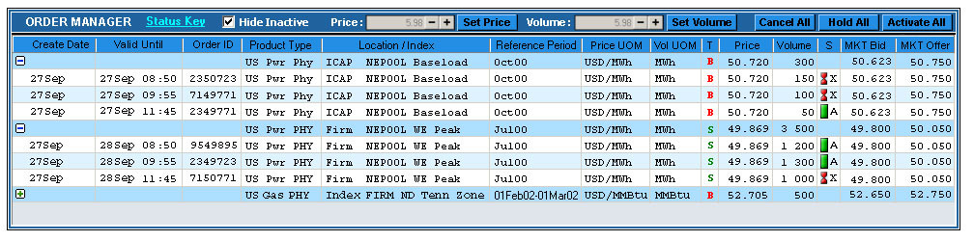
Order Manager
Features added to the Order Manager header:
Volume field and Set Volume button
Hold All button
Activate All button
Hide Inactive checkbox
User’s orders are grouped by Product Type/Location and user can collapse or expand groups
Columns added to the Order Manager screen:
Create Date
Order ID
Price Unit of Measure
Deliver Volume Unit of Measure
Market Bid
Market Offer
Tradable

Slide 6
Marketing Collateral
External
Press Release
Customer Mailer
Getting Started Guide
Marketing Brochure
Folder/Letterhead/Envelope
EnronOnline Slick: post-launch; 1-page overview for general audience consumption
Interactive CD
Internal
eTV
eBiz
Trader communication: (w/ Savita’s team)

Slide 7
Marketing Collateral

