Slide 1
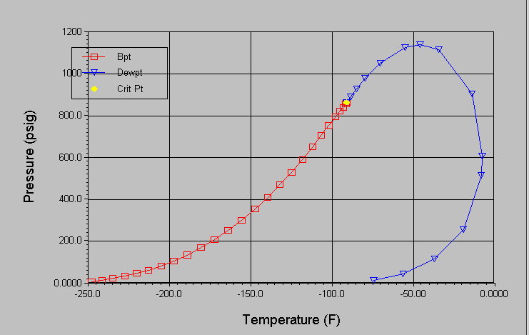
Phase Envelope for Mixed Stream
With 450,000 gpd of Butane
vapour phase
liquid phase
2 phase

Slide 2
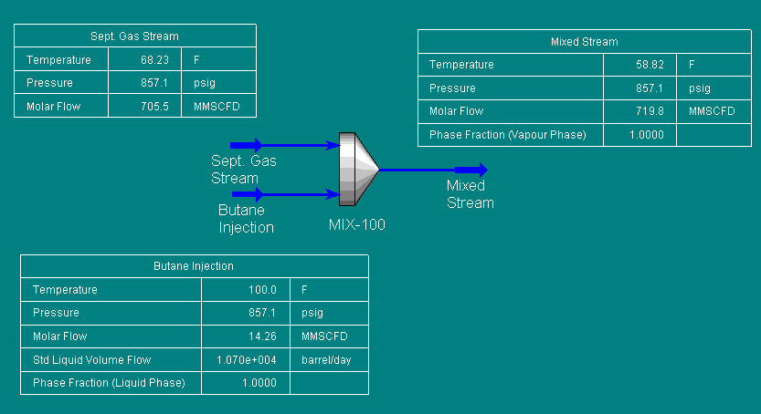
HYSYS Screenshot
Gross HV: 1000.5 BTU/cf
Gross HV: 1045.4 BTU/cf
Mole Fraction %C3: 0.14%
Gross HV: 3265 BTU/cf
Assumption
Gas Stream composition is based on September gas analysis at Needles. Butane injection composition was provided by EOTT.
Baesd on one year history, the coldest gas temperature of 68.23F was used. Average flow and pressure conditions were applied
to gas flow. Butane was assumed to be injected at 100F into a generic mixer, with no pressure losses assumed.

