Slide 1


Overview of U.S. and U.S. West Energy Fundamentals and Business Opportunities
Prepared for:
Petróleos Mexicanos
Privileged and Confidential
October 24, 2001

Slide 2
Agenda
Enron Overview
Fundamentals Overview
Western Energy Issues for Pemex
Pemex/Enron Marketing Opportunities

Slide 3
1. Enron Overview
Enron Structure
Enron’s Market Position

Slide 4

Enron Corporate Structure
Enron Wholesale Services
Enron Global Services
Enron Energy Services
Enron Americas
Enron Europe
Enron Net Works
Enron Global Markets
Enron Industrial Markets
Enron Broadband
Services
Enron Global Assets and
Services
Portland General Electric
Azurix Water
EOTT Energy Corporation
Enron Wind
Retail Energy

Slide 5
Enron Ranked at the Top
Enron ranked 7th on the Fortune 500 List of America’s Largest Corporations

Slide 6
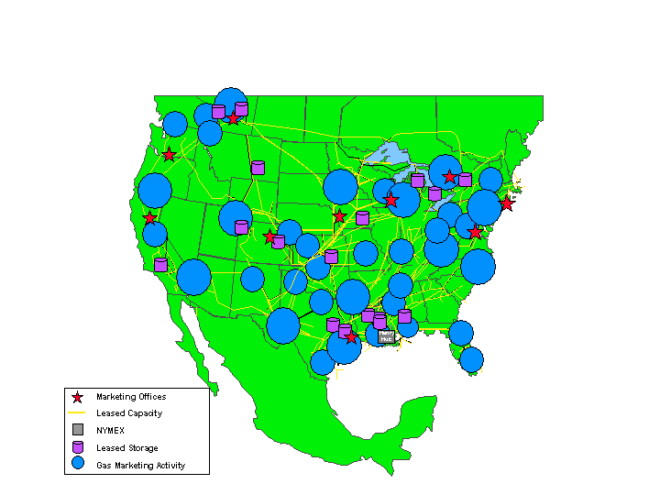
Enron Wholesale Gas Network
Canada
(Volumes in Bcf/d)
Central
6.3
5.9
4.4
43%
2.3
156%
1999
2000
1999
2000
West
East
7.4
2.4
4.1
1.1
118%
80%
1999
2000
1999
2000
Texas
2.7
2.0
35%
1999
2000

Slide 7
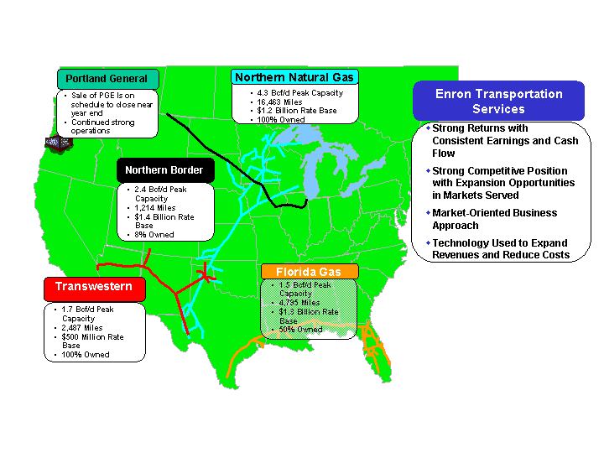
Transportation and Distribution Services

Slide 8
2. Market Fundamentals
What happened in 2000/early 2001?
What is going on today?

Slide 9
Market Fundamentals
2000 and early 2001: The market looked short gas, short power generation and short hydro
    AGA’s were low starting in the winter of 2000 and by Jan 2001, gas levels were 350 Bcf behind the previous year and 310 Bcf behind the 7 year average
    Hydro conditions among one of the lowest since modern records began in 1929
    There were no signs of immediate relief!
The markets were supportive of new generation solutions

Slide 10
Power Prices: Historical and Forward
The forward market at that time was pointing to development/transportation as solution and ability to secure a rate of return

Slide 11
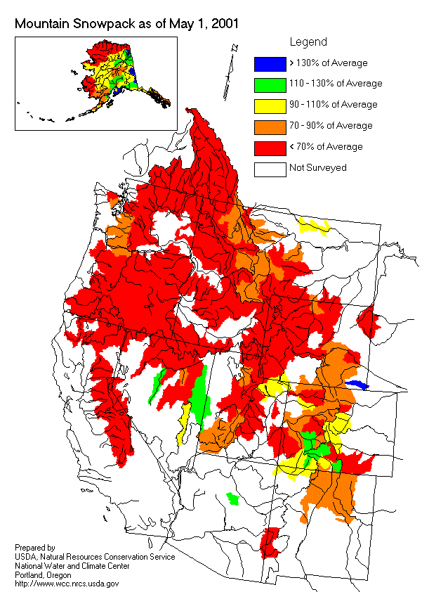
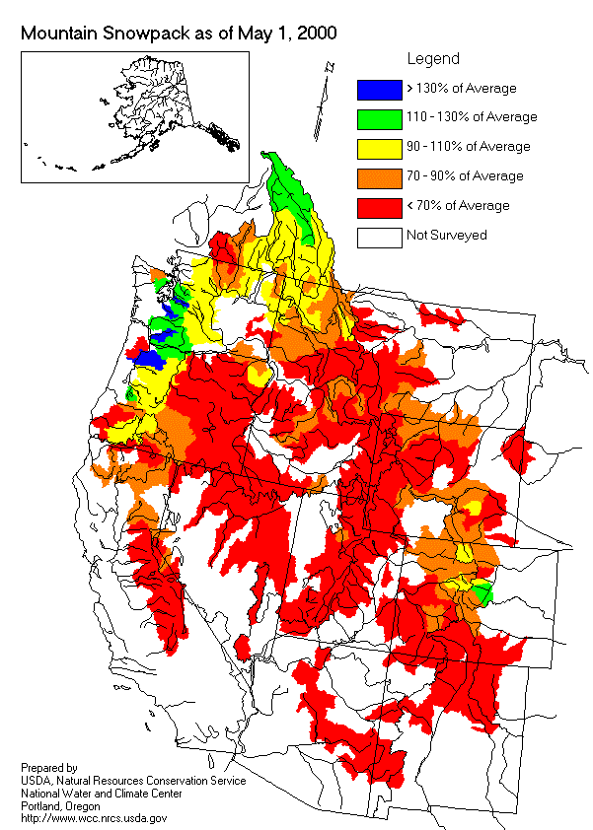
Western Snowpack Levels

Slide 12
WSCC Proposed Generation (in MW)

Slide 13
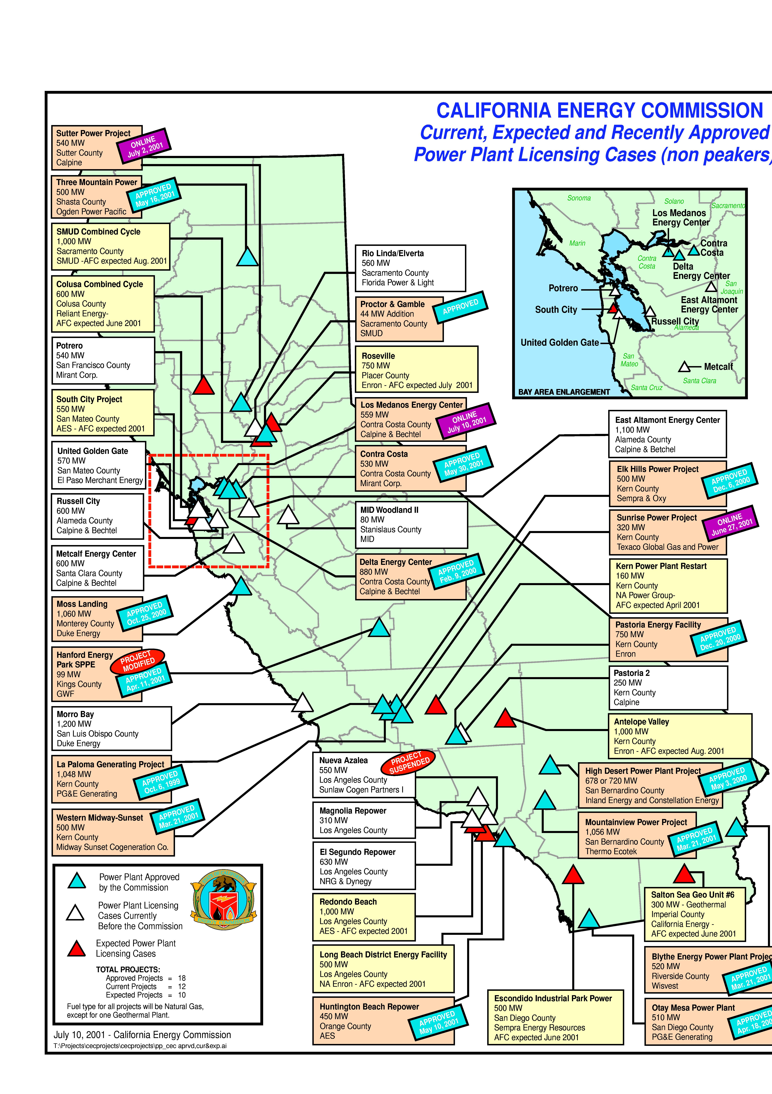
CEC Generation Report

Slide 14
Gas Supply and Transportation
Natural gas had to respond! Fuel plans for natural gas were also caught up in market sentiment
Pipeline expansions appeared everywhere in the west to support development projects
Most of the contracted expansions were underpinned by generators with 2003 start dates
Open Season | Term/Obligation | Estimated Tariff | Probability | Estimated Start Date
Southern Trails | 15 years | $0.52 | < 30% | May 2002
Ruby | 15 years | $0.87 | 50/50 | Late 2004
PGT | 30/52 years | $0.42 | 90% | Nov. 2002/2003
TW – Red Rock | 5/15 years | $0.68/$0.38 | 90% | June 2002
TW – Sun Devil | 15 years | $0.34 | 50/50 | June 2005
Sonoran | 20 years | $0.39 | 50/50 | May 2004
Kern River | 10/15 years | $0.70/$0.57 | 90% | May 2003
North Baja | 7/25 years | $0.29/$0.35 | 100% | June/Sept 2002
El Paso (ENA) | 2.5 years | $0.33 | 100% | Jan 2003

Slide 15
Slowing Growth in U.S. Gas Supply
U.S. Dry Gas Production
(Tcf)
Domestic production flat with increasing levels of gas drilling

Slide 16
More Difficult to Increase U.S. Production
U.S. Gas Rigs
Onshore Offshore
High
Low
Current
Gas Drilling Has Peaked -
942 (7/13/01)
134 (3/23/00)
318 (4/23/99)
38 (5/14/99)
824
112
As rig count increases, rig efficiency and initial production rates decrease
Decline Rates Up -
increasing by double in the major areas over the past decade
Numerous Major Plays
Working -
big plays becoming more remote and capital intensive

Slide 17
Market Fundamentals: What Happened?
Demand Side Management: Everybody backed off!
Pricing Pressure
Industrial load: shut down/bankrupt!
Hydro: peak pressure but made their way through regionally—Weather was normal!
California price caps: downward pressure
Conservation: everybody pitched in
Storage response: 10 week record injection of 100 Bcf/week
Market started to believe the shortage was over! Prices fell for term and daily markets… aggressively!

Slide 18
U.S. Storage Overview
The Rapid Pace Continues
Strong storage levels reflective of weak fundamentals
Unprecedented level of injections have been a critical factor in market declines
As of October 14, the year-over-year storage surplus was 471 Bcf
3,042 Bcf in inventory with 2 weeks left in injection season
High probability of reaching 11/5/98 storage high of 3,094 Bcf

Slide 19
U.S. Electric Power Use
1999
2000
2001

Slide 20
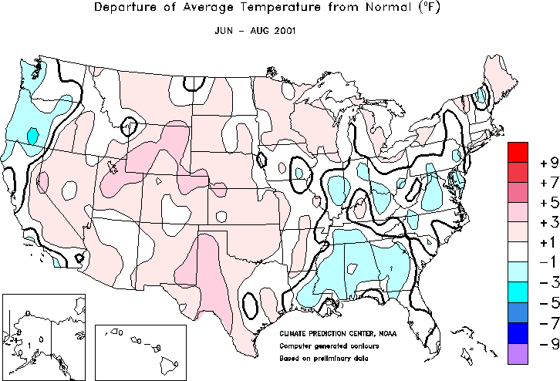

Moderate Summer Weather
Notes:
http://www.cpc.ncep.noaa.gov/products/analysis_monitoring/regional_monitoring/usa.html#seasonal

Slide 21
Power Prices: Historical and Forward
From the time in Jan ’01 that all the decisions were made, to today, the market developed a different theory

Slide 22
Fundamentals Conclusions
Despite expectations of a continued bullish price environment, fundamentals have actually pushed prices down
Gas supply, though on the upswing, is not the primary driver of this bearish environment
Similarly, unremarkable weather has not sparked a demand rally
The weak economy combined with successful conservation efforts are key drivers in pushing down demand and prices
The resulting rapid pace of injections has set the stage for record inventories going into the withdrawal season

Slide 23
3. Western Energy Issues for Pemex
Will there be continued excess U.S. supply available for export to Mexico?
Will new domestic capacity need to be built to accommodate forecasted generation growth?
  Are there infrastructure constraints within the Pemex system?
Is western based gas supply competitive relative to South Texas sources?
What constraints will arise with the forecasted generation growth on both sides of the border?

Slide 24
The Canadian Supply Factor
Importance of Canadian Supply for U.S. Mexico Gas Trade
U.S. market is highly dependent on Canadian supply
Over 56% of Canadian gas is exported to the U.S.
As Canadian exports to the U.S. increase, so will U.S. exports to Canada
This increases the potential for exports to Mexico
9.22% CAGR in Canadian Imports

Slide 25
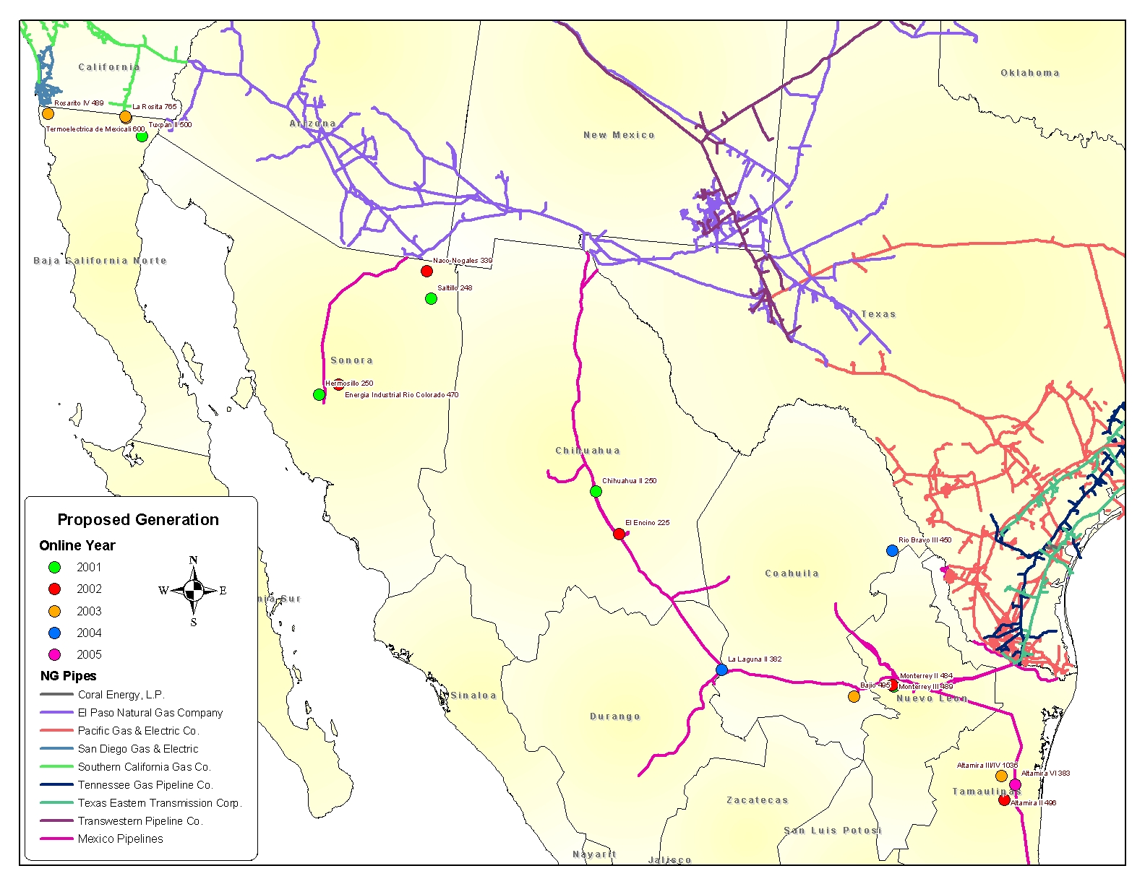
Mexico New Generation Sites

Slide 26
Proposed Generation Fuel Requirements in U.S. Southwest vs. Mexico

Slide 27
Western Region Interstate Pipeline Expansions
Project | Term/Obligation | MMcf/d | Probability | Estimated Start Date
Southern Trails | 15 years | 80 | < 30% | May 2002
Ruby | 15 years | 500 | 50/50 | Late 2004
PGT | 30/52 years | 360 | 90% | Nov. 2002/2003
TW – Red Rock | 5/15 years | 150 | 90% | June 2002
TW – Sun Devil | 15 years | 540 | 50/50 | June 2005
Sonoran | 20 years | 750 | 50/50 | May 2004
Kern River | 10/15 years | 900 | 90% | May 2003
North Baja | 7/25 years | 500 | 100% | June/Sept 2002

Slide 28
El Paso – A Lost Capacity Opportunity?
EPNG confronted with multitude of controversial issues:
  Marketing affiliate violations
  Receipt point allocation process
  Full Requirements vs. CD Shipper rights
  Requests for demand charge reimbursement
EPNG frozen until all issues resolved – unable to add new load due to customer protests and intervention
Are expansions of Samalayuca and Willcox on hold?

Slide 29
EPNG’s Failed Expansion Efforts
Lack of interest and shipper protests have stymied El Paso’s expansion efforts:
  500 MMcf/d Daggett to Ehrenberg: bi-directional lateral priced at $.10/mmbtu
  320 MMcf/d Power Up Line 2000 from Permian Basin only – was to serve south leg load at rolled in rate + 5% fuel

Slide 30
EPNG Expanded Access to Mexico
Willcox Lateral: 130 MMcf/day to CFE Projects
  El Fresnal/Union Fenosa: 50 MMcf/d
  Hermosilla 1: 40 MMcf/d
  Hermosilla 2: Union Fenosa 40 MMcf/d
Pemex/El Paso Samalayuca Lateral: 208 MMcf/d
  Gasoductos/Pemex Pipeline to CFE/Samalayuca power plant: 168 MMcf/d
  Pemex: 40 MMcf/d for Juarez and Chihuahua
Planned expansion to Samalayuca by 100 MMcf/d for Pemex to serve CFE’s Chihuahua II (60 MMcf/d) and El Encino (40 MMcf/d)

Slide 31
North Baja
PG&E/Sempra International JV for 500 MMcf/d from Ehrenberg to Tijuana, Mexico
FERC application filed 300 MMcf/d of contracts:
  InterGen (CFE) 135 MMcf/d for 25 years
  CEG Energy (PG&E) 48 MMcf/d Otay Mesa for 25 years
  Gasoducto Rosarita (CFE) 65-95 MMcf/d for 7 years
  Distrito de Gas Natural de Mexicali 17-25 MMcf/d for 20 years
CFE and Termoelectrical de Mexicali have contracted for the remaining 200 MMcf/d

Slide 32
Race to Fill North Baja
Currently EPNG only supply source
EPNG not able to expand until controversy resolved
Must have primary delivery point designation at North Baja to avoid curtailment
Point competes with markets at SoCal Ehrenberg for supply
Are there alternatives to EPNG?

Slide 33
Current Pipeline Utilization for Export to Mexico

Slide 34
Pipeline Delivery Capacity
Total Pipeline Delivery Capacity = 2,008 mmcf/d
What are takeaway limitations?
Why is capacity so much greater than imports?

Slide 35
Is Western Based Supply Competitive?
Ship Channel Price Drives Competition
The Ship Channel index is at a premium relative to El Paso San Juan Index
Over the previous twelve months this premium, on average, has been $0.48
Will San Juan gas continue to be competitive on a delivered basis?

Slide 36
Issues and Opportunities
Major Hurdles for Pemex
EPNG saddled with conflict between full requirements and CD shippers
South Leg generation and exports to Mexico compete for capacity
Opportunities for Enron/Pemex Partnership
Facilitate immediate capacity solution to export gas
Diversification of supply portfolio

Slide 37
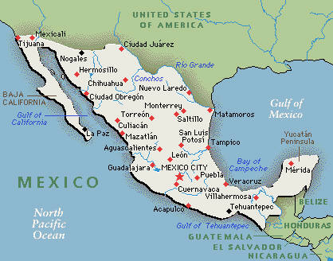
Next Steps
Enron North America
Pemex
Enron Mexico
Marketing and Transportation Plan
  Identify core needs (Pemex)
  Develop a plan to deliver products and services to meet those needs
  Implement strategic and logistical solutions to Pemex by leveraging the strong working relationship between ENA-West and Enron Mexico

Slide 38
Enron Contacts
West Gas Origination
Barry Tycholiz, Vice President
Stephanie Miller, Director
Phil Polsky, Associate
Mexico Origination
Jaime Williams-Quintero, Co-President
Steve Irvin – Co-President
Agustin Perez-Miranda, Manager

