Slide 1


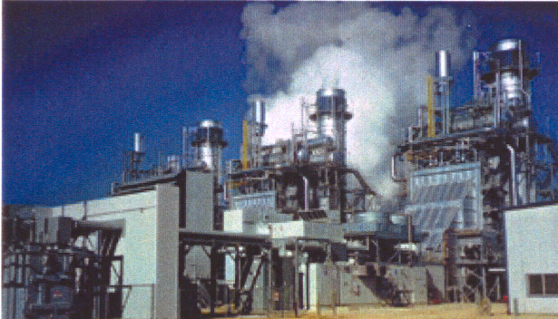


Power Risk Management:
March 20, 2001

Slide 2
Discussion Highlights
Recent Influential Events-- California Crisis
Hedging Volatility
Forward Markets
Developing a Risk Management Program
Developing an Execution Strategy
What the PSC can do

Slide 3

Recent Influential Events-- California Crisis

Slide 4

California Crisis Conditions
1. Demand increasing faster than supply
2. Forward price not supportive of new build
3. No recent power plant development
4. Limited new development expected in short term
5. Long lead time necessary to develop large
generating facilities (3-5 years)
6. Excessively restrictive environmental rules
7. Price caps
8. Utility objective to beat index
9. Illiquid market
10. Threats to take over generators by state authority
11. Majority of load primarily unhedged
NYISO Conditions
1.
2.
3.
4.
5.
6.
7.
8.
9.
10.
11.

Slide 5
Hedging Volatility

Slide 6
Hedging Volatility
Hedging
Specific objective driven
Offset by position
Reduces volatility exposure
Reduces likelihood of large losses/gains
Stable expenses
Speculating
Profit driven
No offsetting position
Volatility driven
Increased likelihood of large losses/gains
Full spectrum-- from home run to bankruptcy

Slide 7
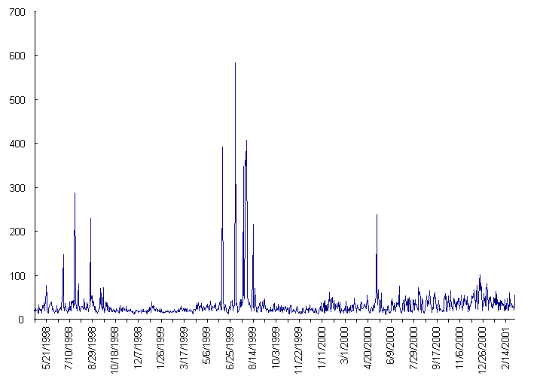
PJM On-Peak Energy Clearing Price May 21, 1999-Feb. 14, 2001
Hedging Volatility

Slide 8
Hedging Volatility

Slide 9
Forward Markets

Slide 10
Forward Markets
Importance of the forward market and liquidity
Planning tool. Sends a forward price signal in time for generation to be built. For example a price for 2003 should show deficiency, and encourage new generation.
Requirement to price more sophisticated hedging tools. Pricing factors in options include:
Underlying market
Time to expiration
Volatility
Strike price
Price Transparency. Comfort that utility transactions are at fair market prices as many buyers and sellers are transacting at given price points
Utilities can be measured on managing their risks, because a valid market exists

Slide 11
Forward Markets
Importance of the forward market and liquidity
Increased liquidity reduces market volatility when a transaction is executed. Currently a 100 MW transaction can move prices against you
Liquidity can narrow bid/offer spreads, making hedging more economical

Slide 12
Forward Markets
Drivers of a forward market
Expectations/uncertainty re: Weather
Fuel Costs
Future Expectations: Generation, Transmission
Compensation for taking on risk: When a generator commits forward, it assumes risk. If a unit trips, they must buyback at potentially high prices (decreased capacity). A generator would not sell forward and take on this risk without being paid a premium
Makes judgment by look-back on index inappropriate
NY Market Power Mitigation Rules: “60 day rule”. If your normal “offer” when there is no threat of capacity shortage; offer cannot be greater than average of last 60 days
Complicated price control mechanism: cannot define value. Lack of confidence keeps participants away, and demands premium

Slide 13
Developing a Risk Management Program

Slide 14
Developing a Risk Management Program
Determine Objectives - Why hedge?
Reduce rate payer exposure: Customers not given opportunity to protect themselves – Shall LSE do it for them?
Prove prudence
Capture existing imbedded optionality in contract to maximize value
Secure energy requirements at better than index (at expense of fixed price protection)
Increase stock price
Lock in margins
Meet budget and earnings expectations
Increase financial flexibility/ lower cost of capital
Develop growth strategy with price certainty
Ensure financial health
Disaster Insurance
Equalize cash flows

Slide 15
Developing a Risk Management Program
Quantify Exposure
Analyze existing portfolio
Load, generation, contracts
Analyze exposure characteristics
Elasticity: Price exposure passed through
Political risk threshold
Assess Management’s Risk Tolerance and Style
Percentage to hedge
Threshold levels
Risk appetite
Sophistication level
Determine Implied view of market
Up, down, or neutral
Understand Available Instruments
Swaps, Options, Combinations

Slide 16

Swap
Description: A swap is a financial agreement to exchange periodic payments. Generally, one party pays a fixed payment, and the other party pays a floating payment based on current market prices. Swaps allow energy users and generators to convert an index price into a known fixed price with no changes to their current physical arrangements. This synthetically creates a fixed price transaction, or can change the structure of an existing contract.
Generator (Long Position): A generator sells its power at the PJM market index (clearing) price. It enters into a swap in which it will pay the PJM power index price each hour specified (i.e. each off-peak hour) for a 6-month term and for 50 MW per hour, and receives a fixed price for the same volume. The generator’s swap offsets the price risk of selling at the unknown PJM price. The index payments for the swap and the physical sale cancel each other out, and net effect is a synthetic fixed price sale.
Load Serving Entity / User: An end user purchases power requirements at the PJM market index (clearing) price. It enters into a swap in which it will receive the PJM market index price for each hour specified (i.e. each on-peak hour) for a 1 year term and for 100 MW per hour, and pays a fixed price for the same volume. The customer’s swap offsets the price risk of buying power at an unknown price. The index payments for the swap and the physical transaction cancel each other out, and the net effect is a synthetic fixed price purchase.

Slide 17
Swap
Market Price
LSE
Fixed Price
Market Price (Index)
Electrons
NYISO
Characteristics:
Provides 100% protection against price risk exposure
Known future price
No benefit if price moves in your favor
Can maintain existing physical arrangements

Slide 18
Developing a Risk Management Program
Understand Available Instruments (cont.)-- SWAP
Hedge Payout Hedge Performance
Market View | Inferior Superior
Very Bullish
Bullish
Neutral
Bearish
Very Bearish
Volatile
Enron pays LSE
LSE pays Enron
Market Swap

Slide 19
Cap To hedge power requirements
Description: The cap buyer has the right but not the obligation to purchase power at the specified price for the specified term. A financial cap pays a cash settlement of the difference that the clearing price (index) exceeds the strike for a pre-specified time period.
Example: A Load Serving Entity (LSE) pays the day ahead or real time prices, but would like to ensure a maximum energy cost, yet take advantage of the market when prices are low – “cap” their costs. The LSE buys cap for up to 100MW, 5X16, with a strike at $50. The LSE pays an upfront fee, and will pay the floating market index price for power when the index is below the cap strike. If the buyer thinks the index will rise above the cap, the buyer exercises the cap (or can be structured as automatic exercise), and would pay only the cap strike price, or (financially) will be reimbursed by Enron the difference between the market price and the cap strike

Slide 20
Cap To hedge power requirements
Characteristics:
Provides 100% protection from a rise in prices above the strike.
Guarantees worst case scenario and still maintain potential to benefit from low price environments
Can be tailored as “disaster insurance” (high strike and low upfront premium)
Option can be customized, i.e., daily ahead, monthly, automatic exercise, averaging
Can be structured physically or financially
Upfront Fee
LSE
Floating Market Price (NYISO DAM Index)
When market price > strike,
customer exercises option.
Enron supplies energy (physical),
Or pays customer the difference between market and strike (financial)
Electrons
NYISO

Slide 21
Developing a Risk Management Program
Understand Available Instruments (cont.)-- CAP
Hedge Payout Hedge Performance
Market View | Inferior Superior
Very Bullish
Bullish
Neutral
Bearish
Very Bearish
Volatile
Enron pays LSE
LSE pays Market Price
Market Cap

Slide 22
Collar: To hedge load
Description: A collar designates a specific price range within which a load serving entity or end user has price protection. It is constructed by buying a cap (set of call options) and selling a floor (set of put options). A “costless collar” can be achieved by establishing the collar bands at strikes that result in exactly offsetting premiums (i.e. no upfront payments). The collar band can be structured at various widths, depending on desired coverage and risk. The cap provides protection against rising prices, and is financed by selling the floor, which limits potential to take advantage of lower prices, thus creating a band of price opportunities.
Example: A load serving entity pays day ahead or real time prices, but would like to protect itself from large price spikes, yet gain some benefit when prices are low. The LSE executes a daily collar on 100MW, 5X16, PJM-W for July/August with a band of $75-$150. The LSE will pay the floating market index price for power when it is within the band. When the index is below the lower band, it pays the lower band of $75. Above the upper band, expenses are capped at $150.

Slide 23
Collar: To hedge load
Characteristics:
Provides a hedge against adverse price move at the upper band.
Receives 100% of a price dip to the lower band..
Can be structured with no upfront fee.
Guarantees worst case scenario and limited upside potential.
Can be customized: physical, financial, daily, monthly, average.
Payoff
Spot Price

Slide 24
Developing a Risk Management Program
Understand Available Instruments (cont.)-- COLLAR
Hedge Payout Hedge Performance
Market View | Inferior Superior
Very Bullish
Bullish
Neutral
Bearish
Very Bearish
Volatile
Enron pays LSE
LSE pays Market Price
LSE pays Enron
Market Collar

Slide 25
Participating Swap
Description: A Participating swap gives complete protection at a predetermined price as well as the opportunity to participate in a percentage of any beneficial move in the energy price.
Example: A Load Serving Entity (LSE) pays the day ahead or real time prices, but would like to ensure a maximum energy cost, as well as be able to take advantage of the market when prices are low. Since the LSE does not desire to spend premium to hedge (i.e. buy a call), they enter into a 50% participating swap for May – Oct, 5X16. The participating swap strike will be higher than the regular swap price, but any price settlements below the strike will benefit the LSE (by 50%). The 50% participating swap is structured by wrapping a call option for half of the volumes with a swap for the other half of the volumes. The increased swap price finances the call premium.

Slide 26
Participating Swap
Characteristics:
No upfront fee
Provides 100% protection at the strike price.
Guarantees worst-case scenario but still maintains ability to participate in a favorable price move.
Customize percent participation by adjusting strike price
Price is higher than regular swap price
LSE pays Enron (effectively shares in 50% of benefit below strike)
Enron pays LIPA
Market 50% Participating

Slide 27
Developing a Risk Management Program
Understand Available Instruments (cont.)– 50% PART SWAP
Hedge Payout Hedge Performance
Market View | Inferior Superior
Very Bullish
Bullish
Neutral
Bearish
Very Bearish
Volatile
LSE pays Enron (effectively shares in 50% of benefit below strike)
Enron pays LSE
Market 50% Participating

Slide 28
Developing a Risk Management Program
Match objectives to strategy
Hedging Objective | Strategy
Disaster Protection | Buy Calls
Cash flow Smoothing | Buy Collar
Hedge Gain Maximization | Various Combinations of Derivatives
Strategic or Project Hedge | Buy Long Term Swap

Slide 29
Developing a Risk Management Program
Match strategy to exposure
1. Blocks of energy Go long or short “fringe” areas. Swap coverage based on fixed quantity throughout coverage period.
2. Load Growth Option: Fix costs for given volumes, LSE can increase coverage at anytime, according to contract terms.
3. Fixed Profile Coverage: Swap coverage based on fixed profiles for on-peak and off-peak days and various temp. categories
4. Flexible Shape Profile: Swap coverage based upon self-shaping, with minimum percentage of peak applied
5. Full Load Following: Swap coverage based on actual usage
Least expensive Most expensive
Highest Risk Lowest Risk

Slide 30
Developing an Execution Strategy

Slide 31
Developing an Execution Strategy
Identify Market Difficulties that must be considered
Illiquidity
Cannot execute large size
Cannot deal (even moderately) without moving market
Limited financial products actively traded

Slide 32
Developing an Execution Strategy
Determine price discovery/execution strategies given market limitations: Size, parties that are aware of the transaction, known date, known size: all push market price against you. Contrast to RFP
Quiet execution, confidentiality
Deal in small increments
Deal on optimal days
Enron-on-Line platform
Diversify hedges by including alternate hedging products in portfolio
Weather hedges
Heat rate swaps/ Btu swaps (link to gas price)
Unit contingent outage option

Slide 33
What The PSC Can Do

Slide 34
What the PSC Can Do
Help achieve true market price signals
Require information disclosure
Encourage utilities to hedge, and thus relying less on the index
Utilities currently confused as to whether to hedge
What if prices fall and we don’t beat index?
If we hedge is that speculation?
How will it be perceived by the PSC?
What is our goal, fixed price protection or better than index?
How will out performance be judged?
“lookback” does not encourage ratepayer protection
“lookback” does not encourage hedging
Simplify market rules so marketplace can understand them and achieve a confidence level, which will also reduce risk premium.

