Slide 1
LPG Market in Puerto Rico Miguel A. Maltes ProCaribe A Division of the Protane Corp. Presented To Purvin & Gertz 6th Annual Latin America LPG Seminar Fort Lauderdale, Florida November 14, 2000

Slide 2


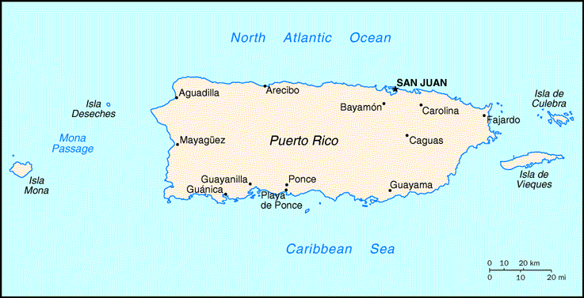
Puerto Rico Country Information
Population: 3.8 million (1999 EST.)
Annual population growth rate: 1%
Population Density: 1,124 / Sq.. mile
Language: Spanish and English
Size: 3,515 square miles
Literacy Rate: 90%
Higher Education rate : 56% (6th in the world)
Currency: US dollar
Gross Domestic Product: $35 Billion
GDP per capita: $9,000
Inflation Rate: 5.7% (1999)
Government: Puerto Rico is a self-governing Commonwealth in association with the United States since 1952. The chief of state is the US President, and the head of government is an elected Governor. Puerto Rico controls its internal affairs, but the US controls its external affairs. Puerto Ricans possess the rights and obligations of US citizens, except for the right to vote in US elections and the obligation to pay federal taxes.
Economy: Puerto Rico has the most favorable economic conditions in the Caribbean and Latin America. Industry (pharmaceutical, electronics, petrochemical), manufacturing, and tourism are the most important industries.

Slide 3
Puerto Rico LPG Market
Annual non-electric power generation LPG consumption is 85 MM gallons.
Little market growth during last twelve years.
507 MW EcoElectrica power project began commercial operations on LPG in March 2000 and LNG in August 2000. LPG is currently a back-up fuel.
EcoElectrica purchases were 96 MM gallons during six months of LPG operations.

Slide 4
Puerto Rico LPG Terminal Locations and Capacity
Tropigas
960 MT
Capeco (Closed)
2300 MT
Corco (Empire)
1820 MT
P R Fuels (Liquilux)
1340 MT
ProCaribe
23,400 MT
(85% of Total Opened)
Phillips (Closed)
3650 MT
Note: Total of 27,520 MT currently available to distribution industry.

Slide 5
Puerto Rico LPG Wholesalers/Importers (1999 est.)
Company MM Gals/Year Market Share
Enron PR Assets* 18.5MM 22%
Other 66.5MM 78%
85.0MM 100%
• 100 % of Puerto Rico Supply is Imported
• No Refineries Producing Propane or Mixes
• All Imports are Waterborne Cargoes
• LPG is Trucked from Terminals
• No Railways on the Island
* Enron P. R. Assets (ProCaribe, Progasco & San Juan Gas).

Slide 6
Puerto Rico LPG Market Composition (1999 est.)
Market Size Market
(MM Gals/Year) Share
Industrial/Commercial* 34 40%
Residential 51 60%
Total 85 100%
• 550,000 Homes Utilize Gas for Cooking (Public Service Commission)
• Gas is Most Common Cooking Fuel, Electricity is Second
• School System Uses Gas for Cooking (Public & Private)
• Cylinders are Moved by Independent Dealers
* Restaurants, Hotels, Manufacturing Outlets, Coffee Bean Driers

Slide 7
ProCaribe LPG Terminal
A Division of The Protane Corporation starting its operations in September of 1986
Storage Capacity 23,400 MT (12.2 MM gallons)
Able to receive large fully refrigerated LPG tankers
Largest fully refrigerated terminal in the Caribbean region
Licensed to import and re-export LPG with the Puerto Rico Public Service Commission and Department of State

Slide 8
ProCaribe LPG Terminal
“Preferential Use” from PR Ports Authority to operate in the Tallaboa docks
ProCaribe signed a 22 year LPG Storage and Service Agreement with 507 MW EcoElectrica power plant
Never Had a Lost Time Accident or Injury
Last Seven Years Won Top Award in Safety from Puerto Rico Manufacturing Association

Slide 9
Tanks
Fully Refrigerated Tanks
Tank 1010 - 76,000 Barrels
Tank 1020 - 50,000 Barrels
Tank 1030 - 125,000 Barrels

Slide 10
ProCaribe LPG Terminal
ProCaribe terminal comprises 85% of Puerto Rico terminal capacity
ProCaribe imported 123 MM gallons during 12 months ending July 31, 2000.
Currently only 22% of Puerto Rico non-electric power generation demand is supplied by ProCaribe.
Capable of supplying all of Puerto Rico’s LPG market
ProCaribe is a source of stable supply for the island of Puerto Rico

Slide 11
Pier
Maximum Vessel Length: 800 Feet
Water Depth: 38 Feet
Maximum Arrival Displacement: 69,000 MT
Modern 8-inch Unloading Arm
First Preferential Use by ProCaribe
Fire Water System Newly Refurbished

Slide 12
Pipelines
One 8-inch Insulated Unloading Line
One 4-inch Insulated Vapor Return Line
9,000 Foot Line from Pier to Terminal
Pressure Tested Once a Year to 225 PSI

Slide 13
Compression System
Three Sulzer Compressors - 3,000 Pounds per Hour Each
One Frick Compressor - 12,000 Pounds per Hour
Two Allen Stuart Compressors - 4,000 Pounds per Hour Each
Two Condensing Units

Slide 14
Fire Water System
Automatic Deluge System
2 Million Gallon Water Tank
System Tested Once per Week
One Electric Pump
One Jockey Pump
Two Diesel Pumps

Slide 15
Emergency Generators
Back-up Power - Diesel Engines
One 750 KVA Generator
One 650 KVA Generator

Slide 16
Loading Area
Three Loading Racks
One Weight Scale
Two Pressurized Tanks
Automatic Odorant Dispensers

Slide 17
Heaters
One Glycol Heater
One Fin Fan Heater

Slide 18
ProCaribe LPG Supply Year 2000
North Sea
Mont Belvieu, Tx
Algeria
Puerto Rico
Venezuela
In Year 2000, Algeria was primary source of supply to ProCaribe. Venezuela, West Africa, and North Sea also provided LPG.
Congo

Slide 19
ProCaribe LPG
Export Potential
Mont Belvieu,Tx
- closer to Central America
and Panama Canal than U.S. Gulf
- must compete with F.O.B.
cargoes in Houston area
ProCaribe’s large capacity results in flexibility in timing of purchases
Has potential for export

Slide 20
New World Class Transshipment Port

