Slide 1
Northwest Power Planning Council Study of Western Power Market Prices Summer 2000
Status Report Sept 12, 2000

Slide 2
Objective
Explain the causes of the high wholesale power prices seen in Northwest and West
Suggest options for mitigating future price spikes

Slide 3
The problem

Slide 4
Off-peak too

Slide 5
Hypothesis
High prices manifestation of tightening supply conditions aggravated by:
High temps/loads
Unusual hydro generation
Planned and forced outages of thermal units
One-sided market -- minimal demand response
Characteristics of the California market
Increased gas prices (minor)
Incomplete, inconsistent and uncertain restructuring

Slide 6
Focus of Analysis
Northwest…and its linkages to the rest of the West
Late June period -- period of highest prices in NW
Look at what was happening physically

Slide 7
Tightening Supplies

Slide 8
High Demand… in the NW
2000 Peak load 7.3% greater than 1999
2000 Energy 4.5% greater

Slide 9
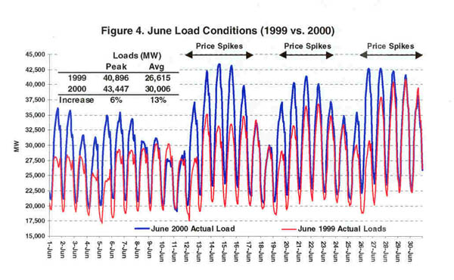
And in California

Slide 10
An Unusual Hydro Year

Slide 11
NW Hydro Production

Slide 12
Thermal Unit Outages
Boardman -- ~500 MW for entire month
Colstrip -- ~ 850 MW out early June, additional ~ 600 MW 6/27-6/29
Bridger -- ~600 MW down 6/26 thru 6/30
Centralia -- ~700 MW out 6/26-6/27
Coyote Springs -- dropped ~ 230 MW mid-day 6/26
Columbia Generating Station -- ~1100 MW out 6/26 thru 6/30

Slide 13
Total Weekly Generation
Total
Hydro

Slide 14
Gas prices?
Gas prices up significantly from a year ago but...
$2/mbtu price increase in gas $20 MWhr from an inefficient power plant (10,000 btu/kWh)
Gas prices and deliverability possibly an issue for long term but not significant contributors to this summer’s extreme prices

Slide 15
Demand Side
Few NW customers see market prices
In June, no interruptions in NW but…
Purchased load reduction at some aluminum smelters
Some resale of purchased (non-federal) power instead of operating
Some “economic” shutdowns for end-users on market-indexed rates
Total impact -- a few hundred megawatts?

Slide 16
Transmission Utilization

Slide 17
Mid-C & PX DA Prices -- June
PX = UCMP

Slide 18
What does the generation data suggest?
Reviewing EHV data set for May, June (about 70 percent of generation capacity)
Additional data for NW generators not reported in EHV (PGE, Puget, Clark, Avista, Columbia Generating Station, smaller federal units
As of yet, nothing leaps out

Slide 19
The California Effect
Issues with design and operation of California market contribute to increasing prices
Limitations on hedging with forward contracts
Rules that result in large percentage of demand being met in real-time market when supplies tight
No congestion on interties  NW and California prices closely linked
$

Slide 20
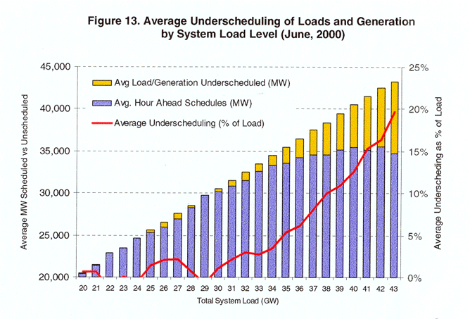
Underscheduling in the CA Market

Slide 21
Summary
NW/Western Loads Up -- Growth, Temperatures
Generation down
Run-off pattern Significantly reduced hydro
Planned and forced outages of thermal units
Minimal demand response to wholesale prices
Interties not filled -- NW/CA prices linked
California market rules increase volatility when supplies tight and affect rest of West

Slide 22
Preliminary Conclusions/ Recommendations
1. Market participants need to take greater advantage of opportunities to manage risk
2. Incentives in California market need to be revised:
promote greater hedging
reduce the amount of power traded real-time during periods of tight supply

Slide 23
Preliminary Conclusions/ Recommendations
3. Investigate need for and options to encourage adequate entry into generation market for reliability
Current market prices high enough but will they persist?
Are non-market means necessary?
Is the RTO the right body, will it have adequate powers, what mechanisms should it employ?

Slide 24
Preliminary Conclusions/ Recommendations
4. Introducing greater demand responsiveness is critical
Shortest lead time
Market will eventually do this, but soon enough?
Council take initiative to convene a “summit” with high level representation from utilities, large consumers, regulators?

Slide 25
Preliminary Conclusions/ Recommendations
5. Until market matures and public has greater confidence, information for monitoring and evaluating market performance needs to be available on a timely basis
6. Get the electricity emergency processes and procedures in place -- they may have to be exercised as early as this winter
Steps underway with PNUCC, Power Pool, BPA, Council, States

