Slide 1
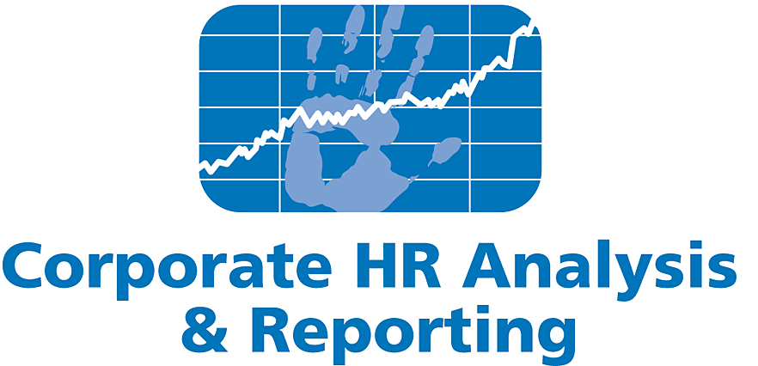
Enron’s PRC
DRAFT
Determination of Success and Suitability of Enron’s
Performance Review process
June 11, 2001
Confidential and Proprietary
Data here is used for illustrative purposes
NOT Actual Data

Slide 2
Table of Contents
Executive Summary
Adoption of PRC within Enron
Effects of Enron’s PRC
Upward Executive Mobility
Churn / Career Movement
Separations
Contribution Loss
Incentive Pay and Earnings Correlation
Income Contribution from PRC units
External Benchmarking
Why Companies Use Forced Rankings
How Enron’s Process Compares
Advantages of a 360 degree / Ranking process vs. a Vertical Process
Risk Mitigation
Supplemental Data

Slide 3
Executive Summary
Points for illustrative purposes only
NOT based on Actual Data yet
Upward Executive Mobility
For VPs and MDs, average time between promotions in PRC participating units is lower at one year than non-participating units at two-plus years. Employees advance quicker to the Executive Level in these units, suggesting that PRC enables the identification of top talent and provides immediate rewards.
More VPs and MDs are promoted from within PRC participating units than non-participating units. Those executives have been, on average, more successful than direct hires into executive positions suggested by the continued advancement, number of top leadership positions, and retention.
The gross margin contribution is greatest among those identified as top talent from PRC, suggesting that PRC directly links performance feedback with shareholder return. Gross Margin contributions continue to increase xx % each year, indicating that PRC raises the bar and allows Enron to identify those who contribute the most to earnings.
Churn / Career Movement
In all units, separation rates were equal indicating that PRC units do not create more voluntary terminations. These units compared to industry comparisons show xxx. PRC allows the enterprise to track how separations impact the company through a new metric, Contribution Loss.
In PRC participating units, overall, employees advance quicker ie. average time between promotions is one year versus three-plus years in non-participating units, suggesting that PRC may enable the identification of top talent more successfully and quicker.
Internal churn is highest among the PRC units, suggesting a more agile culture than their counterpart. These business units tend to move into new markets quicker and profit sooner i.e. first mover advantage.

Slide 4
Executive Summary
Points for illustrative purposes only
NOT based on Actual Data yet
Churn / Career Movement (continued)
In February 2000, fifty top performers were identified and moved to a new business unit, EBS, in one week, allowing the organization to be agile and quick to fill new business units with proven top talent.
Incentive Pay and Earnings Correlation
Profitability both for employees and business unit is greatest among PRC units, suggesting that PRC enables a successful incentive pay strategy.
Greatest success in new business growth evident in PRC units, suggesting that these environments promote and reward entrepreneurs.
Over 75% of income comes from new businesses that did not exist ten years ago, originating from PRC units.
90% of these new businesses are led by top talent identified by a PRC process.
E-Pulse Survey
Annual employee feedback surveys did not show lower ratings for PRC units compared to their counterparts.
External Benchmarking.
Enron’s process and intent varies somewhat with those traditional termed “ rank and yank”.

Slide 5
Adoption of Enron’s PRC
Inception of PRC began in ENA (formerly
known as ECT) in 1991.
Analysts and Associates were governed by
ECT at that time and were included in this
process.
Other business units electively participated
over the years.
Based on the 2000 year-end process, 12,100
employees participated. The remaining employees who did not participate were mostly skill-based pay employees, union employees, other technical/field, and new hires that did not meet the eligibility parameters.

Slide 6
Effects of PRC Ratings Upward Executive Mobility
PRC appears to be an effective recruiting tool for top management, saving the company executive search fees and enhances the morale of employees who hope to advance within Enron. PRC units rely less on direct external executive hires as the PRC process allows PRC units to quickly identify top talent to advance I.e 2% vs. 10%.
78% of the Executive Committee were identified and advanced using a PRC process.
More VPs and MDs are promoted from within PRC participating units than non-participating units.
Those executives have been, on average, more successful than direct hires into executive positions suggested by the continued advancement into top leadership positions such as the Executive Committee.
“The ranking system will work as a recruitment tool, "If I were a young recruit looking to come into a tech company, knowing we had rankings, I'd be excited about it,"
…Jay Salem, EDS, Director of global human resources.
Data here is used for illustrative purposes
NOT Actual Data

Slide 7
Effects of PRC Ratings Internal Churn and Career Movement
Churn and Career Movement
Early PRC Success : 1992- 1994; xx Employees Rated Top 3 Categories
Of these employees, xx or xx% now hold
Positions of VP or above.
xx or xx% have advanced three or more levels
xx or xx% have left to non participating Bus;
xx or xx% have advanced since their departure
(internal only)
Of these employees, xx or xx% have left
the company.
Voluntary
Competitor
Other
Involuntary
Business Reorganization
Poor Performance
Other
Of this population, the average time between
promotions is xx
Externally, the average time between promotions
is xx (provide company specific if possible)
I Banks?
Data here is used for illustrative purposes
NOT Actual Data
Notes:
Source: new hires 1-1-01_current for SK report.xls (2001 Weekly Terminations folder)

Slide 8
Internal Domestic Transfers
1/1/1991 to 6/4/2001
Slide to be reformatted.
Highest Internal Churn is evident in the PRC participating companies.
Total Internal Domestic Transfers XXX
Major Reorganizations XXX
(color coded above)
Self Initiated New Jobs XXX
Analyst/Associate Planned Rotations XXX
Automatic Redeployment XXX
(due to Business Reorganization)
Formal Redeployment XXX
“When Enron created Enron Communications, its broadband trading busines, it moved more than 60 people into the new division--in the space of a week. Companies that are incapable of redeploying resources rapidly across business unit boundaries will find themselves overinvesting in moribund businesses.
…Gary Hamel, Fortune Magazine, April 2, 2001
Data here is used for illustrative purposes
NOT Actual Data

Slide 9
Separation in PRC vs. Non-PRC Companies, Education/Tenure
Most of Enron’s terminations both voluntary and involuntary
were those whose performance was ranked in the bottom
categories. See next slide on Contribution Loss.
The PRC process recognizes merit/contributions versus
rewarding Pedigrees.
The PRC process provides immediate feedback and employees
Who thrive at Enron, tend to use this feedback to their benefit.
Data here is used for illustrative purposes
NOT Actual Data
Notes:
Source: SES Vol and Invol thru May 20.xls

Slide 10
Contribution Loss
2001 YTD Total Separations
Contribution
Separation Rate Loss Total
18.7% 13.5% 1,317
Bonuses
Paid
Contribution loss rate is lower than both voluntary and involuntary separations, indicating that Enron is losing poor vs. good performers.
However, it should be noted the gap between contribution loss and separation rate is narrowing. In fact, voluntary contribution loss exceeded the separation rate during the weeks of 2/5, 2/19, 2/26, 3/12, 3/19, 3/26, 4/9, 4/16, 4/23, 5/7 and 5/14, indicating Enron lost slightly more good performers than poor performers during this time.
2001 YTD Voluntary Separations
Contribution
Date Separation Rate Loss Total
Quarter 1 9.3% 8.0% 419
Quarter 2
Apr 2-Apr 8 8.2% 4.1% 29
Apr 9-Apr 15 8.2% 12.1% 32
Apr 16-Apr 22 6.2% 6.9% 22
Apr 23-Apr 29 4.5% 6.0% 16
Apr 30-May 6 14.8% 6.0% 53
May 7-May 13 3.9% 5.6% 14
May 14-May 20 9.8% 14.4% 35
Subtotal 7.8% 8.9% 201
YTD 8.8% 8.3% 620
Contribution Loss Scale*
PRC Rating Weight
1 - Superior 3
2 - Excellent 2.5
3 - Strong 2
0 - No Rating 1
4 - Satisfactory 1
5 - Needs Improvement -2
6 - Issues -3
2001 YTD Involuntary Separations
Contribution
Date Separation Rate Loss Total
Quarter 1 10.5% 3.3% 482
Quarter 2
Apr 2-Apr 8 3.4% 11.0% 12
Apr 9-Apr 15 0.8% 4.2% 38
Apr 16-Apr 22 0.8% 0.0% 3
Apr 23-Apr 29 2.8% -0.1% 10
Apr 30-May 6 11.8% -0.1% 42
May 7-May 13 18.4% 26.0% 66
May 14-May 20 12.3% 20.7% 44
Subtotal 8.4% 9.4% 215
YTD 9.9% 5.2% 697
Bonuses
Paid
*A new Contribution Loss Scale is being
developed to accommodate the new PRC
rating scale.
2001 Commercial Separations
Job Function Involuntary Voluntary
Acct Mgmt 5 1
Anal/Assoc 12 30
Asset Devel 13 4
Corp Devel 4 2
E-Commerce 3 2
Finance 4 5
Operations 1 0
Origination 62 28
Risk Mgmt 1 6
Structuring 15 5
Trading 6 12
Underwriting 1 0
Total 127 95
2001 YTD Commercial Separations
Contribution
Separation Rate Loss Total
Involuntary 1.8% 0.4% 127
Voluntary 1.3% 1.9% 95
Total 3.1% 2.3% 222
Net: The contribution loss data shows that the company is retaining top talent.
In the past 60 days, 58% of voluntary
commercial separations were rated Strong
or above. 79% of commercial employees
separating in the past 30 days were rated
Strong or above.
Notes:
Source: 5-20-01 weekly term update.xls

Slide 11
2001 YTD Separations by Job Function and Job Group with PRC Ratings
Note: Job Function excludes 24 involuntary and 34 voluntary N/A job functions; Job Group excludes 55 involuntary and 90 voluntary N/A job groups.
Notes:
Source: SES Vol and Invol thru May 20.xls

Slide 12
Compound Annual Growth Rate: Correlation between Pay vs. Earnings
New Business Growth and Profitability is Highest
Among Participating PRC Units
Freight
Credit
Metals
Bandwidth
Australian Power & Gas
Pulp & Paper
Coal
Weather
Scandinavian Power & Gas
Plastics
Emissions
Financials (interest rate, equity)
UK Power & Gas
Electricity
Natural
Gas
Currencies
1985
1991
1991
1996
2000
Xx or xx% of employees earned $500K or greater bonuses of
Which xx or xx% were from PRC participating units.
* Lighter shading indicates a developing market
Darker shading indicates a mature market
Note: Earnings represent EBIT
EES earnings were -$81M in 1999 and $58M in 2000
Corp reported negative earnings in all years
Notes:
Source: new hires 1-1-01_current for SK report.xls (2001 Weekly Terminations folder)

Slide 13
Income Contribution from PRC Companies
PRC Participation
“Eighty percent of our net income comes from businesses that didn’t exist 10 years ago – and we expect to start just as many revolutions in the next decade.
…Jeff Skilling

Slide 14
Employee Feedback Comparisons
Employees from Traditional PRC units rate their units more favorably than Traditional non-PRC units in the following areas:
Is a well-managed operating company.
Employees feel free to voice opinions openly in operating company.
Encouraged to challenge procedures/ policies.
Can believe information from top management.
Supervisor deals fairly with everyone.
Operating Company acts on suggestions of employees.
Would recommend Operating Company as a good place to work.
Feel commitment to Operating Company as more than a place to work.
Expected amount of work is reasonable.
Overall, satisfied with benefits.
Employees from Traditional PRC units rate their units consistently with Traditional non-PRC units in these areas:
Supervisor gives regular feedback on performance.
Supervisor encourages teamwork.
Decisions in Operating Company are well communicated.
Employees from Traditional PRC units rate their unit less favorably than Traditional non-PRC units in these areas:
People treated with respect and dignity.
Paid fairly compared with other employees outside Enron.
Overall satisfied with pay.
Good communications across department lines.

Slide 15





Why Companies Use Forced Rankings
“A company that bets its future on its people must remove that lower 10 percent, and keep removing it every year -- always raising the bar of performance and increasing the quality of its leadership.”
…Jack Welch. CEO, General Electric
Change Corporate Culture
From Entitlement-based to Performance-based
“TopGrading”
Cisco has had a goal of cutting 5% each year even when it was growing so fast it could not fill positions
Voluntary Employee Buyouts
Ford has been offering a generous buyout program to salaried workers whom it considers underachievers
Improve Employee Performance
Sun has recently initiated it “Employee Improvement Program”
Recruiting
EDS considers their ranking system a recruiting tool

Slide 16
Comparison of Enron’s process vs. External Benchmarking
Enron’ Preferred Distribution vs. Industry Standards:
All Employees
Managerial Only
Industry Benchmarks:
**EDS – Utilizes their ranking system as a recruiting tool, attracting employees who prefer a high potential identification process.
**GE - Utilizes use only three clusters when ranking managerial and professional staff and five for other employees.
**Ford – For bottom category, no raise, bonus, stock option - first year; If consecutive for two years, placed in other jobs, demotion, or terminated in second year.
**Cisco - has had a goal of cutting 5% each year even when it was growing so fast it could not fill positions
**Microsoft – does not use their ranking process to reduce staff but instead for pay structure
**HP- Re-calibrates it distribution annually based on corporate performance and other factors
**Sun – Bottom 10% get a one-time chance to resign and take severance; those who choose to stay and remains bottom 10% are fired without severance.
* In forced distribution, companies might not follow a bell curve by aiming to identify more employees as high performers, therefore stressing the positive effects of high performance.
* The majority of companies profiled in a Corporate Leadership Council research brief take into account corporate and/or business unit performance when determining the percentage of employees to place in exceptional or unacceptable categories.

Slide 17
Advantages of PRC Rating System
Vertical
Supervisor
Employee
PRC
PRC Committee
Employee
360 Feedback
Advantages:
Promotes accountability of the supervisor
Disadvantages:
Employees become too focused on supervisor, versus team objectives
Empowers supervisors with unilaterial decision making
Employee evaluations may be significantly skewed by one reviewer
Promotion criteria may not be based on merit but by supervisor comradery
Because it does not account for peer evaluation, teamwork, leadership and other
critical skills may be not fully evaluated and promoted
Fosters animosity between employees and management
Penalizes employees whose managers fail to take performance seriously
May limit an employee’s career if the supervisor is concerned about job security
Advantages:
Provides multi-data points / opinions which may reduce Performance
Appraisal errors and biases.
Employee’s feel that their opinions count.
Reduces grade inflation
Increases self awareness of what others think of us.
Identifies high performing employees for merit increases and promotions
Identifies poor performing employees with developmental needs
Encourages employees to exceed expectations
Forces managers to have honest and actionable performance discussions
Promotes accountability
Disadvantages:
Focus on scores may interfere with personal development
Managers feel that defined distribution curves limits their authority
Fosters animosity between employees and management
Makes company vulnerable to law suits due to forced ranking
Promotes competition, potentially reducing teamwork
Penalizes employees whose managers fail to take performance seriously

Slide 18
Risk Mitigation
Norm has revised
Risk Mitigation Factors:
Elimination of Subjective Criteria
Microsoft, Ford and Conoco have been subject to lawsuits based on discrimination. A claim used to support these allegations is that forced rankings are based on a lack of subjective criteria.
Industry benchmarks
...Microsoft - “Lifeboat” Ranking System
Identification and Assessment of Competencies
Industry Benchmarks:
…Sprint - Commitment to corporate-wide competencies guides the company's performance management. "People at Sprint talk in competency language. The definitions for each competency are clear across the company, and people know exactly what it takes to get a 1 [Sprint's highest rating]. People may not like being rated in the middle, but they know what it means.
…Microsoft - Employees are largely responsible for developing criteria by which they are evaluated.
Representation of Diversity on PRC committees
…Enron has began the process of including xxxx on PRC Comittees.

Slide 19
Supplemental Data

Slide 20
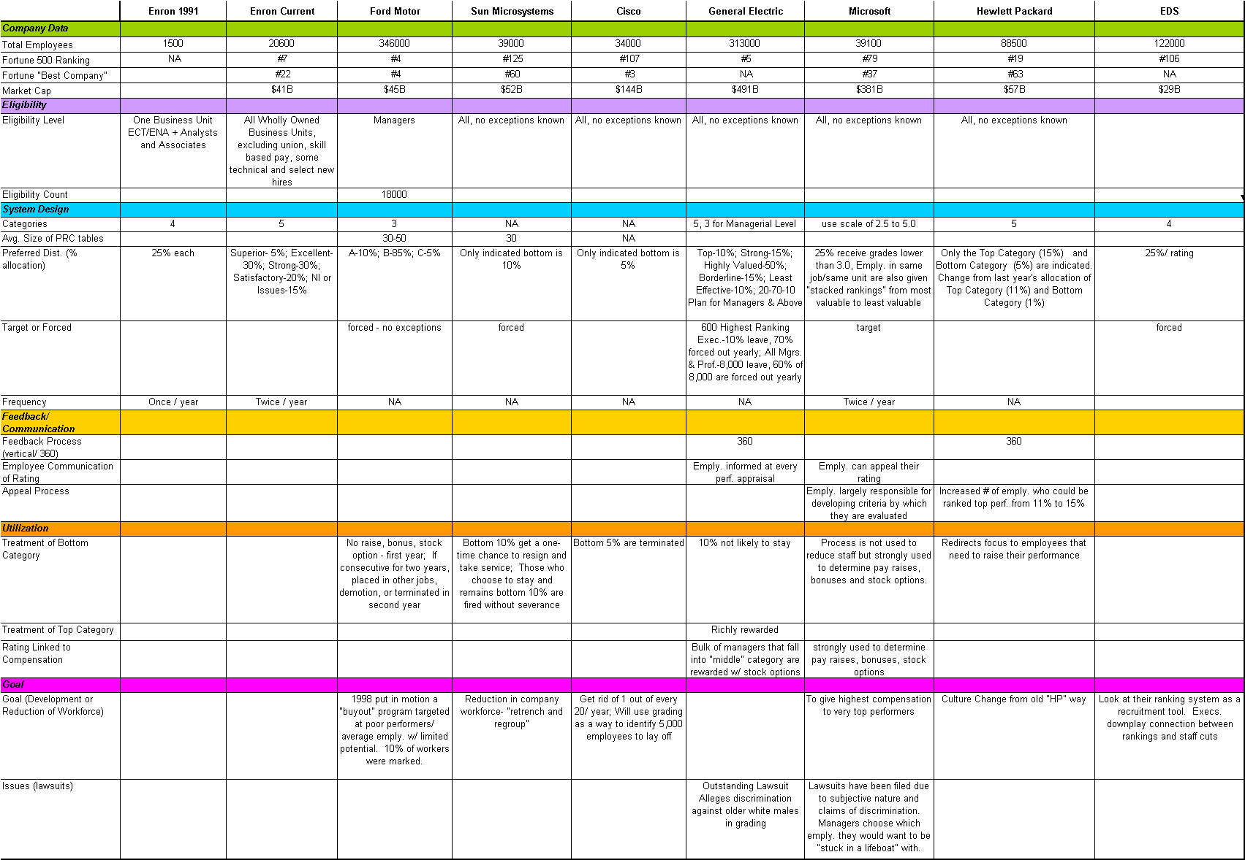
External Benchmarking

Slide 21
Why Companies Use Forced Rankings
“A company that bets its future on its people must remove that lower 10 percent, and keep removing it every year -- always raising the bar of performance and increasing the quality of its leadership.”
…Jack Welch. CEO, General Electric
Change Corporate Culture
From Entitlement-based to Performance-based
“TopGrading”
Cisco has had a goal of cutting 5% each year even when it was growing so fast it could not fill positions
Voluntary Employee Buyouts
Ford has been offering a generous buyout program to salaried workers whom it considers underachievers
Improve Employee Performance
Sun has recently initiated it “Employee Improvement Program”
Recruiting
EDS considers their ranking system a recruiting tool

Slide 22
Effects of PRC Ratings Individual Volatility Index
Churn and Career Movement
Individual Volatility Index
Tracking individual PRC ratings over time,
indicates that these ratings are volatile.
xx, or xx% PRC ratings remain consistent during
an employee’s tenure
When an employee’s rating fell by more two
ratings in consecutive periods, xx or xx% left
the company while xx or xx% found another
internal assignment. Xx or xx% remained
in the same position. Behavior may be
skewed by whether the employee was told of
his/her rating.
Commercial employees tend to be most volatile
while any PRC ratings lower than satisfactory
usually result in termination
Non-commercial employees tend to find new
internal homes quickly when PRC ratings are
lower than historically.
Data here is used for illustrative purposes
NOT Actual Data
Notes:
Source: new hires 1-1-01_current for SK report.xls (2001 Weekly Terminations folder)

Slide 23
Effects of PRC Ratings Culture and Participant Demographics
Culture
Culture defined by PRC participating units
Culture defined by non-PRC participating units
External Culture Benchmarking
Participant Demographics
Median Age; Gender; Ethnicity over the history of PRC
Felecia Acevedo can provide for 2000 year-end PRC process only; historical data will need to be obtained from Kathy Schultea’s team.
In or out
Notes:
Source: new hires 1-1-01_current for SK report.xls (2001 Weekly Terminations folder)

Slide 24
360-degree Feedback
Industry Statistics:
Twenty-two of Fortune's 32 most admired companies were using upward or 360-degree feedback as of 1994.
By 1996, 360-degree programs had became nearly universal among Fortune 500 companies, which spend hundreds of millions of dollars annually to support them
Advantages:
Provides multi-data points / opinions which may reduce Performance Appraisal errors and biases.
Employee’s feel that their opinions count.
Increases Employee’s and possibly customer involvement.
Increases Employer’s ownership of their managers development.
Increases management responsiveness to Employee’s concerns.
Allows honest feedback (when it is anonymous).
Has multiple uses? RIF, Promotion, Assessment of skills, individual development etc.
Increases overall communications.
Increases self awareness of what others think of us.
Disadvantages:
There is no data that it actually improves productivity, increases retention, decreases grievances or that it is superior to standard Performance Appraisal systems
Poor substitute for unassisted 1 on 1 communication and can short circuit natural feedback channels.
The need to use it shows how poorly normal communications channels are working. 360 use discourages efforts to "fix" these essential systems.
There is no evidence of a correlation between high 360 scores and high performance.
It is time consuming (when done periodically) and managers and Employer’s learn to hate the time commitment.
Little evidence that managers actually listen to Employee’s opinions. This can actually decrease productivity due to frustration when the Employee’s realize they have been deceived into thinking their opinions matter.
It's subjective not objective. It is based on opinions not behaviors. Popularity is not performance. Opinions are not business results.

Slide 25
Impact to Wrongful Termination Costs
Consult with Michelle
Wrongful Termination Correlated to PRC
Notes:
Source: new hires 1-1-01_current for SK report.xls (2001 Weekly Terminations folder)

