Slide 1







PEER GROUPS -
CONSOLIDATED MAPPING
MAY, 2001

Slide 2
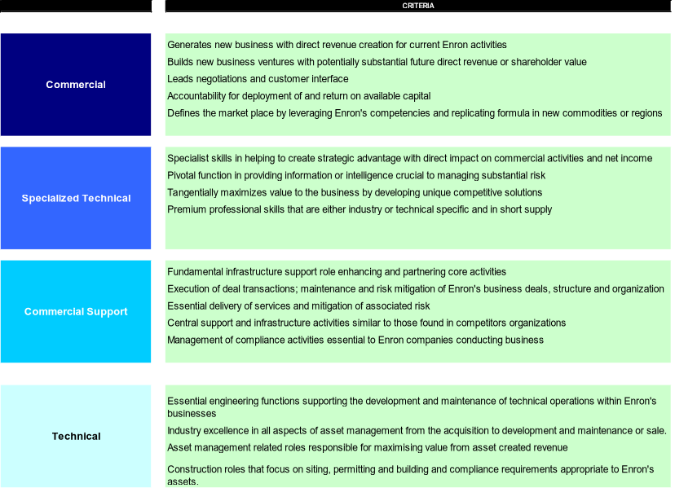
EXISTING PEER GROUP CRITERIA DEFINED

Slide 3
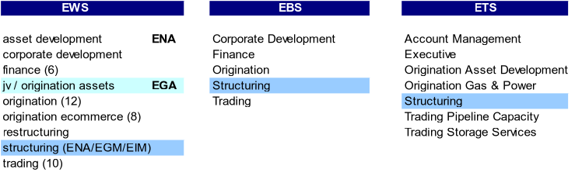
COMMERCIAL PEER GROUP

Slide 4

SPECIALIZED TECHNICAL PEER GROUP

Slide 5
COMMERCIAL SUPPORT PEER GROUP

Slide 6
TECHNICAL PEER GROUP

