Slide 1
MID-YEAR 2000
PRC REVIEW
PROCESS

Slide 2
Scope
PRC-Brief overview/definitions
The approach for Mid-Year, 2000
Introduction of the new feedback forms
Why?
Your role in the Mid-Year Review
PEP: Performance Evaluation Process
Committee Meeting Facilitation
Notes:
States what will be covered.
Actual technical training on PEP system will be done separately (still in development so there may be some changes before it is released for production).

Slide 3
WHAT IS PRC?
PRC = Performance Review Committee
The PRC process allows Enron to evaluate performance across functional groups, departments, and business units.

Slide 4
WHAT IS PRC? (cont’d)
The process is used to determine an overall performance rating, based on job level, across Enron
Enron uses this information to determine various compensation elements, validation of promotional candidates, and to assist with effective deployment of our human capital
Notes:
“Various compensation elements” logically, the process, combined with individual performance management, will directly impact promotional level, merit, and bonus.

Slide 5
How does it work?
For the first time, all Enron employees may be included in the PRC process
Individual performance is evaluated by reviewers, supervisors, and the committee
Notes:
This decision has come from the executive level of Enron.
The benefits include:
Providing consistency across the company in desired skills and behaviors and how they are rated.
Should, when implemented fully, make the evaluation process more straight forward.
Still allows for highly individualized performance management.

Slide 6
PEP Evaluation process
PEP is a web-based performance management system that allows 360° evaluation. The Intra-net platform is user-friendly and will allow access to our global locations
Functionality (see attached appendix)
    Employees will receive an email advising of access and logon details
    Employees suggest selected reviewers online (they have the ability to select external Business Associates). This generates an email to supervisors advising them that their employees have suggested reviewers
Notes:
Employees should be encouraged to select reviewers who can give a balanced evaluation.
Try to select reviewers who will take the time necessary to give feedback and who can list specific examples of performance.
Supervisor can reject or amend the list submitted by employee.
Be aware that reviewers can decline to give feedback; PEP does not require a reason.
It is possible to provide unsolicited feedback; using PEP, employees can enter feedback on someone even if the reviewer has not been specifically requested. (Will be discussed in PEP training.)

Slide 7
PEP (cont’d)
    Supervisors approve/reject/amend reviewers online which then automates an e-mail to reviewers advising them they have been selected and notifies them of :
      their password and the website, if they’re internal
      the attached feedback form for them to complete and send back to ‘perfmgmt@enron.com’, if they’re external
    Reviewers have the opportunity to decline providing feedback
    The feedback forms are attached to the employee’s ENE job group

Slide 8
PEP (cont’d)
    Reviewers complete thorough and informative feedback online and recommend an overall rating and once complete this is attached to the employee’s “PEP” record
    Once all feedback is gathered the Supervisor prints off the consolidated feedback to take along to the Functional/Business Unit PRC meeting to assist in determining the employees overall rating
    The consolidated feedback will also assist the supervisor when compiling the employee’s evaluation

Slide 9
Performance Ratings
    Superior: Consistently goes above and beyond expectations. Role model for criteria. Very little need for growth and change at current level.
    Excellent: Exceeds most expectations. Role model for most criteria. Further development needs are minimal.
    Strong: Exceeds some expectations. Role model for some criteria. Further development needs in some minor areas.
    Satisfactory: Meets most expectations. Demonstrates the criteria. Further development needs in some areas.
    Needs Improvement: Meets some expectations. Demonstrates some of the criteria. Further development needs necessary in many areas.
    Issues: Has significant performance issues. Does not demonstrate most of the criteria. Must make changes or termination likely.

Slide 10
Peer Groups
Technical: Broad-based technical support
Specialized Technical: Focused on specific technical job environments
Commercial: Directly involved in making money; part of a P&L
Commercial Support: Supports those in commercial roles
Notes:
A person’s peer group is determined by HR. It is based on job code, business unit, etc.
This is automated within the compensation (bonus) portion of the system.
Commercial: Trading, Originazation, Finance, Asset Devel., etc.
Spec. Tech.: Legal, Attorneys, IT, RAC, Tax Attorneys
Comm. Support: Energy Ops, Accntg, PR/CR, Regulatory, HR, etc.
Tech.:Field engineers, Field Ops., Asset Operators, etc.

Slide 11
Mid-Year 2000 Approach
The PRC process will be applied across Enron
For most business units, the process will cover all levels of employees
Mid-year is designed to gauge the employees’ performance and address any concerns, development/training needs, etc.
Notes:
There may be some exceptions as business unit heads and their HR teams discuss the process.
The goal is to include as much of the employee population as possible.
All employees not directly involved in PRC will be assigned a rating.

Slide 12
What’s Different?

Slide 13
Some Changes
PRC will now consist of only three feedback forms and are attached to ENE job groups
  VP and Above
  Management/Professional (Include A&A)
  Administration/Support
Goal is to streamline the process and reduce confusion
Notes:
Associates/Analysts will be evaluated using the Management/Professional form; no longer a separate form.
Management/Professional includes Sr. Directors, Directors through specialists levels.
Admin/Support includes assistants, clerks, etc.; all those in roles that support the administrative side of the business processes.

Slide 14
Only 3 Forms?! How?
The forms address basic skills identified as core to Enron’s business model
Job information detail is minimized
Each reviewer interprets/applies the descriptors based on their interaction with and evidence of the employee’s job performance
Notes:
NOT subjective perception…
Objective Perception means:
It is based on evidence, first hand, that can be recounted.
There is solid rationale beyond the rating.
This is what I think based on what I saw, experienced, etc.

Slide 15
Form following Function
The form does not drive the process…
The PROCESS drives the form

Slide 16
What does that mean?
The form does not define the performance of an individual
It only serves as the framework for performance evaluation
How the employee has performed within that framework is evaluated by other employees with whom they have worked
Notes:
Pushback may be received that either the forms are not specific to an individuals actual work or are irrelevant.
Response to the first is that appropriate examples from reviewers will MAKE it specific within the framework of the form.
Secondly, literally no item should be considered irrelevant since the descriptors basically describe “where the bar” is for all employees within the designated levels.

Slide 17
The 3 Forms
VP and Above
Management/Professional
Administration/Support
Notes:
Readable copies of the forms are in your manuals following the powerpoint slides.
These will also be included in the handout materials used for client group training.
Try a few “test” cases: pick various people you know, whose performance you are familiar with. Then try using the form; it should work for anyone. Not every descriptor may be fully applicable, but enough should be to allow for a specific rating.

Slide 18
Notes:
In other words, Enron really has basically one model for defining performance.
These skills/behaviors, as identified by the descriptors, are what it takes to succeed at Enron and to make Enron successful.

Slide 21

Skills/Behaviors Descriptors:
Administration/Support
Performance Feedback

Slide 22
Again, Why Just 3?
Simplicity with maximum flexibility
Same process/guidelines regardless of where you work at Enron
Individuals, their actions and impact on others, define their performance, not the form
It just makes sense!
Notes:
Stress the streamlining which results in a more straight forward process.
Emphasize “One Enron”

Slide 23
Benefits
Simple
Consistent
Encompassing
Inclusive
Leveling
Flexible
Systems-Friendly
User-Friendly
Resource Mgmt.
Benchmarking
Notes:
Simple: Only 3 instead of 48!
Consistent: The same regardless of Business or functional unit
Encompassing: One Enron; Enron wide and deep!
Inclusive: Literally pulling every employee into just three groupings
Leveling: Finally, everyone in my peer group is measured on basically the same way!
Flexible: The reviewers define the terms of the form to meet the individual’s performance.
Systems Friendly: Less is best!
User Friendly: Simple, straight forward, concise.
Resource Management: Tightens up the rating process across groups so the ratings mean similar things to all.
Benchmarking: Simplified by only having three forms and three sets of different but highly complimentary descriptors. The Skills/Behaviors will become more defined based on the freedom of the reviewers. (What really matters, what really counts, what really gets noticed, what does it really take to get a good rating)

Slide 24
Consolidation of Feedback
Once all feedback is complete, supervisor receives it via the PEP system
PEP consolidates the reviews for an employee into one form for the supervisor
Supervisor prints out the form, and, based on the feedback, develops a preliminary rating for each employee
Supervisor utilizes the consolidated feedback as a reference at the meeting
Notes:
There is no automatic tally; each rater/feedback form gets a chance to choose an overall rating.
In the consolidated form, it will show what the reviewer rated each skill/behavior then gives the over all rating assigned by the reviewers.
The overall ranking is NOT averaged. Only the supervisor does this.

Slide 25
Post PRC
The consolidated feedback will be used as the foundation to create the employee evaluation form
Once ratings have been approved, employee and supervisor will:
  Discuss job specific performance
  Identify issues
  Set performance and development goals
Notes:
Performance forms will be made available in Word format for use with employee one-on-one meetings.
Basically identical to the PRC feedback but with signature boxes.
Items such as objectives, development plans, issues, etc. may be placed in the comments boxes in Word which will “grow” as necessary.
It is suggested that the employees performance rating and PRC rating be consistent. More meaningful, no confusion, etc.
Share feedback as appropriate, be objective, substantial, and factual.

Slide 26
The Forms are complete, the feedback is consolidated, the reports have gone to the supervisors...

Slide 27

Now it’s time for...
The Committee Meeting!

Slide 28
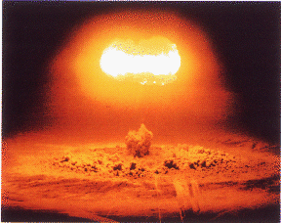

Slide 29
Oh, come on, it is
NOT that bad!!!
And you can make
the difference!!!

Slide 30
The Role of the
HR Facilitator
“Kick-off” the meeting
Establish the Ground Rules
Actively encourage participation
Mediate only if necessary
Keep it moving
“Drive” the on-screen placement and movement of individuals
Notes:
Challenge raters when appropriate; hearsay, subjectivity, no substantial examples, etc.
Prior to the meeting, prepare the senior member for your role as facilitator. Make sure they are comfortable with the process.
Keep your eyes open for problems to consensus.
Restate need for and description of consensus (may not agree but can live with it and will support it).
Do not hesitate to “lock down” consensus; specifically ASK for it by show of hands, nods, no dissent, etc.

Slide 31
What Your Role Isn’t...
You are a facilitator, NOT a participant
This is their meeting, not yours
You do not offer evaluation input
You do not judge comments or ratings either by word or look

Slide 32
You Have Tools
The “Ground Rules”
You set the stage
Experience of others
Basic Facilitation Skills
Notes:
This section is heavily based on real-life experience with the committee process.
HR Professionals who have facilitated many PRC committee meetings have given their input to the information that follows.

Slide 33
Notes:
Prior to the meeting, make sure members know what to bring with them, especially the consolidated evaluation information.
All committee members should be familiar with the Ground Rules
Each meeting should start with YOU reviewing the Ground Rules
Read EACH one, define where necessary:
Objectivity is key, subjectivity is self-defeating and inappropriate.
Consensus: Even if you don’t fully agree, you understand and SUPPORT the committee’s conclusion both within and after the meeting!
Participation means providing input and relevant information for all members.
Members must ensure adherence to the Ground Rules throughout the process.
Confidentiality: What is said in the meeting STAYS in the meeting; members must be free to offer open and frank comments without concern for any possibility of those comments being repeated!
No interruptions. Your absence at a critical point could have a major impact on someone’s final rating.
MAKE SURE YOU PICK UP ALL SENSITIVE/CONFIDENTIAL MATERIALS LEFT IN THE ROOM.

Slide 34
Set the Stage
Introduce yourself and any other person who might be assisting
Acknowledge that you may not know everyone in the room
Have tent cards completed for your benefit and anyone else’s
Review the Ground Rules
Notes:
This is your first and primary chance to identify yourself as the facilitator and establish that role.
Employees may need to be placed in the “Not Reviewed” category for several reasons; no feedback, some outstanding issue, etc.
If an explanation is requested on any “Not Reviewed” employees, defer to the committee member responsible.
If that is not possible, simply state that there are some concerns regarding the feedback process and it will be dealt with off-line.
(If a pre-meeting has been held, it is possible that some individuals will not be rated in the meeting. You should be aware of any such instances.)

Slide 35
Get the Ball Rolling
That first look at the screen with all those names can be daunting
If no one goes first quickly, the facilitator chooses an employee (best if one ranked superior)
Find out who is representing that person
Have that person provide a feedback summary
Ask for other input, rate them, move on
Notes:
Experience shows that the process may be a bit slow at the outset.
Once started, the first phase, the initial placement, usually progresses fairly quickly. If it doesn’t, suggest to the group that this is just the first run and time will be available to make more final placements.
Some percentage of placements from the first phase will “stick” with that initial placement.
The second phase covers those placements where discussion, sometimes intense, is needed and necessary to the process. Remember, the committee members much reach CONSENSUS and this can take some time.
Third phase is total consensus. All agree or not on the individual ratings but ALL AGREE to support the ratings.

Slide 36
The “Unwritten Rules”
Moves up or down more than two ranks are unlikely
Promotion candidates are in either the Superior or Excellent categories
Promotions are at least 12 months apart
First 6 months rule: if the person has held the job for 6 months or less, best rating is a “Strong”
Notes:
Unwritten rules: really unwritten guidelines
Based on common sense.
Can be broken but only in exceptional circumstances.
May be more unwritten rules in specific units; you can usually sense these as the rating progresses, be observant.
When things “get stuck”, take a break
Side bars are OK as long as they are not disruptive; if a sidebar or sidebars are obviously becoming disruptive, ask for a brief pause until obviously important side issues are dealt with.
Use the group to your advantage: “push it back” to them, ask them what to do about it (lack of consensus, lack of real evidence in support of a rating, etc.).

Slide 37
Some Scenarios
Notes:
Here are some examples of what you may see.
Before taking any action yourself, give the group a chance to handle it.
When/if it becomes obvious that momentum and focus are being lost, then take limited and highly specific action.
Always be sensitive to the currents in the room as much as possible (hidden agendas, personal conflicts, etc.)
Again, you can only do so much as the facilitator; the group as a whole is ultimately responsible.

Slide 38
The Unsubstantiated
Someone is ranked Superior/Excellent without concrete examples or only on dollar amount contribution
Challenged by someone who says person should move downward
What can/should you do?

Slide 39
Some Steps
Ask for references/opinions from a third party at the table
Refer to feedback forms
Challenge the challengers: what specific examples suggest to you the individual should be moved?
Refer to the definitions of the Skills/Behaviors

Slide 40
The person who disagrees with everyone...
Take a moment to reiterate the definition of consensus
Do not direct the comments at anyone, just a general “check-point”

Slide 41
The “Rail-Roader”
Ask for 3rd party reference/opinion
Summarize their contribution based on comments so far and ask someone at the table (not the rail roader) if your summary is accurate
If appropriate, refer to the need to let people finish their contribution
Notes:
The “rail-roader” is that person who plows over and through anything in their path.
They feel free to interrupt while refusing to be interrupted.
They usually relish the limelight of being center stage.
They may or may not have specific agendas of their own; it might just by their personality!
They will have no hesitation about trying to railroad you. Be business like and firm. When you are done, defer to someone else at the table to take up the action.
As always, you can only do so much. The rest of the members may take no action and let the railroader take and keep control, even after your intervention.
Your job is to get the best result with minimum intervention.

Slide 42
Inappropriate and/or
Unsubstantiated Comments
Ask open-ended questions
  what (what happened?)
  when (when did it occur?)
  how (how did it happen, circumstances?)
Avoid “Why”
Notes:
The goal here is to go from unsubstantiated to factual interpretation.
Get the details, if there are any. This forces factual discussion and opens the door wider to counter-comments.
Asking “Why” questions only serves to broaden the forum for unsubstantiated opinion and extends the scope of the subjective rather than the objective.

Slide 43
The “Quiet” One
Provide an opportunity
Look for clues they might have a comment to share (body language)
Don’t press it
Don’t “call” on them repeatedly
It is, in the end, their responsibility and their choice
Notes:
Some people, even at Enron, are by nature reticent to speak frankly in an open forum like the PRC.
They may be totally new to the process or to the company and actually don’t know the people being reviewed.
Your goal is to make sure everyone has had the opportunity to speak and knew they were welcome to actively participate.

Slide 44
In Conclusion...
Your job is to explain the new forms and the PRC process
Your role in the committee meetings:
  Keep it moving
  Provide low-level mediation
  Reach consensus
Notes:
Any questions?
Again, this is a real opportunity to add value and to be center stage!
Quick look at the schedule. (next slide)

Slide 45
PRC Mid-Year 2000 Schedule
Training of HR Professionals 4/3-14
HR Trains Client/Business Groups 4/11-5/5
Employee GIS data into PEP 5/01
PEP opens for feedback 5/15
PEP Closes for feedback 6/09
PRC Committee Meetings begin 6/12
PRC Committee Meetings should end 7/14
VP & MD PRC Meeting 8/2-3

Slide 46
PEP
HR Rep Services

Slide 47
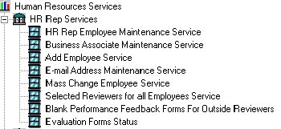
HR Rep Services
Main Menu
For HR Rep Services you will access PEP via the application (This will be rolled out to you by the PRC team). For PRC services you will access PEP via the Intra-net.

Slide 48
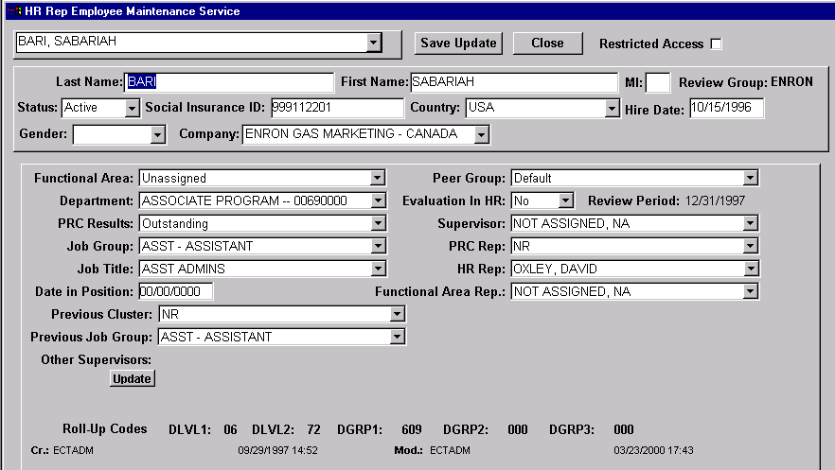
HR Rep Employee Maintenance Service
Look up employee by name and maintain their record...

Slide 49
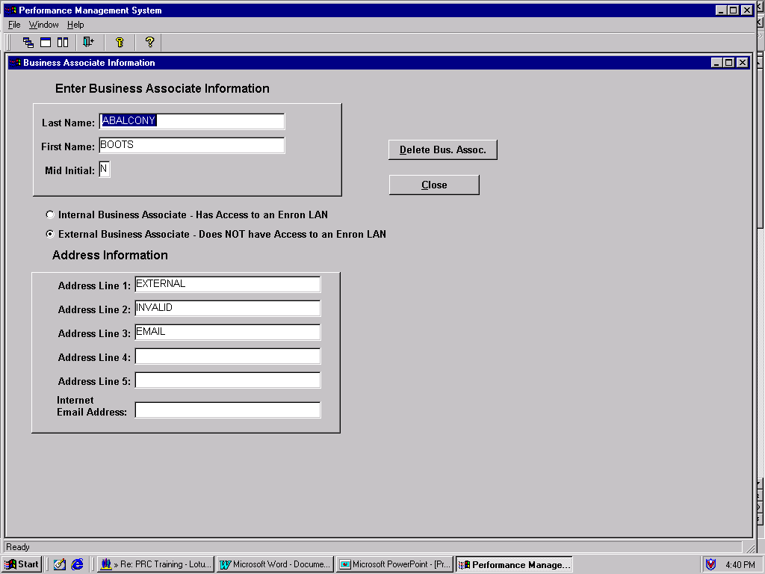
Business Associate Maintenance Service
You will have access to load external business associates on behalf of employees...

Slide 50
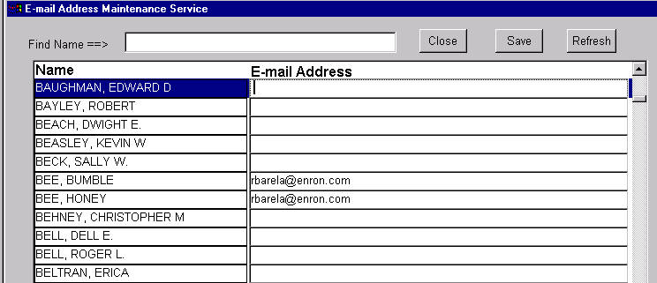
E-Mail Address
Maintenance Service
Add and update e-mail addresses...

Slide 51
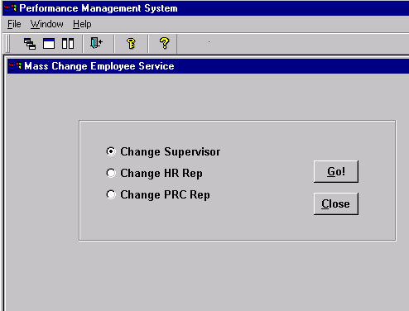
Mass Change Employee Service
NOTE: The Functional HR rep option will be listed on this screen.
Make changes to Supervisor, HR Rep, and PRC Rep, all at once...

Slide 52
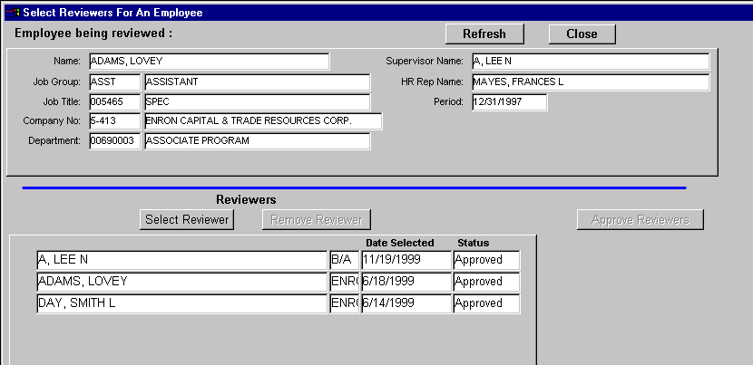
Selected Reviewers for all Employees Service
Provides the ability to select and approve reviewers on behalf of employees...

Slide 53
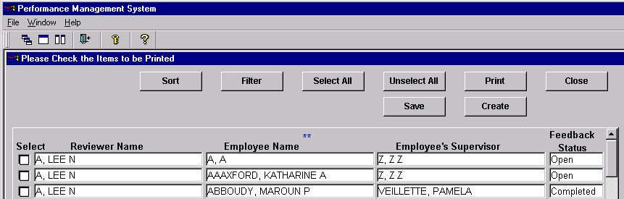
Blank Performance Feedback Forms for Outside Reviewers
The ability to print blank feedback forms...

Slide 54
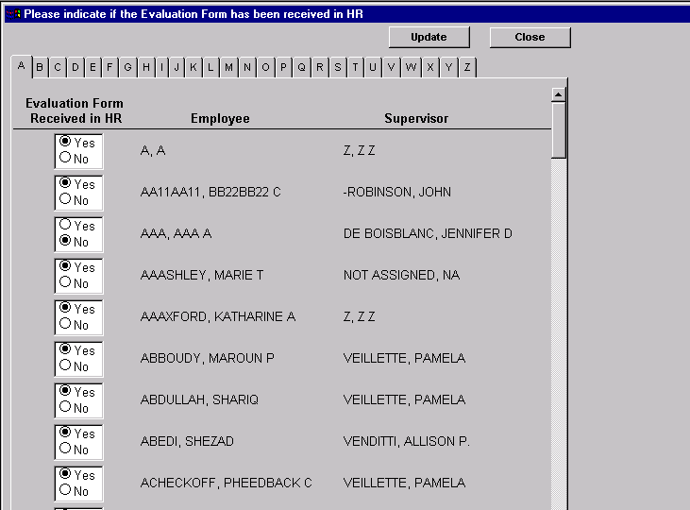
Evaluation Form Status Screen
If required, each business unit will have the ability to track that evaluation forms have been received...

Slide 55
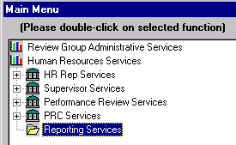
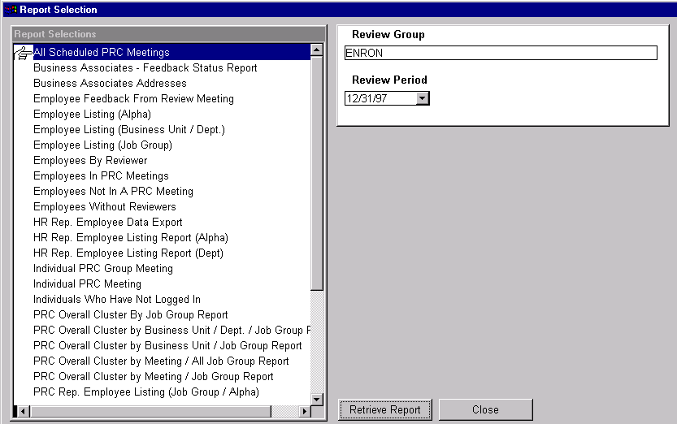
Reporting Services
Step One: Access to reports...
Step Two: Select the report you want to print...

