Slide 1







PROPOSED PEER GROUP STRUCTURE
PRC COMMITTEE MEMBERS
April , 2001

Slide 2
PROPOSED NEW PEER GROUP STRUCTURE
OBJECTIVE
To assess the feasibility of moving the organization from 4 peer groups to 3.
COMMERCIAL
COMMERCIAL
COMMERCIAL SUPPORT
STRATEGIC PROFESSIONAL AND TECHNICAL
SPECIALIZED TECHNICAL
COMMERCIAL RESOURCES
TECHNICAL
ADVANTAGES
Driven by function not by profession; aid to rewarding the actual function and performance of the top contributors.
Streamline the PRC Process; decrease the number of sessions held in PRC meetings.
Clear concise criteria for each peer group; consolidate and finalize placements (reduce the movement between peer groups if correctly placed first time)
CONSIDERATIONS
Short timescale to map incumbents to proposed structure for Mid Year; needs to be complete and in SAP by May 2.
Senior management sign off and communication plan for organizational buy-in.

Slide 3
FUNCTION MAPPING FOR PROPOSED PEER GROUPS
HR FIRST CUT at mapping current roles/functions within organization to the 3 Peer Groups
Criteria was established for each peer group.
The spectrum of functions within Enron was identified.
Basic assumptions and rules were applied. All positions below manager placed in Support. Some functions crossed two peer groups.
Model tested against tie breakers.
COMMERCIAL
Primary purpose of role’s existence is the generation of revenue and creation of new business
Need to demonstrate at least 3 of the established criteria to be considered for the Commercial Peer Group.
Substantial Compensation risk
STRATEGIC PROFESSIONAL AND TECHNICAL
Maximizing value and managing risk on the execution of commercial deals
Creates competitive advantage
Critical role in supporting commercial activities
Need to demonstrate at least 4 of the established criteria to be considered for the Strategic Professional and Technical Group.
Significant Compensation Risk
COMMERCIAL RESOURCES
Essential franchise functions integral to Enron business
Maintenance and mitigation of risk for commercial deals, structures and organization
High Compensation Risk

Slide 4
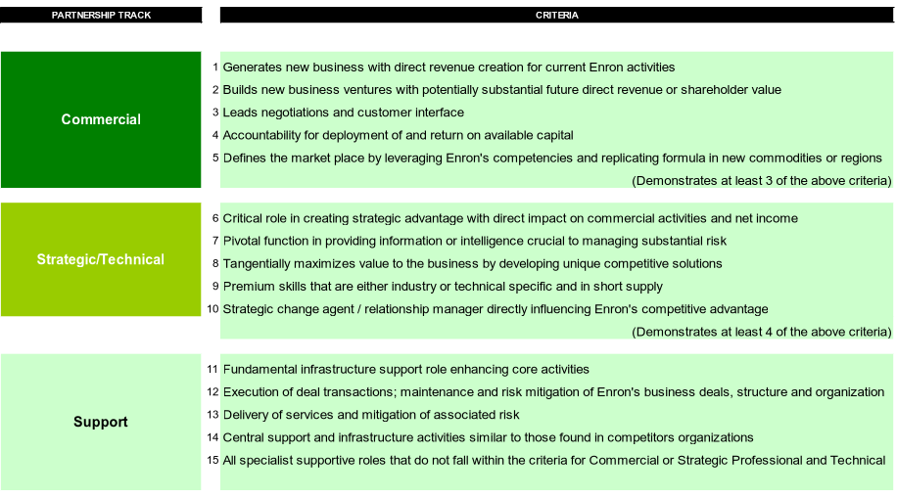
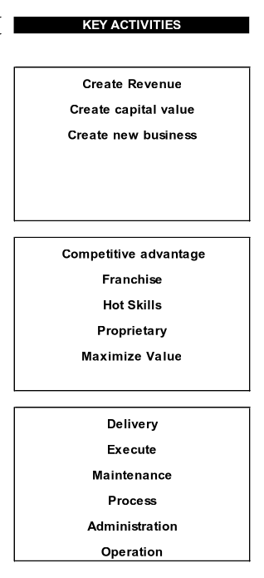
PEER GROUP CRITERIA DEFINED

Slide 5
PROVISIONAL FUNCTION MAPPING RESULTS TO DATE BY HR
PARTNERSHIP MAPPING AT ENRON
D R A F T
PERCENTAGES ABOVE SPLIT BY BUSINESS UNIT, i.e. of the 15% in Commercial Track at Enron, 40% are in EWS
BUSINESS UNIT BREAK DOWN OF CAREER TRACKS, i.e. in EWS 18% of total population mapped are in Commercial Career Track
CURRENT VP AND MD MAPPING SPLIT BY CAREER TRACK
N.B. Above data based on employees as at January 10 2001

Slide 6
FUNCTION MAPPING - ALL BUSINESS UNITS
N.B. Above data based on employees as at January 10 2001

