Slide 1
Beginning Sequence
Everybody walks in
  Mrha: many books
  Oxley, Allen, Tricoli
Oxley
  “up & out distribution”
  Allen write skit
  Show distribution
Cut to Lavo frustrated
  Scratching himself, falls out of chair
  “In Canada”… played by Allen

Slide 2
Jean Debate
Jean /Thompson/Kevin go at it.
Pan to the clock
Jean and Kevin/Thompson continue to battle
Pan to the clock

Slide 3
Dream Sequence Begins
Miller gets bored, starts to nodd off
  Doodling
  Grocery list
  Tic Tac Toe
  Six cups of coffee
  P.eople R.eviewing C.elebrities
Wakes up to the review of Pam Anderson

Slide 4
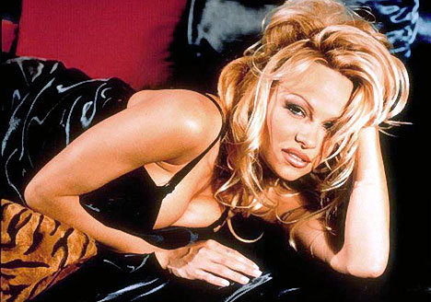
Profile of Pam Anderson
Pam Anderson
  Summer Analyst, EBS
  Expanded EBS’ video content
  Supports Video on
  Demand group through key acting role
  Interfaces well with upper management
  Works all night

Slide 5
Associated Skit with Pam
“She Works for the $ “ Donna Summer
Comments
  Works well with upper management
  Customers love her
  “Does she have numbers?”
  “ Oh yes, She is a 10.”
  “ Nope, 40 DD”
  Oxley “ Guys, scale stops at 5” and transitions to

Slide 6
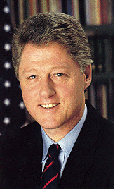
Eval of Bill Clinton
Bill Clinton
  Managing Director, EBS
  Cultivates and mentors junior employees
  Socializes with individuals across all levels in the firm
  Attracts talent

Slide 7
Skit with Clinton pic
“Tell me no lies and keep your hands to yourself” Georgia Satellites
Comments
  “Is there daylight between Pamela and Bill?”
  “Not if Bill has anything to do with it”
  “ He is very charismatic but is he getting anything done?”
  “ But the guy has a lot of traction with female customers…”
  “Yea, in the office with the summer interns. I think this guy could potential be a liability – let’s promote him to the OTC.”
  Oxley“ Mark him with the gold coin … moving on…”

Slide 8
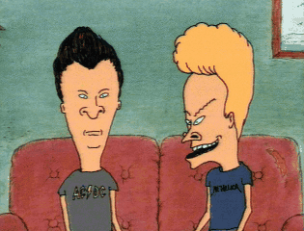
Eval of Beavis/ Butthead
Beavis / Butthead
  Associates, ENA
  Hourly traders for East Power
  Work well as a team
  Excellent communication skills

Slide 9
Skit for Beavis Butthead
“Fight for right .. To party” Beastie Boys
Comments
  “Aren’t these the guys that covered their screens with boogers and passed gas when Skilling walked by?”
  “ Stop playing old tapes…that’s part of the group’s culture!”
  Oxley “Are they fairly placed as a 3?”
  “ If that is their I.Q…”
  Oxley – “Moving on..”

Slide 10
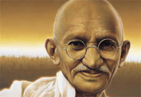
Eval of Gandhi
Gandhi
Director, Enron International
Nobel Peace Prize
Loved by thousands
Emulated across the world

Slide 11
Skit for Gandhi
Enigma song “Age of Innocence”
Comments
  “ Does this guy have numbers next ot his name? Is he even commercial? I mean what deals has he closed?”
  “He should have an LOI by 2004.”
  “ Sounds like commercial support .”
  “ Not a closer, He’s a five – move on.”

Slide 12
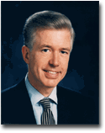
Eval of Gray Davis
Gray Davis
  Vice President, Regulatory
  Negotiated with California Commission for fair rate treatment
  Board Member for Greenpeace

Slide 13
Skit for Gray Davis
“The night the lights went out in GA”
Comments
  “Too stupid to work here.”
  “Enron is into capitalism the last time I checked, besides this one is on grandma.”
  “He just doesn’t get it.”
  Oxley:”I’m sensing a 5. Next.”

Slide 14
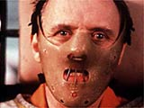
Eval on Lector
Hannibal Lector
Director, ENA
P&L $ 100 Million
Wrote the book on commodity trading

Slide 15
Skit for Lector
AC/DC song
Comments
  “He is natural trader- he just eats up the competition.”
  “I just saw him rip someone’s face off last week.”
  “Clearly a 1, he’s the benchmark.”

Slide 16
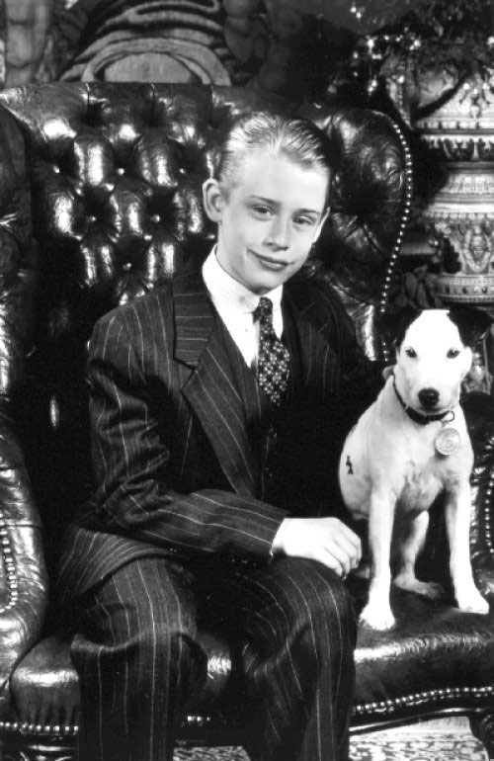
Eval of Culkin
Macaulay Culkin
  President & CEO, Enron, Age 12`
  Chairman of EnronOnLine, Age 10
  President & CEO, Enron Americas, Age 11
  President & CEO, EWS, Age 11 ½
  Great timing on sale of ENE Stock

Slide 17
Skit for Caulkin
Kid Song – Seasame Street, Barney
Comments
  Brings a lot energy, a little immature , but has a lot of new ideas
  Willing to try new things
  Oxley “Moving on”

Slide 18
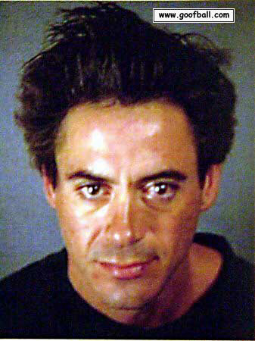
Eval for Downey
Robert Downey Jr.
  Manager, ENA
  Middle Market, Gas
  Shows customers a good time
  Frequents the streets for deal opportunities

Slide 19
Skit for Downey
Eric Clapton “Cocaine”
Comments
  Customers love him.
  How long has he been a Manager?
  Six years.
  Why does he spend so much time in the bathroom.
  This guy produces and customers love him.
  Oxley “Correctly placed. Next”

Slide 20
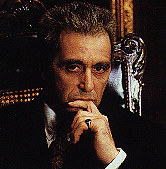
Eval for Al Pacino
The Godfather
  Managing Director, The Xcelerator
  Great at building new business
  Has a great network of connections

Slide 21
Skit for Al Pacino
Theme from Godfather
Comments
  Extremely aggressive. It’s like he would kill to get a deal.
  Always been a great closer
  He gives his customers a deal they can’t refuse.
  He runs a helluva organization.

Slide 22
Miller wakes Up Sequence
Miller wakes up
Jean and (Fred) are still arguing
Look to clock
Oxley says “ Cmon it is we have got a lot more work to do, this is the first name.”
Miller sighs and shakes his head. Then goes back to sleep.
The END.

