Slide 1
Putting the Energy into e-commerce™

Slide 2
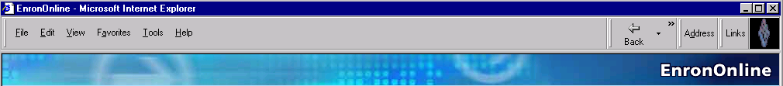
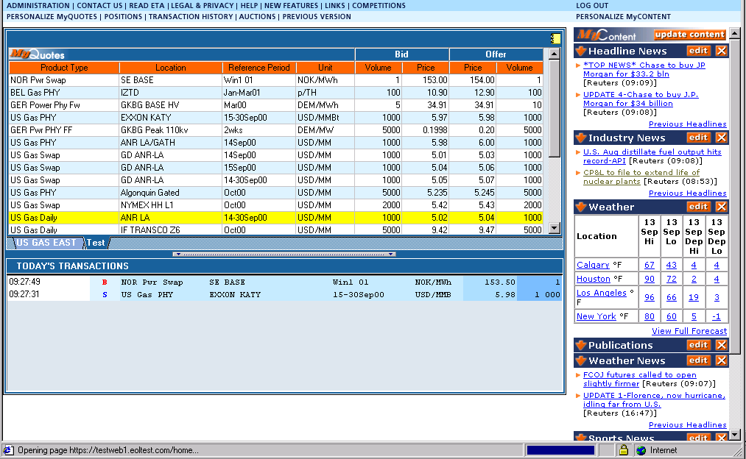
What is EnronOnline?
A Free, Internet-based, Global Transaction System Which Allows Counterparties to View Real Time Prices From Enron’s Traders and Transact Instantly Online

Slide 3
Benefits of EnronOnline
Free of Charge
Enron’s Best Prices
Real-Time Pricing Information
Faster than Traditional Channels
Access to Complementary Markets
and Product Information
Simple Access via the Internet
Easy to Use

Slide 4
Benefits of EnronOnline
Secure Execution
Market News and Quotes
Price Limit Orders
Industry Publications
Weather Insights
Advance Customization
Downloadable Transactions
Floating Windows

Slide 5
Markets Available on EnronOnline
Commodity Types
Argentine Natural Gas
Asian Crude & Products
Australian & Japanese
Weather
Australian Power
Austrian Power
Bandwidth
Belgian Natural Gas
Canadian Natural Gas
Credit Derivatives
Dutch Power
Emissions
European Coal
European Weather
German Power
International Coal
Japanese Aluminum
LPG
Nordic Power
Oil & Refined
Products
Petrochemicals
Plastics
Pulp & Paper
Sea Freight
Spanish Power
Swiss Power
UK Natural Gas
UK Power
US Gas Pipeline Capacity
US Metals
US Natural Gas
US Power
US Weather
Auctions
Emissions Auctions (US)
EnBank Virtual Storage
Auction (UK)
Pipeline Capacity Auction
Options
Continental Power Options
Nuclear Outage
Knock-In Call Options
Nordic Power Options

Slide 6
EnronOnline Prices on Other Electronic Trading Systems
Increase general customer access to Enron by providing additional transaction channels
Give Enron access to customers who prefer to transact via multilateral platforms
Leverage the proven technology, liquidity and Enron resources that together provide superior services to all Enron customers

Slide 7
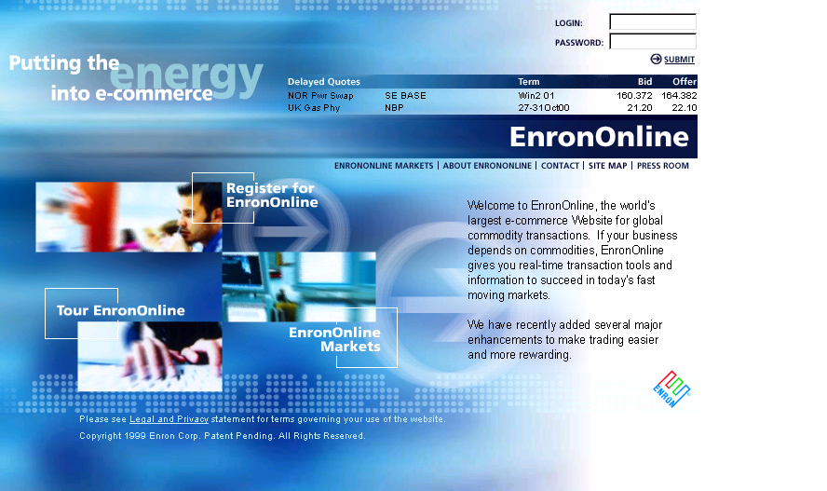
www.EnronOnline.com

Slide 8
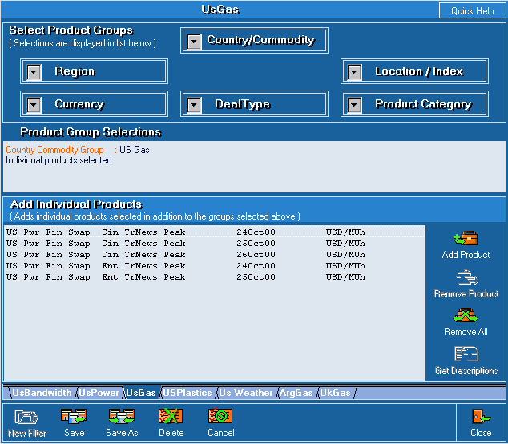
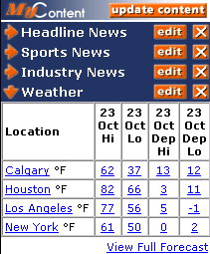
Customized Information
Customize your products and information according to your interests.
Commodity
Content

Slide 9
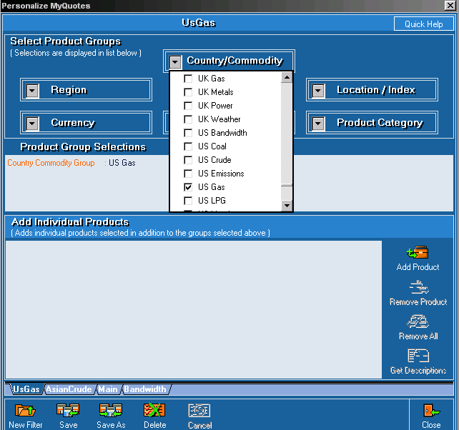
Customize Your Quotes
Customize by:
Country
Commodity
Region
Currency
Location/Index
Product Category
Deal Type

Slide 10
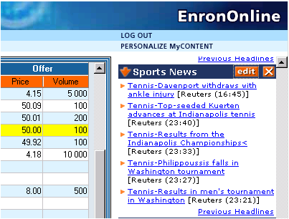
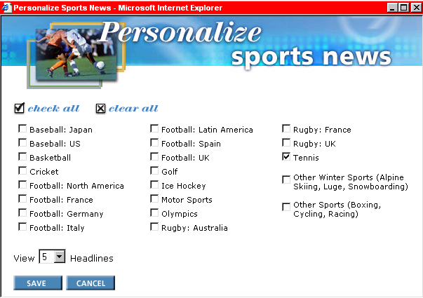
Customize Your Content

Slide 11
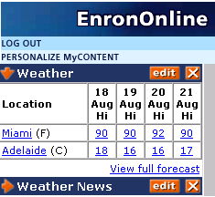
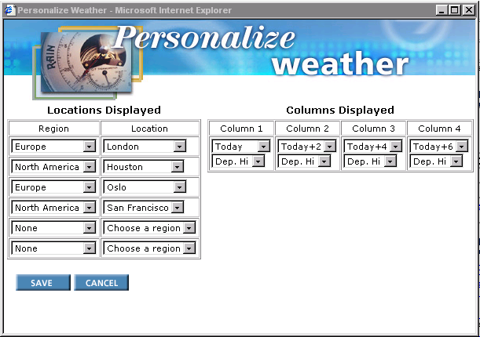
Customize Your Weather

Slide 12
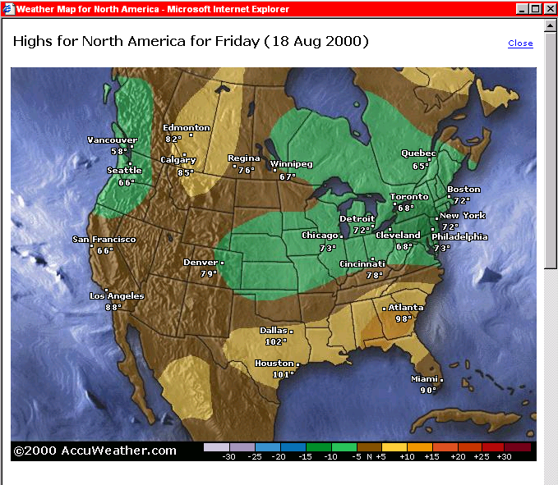
Weather Maps

Slide 13
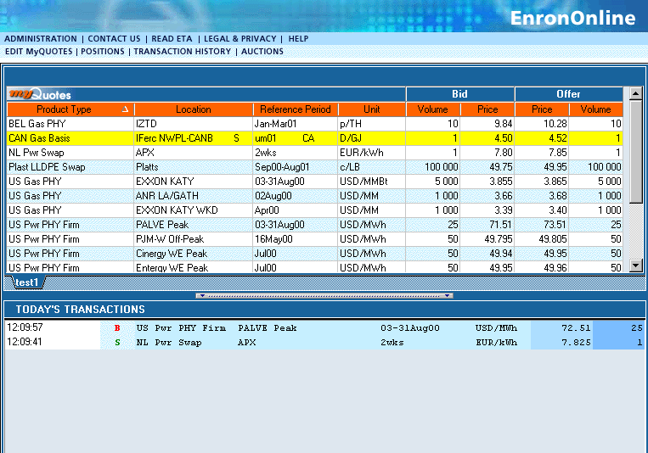
Quotes Page

Slide 14
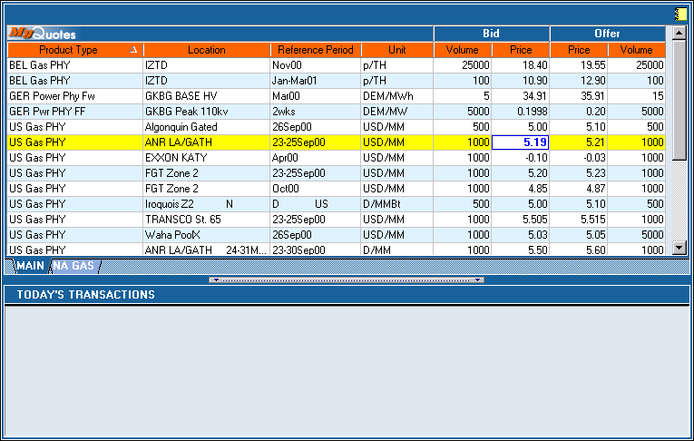
Click On Bid Or Offer Price

Slide 15
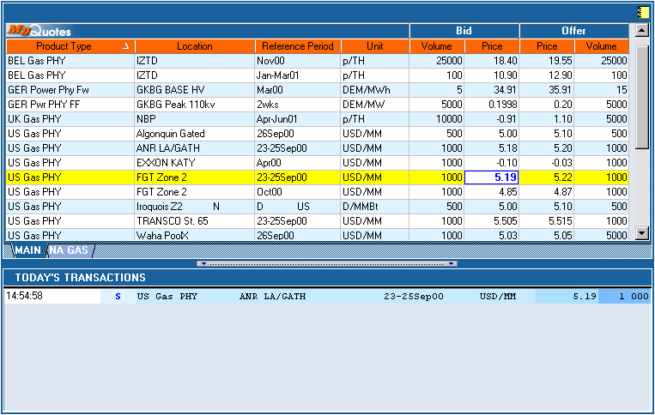
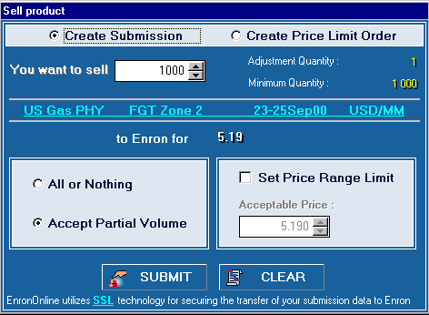
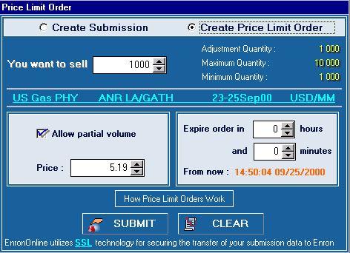
Submission Screen

Slide 16
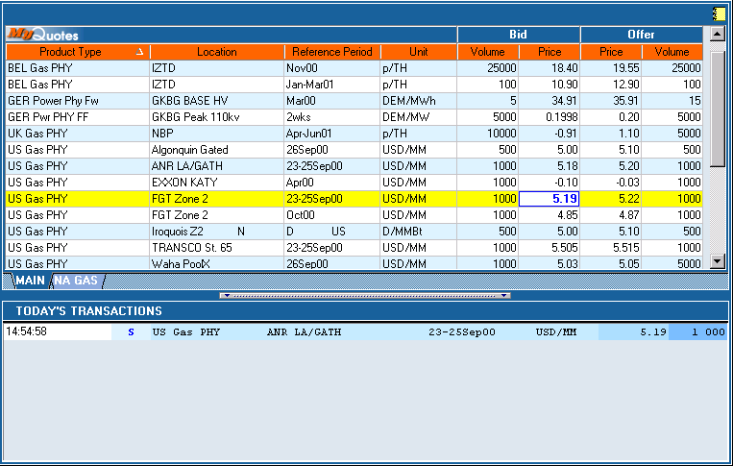
Successful Transaction

Slide 17
EnronOnline Statistics
Total Life to Date Transactions > 387,000
Average Daily Transactions > 2,600
Life to Date Notional Value of Transactions > $208 billion
Daily Notional Value Approximately $1.7 billion
Number of Products Offered: Approximately 1,100
Number of Currencies Traded in = 13
EnronOnline Version 1.0 Launch Date: November 29, 1999
EnronOnline Version 2.0 Launch Date: September 18, 2000

Slide 18
Utilization of EnronOnline
EnronOnline Transactions as a % of Total Transactions
Traditional Channels
* The percentage of transactions on EnronOnline
declined in 3Q00 due to the purchase of MG Metals.
EnronOnline

Slide 19
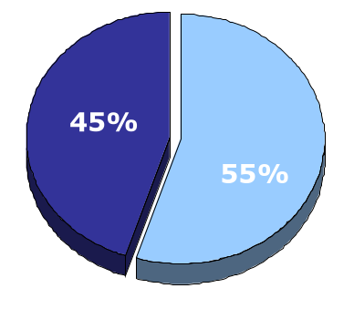
EnronOnline vs. Traditional Channels
Transactions
Daily % (30-day trailing average)
Traditional Channels
EnronOnline

Slide 20
Transactions via EnronOnline
Quarterly

Slide 21
E-Commerce Initiatives
Energy EnronOnline.com
Credit EnronCredit.com
Pulp & Paper ClickPaper.com
Metals MG plc (EnronOnline.com)
Financial Products DealBench.com
Energy Settlements CommodityLogic.com

Slide 22
Contact Us
If you have questions or problems regarding registration or using EnronOnline:
Call us:
The Americas: Asia and Australia All Other Regions:
+1 (713) 853-4357 (HELP) +61 2 9229 2300 +44 (0)20 7783 7783
Write us:
EnronOnline EnronOnline EnronOnline
P.O. Box 4656 Level 21 Enron House
1400 Smith Street 9 Castlereagh Street P.O.Box 29173
Houston, TX 77002 Sydney NSW 2000 London SW1X 7WB
USA Australia UK
E-Mail us at help@enrononline.com

Slide 23
Putting the Energy into e-commerce™

