Slide 1
Putting the Energy into e-commerce™

Slide 2
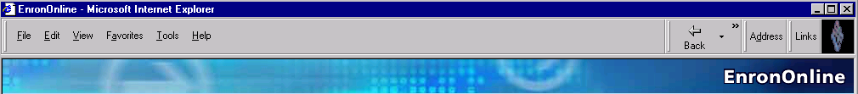
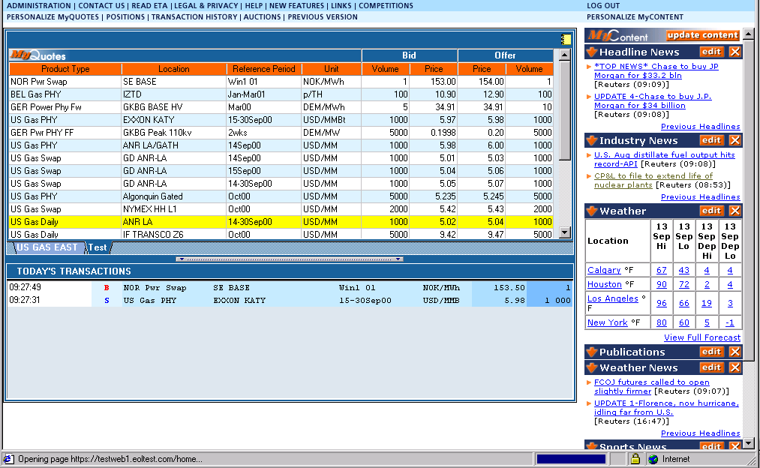
What is EnronOnline?
A Free, Internet-based, Global Transaction System Which Allows Counterparties to View Real Time Prices From Enron’s Traders and Transact Instantly Online

Slide 3
Benefits of EnronOnline
Free of charge
Enron’s Best Prices
Real-Time Pricing Information
Access to complementary markets and product information
Secure execution
Simple access via the internet
Easy to use

Slide 4
Benefits of EnronOnline
Fast and Secure Execution
Market News and Quotes
Price Limit Orders
Industry Publications
Weather Insights
Advance Customization
Downloadable Transactions
Floating Windows

Slide 5
EnronOnline Launch Schedule
November 1999 US & Canadian Natural Gas
December 1999 US Power
Nordic Power
Plastics
Pulp & Paper
Coal
January 2000 Belgian Natural Gas Spanish Power
Emissions Swiss Power
German Power UK Natural Gas
LPG UK Power
Oil & Refined Products US Weather
Petrochemicals
February 2000 EnBank Virtual Storage Auction (UK)
European Weather

Slide 6
Enron’s global wholesale transaction business ...moves online
March 2000 Australian Power
Credit Derivatives
Dutch Power
Emissions Auctions (US)
April 2000 Austrian Power
May 2000 Bandwidth
Asian Crude & Products
June 2000 Pipeline Capacity Auction
July 2000 US Metals
International Coal
Continental Power Options
Nuclear Outage Knock-In Call Options
Australian and Japanese Weather
Sea Freight

Slide 7
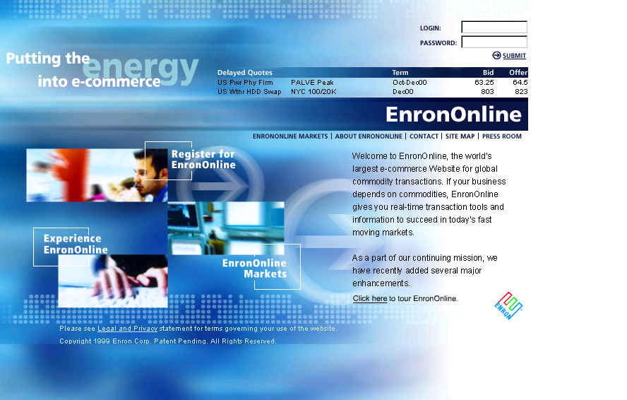
www.EnronOnline.com

Slide 8
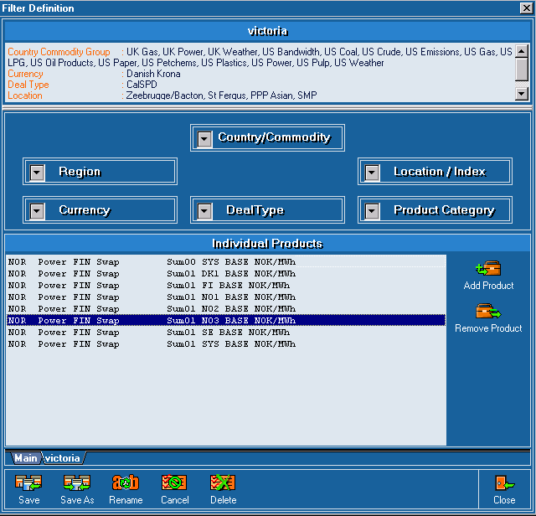
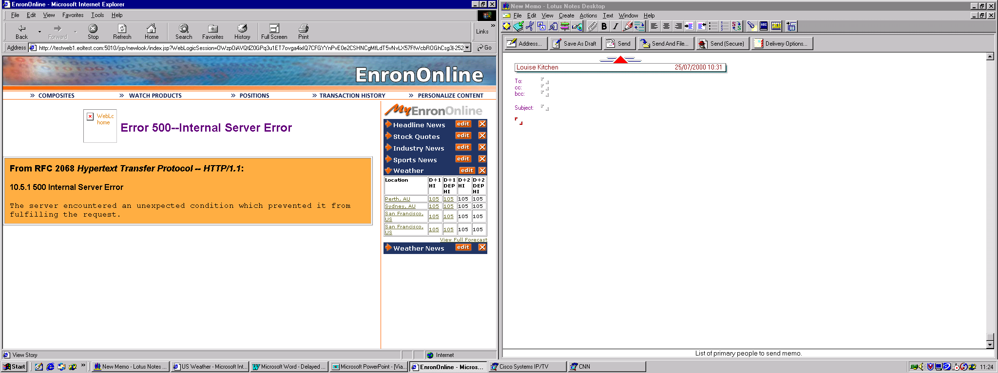
Customized Information
Customize your products and information according to your interests.
Commodity
Content

Slide 9
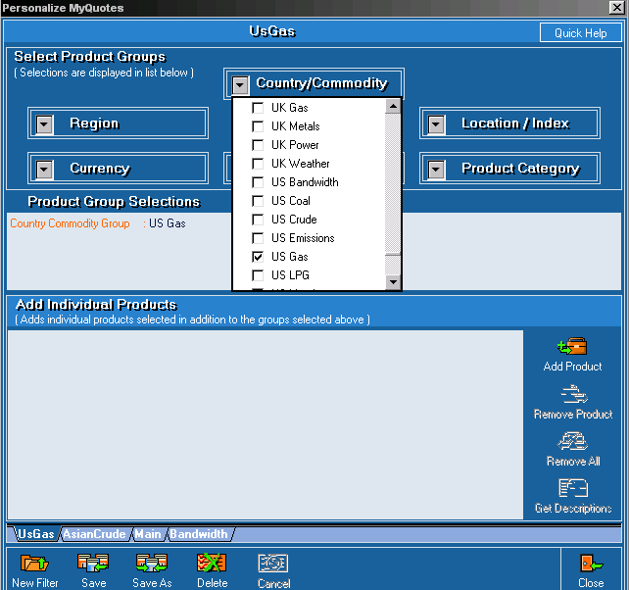
Customize your Quotes
Customize by:
Country
Commodity
Region
Currency
Location/Index
Product category
Deal Type

Slide 10
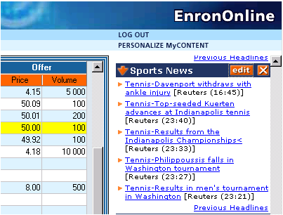
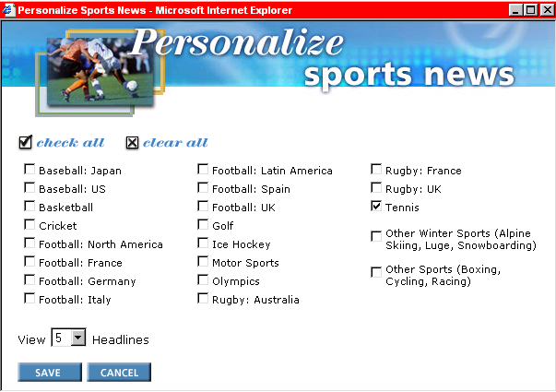
Customize your Content

Slide 11
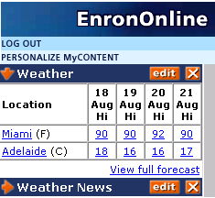
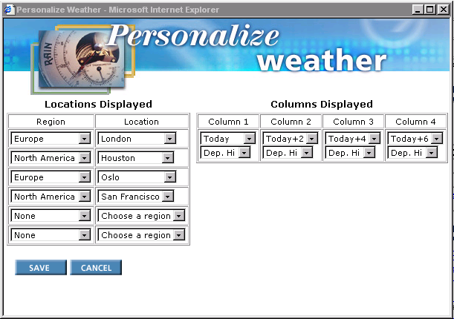
Customize your Weather

Slide 12
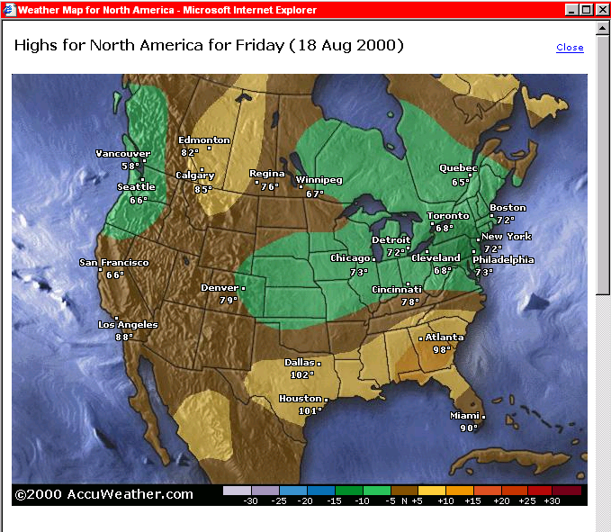
Weather Maps

Slide 13
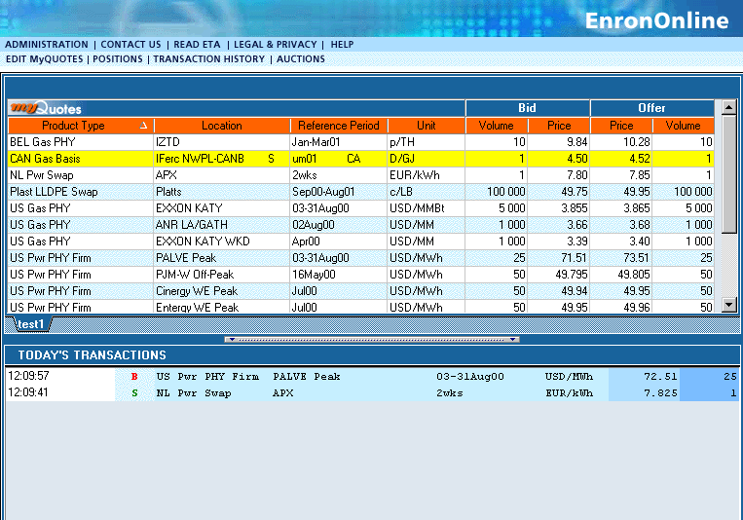
Quotes Page

Slide 14
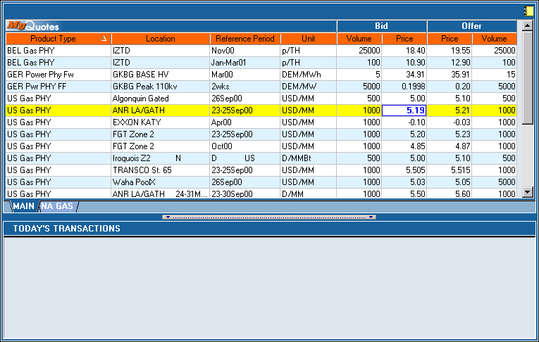
Click On Bid Or Offer Price

Slide 15
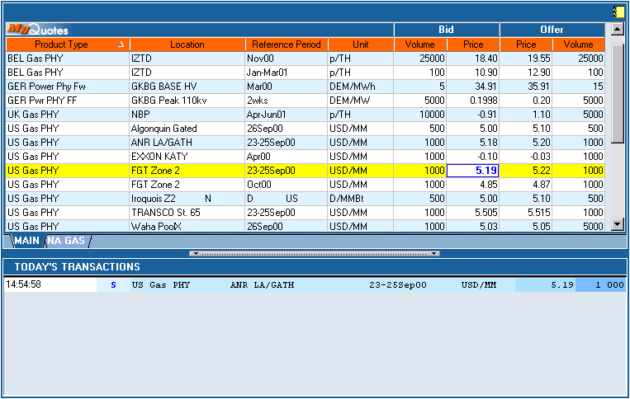
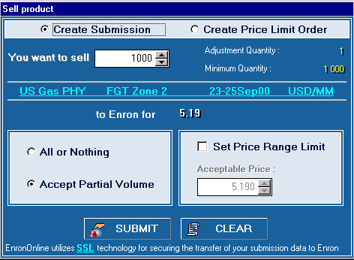
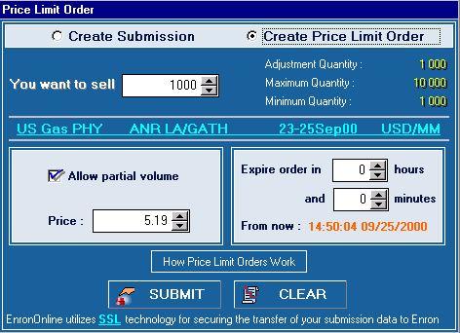
Submission Screen

Slide 16
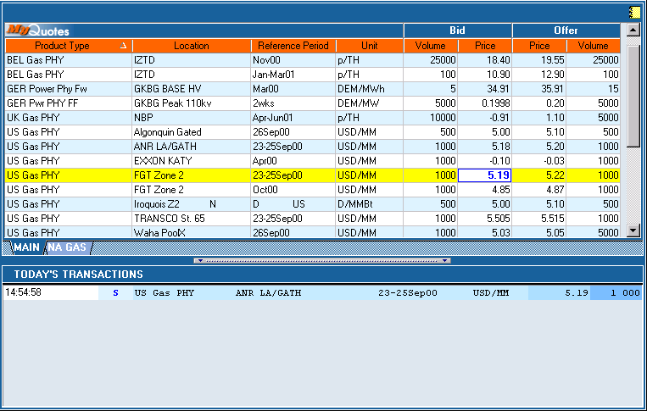
Successful Transaction

Slide 17
EnronOnline Statistics
Total Life to Date Transactions > 343,000
Average Daily Transactions > 2,300
Life to Date Notional Value of Transactions > $178 billion
Daily Notional Value Approximately $1 billion
Number of Products Offered: Approximately 1000
Number of Currencies Traded in = 13
Development Time: Approximately 7 Months
Launch Date: November 29, 1999
EnronOnline Version 2.0 Launch Date: September 18, 2000

Slide 18
Utilization of EnronOnline
(% of Transactions)
Traditional Channels
EnronOnline

Slide 19
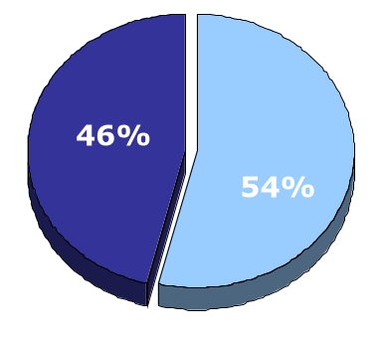
EnronOnline vs. Traditional Channels
Transactions
(Month to Date)
Traditional Channels
EnronOnline

Slide 20
Transactions via EnronOnline
(Weekly)

Slide 21
eCommerce Business Comparison
Value of Goods
(Millions)
Business To Consumer (B2C)
eBay
Amazon.com
Dell.com
$ 2,650
1,600
10,190
1999 Data*
Business To Business (B2B)
FreeMarkets
Cisco
Intel
Altrade
$ 1,400
9,480
10,500
9,000
2000 to Date **
EnronOnline
> $ 178,000
* Est. 1999 Annual Results
** Year to Date Notional Value of Transactions

Slide 22
Contact Us
If you have questions or problems regarding registration or using EnronOnline:
Call us:
The Americas: Asia and Australia All Other Regions:
+1 (713) 853-4357 (HELP) +61 2 9229 2300 +44 (0)20 7783 7783
Write us:
EnronOnline EnronOnline EnronOnline
P.O. Box 4656 Level 21 Enron House
1400 Smith Street 9 Castlereagh Street P.O.Box 29173
Houston, TX 77002 Sydney NSW 2000 London SW1X 7WB
USA Australia UK
E-Mail us at help@enrononline.com

Slide 23
Putting the Energy into e-commerce™

