Slide 1
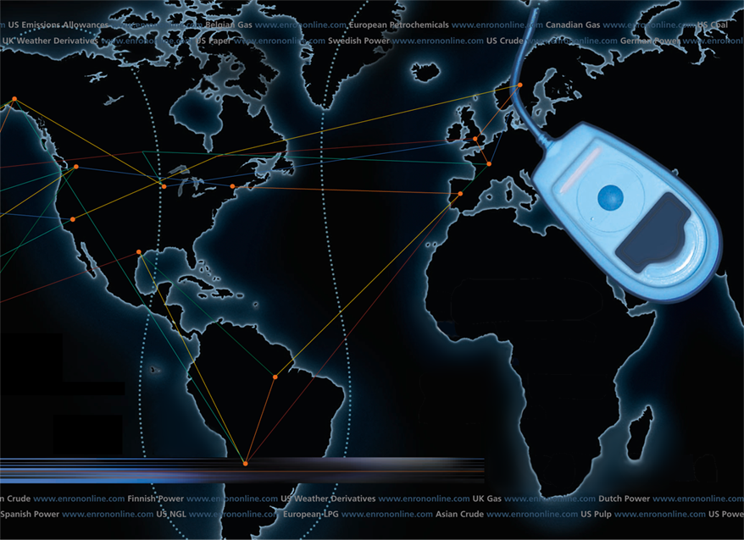
Putting the Energy into e-commerce
EnronOnline
TM
TM

Slide 2
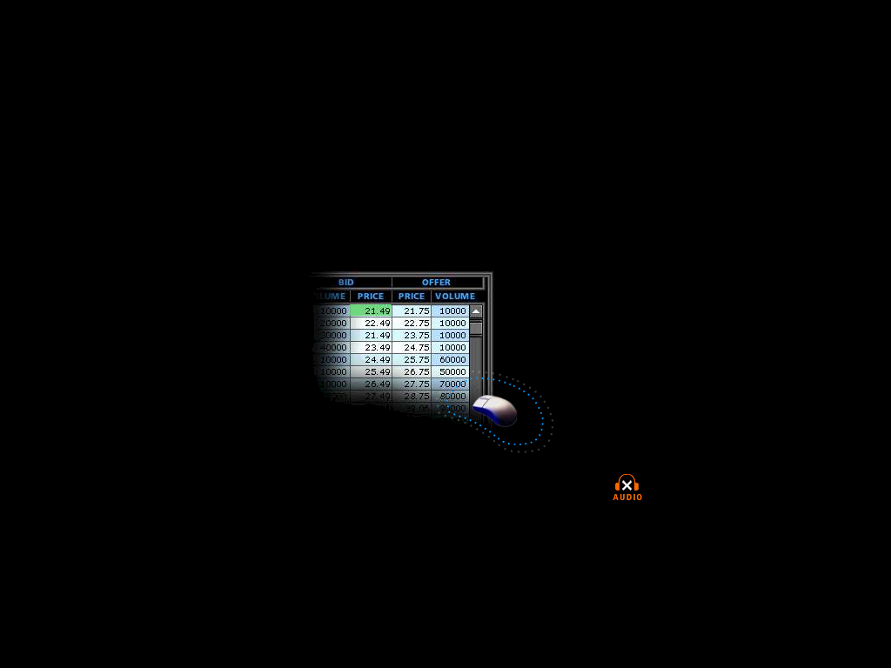
What is EnronOnline?
A Free, Internet-based, Global Transaction System Which Allows Counterparties to View Real Time Prices From Enron’s Traders and Transact Instantly Online
click & transact

Slide 3
Benefits of EnronOnline
Free of charge
Real-Time Pricing Information
Access to complementary markets and product information
Simple access via the Internet
Easy to use
Fast and Secure Execution
Enron’s Best Prices

Slide 4

EnronOnline Launch Schedule
November 1999 US & Canadian Natural Gas
December 1999 US Power
Nordic Power
Plastics
Pulp & Paper
Coal
January 2000 Belgian Natural Gas
Emissions
German Power
LPG
Oil & Refined Products
Petrochemicals
Spanish Power
Swiss Power
UK Natural Gas
UK Power
US Weather
Putting the Energy into e-commerceTM

Slide 5
Enron’s global wholesale transaction business …………..moves online
February 2000 EnBank Virtual Storage Auction (UK)
European Weather
March 2000 Australian Power
Credit Derivatives
Dutch Power
Emissions Auctions (US)
April 2000 Austrian Power
May 2000 Bandwidth
European Coal
Asian Crude & Products
June 2000 Pipeline Capacity Auction (US)
July 2000 US Metals
International Coal
Nordic Power Options
Nuclear Outage Knock-In Call Options
Australian and Japanese Weather

Slide 6
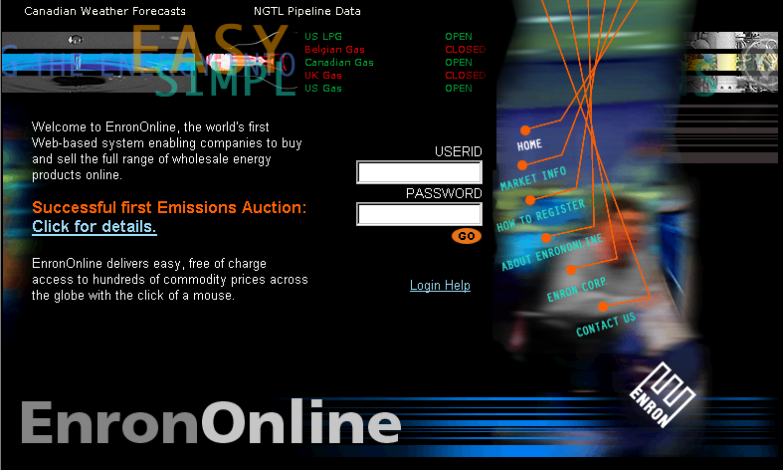
www.EnronOnline.com
New User
*******

Slide 7
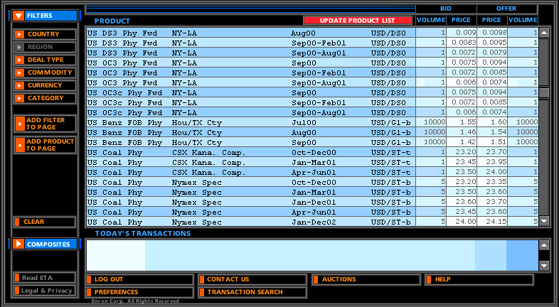
Quotes Page

Slide 8
Click on Bid or Offer Price

Slide 9
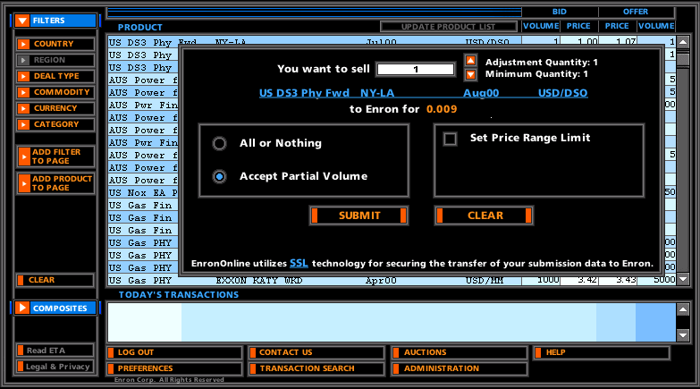
Submission Screen

Slide 10
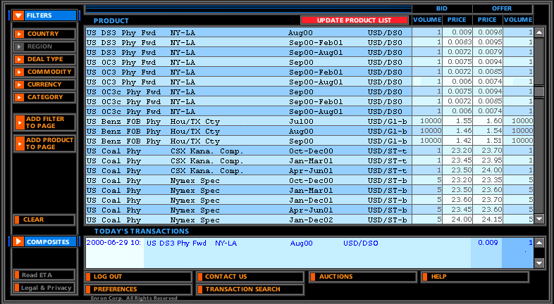
Successful Transaction

Slide 11
EnronOnline Statistics
Total Life to Date Transactions > 215,000
Average Daily Transactions > 2,000
Life to Date Notional Value of Transactions > $102 billion
Daily Notional Value Approximately $1 billion
Number of Products Offered - Approximately 820
Number of Currencies Traded in = 13
Development Time Approximately 7 Months
Launch Date November 29, 1999

Slide 12
Utilization of EnronOnline
(% of Transactions)
Traditional Channels
EnronOnline

Slide 13
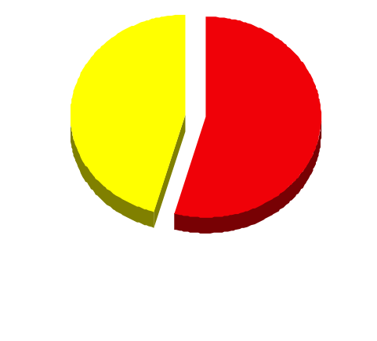
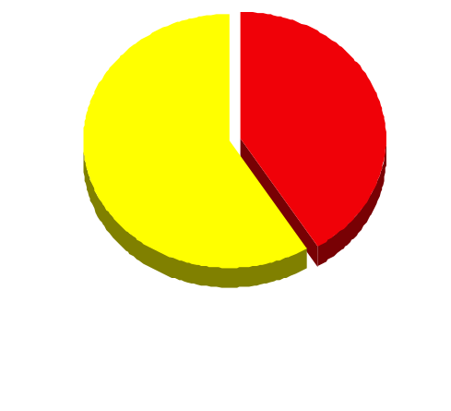
EnronOnline Versus Traditional Channels (Currently)
Volume
Transactions
45.5%
59%
41%
54.5%
EnronOnline
Traditional Channels

Slide 14
Transactions via EnronOnline (Weekly)

Slide 15
eCommerce Business Comparison
Value of Goods*
Value of Goods
(Millions)
Business To Consumer (B2C)
eBay
Amazon.com
Dell.com
$ 2,650
1,600
10,190
1999 Data*
Business To Business (B2B)
FreeMarkets
Cisco
Intel
Altrade
$ 1,400
9,480
10,500
9,000
2000 to Date **
EnronOnline
> $ 100,000
* Est. 1999 Annual Results
** Year to Date Notional Value of Transactions

Slide 16
Contact Us
If you have questions or problems regarding registration or using EnronOnline:
Call us:
The Americas: All Other Regions:
+1 (713) 853-4357 (HELP) +44 (0)20 7783 7783
Write us:
EnronOnline EnronOnline
P.O. Box 4656 Enron House
1400 Smith Street P.O.Box 29173
Houston, TX 77002 London SW1X 7WB
UK
E-Mail us at help@enrononline.com

Slide 17
Putting the Energy into e-commerceTM

