Slide 1
Putting the Energy into e-commerce™

Slide 2
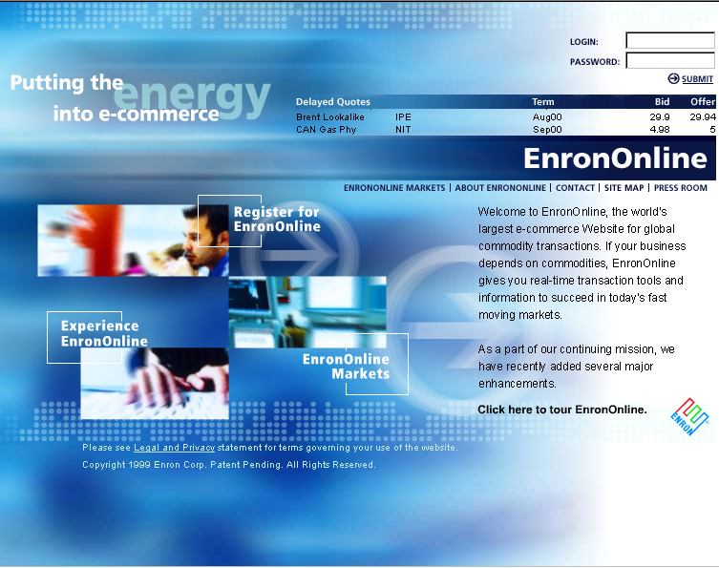
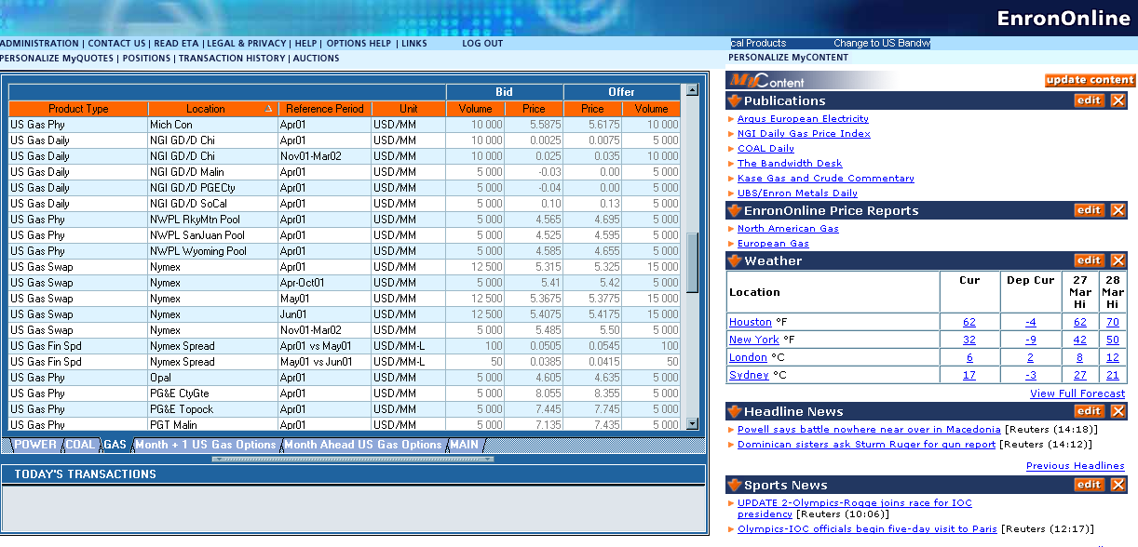
What is EnronOnline?
The Free, Internet-based, Global Transaction System Which Allows Counterparties to View Real Time Prices From Enron’s Traders and Transact Instantly Online

Slide 3
Benefits of EnronOnline
Free of Charge
Enron’s Best Prices
Real-Time Pricing Information
Faster than Traditional Channels
Access to Complementary Markets and Product Information
Simple Access via the Internet
Easy to Use

Slide 4
Benefits of EnronOnline
Secure Execution
Market News and Quotes
Price Limit Orders
Options
Industry Publications
Weather Insights
Advance Customization
Floating Windows

Slide 5
Markets Available on EnronOnline
Commodity Types
Argentine Natural Gas
Asian Crude & Products
Asian Metals
Australian & Japanese Weather
Australian Power
Austrian Power
Bandwidth
Belgian Natural Gas
Canadian Natural Gas
Canadian Power
Credit Derivatives
Dutch Power
Dutch Aluminium
Emissions
European Coal
European Weather
German Power
International Coal
Japanese Aluminum
LME Metals Contracts
LPG
Nordic Power
Oil & Refined Products
Petrochemicals
Plastics
Pulp & Paper
Sea Freight
Spanish Power
Swiss Power
UK Metals
UK Metal Spreads
UK Natural Gas
UK Power
US Gas Pipeline Capacity
US Gas Spreads
US Lumber
US Metals
US Natural Gas
US Power
US Steel
US Weather

Slide 6
Markets Available on EnronOnline
Auctions
Emissions Auctions (US)
EnBank Virtual Storage Auction (UK)
Pipeline Capacity Auction
Options
Continental Power Options
Nuclear Outage Knock-In Call Options
Nordic Power Options
UK & US Gas Options

Slide 7
EnronOnline Prices on Other Electronic Trading Systems
Increase general customer access to Enron by providing additional transaction channels
Give Enron access to customers who prefer to transact via multilateral platforms
Leverage the proven technology, liquidity and Enron resources that together provide superior services to all Enron customers

Slide 8
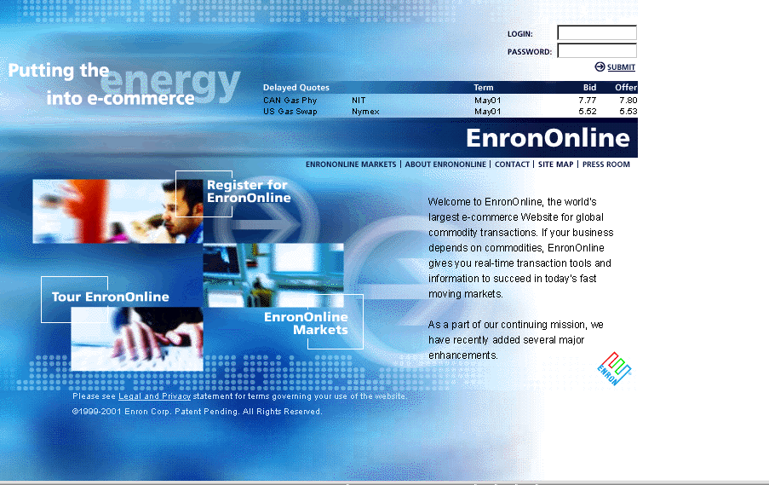
www.EnronOnline.com

Slide 9
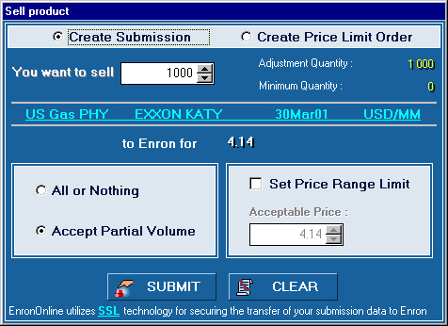




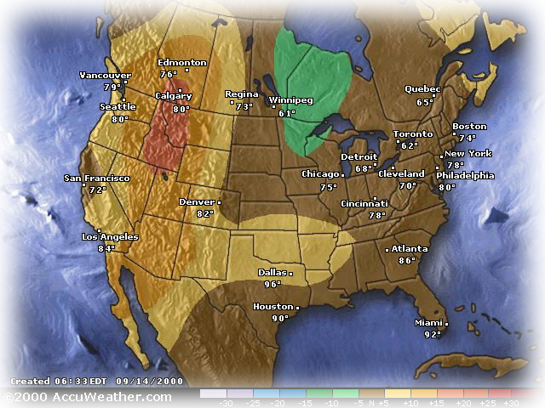




EnronOnline Features
Valuable Transaction Functionality
1600 Products Available (bids and offers)
Instantaneous Pricing
Options
Limit Orders
Spreads
24 x 7, 365 days a year
Attractive Features
Specialized Access and Content
Customers Choose From 40 Different Entry Methods (eg. www. Weather-Risk.com, www.EnronSteel.com)
Dynamically Updated Information Direct from Enron’s Marketers

Slide 10
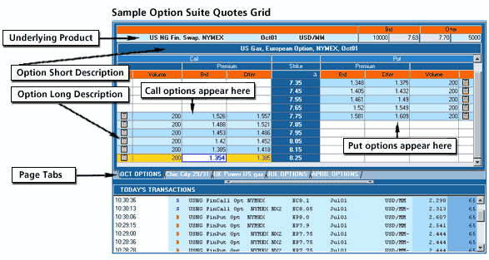
Options

Slide 11
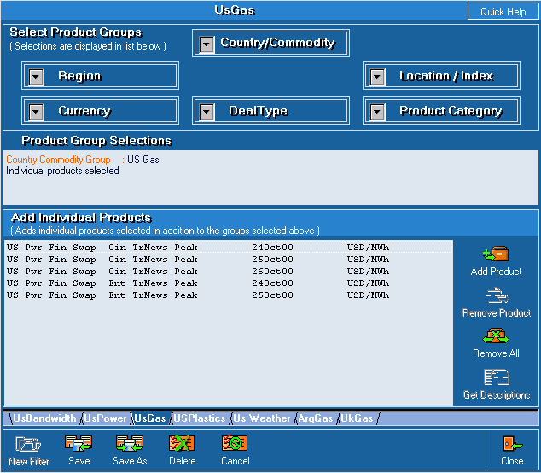
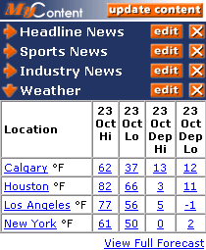
Customized Information
Customize your products and information according to your interests.
Commodity
Content

Slide 12
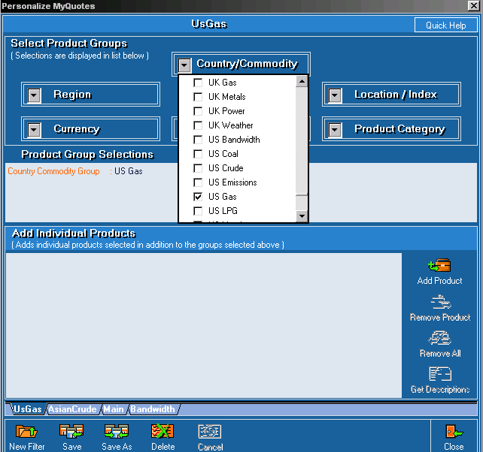
Customize Your Quotes
Customize by:
Country
Commodity
Region
Currency
Location/Index
Product Category
Deal Type

Slide 13
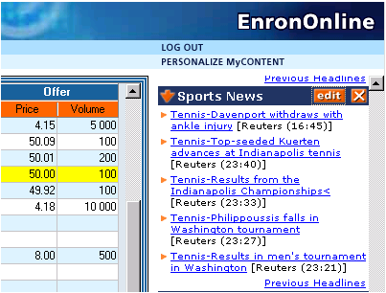
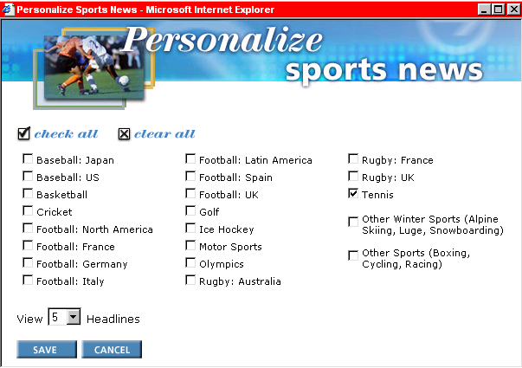
Customize Your Content

Slide 14
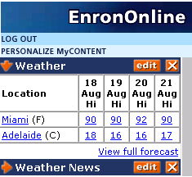
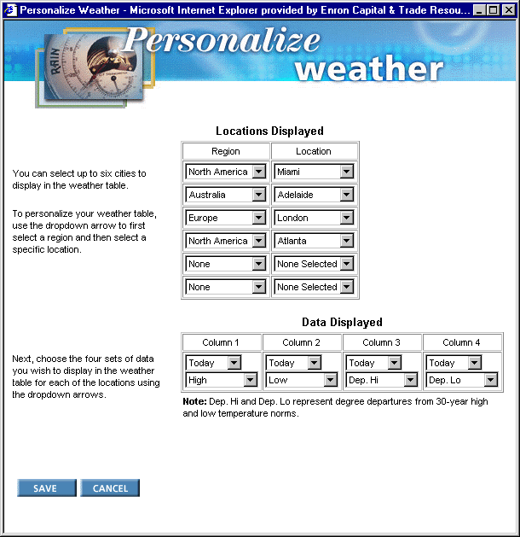
Customize Your Weather

Slide 15
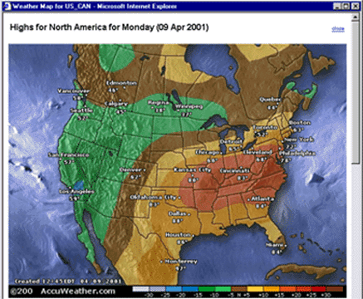
Weather Maps

Slide 16
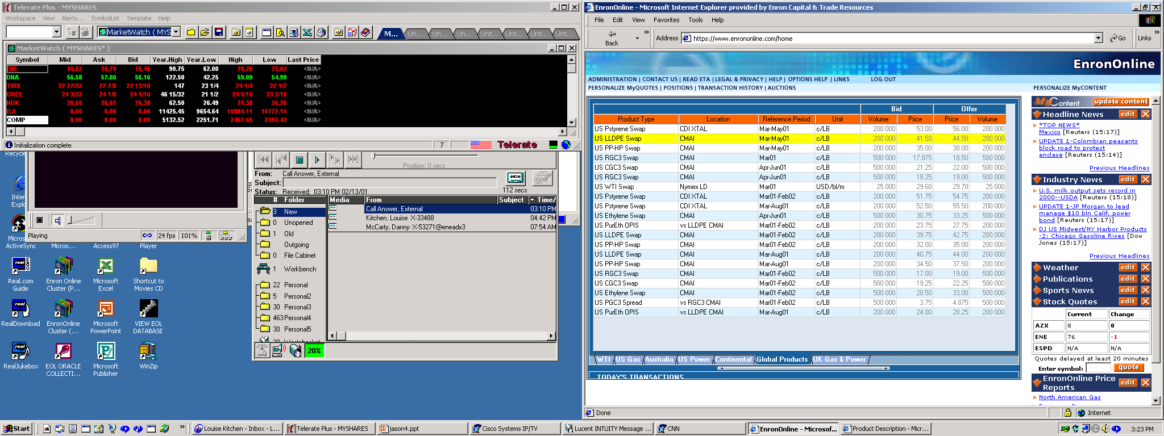
Contract & Description

Slide 17
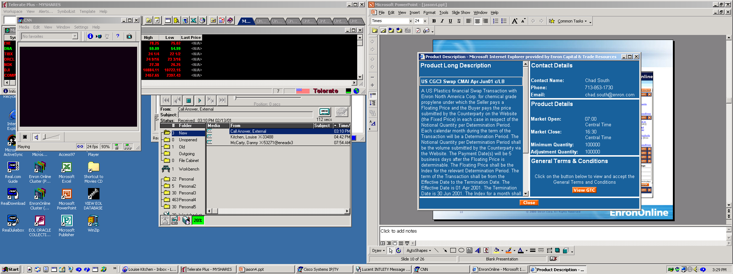
Contract & Description

Slide 18
Contract & Description

Slide 19
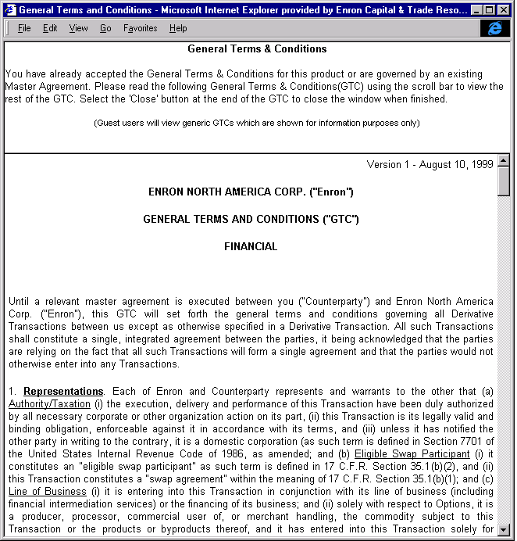
Contract & Description

Slide 20
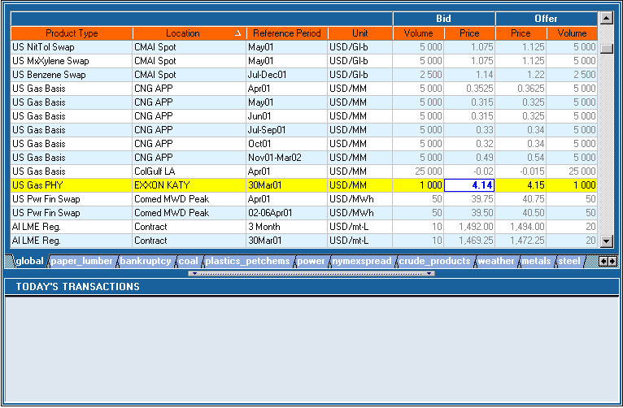
Click On Bid Or Offer Price

Slide 21
Click On Bid Or Offer Price

Slide 22
Submission Screen

Slide 23
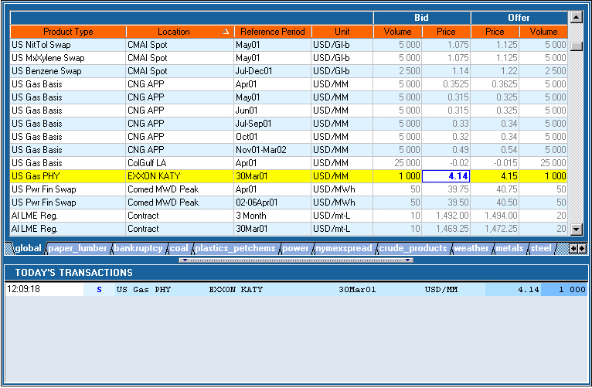
Successful Transaction

Slide 24
Click On Bid Or Offer Price - Limit Orders
4.14

Slide 25
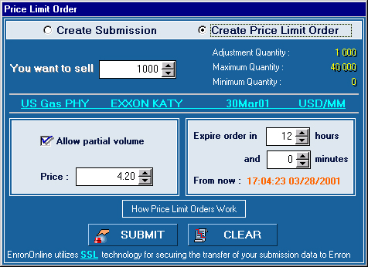
Submission Screen

Slide 26
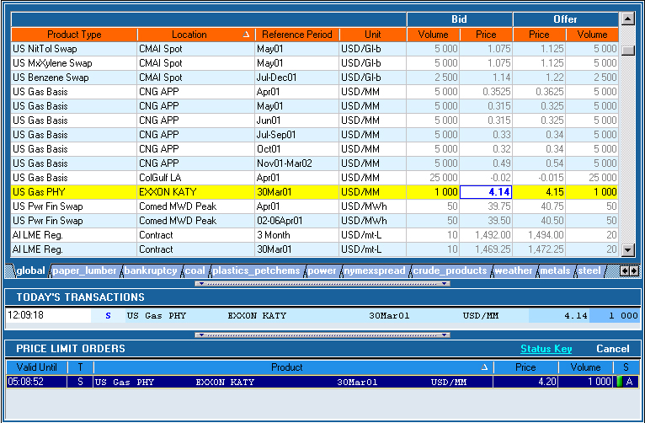
Successful Transaction

Slide 27
Successful Transaction
4.20
4.21
05:06:02
4. 20
√

Slide 28
EnronOnline Statistics
Total Life to Date Transactions >1,190,000
Average Daily Transactions > 5,600
Life to Date Notional Value of Transactions > $690 billion
Daily Notional Value Approximately $2.7 billion
Number of Products Offered: Approximately 1,600
Number of Currencies Traded in = 15
EnronOnline Version 1.0 Launch Date: November 29, 1999
EnronOnline Version 2.0 Launch Date: September 18, 2000

Slide 29
Utilization of EnronOnline
EnronOnline Transactions as a % of Total Transactions
Traditional Channels
* The percentage of transactions on EnronOnline declined in 3Q00 due to the purchase of MG Metals.
EnronOnline

Slide 30
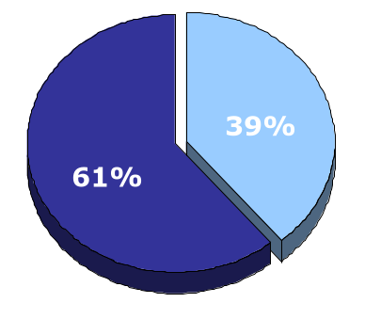
EnronOnline vs. Traditional Channels
Transactions
Daily % (30-day trailing average)
Traditional Channels
EnronOnline

Slide 31
Transactions via EnronOnline
Quarterly

Slide 32
Other e-Commerce Initiatives
EnronCredit.com
Credit Products
ClickPaper.com
Pulp, Paper & Lumber
DealBench.com
Auctions/RFQs
M&As
Syndications
CommodityLogic.com
Settlements and Back Office

Slide 33
Contact Us
If you have questions or problems regarding registration or using EnronOnline:
Call us:
The Americas: Asia and Australia All Other Regions:
+1 (713) 853-4357 (HELP) +61 2 9229 2300 +44 (0)20 7783 7783
Write us:
EnronOnline EnronOnline EnronOnline
P.O. Box 4656 Level 21 Enron House
1400 Smith Street 9 Castlereagh Street P.O.Box 29173
Houston, TX 77002 Sydney NSW 2000 London SW1X 7WB
USA Australia UK
E-Mail us at help@enrononline.com

