Slide 1

Gas Fundamentals
In the Pacific Northwest
Presentation by Dave Fuller
Proprietary and Confidential 9/01

Slide 2
PNW Gas Issues
Supply - no local production
Demand – from strong growth to reduction
Storage – limited storage capacity
Pipelines - pipes fully subscribed
Gas-fired generation – is the dream over
California – proximity creates uncertainty
Weather – forecasts move markets
Prices – aforementioned issues drive volatility

Slide 3
PNW Supply Summary

Slide 4
Gas Flows in the West
Northwest
Alliance
Northern Border
PGT
WBI
Northwest
Big Horn Basin
Powder River Basin
To
Chicago
Wind River Basin
Green River Basin
KN
CIG
Overthrust
WIC
Trailblazer
Uinta Basin
Piceance Basin
DJ Basin
NGPL
Kern
Paradox Basin
Northwest
CIG
Raton Basin
El Paso
San Juan Basin
= Glenrock
= Cheyenne/Rockport
= OPAL
El Paso
Permian Basin

Slide 5
Canadian Rig Counts are Up
Record Levels of Canadian Activity
Recent data indicates 328 active rigs at the end of August
This is off 43% from the year-to-date high of 539 rigs in January 2001
Similar constraints as those found in the U.S. market

Slide 6
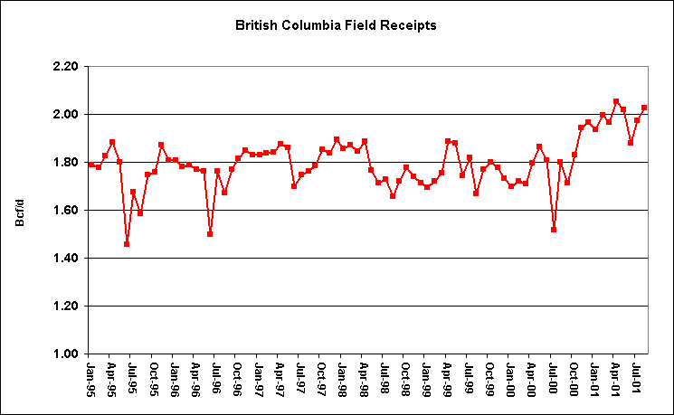
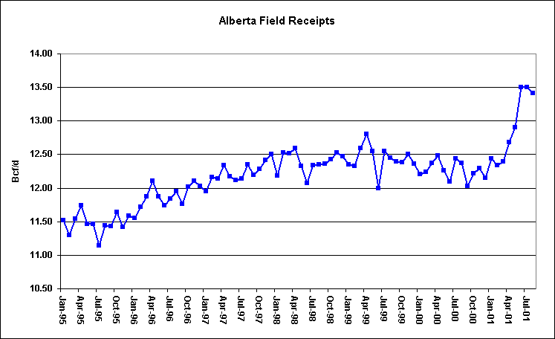
Canadian Field Receipts are Up

Slide 7
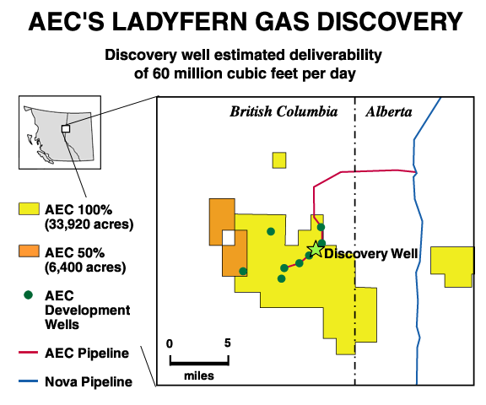
Ladyfern May Represent a Significant
Supply Addition
A mosquito-ridden bog in remote northeastern British Columbia has become one of Canada's richest finds of the past two decades
Canadian Natural said test results from its recent Ladyfern well showed it had the capability of producing 100 million cubic feet of gas a day, rivaling some finds in the deep water Gulf of Mexico
Ladyfern is expected to deliver between 100 million and 150 million cubic feet per day during the last half of 2001.

Slide 8
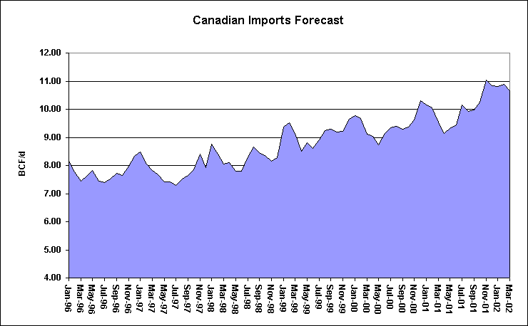
Canadian Imports are Strong and Growing
Note: The bulk of these imports are
going to the Midwest and Northeast.
Increases come largely from new
production not cannibalization of
existing production.

Slide 9
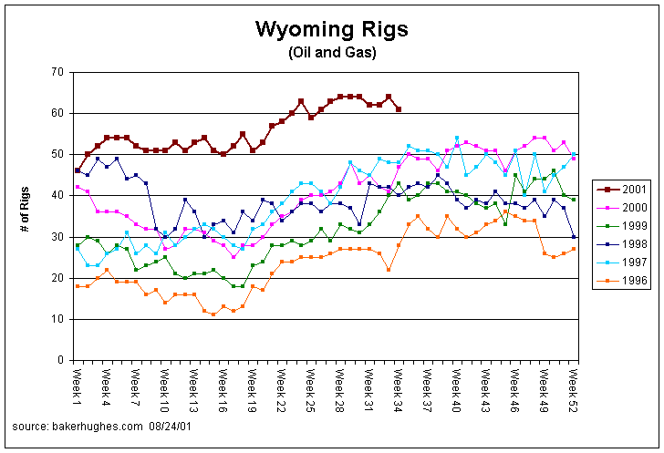
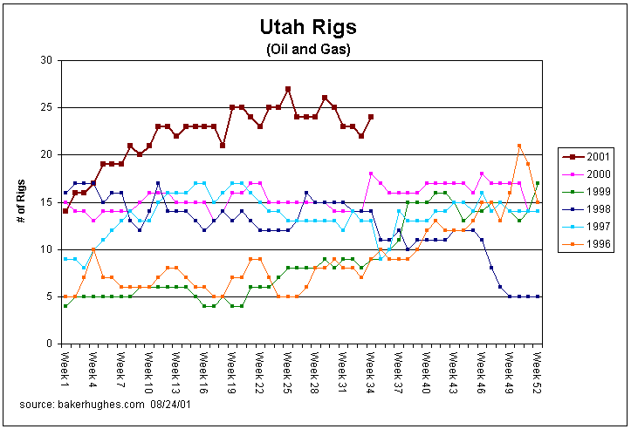
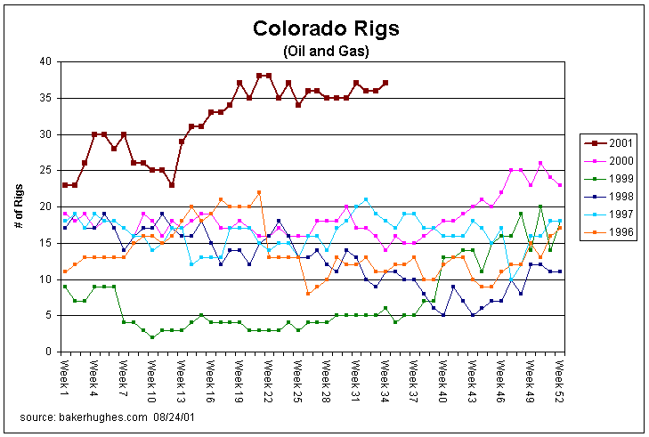
Rockies Rig Counts are Up Too
Drilling is continuing at the highest pace in over a decade despite the infrastructure constraints that have appeared over the last year.
Note: Powder River Basin CBM rigs are excluded from the Baker-Hughes Wyoming rig count due the shallow nature of the CBM wells
<number>

Slide 10
Rockies Receipts are Flat

Slide 11
Coal Bed Methane Play will Increase Rockies Production
Key Features
- On pace to drill 4,500 wells per year, average of 11 wells per day
- Average production per well = 125 Mcf/d
- No production decline curve has been established, but industry is working on one
- CBM play has an estimated life span of 35 years, with each individual well lasting between
5-10 years
- Peak daily production estimated to be 2 Bcf/d
Possible Delays to Future Development
- Water discharge permits
- BLM EIS, These studies are on going and continually analyze the cumulative effect on the
environment

Slide 12
Gas Demand

Slide 13
Natural Gas Demand in the US
Source EIA

Slide 14
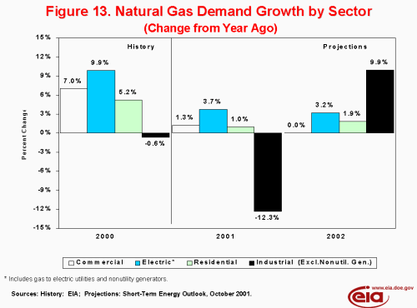
Negative Industrial Demand Growth is Real

Slide 15
Total US Natural Gas Demand
US Demand by Month
Total Demand
Industrial Demand
Electric Utility Demand
Source EIA

Slide 16
Power Demand Response in the PNW
Percent Change in Electricity Demand
As of June 01
Source: Northwest Power Pool

Slide 17
Gas Storage

Slide 18
The US Storage Picture
The Rapid Pace Continues
Strong storage levels reflective of weak fundamentals
Unprecedented level of injections have been a critical factor in market declines
As of September 2, the year-over-year storage surplus was 386 Bcf
8 weeks left in injection season
High probability of reaching 11/5/98 storage high of 3,094 Bcf

Slide 19
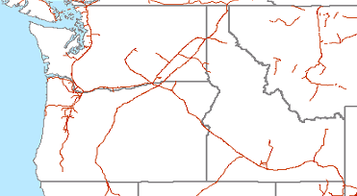
Limited Storage in the PNW
Jackson Prairie
Mist
Clay Basin
LNG
UG Storage

Slide 20
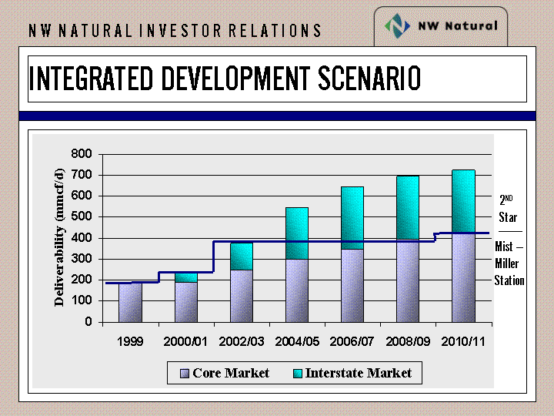
NWN Building Merchant Storage at Mist
Mist Expansion Scenario

Slide 21
Pipeline Infrastructure

Slide 22
PGT
Conduit for Canadian gas: Kingsgate
(2.3 Bcf/d) to Malin (1.9 Bcf/d)
Key delivery points: Stanfield and Malin
Tremendous growth in generation upstream of Malin (Hermiston, Coyote Springs, Rathdrum)
No storage – balancing issues, volumetric OBA’s
Mileage based rates and fuel
Vintage capacity holds tremendous value relative to new build

Slide 23
2002 PGT Expansion
211 MMcf/d to Malin with Nov. 2002 start
Newport Generation: 52 years, 175 MMcf/d
Calpine: 40 years, 35.8 MMcf/d annual plus 20.4 MMcf/d winter
Rolled in rates and incremental fuel: 3.5% vs. 6.0%
Probable fuel tracker, method to be determined
Shippers matched on upstream capacity

Slide 24
2003 PGT Expansion
230 MMcf/d at Kingsgate: 130 MMcf/d at Malin, 100 MMcf/d at Stanfield
November 2003 start
Incremental rates of $.445 to Malin, $.20 to Stanfield and ?% fuel
2003 expansion shippers given priority on upstream Canadian pipeline expansions (move to front of queue)
2004 expansion shippers subject to NPV calculation on Canadian pipes based on bids – contentious issue!
2004 expansion competes with Ruby

Slide 25
Washington Lateral
Lateral targeted to cross central Washington to access generation growth along path to Seattle and I-5 corridor
Incremental mileage based lateral fee
300 – 400 MMcf/d with Nov. 2004 start
Need Puget as an anchor

Slide 26
Northwest Pipeline
2.9 Bcf/d pipeline to the Pacific Northwest sourced by Canadian gas at Sumas, Stanfield and the Rockies
Original firm obligations based upon 250 MMcf/d displacement (Pan Alberta)
Postage stamp rates and fuel

Slide 27
Issues/Opportunities
Growth in generation load on I-5 corridor has created race between PGT and NWPL
Capacity extremely tight
Cumbersome displacement OFO’s and penalties until Nov. 2003 displacement fixes

Slide 28
NWPL Expansions
Evergreen: 278 MMcf/d from Sumas to I-5 generation (Duke, Idaho Power, Tractabel, Engage, Transalta) with June 2003 start.
- only 254 MMcf/d incremental capacity
- $.41/mmbtu + incremental fuel (not public)
Nov. 2003 Displacement fixes: 175 MMcf/d Rockies to Stanfield, 50 MMcf/d Gorge to I-5
- settlement agreement to small rate increase
Expect Fall open seasons for Evergreen II and incremental Gorge Crossing

Slide 29
Gas Fired Generation

Slide 30
New Power Generation
Is the dream over for developers?
Big rush to build
12-month boom
Power prices have crashed
Market heat rates are down
Significant demand response
Supply/Demand balance equilibrating
$

Slide 31
Summary of New Generation in the West

Slide 32
Prices at Mid-C Have Crashed

Slide 33
Market Heat Rates have
Come Off
Note: Oct 01 market heat rate
was 12,700 (peak) and 11,100
on 9/4/01.

Slide 34
PNW Hydro Power – Why Didn’t the Lights Go Out
The hydro shortage is real: Dams are at 55% of capacity second worst year on record
Storage for next year is way behind
Load bottoms out in September and builds through the winter
Load shedding averted the widely forecast crisis
1800 MW of aluminum smelting shut off
Seattle and Tacoma raised rate 45% before summer
No meaningful forecasts until December

Slide 35
The Hydro Power Shortage
Is Real… and Ongoing
Pacific Northwest Hydro Generation
MW
Forecast

Slide 36
California Update

Slide 37
Current Events in California
PG&E in bankruptcy and will be largely implemented by Federal Bankruptcy judge and in the courts.
SCE has deal with state PUC. Requires financing, details to be implemented at state PUC.
Rate increases of 40-80% or more for C&I customers
Current West-wide mitigation caps prices at $91.87, but markets are clearing below this amount
Rolling blackouts since Summer ’01 have been minimal or have not occurred
  Reasons include 10,000 MW of new capacity in the WSCC, price-induced conservation in the PNW and—beginning June ’01—California, economic downturn, cooler-than-normal weather

