Slide 1

Gas Fundamentals
In the Pacific Northwest
Presentation by Dave Fuller
Proprietary and Confidential 9/01

Slide 2
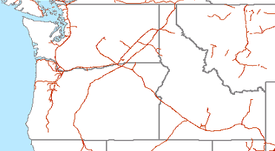
PNW – Natural Gas Infrastructure
Sumas
Kingsgate
Jackson Prairie
Mist
Stanfield
Malin
Clay Basin
Opal
Trading Point
LNG
UG Storage
Pipeline

Slide 3
PNW Gas Issues
Supply - no local production
Demand – from strong growth to reduction
Storage – limited storage capacity
Pipelines - pipes fully subscribed
California – proximity creates uncertainty
Gas-fired generation – is the dream over
Weather – forecasts move markets
Prices – aforementioned issues drive volatility

Slide 4
PNW Supply Summary

Slide 5
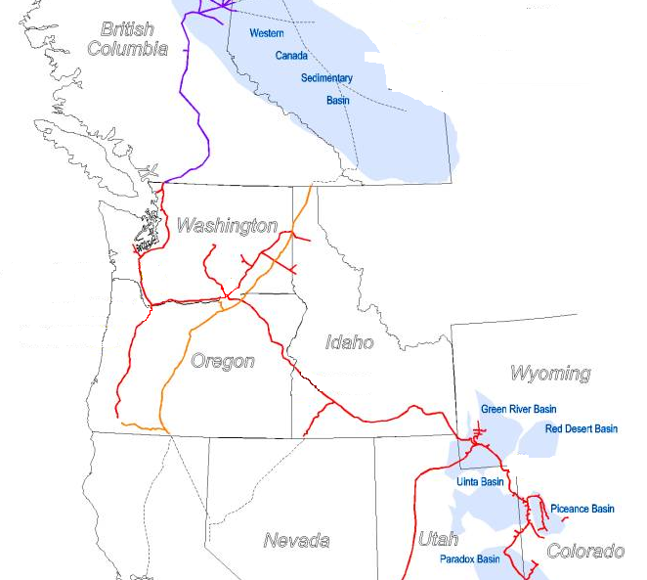
Gas Supply Basins for the PNW
PNW – Supply Basins, Major Pipelines, and Trading Points
Sumas
Kingsgate
Opal/NW Rockies
Malin

Slide 6
Gas Flows in the West
Northwest
Alliance
Northern Border
PGT
WBI
Northwest
Big Horn Basin
Powder River Basin
To
Chicago
Wind River Basin
Green River Basin
KN
CIG
Overthrust
WIC
Trailblazer
Uinta Basin
Piceance Basin
DJ Basin
NGPL
Kern
Paradox Basin
Northwest
CIG
Raton Basin
El Paso
San Juan Basin
= Glenrock
= Cheyenne/Rockport
= OPAL
El Paso
Permian Basin

Slide 7
Canadian Rig Counts are Up
Record Levels of Canadian Activity
Most recent data indicates 328 active rigs at the end of August
This is off 43% from the year-to-date high of 539 rigs in January 2001
Similar constraints as those found in the U.S. market

Slide 8
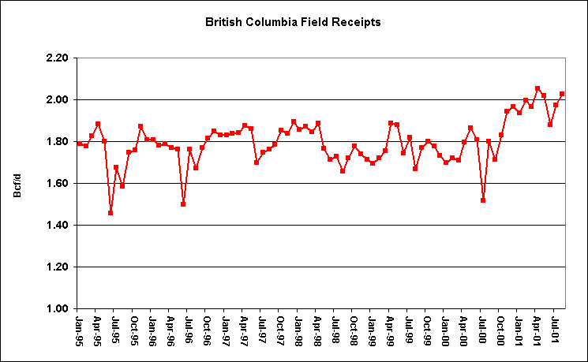
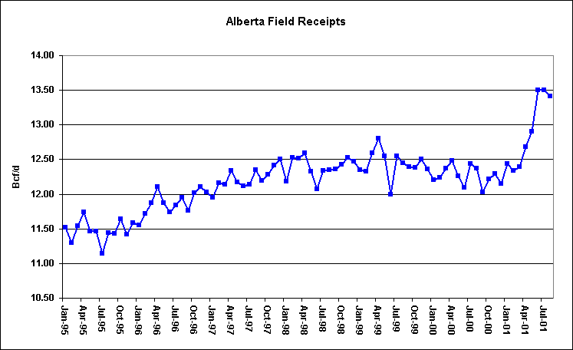
Canadian Field Receipts are Up

Slide 9
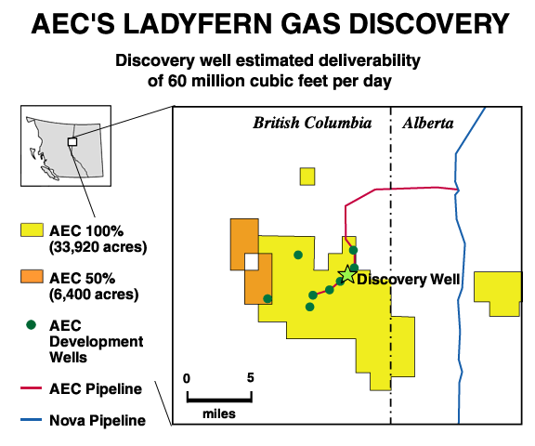
Ladyfern May Represent a Significant
Supply Addition
A mosquito-ridden bog in remote northeastern British Columbia has become one of Canada's richest finds of the past two decades
Canadian Natural said test results from its recent Ladyfern well showed it had the capability of producing 100 million cubic feet of gas a day, rivaling some finds in the deep water Gulf of Mexico
Ladyfern is expected to deliver between 100 million and 150 million cubic feet per day during the last half of 2001.

Slide 10
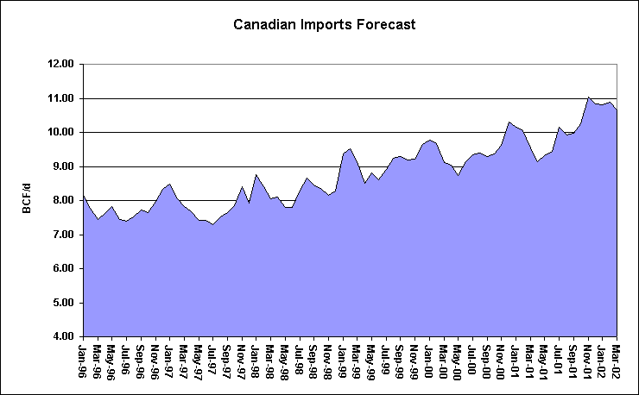
Canadian Imports are Strong and Growing
Note: The bulk of these imports are
going to the Midwest and Northeast.
Increases come largely from new
production not cannibalization of
existing production.

Slide 11
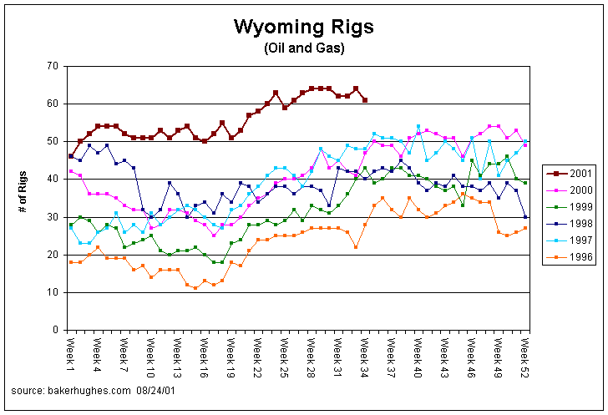
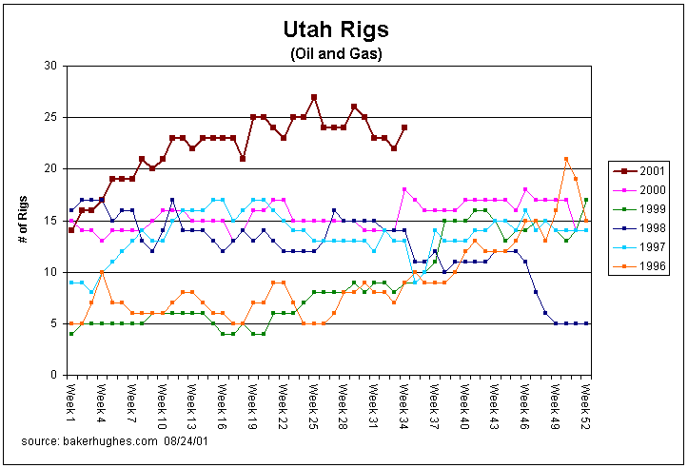
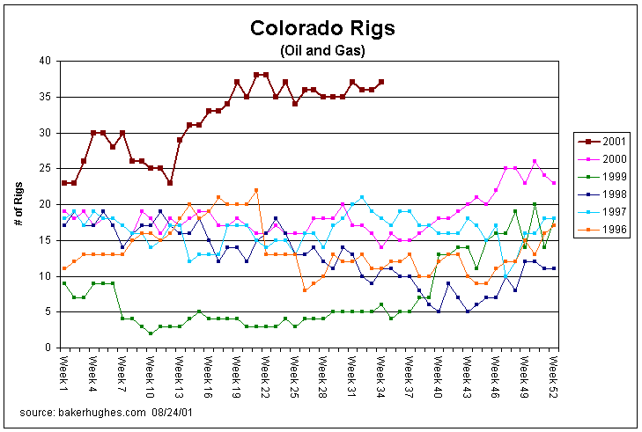
Rockies Rig Counts are Up Too
Drilling is continuing at the highest pace in over a decade despite the infrastructure constraints that have appeared over the last year.
Note: Powder River Basin CBM rigs are excluded from the Baker-Hughes Wyoming rig count due the shallow nature of the CBM wells
<number>

Slide 12
Rockies Receipts are Flat

Slide 13
Coal Bed Methane Play will Increase Rockies Production
Key Features
- On pace to drill 4,500 wells per year, average of 11 wells per day
- Average production per well = 125 Mcf/d
- No production decline curve has been established, but industry is working on one
- CBM play has an estimated life span of 35 years, with each individual well lasting between
5-10 years
- Peak daily production estimated to be 2 Bcf/d
Possible Delays to Future Development
- Water discharge permits
- BLM EIS, These studies are on going and continually analyze the cumulative effect on the
environment

Slide 14
Gas Demand

Slide 15
Natural Gas Demand in the US
Source EIA

Slide 16
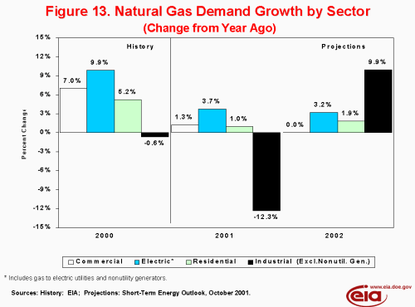
Negative Industrial Demand Growth is Real

Slide 17
Total US Natural Gas Demand
US Demand by Month
Total Demand
Industrial Demand
Electric Utility Demand
Source EIA

Slide 18
Power Demand Response in the PNW
Percent Change in Electricity Demand
As of June 01
Source: Northwest Power Pool

Slide 19
Gas Storage

Slide 20
The US Storage Picture
The Rapid Pace Continues
Strong storage levels reflective of weak fundamentals
Unprecedented level of injections have been a critical factor in market declines
As of September 2, the year-over-year storage surplus was 386 Bcf
8 weeks left in injection season
High probability of reaching 11/5/98 storage high of 3,094 Bcf

Slide 21
Limited Storage in the PNW
Jackson Prairie
Mist
Clay Basin
LNG
UG Storage

Slide 22
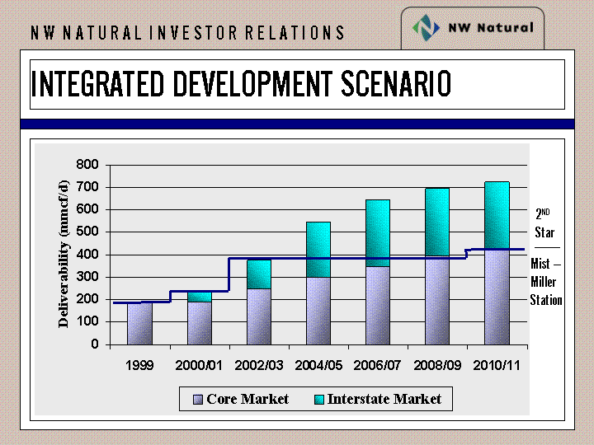
NWN Building Merchant Storage at Mist
Mist Expansion Scenario

Slide 23
Gas Fired Generation

Slide 24
New Power Generation
Is the dream over for developers?
Big rush to build
12-month boom
Power prices have crashed
Market heat rates are down
Significant demand response
Supply/Demand balance equilibrating
Dreamers - Utilities Industrials and IPPs
$

Slide 25
Summary of New Generation in the West

Slide 26
WSCC Capacity Additions
NOTE: 100% of Capacity Under Construction, 50% of Permitted Capacity

Slide 27
Prices at Mid-C Have Crashed

Slide 28
Market Heat Rates have
Come Off
Note: Oct 01 market heat rate
was 12,700 (peak) and 11,100
on 9/4/01.

Slide 29
The Impact of Market Heat Rate on Gas Demand in the WSCC
Current
Market HR
MW
(Bars)
MMBtu
(Line)

Slide 30
PNW Hydro Power – Why Didn’t the Lights Go Out
The hydro shortage is real: Dams are at 55% of capacity second worst year on record
Storage for next year is way behind
Load will bottoms out in September and builds through the winter
Load shedding averted the widely forecast crisis
1800 MW of aluminum smelting shut off
Seattle and Tacoma raised rate 45% before summer
No meaningful forecasts until December

Slide 31
The Hydro Power Shortage
Is Real… and Ongoing
Pacific Northwest Hydro Generation
MW
Forecast

Slide 32
Examples of Structures for PNW Customers

Slide 33
Peaking Structure
Industrials and Utilities
Sumas Peaking Structure – Physical Settlement
For any 10 days from November 1, 2001 thru January 31, 2002
Sumas MI
+ US$1.50 per MMBtu
ENA
Industrial
20.0 MMBtu per day
20.0 MMBtu
per day
Sumas MI
+ US$2.00 per MMBtu
Utility

Slide 34
Reverse Tolling
Generators
power
gas
Power
Market
Gas
Supplier
Generator
Tariff Rate
$3.00
$
Power
Gas
$5.00
ENA
Example: Gas fired generator has fixed winter gas at $3.00.
Winter gas goes to $5.00. The generator buys power from
ENA in exchange for gas, generator never runs.

Slide 35
Services Transaction
IPPs and Cogens
Physical Gas
Physical Power
ENA
EPMI
Generator
Daily Index
Physical Gas
Physical Power
Daily Index
Power
Market

Slide 36

Marketing Partnerships
Utilities
Example with Cascade Natural Gas:
Cascade
ENA
Firm capacity
Customer identification
Real-time metering and balancing
Back office
Physical gas
Risk management
Credit
Non-Cascade customer identification

Slide 37
Basis Hedging and Book Optimization
Industrials
Henry Hub DI + [Sumas DI basis settle]
Floor @ $0.40 $US/MMBtu
Cap @ $1.50 $US/MMBtu
ENA
Industrial
Daily Gas at Sumas
Nymex hedged independent of basis

