Slide 1
Project Overview
Project Management Focus Group
Enron Net Works – AD&S
Rich Hall

Slide 2
Project Objectives
Identify and Implement Project Management Solutions for AD&S
Identify and Implement Software Development Methodology Solutions
Identify and Implement Guidelines and Procedures
Define Expectations of a Project Manager
Train the Organization

Slide 3
Project Goals
High-level Processes for Managing Software Development Projects based on Enron’s Culture
Enhanced Communication Across Projects & Departments
Reduce Risk of Unforeseen Costs of Software Development
Improved Management of IT Project Resources
Implement Tools to Manage Priorities
Build Foundation for Measuring Effectiveness
On-Time & On-Budget

Slide 4
Description
Focus Group formed from Representative Departments within AD&S and Infrastructure – July 12th
Focus on Enhancing Project Management Processes, Tools, and Training – Not the creation of a PMO
Enron culture values knowledge of the “business”
Project Management is not currently recognized as a career path at Enron
Working Groups Established to Focus on:
Application Development Methodology & Roadmap
Project Management and Training
Online Status & Reporting Tools
Team Dynamics
20+ Enron Employees
2 Consultants (EnForm)

Slide 5
Technology
“Enronized” Unified Process
Industry Best Practices
Training based on “Enron” process
Overview course for PMs & Developers
Follow-up Training based on Individual’s Needs
Project Dashboard
Web-enabled
Interface with SAP data
Accessible by “Business” & “IT”

Slide 6
Team/Resources
Sponsor – Beth Perlman
Sponsor Committee – Beth’s Direct Reports
Focus Group Leader – Rich Hall
Team
Project Managers
Business Analysts
Developers
Accounting
Human Resources/Training
Infrastructure
Consultants - EnForm

Slide 7
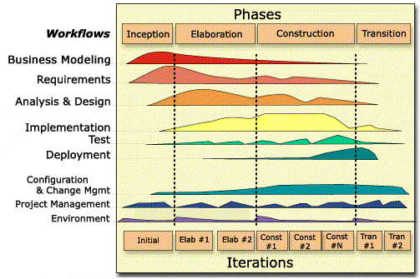
Procedures
High-Level Adoption of Unified Process
Creation of Project Start-up Procedures Compliant with GAAP
Scaleable Process Based on Size of Project
Project Plan Templates

Slide 8
Organization Commitments
Meetings
Sponsor Committee – Monthly (or as needed)
Entire Focus Group – Every 2 weeks
Working Groups – Weekly (Minimum)
Working Sessions - Daily

Slide 9
Current Status
Application Development Methodology – Green
“Enronizing” Unified Process
Project Management & Training - Green
Expectations of a Project Manager
Online Status & Reporting – Yellow
“Buy” vs “Build”
Requirements Gathering Underway
Vendor Package Analysis Underway
Evaluation of “Sprite”

Slide 10
Schedule of Events
Timeline
September October November
Working Groups
Application
Development
Training Course
Combined
Working
Group
Sponsor
Approval
Scale
Roadmap
Project
Plan
Templates
Final
Sponsor
Review
Project
Management
Change Management
Change
Management
Rollout
Online Status
& Reporting
Tool Development

Slide 11
Organizational Maturity – Next Steps
The items identified below are not in scope for the current effort but should be considered for next steps:
Return on Investment (ROI) Methodology
Are we getting the value we expect for the project?
Should we do the project?
Estimation Methodology
Consistent and improved methods for estimating project duration and cost

Slide 12
Questions & Answers

