Slide 1

®
PIPELINE INTEGRITY AND SAFETY
Response To Current Regulatory
And Public Relations Environments
Stan Horton, CEO
Enron Transportation Services
September, 2001

Slide 2
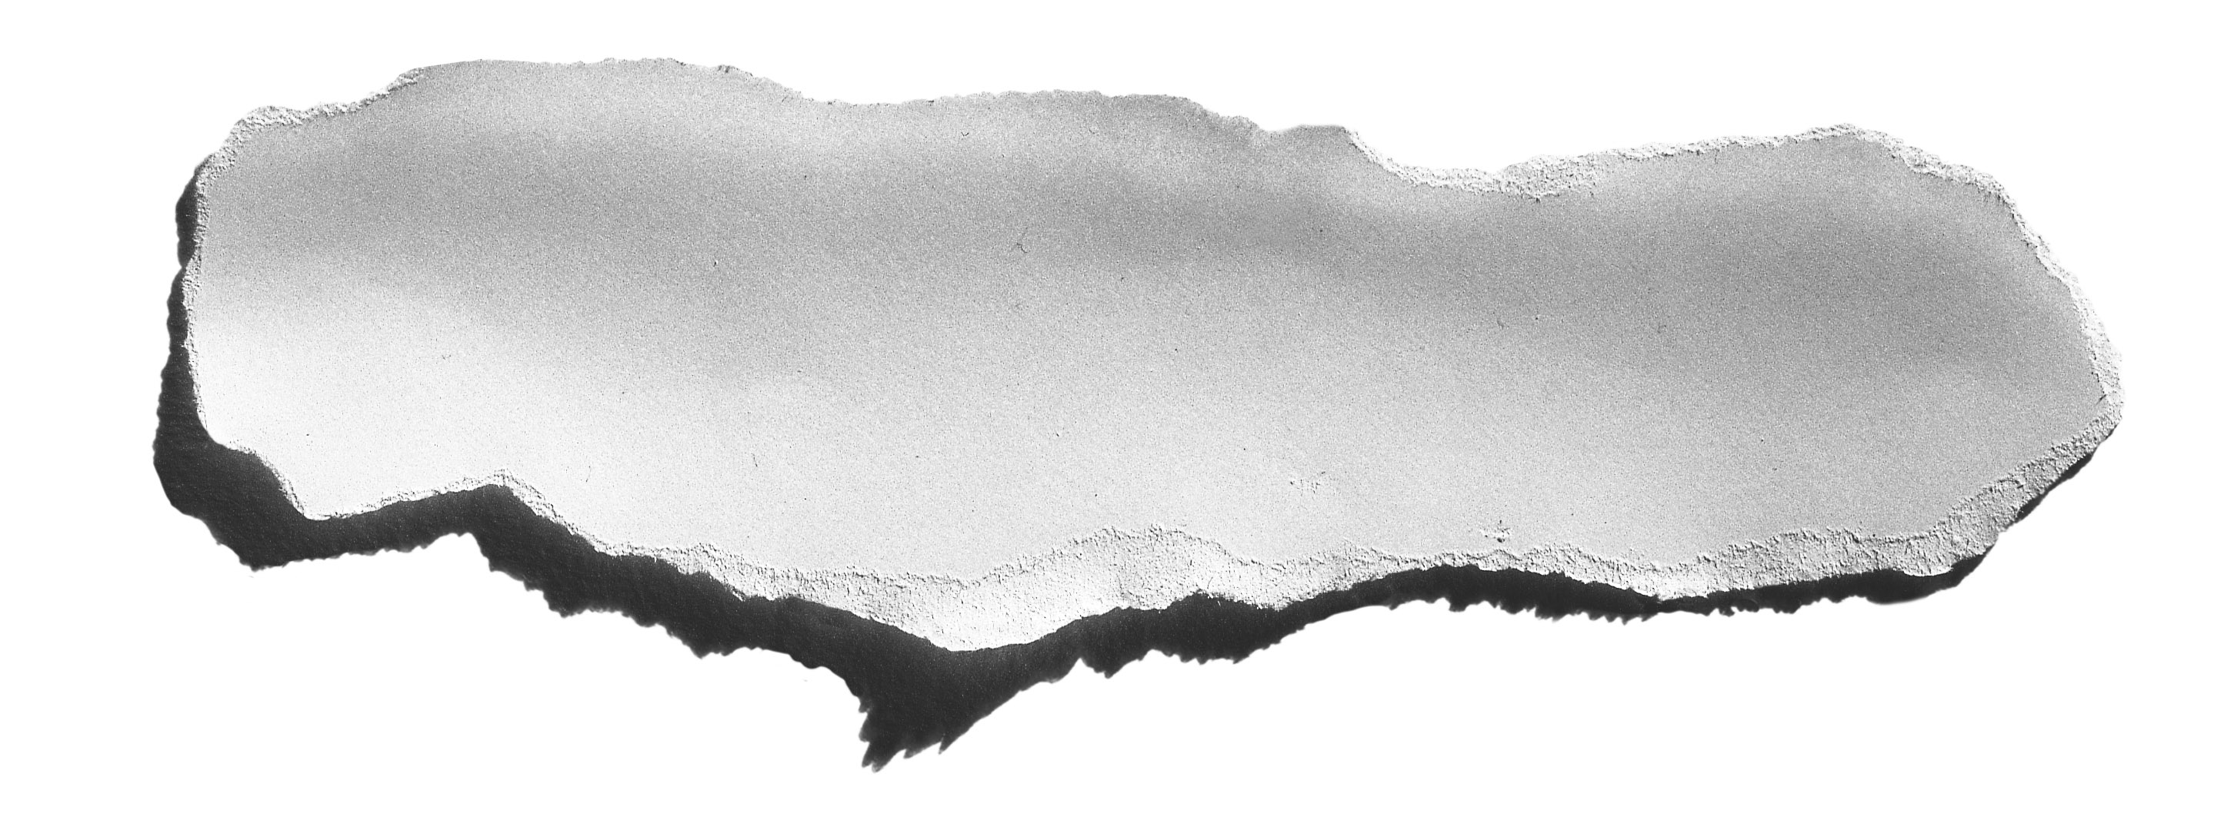

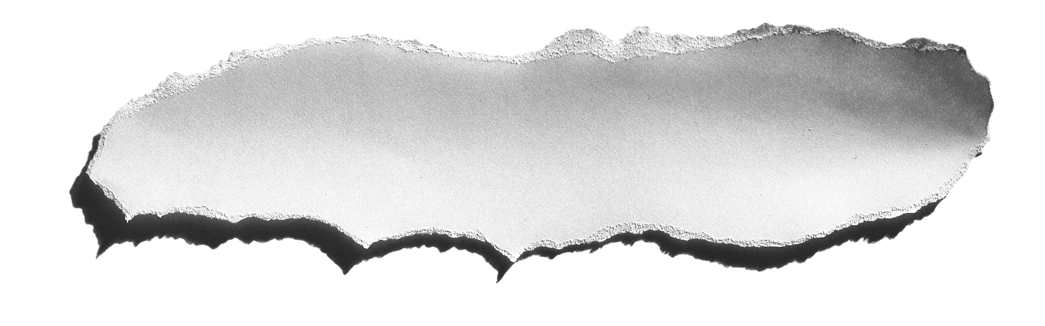
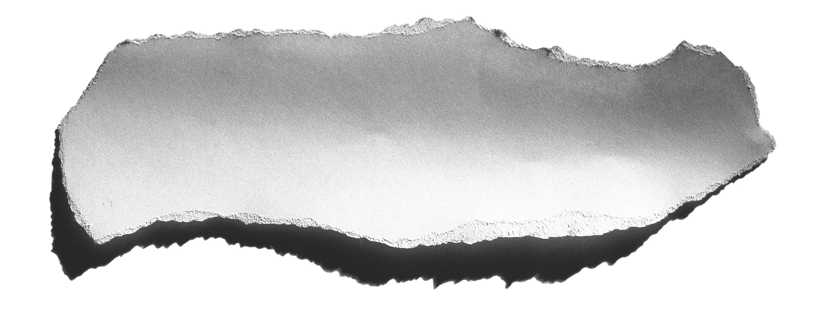
Court of Public Opinion
June 10, 1999 Olympic Pipeline explosion in Bellingham, WA
August 19, 2000 El Paso Natural Gas explosion near Carlsbad, NM
“3 families, trapped at GROUND ZERO
12 campers killed in explosion from pipe that had clean bill of health”
— Austin American-Statesman, 7/22/01
“Spills and explosions reveal lax regulation of powerful industry”
— Austin American-Statesman, 7/22/01
"Unless the basic system of requirements of the system that regulate the pipelines are increased nationwide, these kinds of events are going to happen again somewhere else.”
— Bellingham Mayor Mark Asmundson
“Time is running out as lines deteriorate”
— Austin American-Statesman, 7/22/01

Slide 3

Court of Public Opinion
“…[pipeline industry] enjoyed a net profit of 40 percent
in 1999, while communities across the nation will continue to experience horrific failures of aging pipelines.”
        — from editorial written by parents of 3 killed at Bellingham,
        The Seattle Times, 10/6/00
“..Pipeline industry has resisted …mandatory periodic inspections…pipelines continue to age…now more than 50 years old…”
— WSJ, 8/1/01
“… pipes are under-regulated and at risk of leaks and fires”
— Houston Chronicle, 2/28/00
"Aging infrastructure, lax safety standards, and weak oversight and enforcement have turned New Mexico's pipelines into accidents waiting to happen”
— NMPIRG, 6/6/01

Slide 4
Legislative and Regulatory Drivers
Regulations Becoming More Stringent
Office of Pipeline Safety anticipated to issue Pipeline Integrity Ruling for natural gas pipelines by end of 2001
  64% of 25,000 total miles of natural gas pipeline operated by Enron potentially will require inspection to ensure coverage of high consequence areas (HCA)
February, 2001 U.S. Senate passed and the House appears to support a bill directing DOT to require:
  Inspections of pipelines every five years for high consequence areas
  Increased maximum civil penalties from $25k to $500k
U.S. House of Representatives considering:
  Enhanced qualification requirements for pipeline operators
  Could potentially be passed as an amendment to a separate bill intended to speed review of new pipelines

Slide 5
Response of Peer Companies

Slide 6
Project Summary
ETS Pipeline Integrity Analysis Project
  Internally inspect 15,000 miles of pipeline within 10 years
    4,500 miles can be intelligent pigged without modifications
    3,000 miles require launchers and receivers
    7,500 miles require pipeline modifications
Project Cost (in 2001 dollars)
  Intelligent Pigging Project
    12,000 miles in high consequence areas (HCA) $327 MM
    3,000 miles in non-HCA areas $ 83 MM
  Total Project Cost $410 MM

Slide 7
Project Cost and Time Frame by Asset
Project Cost (in Millions, in 2001 dollars)
TOTALS REFLECTED ABOVE ARE GROSS NUMBERS AND EXCLUDES REMEDIATION/REPAIRS FOR ANOMOLIES FOUND
2002 COSTS ASSUME LEGISLATION WILL BE PASSED LATE IN THE YEAR REQUIRING MINIMUM EXPENDITURES

Slide 8
®

