Slide 1
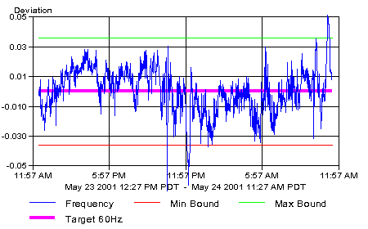
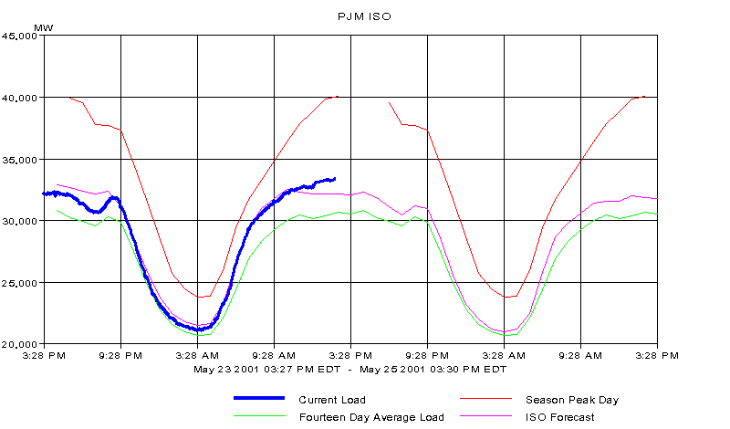
Front
Page
Power
Flows
Market
Notices
Available
Transmission
Notification
Center
CA ISO
PJM ISO
Regional Summary
Supply
Demand
Transmission
Maps
System Frequency in PJM
Select a time range: Hour Day What does this chart mean?
PJM ISO Load
Select a time range: Day Two Weeks Month Year
ISO System Summary
Current PJM Emergencies
Description | Day/Time | Total MWs
Current Load
Forecasted Load
Today’s Expected Peak
Today’s Actual Peak
Net Interchange
Time | Emergency Type | Description

Slide 2
Front
Page
Power
Flows
Market
Notices
Available
Transmission
Notification
Center
CA ISO
PJM ISO
Regional Summary
Choices in pull down menu are:
*All
*500 KV
*Aggregate
*Interface
*Hub
Supply
Demand
Transmission
Maps
Current LMPs
LMP Chart
LMP Profile
Select a LMP Type:
500 KV
Date | LMP Type | Name | Current LMP ($/MWh) | LMP Direction Indicator | Day Ahead LMP ($/MWhr) | Difference between Day Ahead and Realtime LMP | LMP Direction Indicator
May 24, 12:00 pm EDT | 500 KV | BRANCHBU | 50 |  | 60 | -10
May 24, 12:00 pm EDT | 500 KV | BRIGHTON | 51 |  | 60 | -9
May 24, 12:00 pm EDT | 500 KV | BURCHESH | 53 |  | 60 | -7
May 24, 12:00 pm EDT | 500 KV | CALVERTC | 60 |  | 60 | 0
May 24, 12:00 pm EDT | 500 KV | CHALKPT | 50 |  | 60 | -10
May 24, 12:00 pm EDT | 500 KV | CONASTON | 59 |  | 60 | -1
May 24, 12:00 pm EDT | 500 KV | … | …
May 24, 12:00 pm EDT | 500 KV | … | …
May 24, 12:00 pm EDT | 500 KV | … | …
May 24, 12:00 pm EDT | 500 KV | … | …
May 24, 12:00 pm EDT | 500 KV | … | …
May 24, 12:00 pm EDT | 500 KV | … | …
May 24, 12:00 pm EDT | 500 KV | … | …
May 24, 12:00 pm EDT | 500 KV | … | …
May 24, 12:00 pm EDT | 500 KV | … | …
May 24, 12:00 pm EDT | 500 KV | … | …
May 24, 12:00 pm EDT | 500 KV | WHITPAIN | 63 |  | 65 | -2

Slide 3
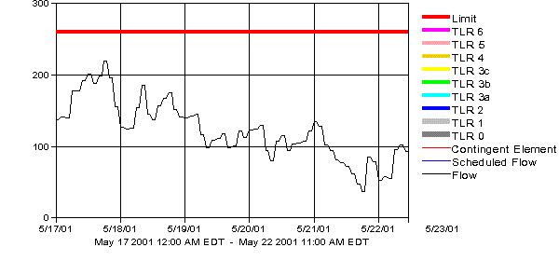
Front
Page
Power
Flows
Market
Notices
Available
Transmission
Notification
Center
CA ISO
PJM ISO
Regional Summary
Supply
Demand
Transmission
Maps
Current LMPs
LMP Chart
LMP Profile
Select a LMP Type:
500 KV
Choices in pull down menu are:
*All
*500 KV
*Aggregate
*Interface
*Hub
LMP
Select a time range: Day Two Weeks Month Year
Available LMPs
LMP Type | Name | Add to Chart?
500 KV | BRANCHBU | Delete
500 KV | BRIGHTON | Add
500 KV | BURCHESH | Add
500 KV | CALVERTC | Add
500 KV | CHALKPT | Add
500 KV | CONASTON | Add
500 KV | … | Add
500 KV | … | Add
500 KV | … | Add
500 KV | … | Add
500 KV | … | Add
500 KV | … | Add
500 KV | … | Add
500 KV | … | Add
500 KV | … | Add
500 KV | … | Add
500 KV | … | Add
500 KV | … | Add
500 KV | … | Add
500 KV | WHITPAIN | Add

Slide 4
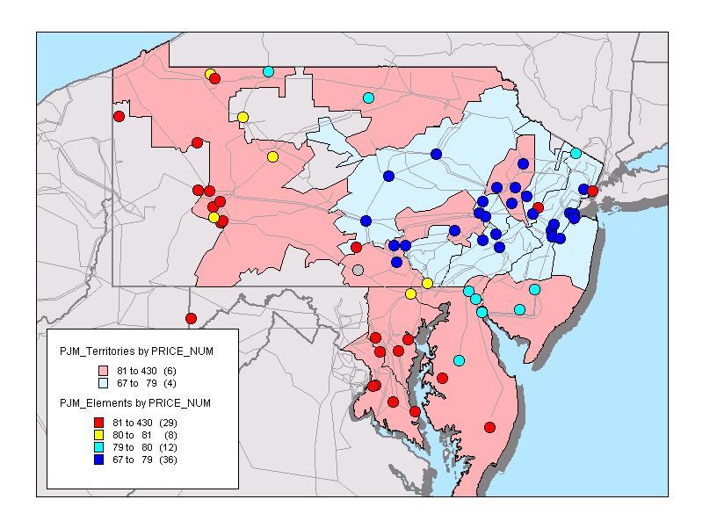
Front
Page
Power
Flows
Market
Notices
Available
Transmission
Notification
Center
CA ISO
PJM ISO
Regional Summary
Supply
Demand
Transmission
Maps
Current LMPs
LMP Chart
LMP Profile
LMP Data
Name | LMP Type | Current LMP ($/MWh) | LMP Direction Indicator | Full Name | Min LMP Last 24 Hours ($/MWh) | Max LMP Last 24 Hours ($/MWh) | Min LMP Last 24 Hours ($/MWh)
BRANCHBU | 500 KV | 35 |  | Brancha Bu Bu | 25 | 42
LMP
Select a time range: Day Two Weeks Month Year

Slide 5
Front
Page
Power
Flows
Market
Notices
Available
Transmission
Notification
Center
CA ISO
PJM ISO
Regional Summary
Supply
Demand
Transmission
Maps
PJM Load Charts
PJM Load Distribution
PJM Area Weather
Load vs. Temp
PJM ISO Load
Select a time range: Day Two Weeks Month Year
These charts are like the current load charts only with all of the previous updated forecasts posted for a more probablistic focus.

Slide 6
Front
Page
Power
Flows
Market
Notices
Available
Transmission
Notification
Center
CA ISO
PJM ISO
Regional Summary
Supply
Demand
Transmission
Maps
PJM Load Charts
PJM Load Distribution
PJM Area Weather
Load vs. Temp
PJM ISO Load Distribution
Select a time range: Annual Seasonal Current Hour On-Peak Off-Peak
Current Load: 31,336
5/25/2001 1:30 pm
63rd percentile
The current real-time load is highlighted. These distributions are calculated real-time

Slide 7
Front
Page
Power
Flows
Market
Notices
Available
Transmission
Notification
Center
CA ISO
PJM ISO
Regional Summary
Supply
Demand
Transmission
Maps
PJM Load Charts
PJM Load Distribution
PJM Area Weather
Load vs. Temp
PJM ISO Load Distribution
Select a time range: Annual Seasonal Current Hour (Season) On-Peak Off-Peak
Current Load: 31,336
5/25/2001 1:30 pm
78th percentile

Slide 8
Front
Page
Power
Flows
Market
Notices
Available
Transmission
Notification
Center
CA ISO
PJM ISO
Regional Summary
Supply
Demand
Transmission
Maps
PJM Planned Transmission Outages
Current Constraints/Emergencies
FTR Auction Results
FTR Nodal Clearing Prices
230 KV lines and up have been mapped so we should be able to visualize planned outages. This map will change along with the time period of the outages
Today
This Week
This Month
Line Description | Voltage | LMP Zone | Start Date | End Date
A | 500 KV | GPU | May 24, 12:00 pm EDT | May 25, 12:00 pm EDT
B | 500 KV | AP | May 24, 12:00 pm EDT | May 25, 12:00 pm EDT
C | 500 KV | DPL | May 24, 12:00 pm EDT | May 25, 12:00 pm EDT
D | 500 KV | … | May 24, 12:00 pm EDT | May 25, 12:00 pm EDT
E | 500 KV | … | May 24, 12:00 pm EDT | May 25, 12:00 pm EDT
F | 500 KV | … | May 24, 12:00 pm EDT | May 25, 12:00 pm EDT
G | 500 KV | … | May 24, 12:00 pm EDT | May 25, 12:00 pm EDT
H | 500 KV | … | May 24, 12:00 pm EDT | May 25, 12:00 pm EDT
I | 500 KV | … | May 24, 12:00 pm EDT | May 25, 12:00 pm EDT
J | 500 KV | … | May 24, 12:00 pm EDT | May 25, 12:00 pm EDT
K | 500 KV | … | May 24, 12:00 pm EDT | May 25, 12:00 pm EDT
L | 500 KV | … | May 24, 12:00 pm EDT | May 25, 12:00 pm EDT
M | 500 KV | … | May 24, 12:00 pm EDT | May 25, 12:00 pm EDT
N | 500 KV | … | May 24, 12:00 pm EDT | May 25, 12:00 pm EDT
O | 500 KV | … | May 24, 12:00 pm EDT | May 25, 12:00 pm EDT
P | 500 KV | … | May 24, 12:00 pm EDT | May 25, 12:00 pm EDT
Q | 500 KV | … | May 24, 12:00 pm EDT | May 25, 12:00 pm EDT
Map of outages here
Similar to the transmission outages except with a toggle for time periods instead of the Gantt chart

Slide 9
Front
Page
Power
Flows
Market
Notices
Available
Transmission
Notification
Center
CA ISO
PJM ISO
Regional Summary
Supply
Demand
Transmission
Maps
PJM Planned Transmission Outages
Current Constraints/Emergencies
FTR Auction Results
FTR Nodal Clearing Prices
This page will be like the TLR map under market notices, only just for PJM
Map of PJM constraints and emergencies here
Time | Emergency Type | Description

Slide 10
Front
Page
Power
Flows
Market
Notices
Available
Transmission
Notification
Center
CA ISO
PJM ISO
Regional Summary
Supply
Demand
Transmission
Maps
PJM Planned Transmission Outages
Current Constraints/Emergencies
FTR Auction Results
FTR Nodal Clearing Prices
Off Peak
On Peak
24 hr
Source | Sink | Owner | Month | MW | Price ($/MW)
AECO | … | … | July 2001 | 10.0 | 43.47
10th ST | 69 KV | PECO | July 2001 | 89.6 | -1.00
12th ST | 13 KV | DPL | July 2001 | 88.2 | 60.00
Adams | 230 KV | AECO | July 2001 | 2.8 | 150.00
Bayview | 230 KV | BGE | July 2001 | 25.0 | -100.00
Bayonne | 26 KV | … | July 2001 | 10.0 | 41.97
AECO | … | … | July 2001 | 89.6 | 43.47
10th ST | 34 KV | PECO | July 2001 | 88.2 | -1.00
12th ST | 13 KV | DPL | July 2001 | 2.8 | 60.00
Adams | 138 KV | AECO | July 2001 | 25.0 | 150.00
Bayview | 69 KV | BGE | July 2001 | 10.0 | -100.00
Bayonne | 13 KV | PECO | July 2001 | 89.6 | 41.97
AECO | … | … | July 2001 | 88.2 | 43.47
10th ST | 230 KV | AECO | July 2001 | 2.8 | 43.47
12th ST | 26 KV | BGE | July 2001 | 25.0 | -1.00
Adams | 69 KV | … | July 2001 | 89.6 | 60.00
Bayview | 500 KV | … | July 2001 | 88.2 | 150.00
Other column data showing the various measures of the value of the FTR.
We can provide a roll-up feature for owners like a pivot table in Excel with sum MW and average price.

Slide 11
Front
Page
Power
Flows
Market
Notices
Available
Transmission
Notification
Center
CA ISO
PJM ISO
Regional Summary
Supply
Demand
Transmission
Maps
PJM Planned Transmission Outages
Current Constraints/Emergencies
FTR Auction Results
FTR Nodal Clearing Prices
Off Peak
On Peak
24 hr
Price Node | Voltage | LMP Zone | Month | Price ($/MW)
AECO | … | … | July 2001 | 2.49
10th ST | 69 KV | PECO | July 2001 | 3.01
12th ST | 13 KV | DPL | July 2001 | 2.42
Adams | 230 KV | AECO | July 2001 | 2.90
Bayview | 230 KV | BGE | July 2001 | 9.22
Bayonne | 26 KV | … | July 2001 | 4.79
AECO | … | … | July 2001 | 2.49
10th ST | 34 KV | PECO | July 2001 | 3.01
12th ST | 13 KV | DPL | July 2001 | 2.42
Adams | 138 KV | AECO | July 2001 | 2.90
Bayview | 69 KV | BGE | July 2001 | 9.22
Bayonne | 13 KV | PECO | July 2001 | 4.79
AECO | … | … | July 2001 | 2.49
10th ST | 230 KV | AECO | July 2001 | 3.01
12th ST | 26 KV | BGE | July 2001 | 2.42
Adams | 69 KV | … | July 2001 | 2.90
Bayview | 500 KV | … | July 2001 | 9.22
We can map the price nodes to zones and then provide a roll-up feature (not shown) similar to plant outages in Cal

Slide 12
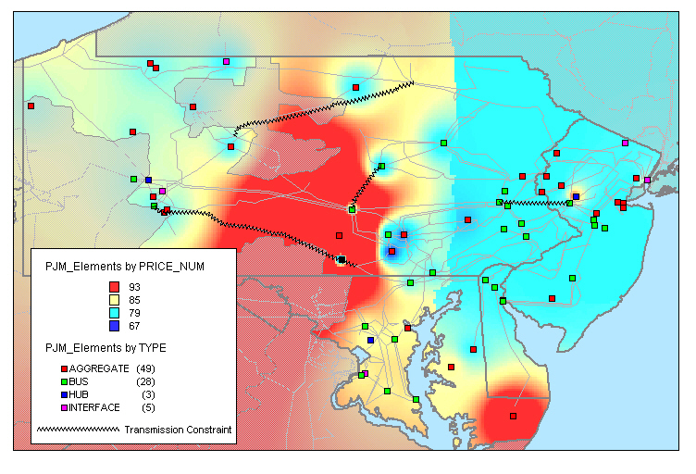
Front
Page
Power
Flows
Market
Notices
Available
Transmission
Notification
Center
CA ISO
PJM ISO
Regional Summary
Supply
Demand
Transmission
Maps
LMP Maps
  Zone LMPs
  Aggregate LMPs
  Interface LMPs
  500 KV LMPs
  Hub LMPs
Emergency Maps
Transmission Outage Maps

