Slide 3
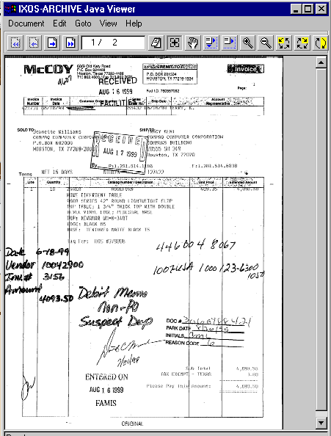

Slide 4
Forward Invoice
To search for a user, user must enter at least 2 characters of the user’s last name. To further narrow down the search, you may enter Job Group and/or Job Function.
Last Name:
Job Group:
Job Function:
Please Select Recipient:
User is shown results from Search here. Full Name, Job Group, Job Function, and Company Number will all be displayed for each user returned.
Additional Comments:
User is required to type additional comments here that will appear in the document history.

Slide 5
Reject Invoice
Please select reason for rejection and provide supporting rejection information in the text box below.
Reason for Rejection:
Additional rejection information:
User types additional rejection info here.
Rejection Reasons
Goods/services not received
Incorrect user
Incorrect company number
Do not pay
Invoice information incorrect/unreadable
Advanced Coding Required
Other

Slide 6
Invoice History
History of Invoice provided below.
Date:
User:
Action:
Comments:
(1)
3/31/00
AP
Created
Exception created from SAP for SAP Employee ID [501]
(2)
4/10/00
Lenig, Christopher
Forward
Sent to Terrie Wheeler
Forward
Reject
History
(3)
4/15/00
Wheeler, Terrie
Forward
Sent to Carolyn Centilli
Add Coding
Work List
Save
(4)
4/31/00
Centilli, Carolyn
Rejection
Do Not Pay -- “I did not order this”

Slide 7
User Comments
User Comments are provided below. User may add additional comments.
Date:
User:
Comments:
(1)
3/31/00
Childress, Matthew
Chris, can you take a look at this invoice and tell me if you know anything about it?
Forward
Reject
History
(2)
4/31/00
Lenig, Christopher
Matthew, this invoice is for goods we ordered and receiving regarding Project XYZ.
Add Coding
Work List
Save
Additional Comments:
User types additional comments here.

Slide 8
P
Invoice Header Coding
Please answer the following questions, then click Next to proceed to the Line Item coding.
Click to view invoice image
Invoice Header Coding:
(1)
Is the Company Number Correct?
Enron Corporation -- 0011
No selection is defaulted

Slide 9
P
Invoice Header Coding
Please answer the following questions, then click Next to proceed to the Line Item coding.
Click to view invoice image
Invoice Header Coding:
(1)
Is the Company Number Correct?
Enron Corporation -- 0011
(2)
Please provide the correct Company Number:
Forward
Reject
History
Add Coding
Work List
Save
When Finish is pressed, the Work Item will be returned to Accounts Payable to reset the Company.

Slide 10
Invoice Header Coding
Please answer the following questions, then click Next to proceed to the Line Item coding.
Click to view invoice image
Invoice Header Coding:
(1)
Is the Company Number Correct?
(2)
Tax Code:
(i) In which country was this purchased?
(ii) Is there tax on the invoice?
(iii) What type of purchase(s)?
(3)
Will you be picking this check up?
If Yes, provide special handling instructions below:
(i) First and Last Name
(ii) Telephone
(iii) Location
(4)
Is this a Contract/RAC Approved Invoice?
(Insert description of Contract/RAC Invoices)

Slide 11
Invoice Line Item Coding
2
P
Please enter Line item coding below. All fields marked with an (*) are required.
Amount to be allocated: $92.00
to line item(s)
Click to view invoice image
Invoice Line Item (1) Coding:
(1)
Line Item Amount: (*)
USD
(2)
Company Number: (*)
(3)
Select either G/L or Asset below: (*)
(4)
Line Item Tax Code: (*)
(5)
Jurisdiction Code: (*)
(6)
Material Number:
(7)
One item from drop-down below is required: (*)
Statistical Order Number:
Statistical WBS Number:
Profit Center Number:

Slide 12
Invoice Line Item Coding
P
Please add any additional information in the fields below to complete the line item coding. NONE of the below fields are required.
Click to view invoice image
Invoice Line Item (1) Coding:
(8)
Functional Area:
(9)
Description:
Forward
Reject
History
(10)
Quantity:
Add Coding
Work List
Save
(11)
Unit of Measurement:
(12)
Trading Partner Number:
Please click “New Line Item” to add additional line item coding information. If you have completed all of the coding, please click “Finish.”

Slide 13
Forwarding Invoice for Higher Approval
To search for a user, you must enter selection criteria into one of the three fields below and select the Search button. To enter a last name, please enter at least 2 characters of the user’s last name.
Last Name:
Job Group:
Job Function:
Click to view approval level descriptions
Please Select Recipient:
User is shown results from Search here. The Full Name, Job Group, Job Function, and Company will all be displayed for each user returned.
Approve/Forward
Additional Comments:
Invoice amount total yet to be distributed to a line item:
User types additional comments here that will appear in the document history.
$0.00
Header Tax Code:
Special Handling:
RAC Approved:
I1
No
No

Slide 14
Forwarding Invoice to Accounting (INVOICE AMOUNT OVER $1 MILLION)
To search for an Accounting user please select the Search button below. You may narrow down your search by entering in at least 2 characters of the user’s last name and/or select Job Group.
Last Name:
Job Group:
Job Function:
Please Select Recipient:
User is shown results from Search here. The Full Name, Job Group, Job Function, and Company will all be displayed for each user returned.
Approve/Forward
Additional Comments:
Invoice amount total yet to be distributed to a line item:
User types additional comments here that will appear in the document history.
$0.00
Header Tax Code:
Special Handling:
RAC Approved:
I1
No
No

