Slide 1




Enron Government Affairs
Status Report to Enron Americas/Enron Energy Services
September 6, 2001
<number>
Notes:
This is an excellent opportunity to meet with you guys in order to introduce Government and Regulatory Affairs to you. It is a short presentation after which I will be glad to receive your questions.
The structure of the presentation is pretty straight forward. It starts by

Slide 2
Overview
Government Affairs Objectives are focused and closely aligned with the Commercial Objectives
The mode of operation is to “pay the rent” through capturing and exploiting short-term opportunities, while actively developing longer-term market opening opportunities.
Rigorous internal allocation processes and constant communication with our commercial counterparts to ensure appropriate prioritization.
Sustained involvement in the government/regulatory arena critical to growth needs of the company: Significant risk to Enron in “taking markets as they come”

Slide 3
Government Affairs – Core Functions
Market Advocacy
Deal Support
Regulatory Risk Management
Regulatory Risk Management
Regulatory Origination
Objective: Remove all barriers and restrictions to energy markets
Key Wholesale = RTO
Key Retail = Direct Access
Objective: Support commercial transactions
Information and Intelligence gathering
Power Desk Coverage
Objective: Identify regulatory and political risks in current book and pending transactions.
Develop and implement mitigation plan to protect value
Objective: Identify Enron-only market opportunities for commercial teams

Slide 4
Government Affairs - Approach
Leading Role - Enron positioned as the leading voice and thought leader for competitive energy markets
Enlisting Allies – Coordinate ad-hoc and permanent coalitions to effect necessary changes and protect our books
Refining Focus - From pure market advocacy to include Deal Support and Regulatory Risk Management
Aligning Resources – Employ centralized resource allocation process for $ and people to ensure consistency with business units.

Slide 5
Government Affairs – Key Issues
Minimize California crisis’ impact on Enron
Finish opening wholesale electricity markets
Push for additional retail market openings
Prevent regulators from disrupting functioning markets
Protect EWS retail tariff positions

Slide 6
Minimize California Crisis’ impact on Enron
Recover Outstanding Debts
  Negative CTC
  Trade credit with utilities and ISO/PX
  ISO Undercollection penalty
Manage FERC Refund Cases
  CA refund proceedings
  PNW refund proceedings
Continue Direct Access
  Delay CPUC suspension action under ABX1 to give Legislature opportunity to fix
  Ensure suspension, if it occurs, is temporary
  Ensure best economic value proposition
Focus regulators on getting infrastructure in place
  Independent and workable CAISO
  Replace/remove WSCC price cap
  Natural gas takeaway capacity
Protect EWS Retail Tariff positions in California
  12.1 million MWh short in 6 Utilities.
Notes:
The six utilities are:
Riverside
LADWP
Imperial ID
PG&E
SoCalEd
SDG&E

Slide 7
Finish Opening Wholesale Electricity Markets
Push FERC on Order 2000
  Turn “voluntary” nature into $ pain for transmission owners if further delays
  Ensure RTOs offer services in non-discriminatory manner
  Broad regional scope (NE, SE, MW, ERCOT, West)
Support workable Wholesale Electricity Markets
  Drive FERC on sustainable market structures – PJM model
  Assist FERC with market power debate – “end” generator abuse
Conform Retail and Wholesale Markets
  Balancing provisions uniform to all participants
  Congestion management with financial rights
  ICAP and ancillary services issues satisfactorily resolved.
Establish Mandatory Reliability Function Under FERC

Slide 8
Push for Additional Retail Market Openings
  Finish implementing Texas, Ohio and Virginia
  Enhance retail Markets in NY, IL, and PA
  Focus on opening MO, NV, FL for C&I

Slide 9
Keep regulators from disrupting functioning markets
Promote pro-market rules/restrictions for market based rate authority.
Preserve and protect role of e-Commerce in energy markets and Industry.
Minimize impact of FERC changes to natural gas & power affiliate codes of conduct
Minimize cost and intrusiveness of natural gas & power reporting requirements

Slide 10
Protect EWS Retail Tariff positions
Provide regulatory inputs for 80% of total tariff positions (the total is 103.6 million MWh in 43 States), and assist in determining, and managing, the appropriate strategy.
Notes:
We also have a small position in Canada (4.3 million MWh) – It is included in the total.

Slide 11
Government Affairs’ Recent Contributions, I
Driver behind FERC RTO Orders
Effectively managing FERC refund cases
Sustained DA after passage of AB1X in January
Structured 3 c/KWh surcharge as DA bypassable
Limiting 1c/kWh surcharge application
Established negative CTC as “qualified” payable in SB2X 78 - SCE MOU
Developed DA economics post SB2X 78
  Opportunity to avoid surcharges for Existing DA
  Minimize surcharges for New DA
    Net unavoidable of future CDWR costs
    Net short without any CDWR costs
    Fair proportion of CDWR bonds

Slide 12
Government Affairs’ Recent Contributions, II
Managing PG&E / SCE complaints over negative CTC recoupment
Managing PX Credit replacement issues
  URG costs
  CDWR costs
Supported ENA and EES deals
  Examples: QF restructuring, CDWR S-T power deals; power plants; Hail Mary I, Hail Mary II

Slide 13
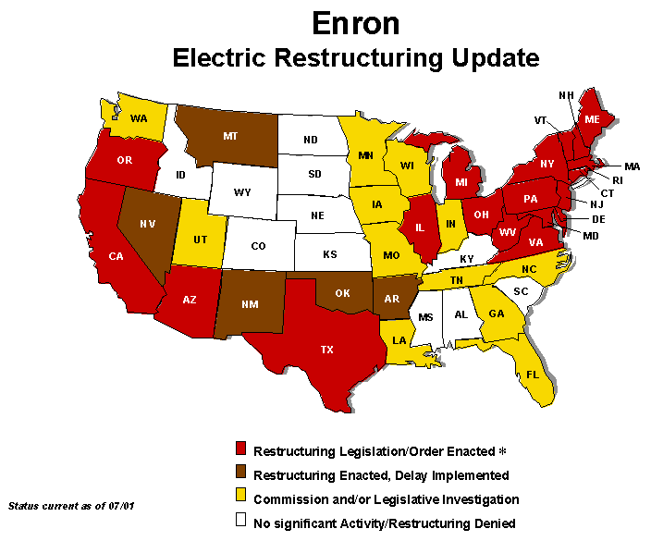
* California market temporarily closed ** California market reopens.
 | 1998/99 | 2000 | 2001⁺
Number of States in which Legislation is Enacted. | 5 | 21 | 20
Number of States in which restructuring enacted but delays of implementation. | 9 | 4 | 5
Number of States in which a Commission and/or legislative investigation is ongoing | 35 | 24 | 12
Number of States in which no significant activity is taking place. | 1 | 1 | 11
+ excludes AK, and Hawaii

Slide 14
Retail Risk, Nominal MWh (URM), Sep. 2001, by NERC Region
Total of 103 TWh, $1 per MWh of price change = $ 103 million.

Slide 15
Retail Risk, Nominal MWh (URM), Sep. 2001 By State

