Slide 1
CHANGES IN 2002
WHAT’S NEW?
Savings & ESOP Plan – Hewitt Associates NEW!!
800-332-7979, option 5 - Open Enrollment link NEW!!
NEW!! Transportation Spending Account monthly maximums increased
Parking to $180/month
Mass Transit to $100/month
Notes:
New vendor for Savings Plan & ESOP Plan
New option on our Benefits Customer Service line to enroll in 2002 elections
New monthly maximums for the Transportation Spending Accounts - $180/mth for Parking and $100/mth for Mass Transit.
Two HMOs were dropped – Care Choice and Healthplan Southeast
Long Term Care has no restrictions to the plan – Now offered in Washington, South Dakota and Vermont.

Slide 2
OPEN ENROLLMENT 2002 – KEY DATES
    All employees with benefits elected were sent on 9/24 to participate in Open Enrollment
    10/29-11/12 - WEB and IVR open
    11/19 Confirmation statements mailed
Notes:
Read through each bullet and highlight the Open Enrollment windows.

Slide 3
OPEN ENROLLMENT 2002 - No Dual-Year Enrollment Forms
Year-end Qualifying Life Events (QLE)
  Year 2001 changes must be made by calling the Enron Benefits Service Center and speaking with a Service Center Representative (SCR). (800-332-7979, option 1)
  Year 2002 changes must be made through Open Enrollment website – www.enron.benefitsnow.com.
    Attention: There will be a time delay – It will take a week to process changed elections to the Open Enrollment website. Employees must make QLE with SCR, then wait one week to change 2002 elections
Notes:
All employees with qualifying life events must speak to an Enron Benefits Service Center Representative to make changes to their 2001 elections. The Service Center Representative will enforce the importance for the employee to go on-line in a week to re-elect his 2002 elections.
We will not be rolling over any qualifying life event changes – The employee must re-elect his choice for 2002!!
Don’t forget we are passing 2001 elections weekly to extend the enrollment window for year-end qualifying life events.

Slide 4
OPEN ENROLLMENT 2002 - No Dual-Year Enrollment Forms
Year-end Qualifying Life Events (QLE) - Examples
Example 1:
Employee has QLE on 11/15
  2001 election changes made 12/4 only through SCR
Example 2:
Employee has QLE on 12/17
  2001 election changes made 12/24 only through SCR
Notes:
EXAMPLE 1:
Employee has qualifying life event on 11/15. He makes changes on 12/4 through a Service Center Representative. Benefits Service Center sends elections on the 12/7 refresher file. The employee may enroll in 2002 elections during 12/10-1/6 or after 1-1-02 through an Enron Benefits Service Center Representative.
EXAMPLE 2:
Employee has qualifying life event on 12/17. He makes changes on 12/24 through a Service Center Representative. Benefits Service Center sends elections on the 12/28 refresher file. The employee may enroll in 2002 elections during 12/31-1/6 or after 1-1-02 through an Enron Benefits Service Center Representative.

Slide 5
OPEN ENROLLMENT 2002 - HOW TO ENROLL/INQUIRE
WEB
Log in from work: http://benefits.enron.com - Health & Group Plans
Log in from home: http://enron.benefitsnow.com
  Elections are always available to review and print.
IVR
Call 800.332.7979 and press the option or click the button for the appropriate benefit plans.
Pesky Personal Identification Numbers (PIN)
It’s easy! For Open Enrollment – Your PIN is the last 4 digits of your SSN.
Customer Service Representatives are available to answer all of your questions
Monday – Friday, from 8:00 a.m. to 5:00 p.m. CST
Notes:
How to Enroll – Two methods – WEB and IVR
Go online at benefits.enron.com and click the Open Enrollment link OR log on from home through enron.benefitsnow.com.
Go through the phone by dialing the same great Benefit number – 800-332-7979, option 5.
PIN – It’s easy – your PIN is the last 4 digits of your social security number.
Representatives are staffed from Monday – Friday from 8 am to 5 pm Central Standard Time.

Slide 6
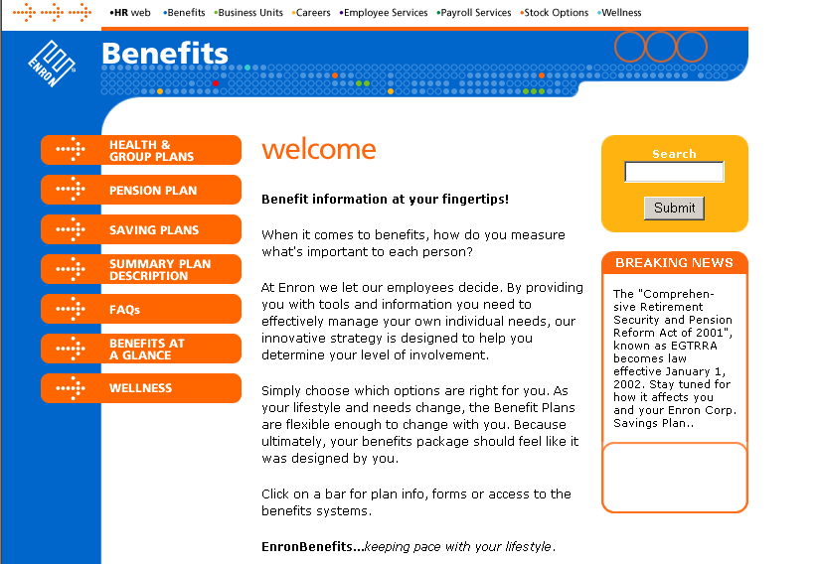
http://benefits.enron.com
Notes:
Here’s a snap shot of the Benefits Home Page.

Slide 7
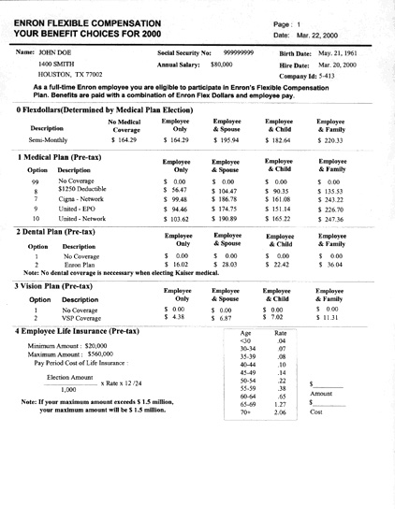
BENEFIT ENROLLMENT WORKSHEET
2001 & 2002
Look Familiar?
A Personalized Worksheet showing available options based on home zip code, work status, and payroll frequency.
Notes:
Look familiar? The Benefit Enrollment Worksheet will have minor changes for 2002.
You will still be required to print two worksheets for year-end new hires
One for 2001 and one for 2002.

Slide 8
TIMING IS EVERYTHING!
Coverage is provided under the Health & Group Plans as of your hire date and changes may be made to your benefits with a Qualifying Life Event.
However…Enrollments and Qualifying Life Events MUST be made within 45 days of this date OR…
Default coverage is assigned:
  Medical Plan Option
    $1,250 Deductible for Employee Only
  Employee Life Insurance
    $20,000
  Long Term Disability
    40% of base pay
Notes:
Enron covers each employee as the

Slide 9
WHEN CHANGES ARE ALLOWED
  Annual Open Enrollment Period (late fall)
  Marriage
  Divorce / Legal Separation
  Death of a Spouse or Child
  Birth or Adoption of Child
  Disqualification / Re-qualification of Child
  Gain / Loss of Spouse’s Employment
  Loss of Coverage (HIPAA Special Enrollment)
Notes:
All elections will remain in effect for the current year until open enrollment for 2002 or a Life Event Change.
Be sure you talk over your elections with your spouse to make sure you all are not paying for double coverages and also to see who can get a better rate.

Slide 10
RESOURCES & ONLINE FORMS (http://enron.synhrgy.com)
  Temporary Identification Cards and Online Provider Directories
    United HealthCare
    Cigna Healthcare
    Merck Medco/Paid Prescription
    MetLife Dental
    Vision Service Plan (No Temporary ID Card)
  Active/Inactive Beneficiary Form
  Claims Forms and Kits
  Domestic Partner Affidavits
  Benefit Brochures
  HMO/DMO Customer Service Number
www.WHERE?.com
www.What?.com

Slide 11
REMINDERS!!
All Flexible Spending Accounts annual elections will rollover, if no change is made during Open Enrollment.
NEW!! First time ever – Temporary ID Cards are available on Open Enrollment website.
  Anticipate not having new ID cards mailed prior to 1/1/02. Every employee enrolling in a new medical or dental plan MUST print a new ID card until receipt of regular ID card after 1/1/02.
To insure year 2002 claims are paid correctly -
  Show ID card (temporary or regular) on first office visit or to new physician.

Slide 12
BENEFIT PLANS 2001
For detailed information on any of these plans, refer to the Summary Plan Description and updates located online at www.benefits.enron.com.
If there is any difference between this program and the official documents, the documents will govern.

