Slide 1
Enron North America
Coal Group

Slide 2
Agenda
ENA Coal Marketing & Trading
ENA Offerings

Slide 3
ENA Coal Marketing & Trading
© 1999 BO-9120155-<number>

Slide 4
Enron’s Coal Group
Group formed in 1997 to leverage commodity and risk management expertise in the domestic and overseas coal markets
Enron is currently the largest trader of US coal with 25 million tons shipped in 1999 and over 28 million tons under contract for delivery in 2000
International coal trading and finance group formed in January 1999 with 1.7 million tons shipped in 1999 and over 5 million tons under contract for delivery in 2000
Concentration on risk management products and services, physical coal sales to generators, producer finance, and OTC market
Integration of emission allowances (SO2, NOx) and weather derivatives into bundled coal services

Slide 5
ENA’s North American
Coal Offices
Pittsburgh, PA
Charleston, WV
Houston, TX
International Coal Offices: London, Sydney, Frankfort
© 1999 BO-9120155-<number>

Slide 6
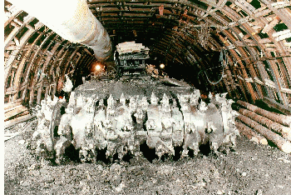

ENA Has Strong Relationships with Both Producers and Generators
Term supply agreements underscore strong relationships with over 14 major producers in West Virginia, Kentucky, Pennsylvania, Illinois, Ohio, Wyoming, Colombia, and Australia
ENA has established a reputation for reliable physical supply with major utilities

Slide 7
ENA Coal Supply and Pricing Alternatives.
© 1999 BO-9120155-<number>

Slide 8

Physical Pricing Alternatives
Fixed Price Structures
Option Instruments (Caps, Floors, Collars, etc.)
Portfolio Pricing
  Staggered Pricing Structures
  Staggered Pricing Terms
Optionality resulting from wider coal specs

Slide 9


Inventory and Transportation Optimization
Transportation Optimization
  Aggregation and Assumption by ENA of all transport (rail, barge, truck) contracts.
  ENA will guarantee transportation pricing at least as competitive as existing contracts with possibility of reduced pricing.
Inventory/Stockpile Optimization
  Inventory Volumes are varied to provide delivery optionality

Slide 10
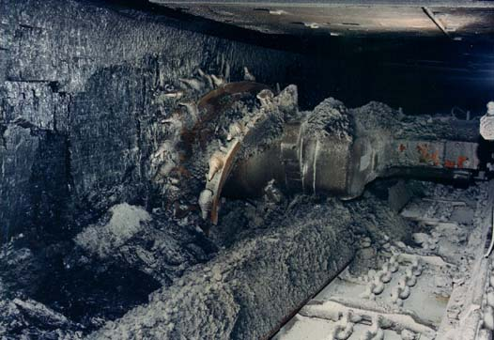
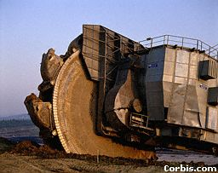
Producer Finance
ENA has financing relationships with over 3 major producers mining coal in Virginia, West Virginia, Illinois, Pennsylvania, and Kentucky
Financing positions allow ENA to have control of over 9 million tons of coal

