Slide 1
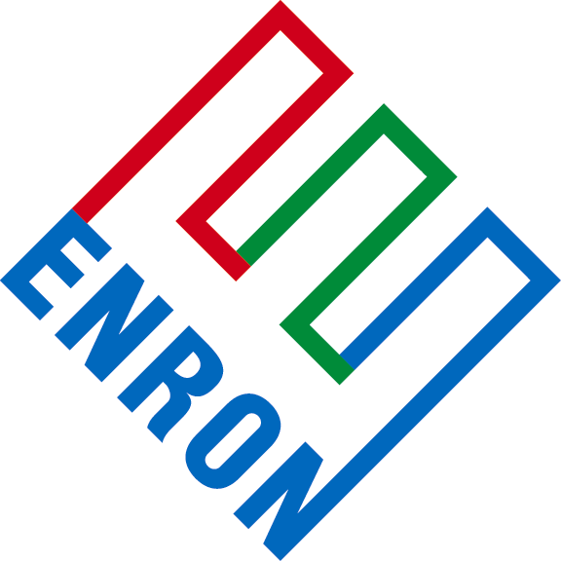
®
Enron Asset Management Resources
ETS Operations Services
August 28, 2001

Slide 2
ETS Operations Resume
70+ years of reliable energy facility operations
1600+ Operational Personnel across the US and abroad
Operates 25,000 miles of natural gas pipelines, transporting 15% of the total natural gas consumed in the U.S. annually
Operates four underground natural gas storage facilities and two LNG peaking storage facilities
Operates 8,200 miles of active crude oil pipelines
Successful utilization of self-directed work teams supported by skill-based pay since 1993 (130+ teams across the U.S.)
Progressive technology utilization for operations improvement
Provides operations technical services to Enron’s International assets as well as non-Enron owned assets.
Recognized as world-class operator of pipelines by peer companies

Slide 3
ETS Operations
Enron’s Center of Excellence for Pipeline and Compression
  Due Diligence
  Operations and Maintenance
  Engineering and Construction
  Technical and Professional Services
ETS Quality Management
  Operational Audit Program for all Enron domestic assets

Slide 4
EAMR Services
Management Consulting
Service Characteristics
  Organizational Management Consulting
  Transportation Management Services and Gas Control
  Pipeline Control Management
  Quality Management
  Environmental Health and Safety Program Consulting
  Process Safety Management Consulting
  Communications Program Consultation
  Mechanical Integrity and Predictive Maintenance Program
  Operations Information Management
  Crisis Management Program Consultation
  Continuous Improvement
Model Customer
  Interesting in improving their operations effort
  In need of cost reduction assistance, program improvement, etc.
Types of deals
  Package services to meet customer needs
Technical Services
Service Characteristics
  Mechanical Analysis
  Corrosion Control Consulting
  Engine Operation Optimization
  Engine Emission Testing
  Measurement Consulting
  Unaccounted For Loss Consulting/STAR System Consulting
  Controls Consulting
  Pipeline Welding Consultation
  Metallurgy Consultation
  Failure Investigation
  Material Selection and Specialization
  Technical Evaluation for new construction or retrofits
  Pipeline Internal Inspection Consulting
  Pipeline Stoppling and Hot Taps
  Integrity Assessment Program
Model Customer
  Asset owners or operators located in relatively close proximity to Enron
  Due to aging workforce or other factors, expertise is no longer in-house
Types of deals
  Periodic services performed at asset location

Slide 5
EAMR Services
Engineering & Construction
Service Characteristics
  Project Management.
  Engineering
  Construction
  Owners Engineer
  System Optimization and Planning
  Materials procurement and supply management
  Records management
  Pipeline hydrostatic testing consulting
  Startup and commissioning
  HAZOP Review
  Gas processing/LNG consulting
  Expert testimony
Model Customer
  Asset owners looking to expand their facilities
  Asset owners / operators in need of system or procurement optimization
Types of deals
  Project Engineering and Construction
  Owners Engineer
  Optimization Consulting
Outsourcing
Service Characteristics
  Physical operations and maintenance of assets (O&M)
  Gas Control and Transaction Management
  Guaranteed performance contracting
Model Customer
  Companies going through transition due to M&A or other factors
  Companies focused on cost reduction, strategic alignment, etc...
Types of deals
  Longer duration - ongoing for some specified term
  Potential for guaranteed savings
  Customize package of services to meet customers needs

Slide 6
EAMR Services
Due Diligence
Service Characteristics
  ETS’ deep bench strength is available to provide a broad range of due diligence support for on-going or future projects
  Support personnel can be made available on short notice
Model Customer
  Enron M&A activity
  Enron Investments
Types of deals
  Expertise on construction estimates
  Evaluation of operation and maintenance conditions
  Evaluation of environmental, health and safety issues
  Evaluation of regulatory compliance
Enron Quality Management
Service Characteristics
  Audit of O&M, Environmental, Safety and Administrative process and procedures
  Operational Audit of assets - International and Domestic
  Assets audited to Enron, Federal, State, Local Standards
Model Customer
  Asset owners concerned about operational performance, reliability and safety
  Potential purchasers of assets as a due diligence function
Types of deals
  Bundled cost + mark-up price
  Retainer / Annual fee

Slide 7
“A vision without the ability to execute is probably a hallucination.” Stephen M. Case
Management Mandates
  “Gross negligence capped at the value of the service contract on an annual basis”.
  Protect balance sheet of ENE.
  Protect ETS from fluctuations in allocated annual insurance premiums.
  If a services deal is part of a larger package of services to the customer with multi-million dollar potential, Marketing can backstop the deal and alternative risk mitigation can be considered.
Citizens Communications – Griffith Power Plant, Kingman, AZ
  General liability insurance put in place with EAMR and Citizens as co-insureds.
  Professional liability insurance put in place specifically for Citizens deal.
EAMR has the ability going forward to put general and professional liability insurance in place for EAMR transactions

Slide 8




ETS Operations – The Real World
®
June 10, 1999 Olympic Pipeline explosion in Bellingham, WA
August 19, 2000 El Paso Natural Gas explosion near Carlsbad, NM
“3 families, trapped at GROUND ZERO
12 campers killed in explosion from pipe that had clean bill of health”
— Austin American-Statesman, 7/22/01
“Spills and explosions reveal lax regulation of powerful industry”
— Austin American-Statesman, 7/22/01
"Unless the basic system of requirements of the system that regulate the pipelines are increased nationwide, these kinds of events are going to happen again somewhere else.”
— Bellingham Mayor Mark Asmundson
“Time is running out as lines deteriorate”
— Austin American-Statesman, 7/22/01

Slide 9

ETS Operations - The Real World
®
“…[pipeline industry] enjoyed a net profit of 40 percent
in 1999, while communities across the nation will continue to experience horrific failures of aging pipelines.”
        — from editorial written by parents of 3 killed at Bellingham,
        The Seattle Times, 10/6/00
“..Pipeline industry has resisted …mandatory periodic inspections…pipelines continue to age…now more than 50 years old…”
— WSJ, 8/1/01
“… pipes are under-regulated and at risk of leaks and fires”
— Houston Chronicle, 2/28/00
"Aging infrastructure, lax safety standards, and weak oversight and enforcement have turned New Mexico's pipelines into accidents waiting to happen”
— NMPIRG, 6/6/01

Slide 10
Legislative and Regulatory Drivers
Regulations Becoming More Stringent
Office of Pipeline Safety anticipated to issue Pipeline Integrity Ruling for natural gas pipelines by end of 2001.
February, 2001 U.S. Senate passed and the House appears to support a bill directing DOT to require:
  Inspections of pipelines every five years.
  Increased maximum civil penalties from $25k to $500k.
U.S. House of Representatives considering:
  Enhanced qualification requirements for pipeline operators.
  Potentially will be attached to bills intended to speed review of new pipelines.

Slide 11
®

