Slide 1






Challenges and Opportunities for Natural Gas in a Winter of Discontent
- Dr. Kenneth L. Lay Chairman & CEO
National Governors Conference Columbus, Ohio September 20, 2000
®

Slide 2
Introduction
Natural gas resource base
Current gas prices in historical context
The new natural gas industry
Opportunities for market best-practices
and public policy reform

Slide 3
Proved and Potential U.S. Natural Gas Resources
Current estimates:
1,470 average
Shortage
Era
Trillion Cubic Feet

Slide 4
U.S. Natural Gas Replenishment
Trillion Cubic Feet--Proved Reserves
828
167
147
YE 1944
Reserves
1945-99
Production
YE 1999
Reserves

Slide 5
Canadian Natural Gas Replenishment
Trillion Cubic Feet--Proved Reserves
94
62
46
YE 1964
Reserves
1965-99
Production
YE 1999
Reserves

Slide 6
U.S. Lower-48 Natural Gas Resources Subject to Access Restrictions
*29 Tcf closed; 108 Tcf available restrictions
Source: National Petroleum Council

Slide 7
U.S. Residential Natural Gas Prices Since 1984
(1999 $/MMBTU)
2000/2001
Winter Estimate
1984
1986
1988
1990
1992
1994
1996
1998
1985
1987
1989
1991
1993
1995
1997
1999
Residentials could purchase gas this winter
at real prices last paid in 1986/87
Source: U.S. DOE (EIA)

Slide 8
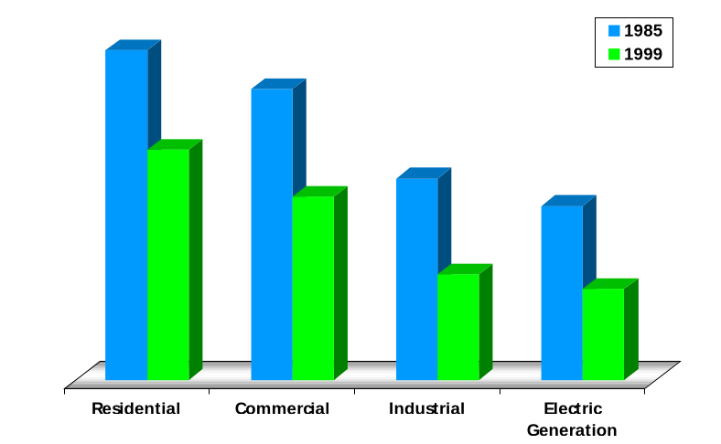
U.S. Average Gas Prices by Sector
1985 vs. 1999 (1999$/MMBTU)
-30%
$9.48
-37%
$8.36
$6.62
-48%
$5.79
-48%
$5.27
$5.00
$3.04
$2.62

Slide 9

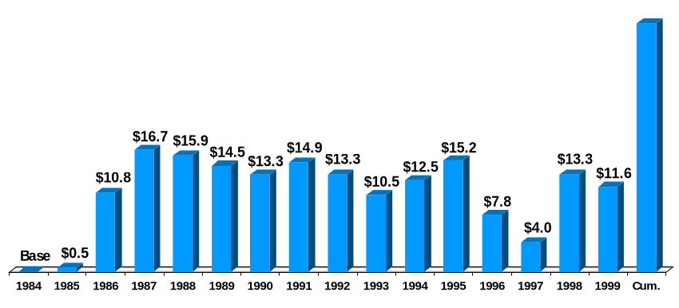
U.S. Natural Gas City Gate Cost Decline
(Billions 1999$)
$174.2
Total savings
since 1984
[Price savings volume = total savings]
x
Source: U.S. DOE Natural Gas Annual, Table 21, and Natural Gas Monthly, May 2000

Slide 10
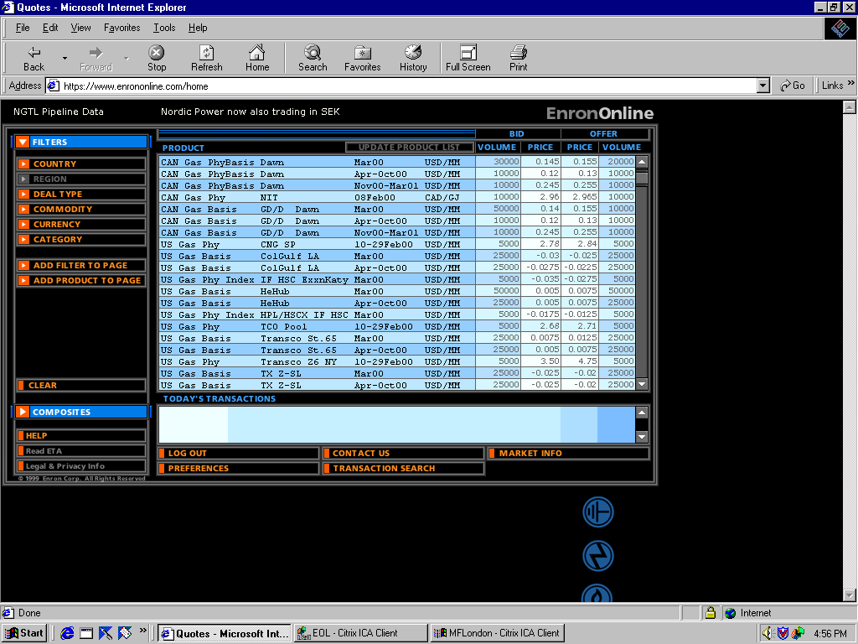

It’s a New Industry!

Slide 11
Natural Gas A Maturing Financial Commodity
Source: Enron, NYMEX
© 2000 RB-NGC-0800-13a

Slide 12
Comparative Annualized Daily Volatility
Spot Price Electricity ERCOT
NYMEX Natural Gas
NYMEX Sweet Crude
30-year Treasury Bond Yield
Power
Oil
Gas
Bonds
Natural gas is a mature commodity

Slide 13
Trading Margins Natural Gas vs. Electricity
(MMBTU equivalent - October 2000 Spreads)
Natural Gas
Electricity
Inefficient Wholesale Grid
Efficient Wholesale Pipeline System

Slide 14
2000/01 Winter Price Hedging
($/MMBtu)
8/31/00 Lock-in Price for Dec. ‘00/Jan ‘01 - $4.80/MMBtu
Historic 2000 prices through August
Jan/Feb 2000 Hedge for Dec. ‘00/Jan ‘01 - $2.79/MMBtu
Jan
Feb
Mar
Apr
May
Jun
Jul
Aug
2000

Slide 15
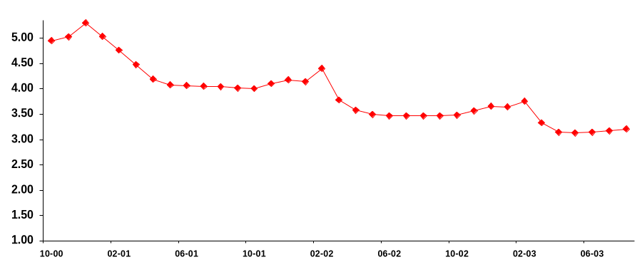
Backwardation Price Curve for Wellhead Gas
($/MMBtu)
$5.30
This Winter
$4.40
Next Winter
Hedge-Dec ‘00 - Mar ‘03 = $4.25
$3.75
Winter 02/03
Source: NYMEX (September 15, 2000)

Slide 16

The New Power Company
TM
A major new entrant in the residential market for natural gas and electricity
Online strategy to efficiently procure and service customers
Back office outsourced for cost effectiveness
Partnership of core competencies:
AOL
IBM
DLJ
CalPERS
Ontario Teachers
GE Capital

Slide 17
Public Policy Opportunities
Expand drilling access and incentives
Expedite certification for midstream and downstream infrastructure
Improve the hedging environment for utilities and other market participants
Promote a robust competitive environment for natural gas retailing
Do no harm!

Slide 18
A Real Energy Crisis - 1970s Headlines
INDUSTRIAL OUTPUT DOWN 1% IN JANUARY-
SHORTAGES BLAMED
CARTER WARNS OF “IMPENDING CRISIS”
FORD, GOVERNORS DISCUSS GAS SHORTAGES
GAS DIVERSION CURBED
EMERGENCY GAS BILL SIGNED
LAW WAIVED TO EASE GAS TRANSPORT
BLIZZARD STRIKES GAS-SHORT STATES
FACTORIES CLOSED IN 15 STATES
FPC HIKES “NEW” NATURAL GAS RATE; COURT ORDERS REFUND
SCHOOLS CLOSED FOR LACK OF HEAT
DATA LACKING
COMPANY BUYS OWN GAS FIELD
GAS WITHHOLDING CHARGES DENIED
FPC ACTS TO EASE FUEL SHORTAGES
FPC REPRISALS CHARGED
WITHHOLDING OF GAS NOT FOUND
RESERVES FALL
INDUSTRY ACCUSED
UTILITIES BLAMED
OVERCHARGE SUIT SETTLED

Slide 19
California Power Price Cap Experience
Discourage exports of out-of-state power to California
Discourage entry of new power plants
Discourage conservation and energy efficiency
Treats symptoms, not causes
Regulatory quick-fixes worsen market challenges

Slide 20
Electricity–More Important Than Ever
“The Internet consumed 8 percent of U.S. electric output in 1998, and is responsible for 40 percent of the U.S. load growth over the last 10 years.”
-Robert Nardelli,
CEO, GE Power Systems
“The [demand] battlefield . . . is in data centers where thousands of servers and other powerful computers are stacked floor to ceiling. A single data center will use as much electricity as six 40-story office buildings. Roughly 20 data centers are currently planned for the Chicago area.”
-Fortune (August 14, 2000)

Slide 21
California Electricity Imbalance 1996-99
11,000 MW
12% Increase
5,500 MW
1% Increase
672 MW
Peak Demand
Increase
Powerplant Capacity
Additions
Proposed Capacity
Backlog
Source: CPUC; Electricity Oversight Board

Slide 22
U.S. Peak Electricity Demand Growth
in Gigawatts
625
593
562
63 GW
All Others
172
200
191
New Capacity
20.4 GW
SERC
157
147
149
ERCOT
55
47
51
WSCC
113
104
110
ECAR
92
92
100
1995
1997
1999
Peak electricity demand has increased 11% since 1995, yet new capacity additions increased 2.5%
Source: Cambridge Energy Research Associates

Slide 23
Regulatory Death Spiral
Tight Supply
Regulated
Shortages
Less Supply
More Demand
Price Surge
Brownouts
Blackouts
Blackouts
Price Caps

Slide 24
®

