Slide 1
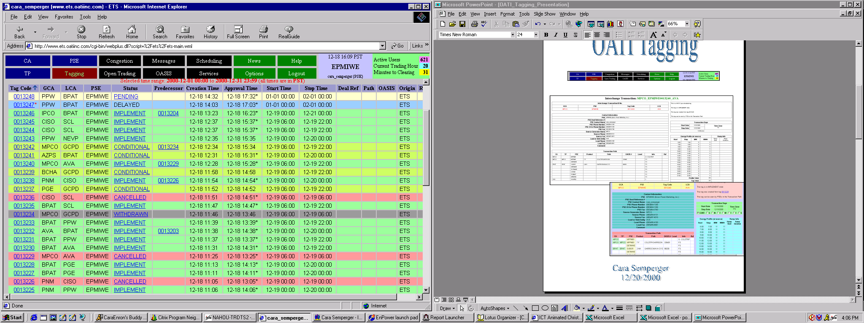
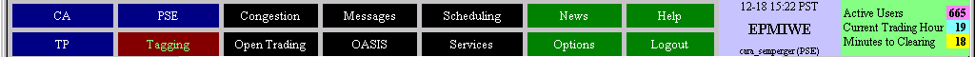
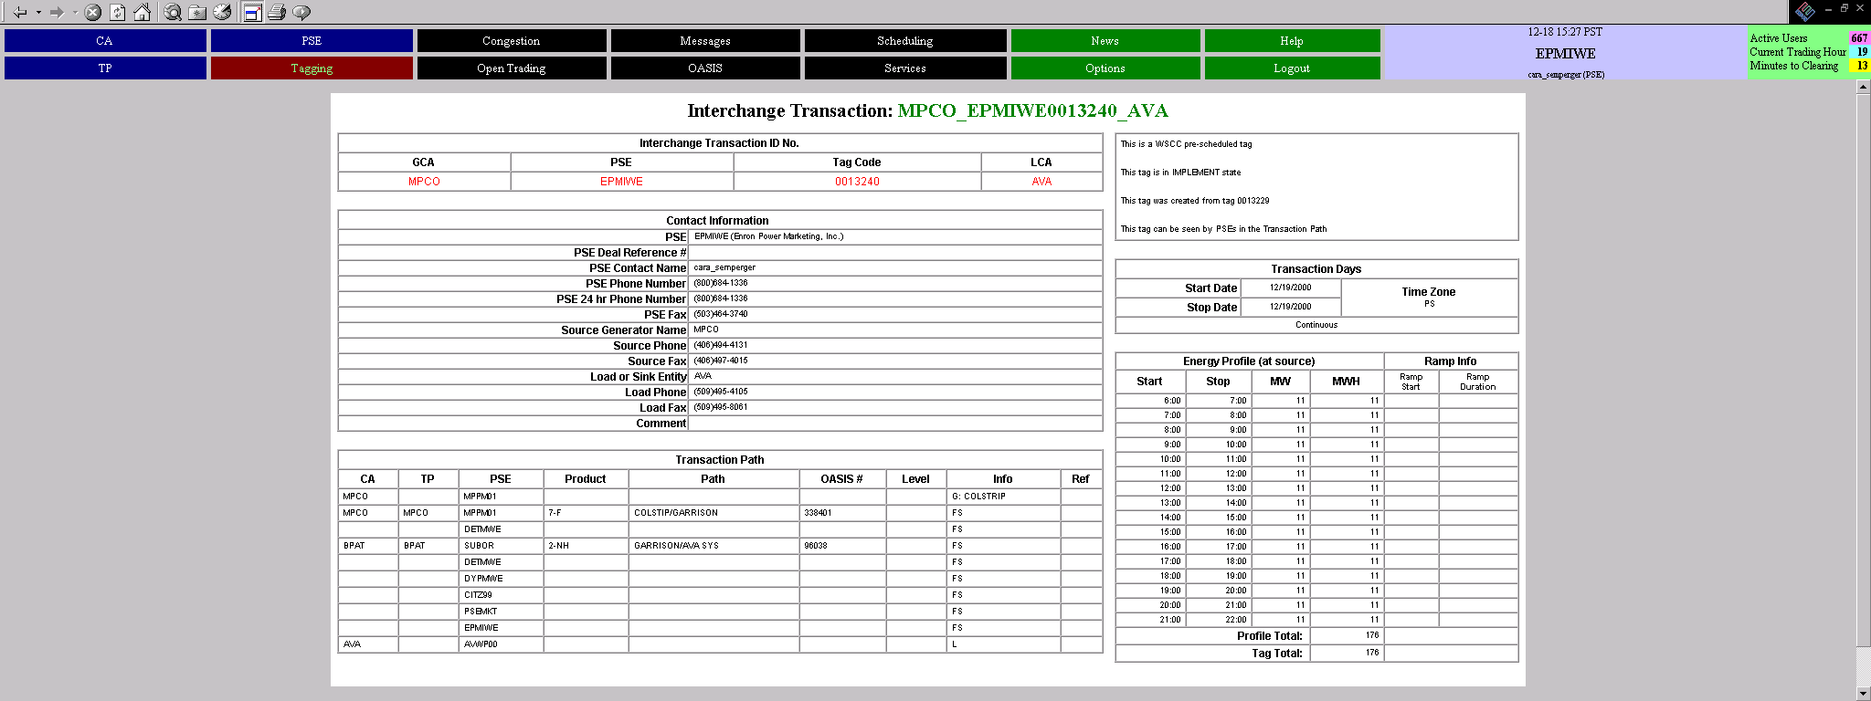
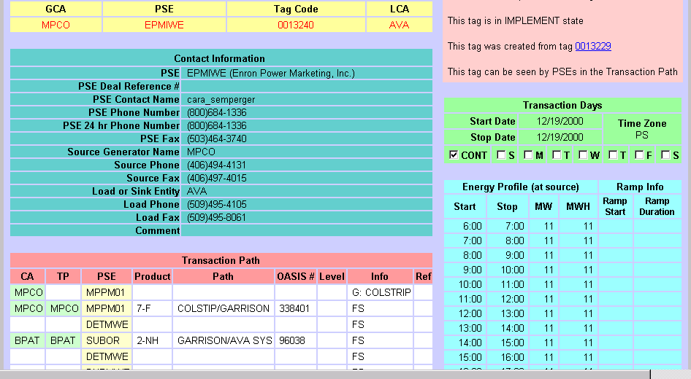

OATI Tagging
Cara Semperger
1/9/2000

Slide 2
Finding the OATI Site
Main Website:
http://www.ets.oatiinc.com/
Alternate Website*:
http://www3.ets.oatiinc.com/
*Use this site when the regular site is down or
acting erratic.

Slide 3
Terms
Tag Status Terms:
Pending: A tag that has been made but not approved by any tagging authority.
Attention Required: A tag that has not been delivered due to a technical
problem with another entity.
Conditional: A tag that has not been fully approved, but not denied within a
2-3 hour window after being made.
Implement: A tag that has been approved by all CA’s.
Denied: A tag that has been refused approval by one or more CA’s.
Withdrawn: A tag that has been removed from active scheduling by the
creating PSE.
Cancelled: A tag that has been withdrawn by the creating PSE after all of the
CA’s have approved it.
Rejected: A tag that has not passed the Oati software due to a format or
protocol error.
Delayed: A tag that has been created, but not released into active scheduling.
Undelivered: A tag that has not been delivered to anyone due to a technical
problem at Enron or OATI.
Late: A Preschedule tag made after the Preschedule deadline.

Slide 4
Terms
Transmission Terms:
All Transmission has a degree of time and firmness.
This information is vital on an e-tag, and failure to properly identify the transmission will result in rejected or denied tags.
Product Codes:
1-NS- Non-Firm Secondary
2-NH- Non-Firm Hourly
3-ND - Non-Firm Daily
4-NW- Non-Firm Weekly
5-NM-Non-Firm Monthly
6-NN-Non-Firm Network
7-F-Firm
Each time a transmission path is used, a corresponding OASIS number must be entered on the same row. The tag will not even go into the system without it. Numbers and Letters can be used, but the capacity of the OASIS number space is limited to 12 characters.

Slide 5
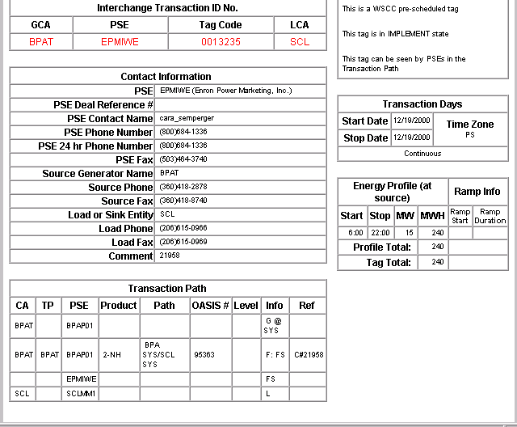
Tagging Basics
This is the print view of a tag
These 4 components make up the unique tag identifier:
This tag’s unique code is “BPAT_EPMIWE0013235_SCL”
This determines the
scheduling nature of the tag
PreSchedule vs. Real Time
The login ID
of the tagger
and PSE info
The tag approval status
The dates
of Power Flow
The time and
volume of
Power flow
The Entire
Path, with any
relevant numbers
Contact numbers of the Generator and Sinking
Control Areas

Slide 6
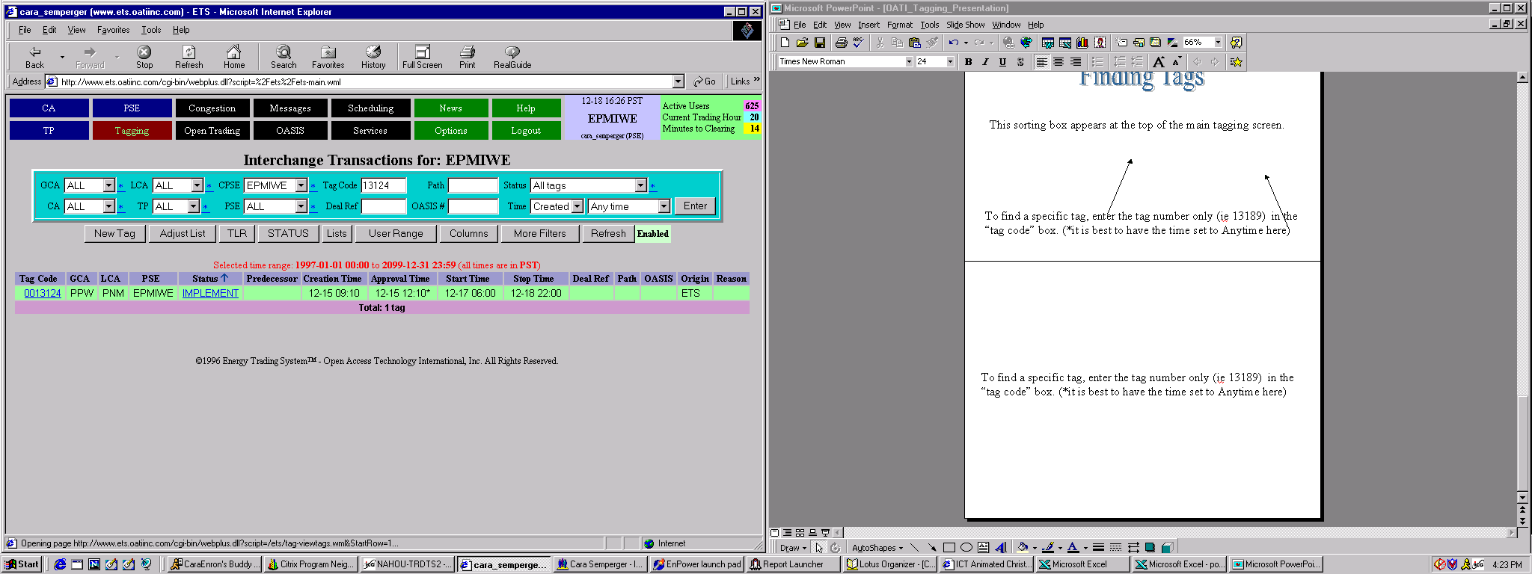
Finding Tags
This sorting box appears at the top of the main tagging screen.
Generating
Control
Area
Entity who
Created the
Tag
Path or
Delivery
Point
Tag
Number
Load
Control
Area
Oasis
or
Global ID
Time Criteria
to sort by
To find a specific tag, enter the tag number only (ie 13124) in the
“tag code” box. (*it is best to have the time set to Anytime here)
The result:

Slide 7
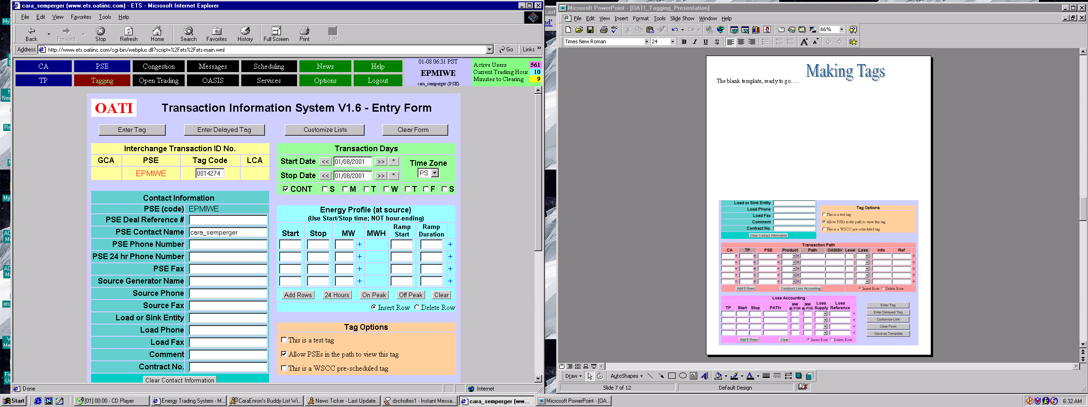
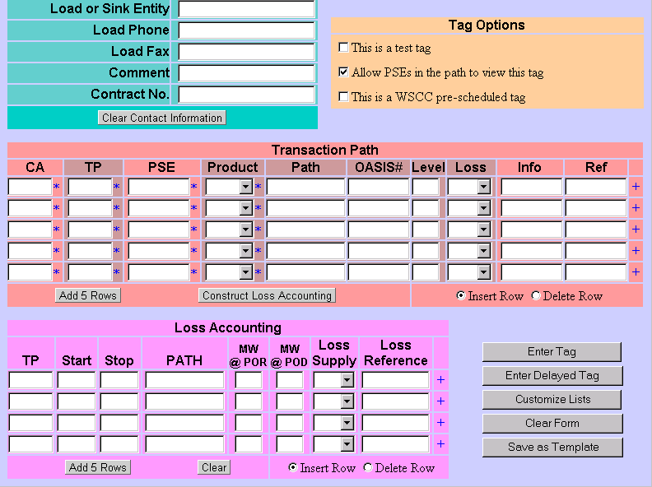
Making Tags
The blank template, ready to go…..

Slide 8
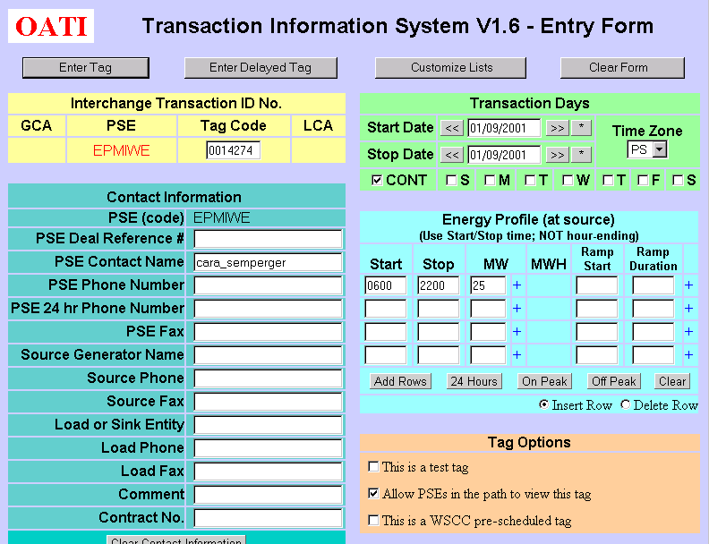
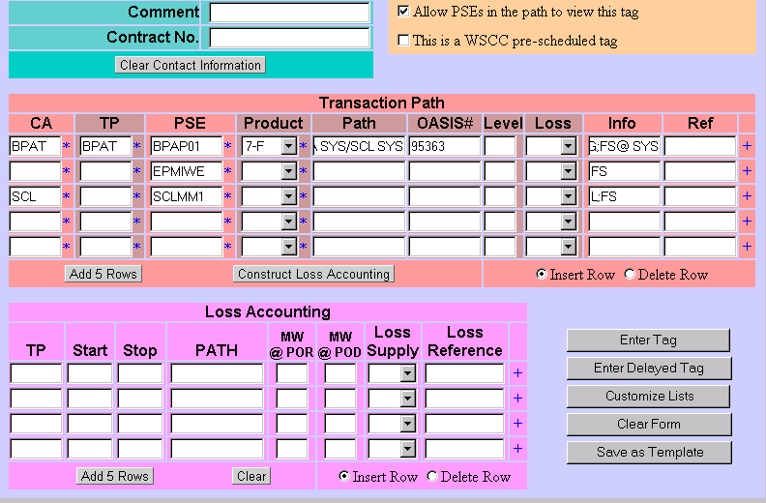
Making Tags-2
The information entered, ready to send………...
All of this
info is
auto generated
when the
tag is
entered
Clicking these
asterisks will
pop up a screen
that allows
the user to
choose from a list
Sends the tag
to a
“Preview Screen”
Saves the tag in the system
for later modification
and sending
NEW! Saves the tag in the system
as a template

Slide 9
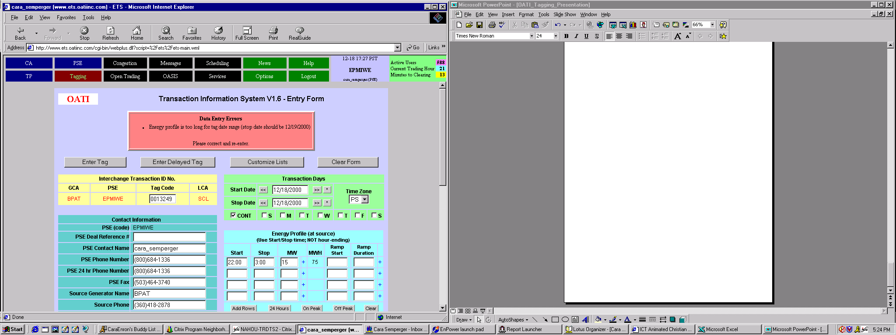
Making Tags-3
This error message box will point out
any serious flaws in the tag. These errors
must be corrected before the tag can be entered.
In this example, a tag with a profile that flows past
midnight was initially tagged as the same day. The
corrected tag will show a stop date of 12/19/2000

Slide 10
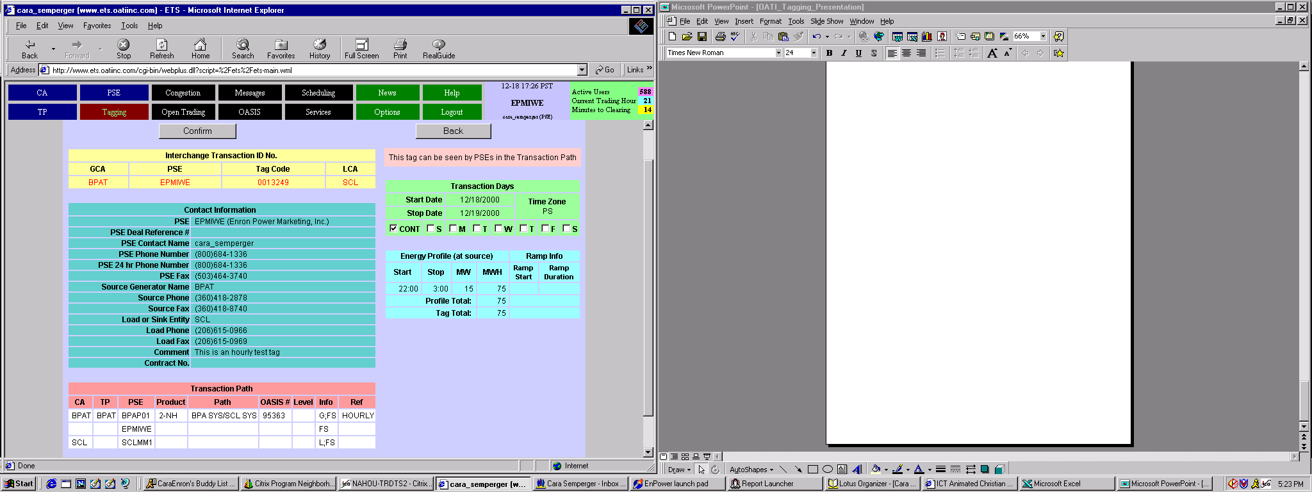
Making Tags-4
The tag below is in the preview screen. Use this to
check over the path, the date, and the total MW that
are flowing. Any errors can be corrected by clicking
the “Back” button.
When the tag is perfect, the “Confirm” button will
release it to the rest of the path participants. Once a tag
has been confirmed, it can only be Withdrawn, Cancelled or
Terminated by the PSE who made it.

Slide 11
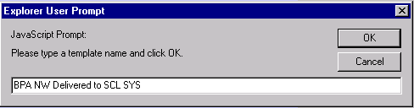
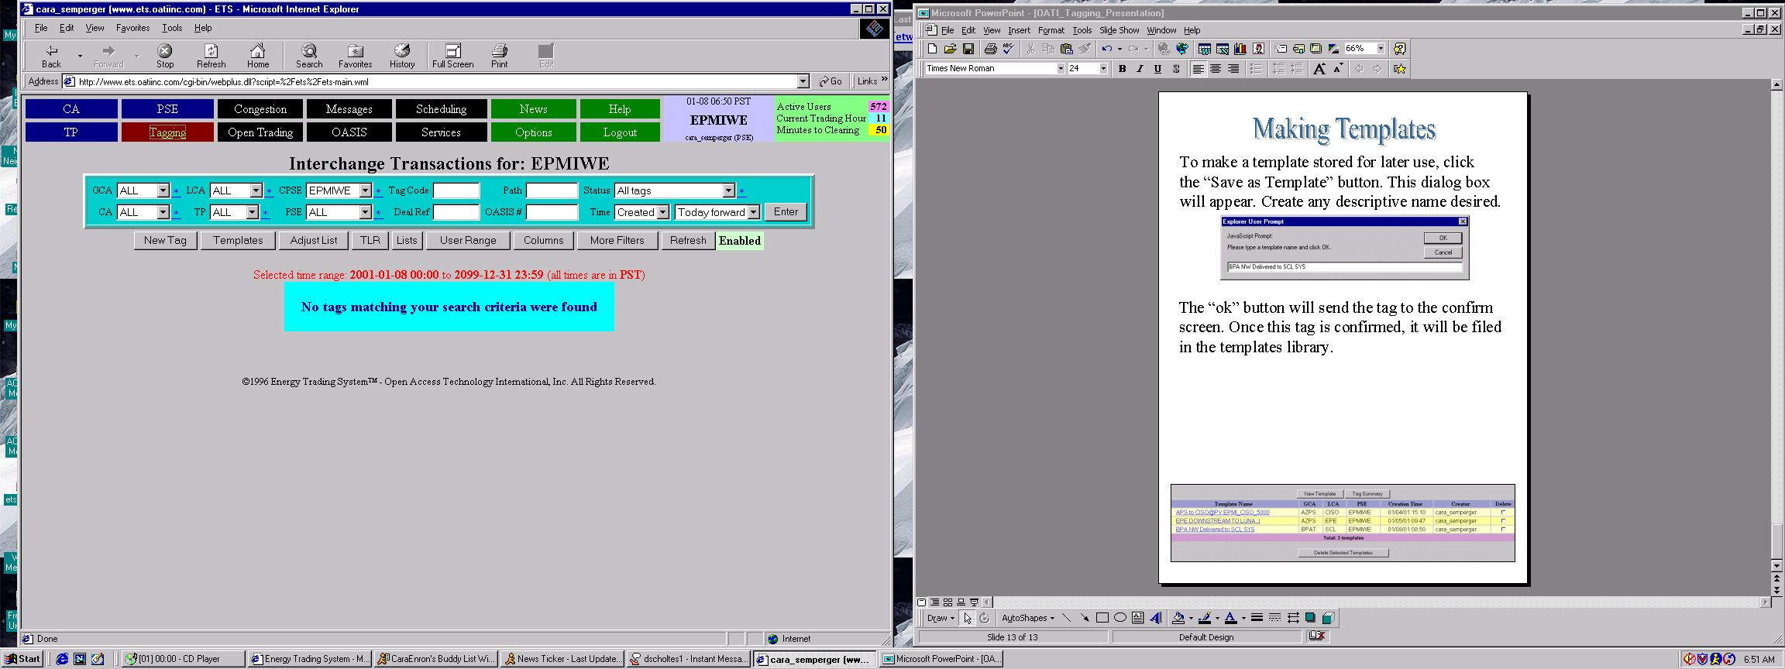
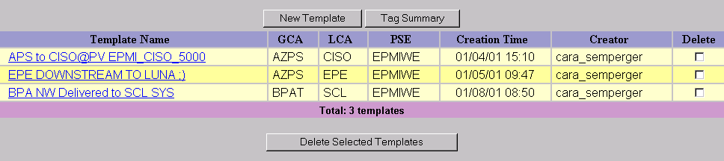
Making Templates
To make a template stored for later use, click the “Save asTemplate”
button. This dialog box will appear. Create any descriptive name desired.
The “ok” button will send the tag to the confirm screen. Once this tag is confirmed, it will be filed in the templates library. The Templates
library can be accessed through the main scheduling screen.
The view of the template library. To access the template needed, just
double-click the title. To make a new tag from the template, click the
“Create New Tag” button when the template opens.

Slide 12
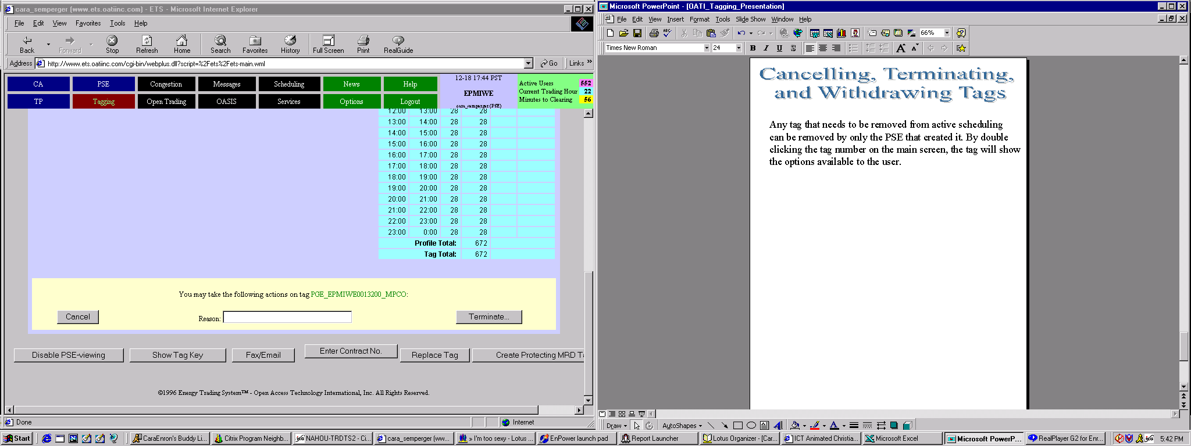
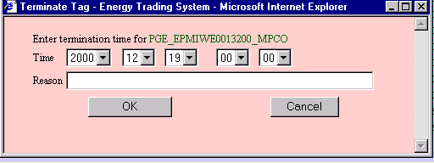
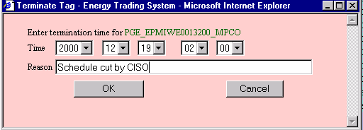
Cancelling, Terminating,
and Withdrawing Tags
Any tag that needs to be removed from active scheduling
can be removed by only the PSE that created it. By double
clicking the tag number on the main screen, the tag will show
the options available to the user.
This tag is in “Implement” status,
so the only choices available are Cancel
or Terminate
Canceling a tag removes the entire tag from active scheduling,
The Terminating a tag removes it from a specific point forward.
The pink dialogue box below will appear when “Terminate” is clicked.
In this example, the tag was stopped at HE 0200 on 12/19. The
schedule that existed before that time was still valid, but after
that time is removed from active scheduling.

Slide 13
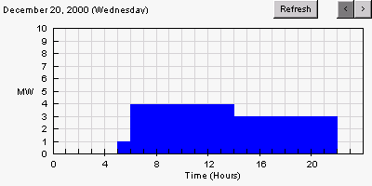
New Feature
A graph at the bottom of a tag in active scheduling
will now show the energy profile. This feature was
just added on 12/19/2000

