Slide 1
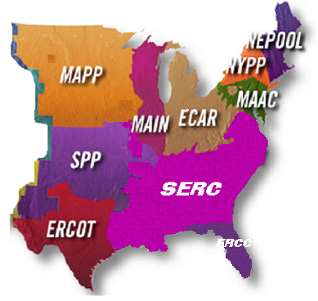

Enron North America, East Power
Dana Davis
Vice President East Power Trading

Slide 2
East Power
Northeast
Southeast
Midwest
ERCOT
Development
Structuring
Fundamentals
NEPOOL
NYPP
PJM
SERC
SPP
FRCC
MAIN
MAPP
ECAR
ERCOT (TX)
Maintain site bank at current levels (30 sites in 14 states) and expand site bank in select strategic regions
Monetize sites and associated development assets
Utilize existing sites for leverage into higher proposition structured transactions
Maintain integrity of risk assessment/ valuation
Deal structure development
Be a primary training and development ground for future commercial talent in Origination and Trading
Create deal flow efficiencies
Leverage the analyst and trading track program to improve and deliver better fundamental data and processes
Create an education and training plan for core staff in the fundamentals group
Evaluate/Procure leading edge fundamental and technical analysis tools and products that support East Power Trading
Northeast
Focused on financial markets (broker,OTC, exchanges) and physical customer markets (IOU, IPP, Muni, Cooperative, and Industrial)
Make markets at the trading hubs to promote liquidity and price transparency
Customer penetration brings information and high yield structured transactions

Slide 3
Eastern Interconnect Grid Overview
Consists of the following NERC regions:
  NEPOOL
  NYPP
  PJM
  ECAR
  MAIN
Approximately 600,000 MW of installed capacity
  44% coal
  29% gas
  14% nuclear
Distinct summer and winter daily load profile
  Graphical description to come for each NERC region
The majority of maintenance outages occur in the spring and fall
Capacity margin for 2001 is approximately 13%
  Capacity margin is defined as the excess installed capacity over peak load (considered reserve)
    MAPP
    SPP
    FRCC
    SERC

Slide 4
North America
Physical Power Volumes
(Million MWh)
579
402
381
192
+52%
1997
1998
1999
2000

Slide 5
EnronOnline – “The” Energy Market-Maker
(Average Daily Transactions)
EnronOnline
Traditional
4,922
4,042
3,463
3,539
3,049
3,076
3,171
2,761
2,165
2,166
1,898
1,499
650
917
1999
2000
Expanded Market Reach, Scalability, Information and Liquidity
North America Natural Gas and Power Transactions

Slide 6
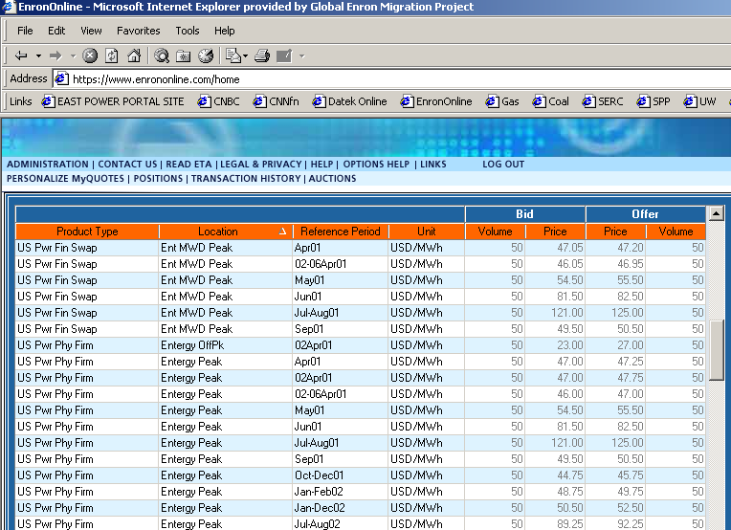
Trading Platform: Enron Online
Price
Term
Region

Slide 7
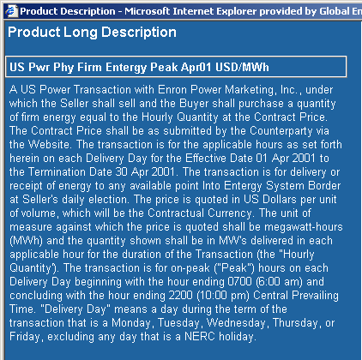
Physical Firm Products
50MW blocks
On peak:
  - 6:00 a.m. – 10:00 p.m.
Off peak:
  - 12:00 a.m. –6:00 a.m.
  - 10:00 p.m. – 12:00 p.m.

Slide 8
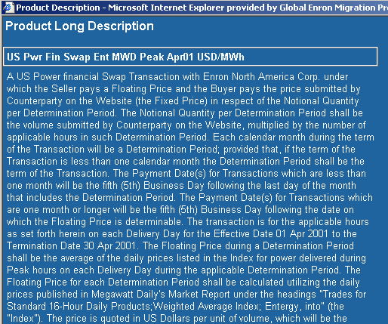
Financial Swap
Floating Price
  Settled against Megawatt Daily
Fixed Price
  - As shown on EOL

Slide 9
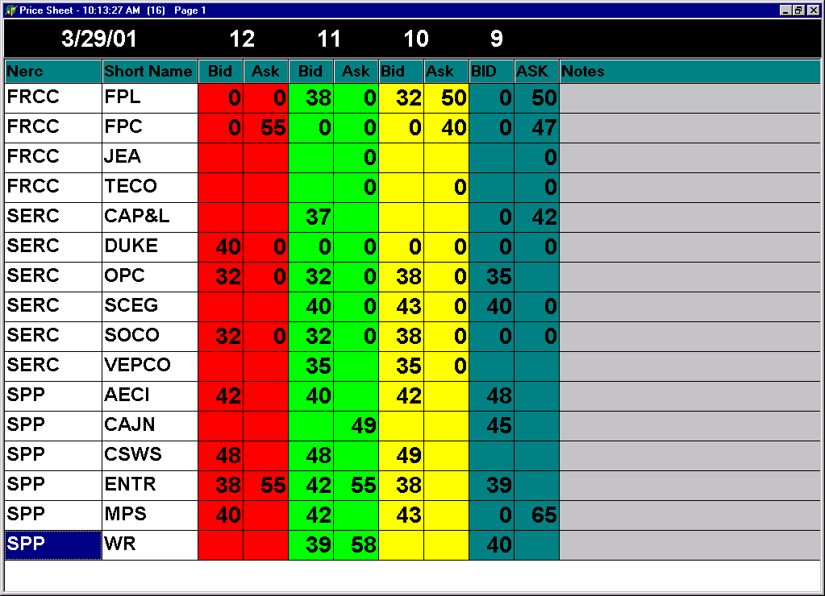
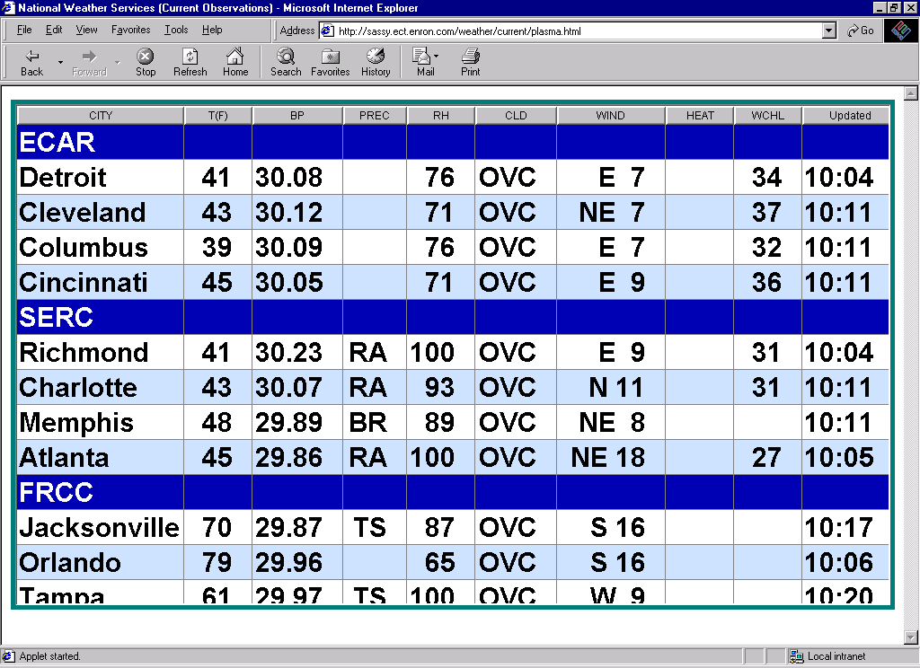
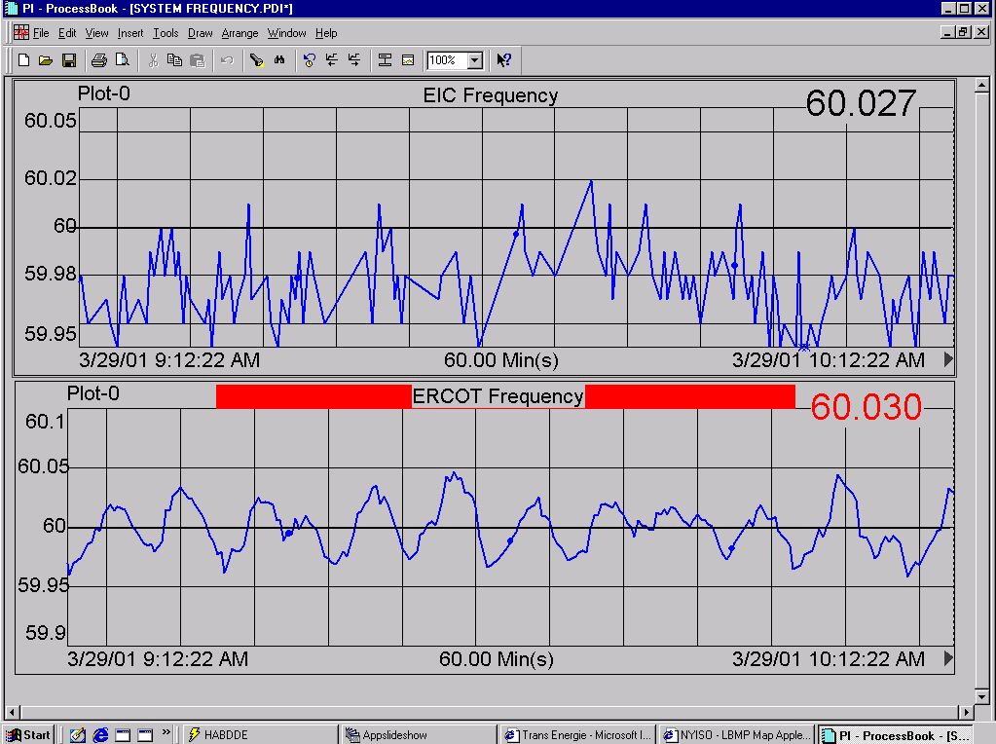
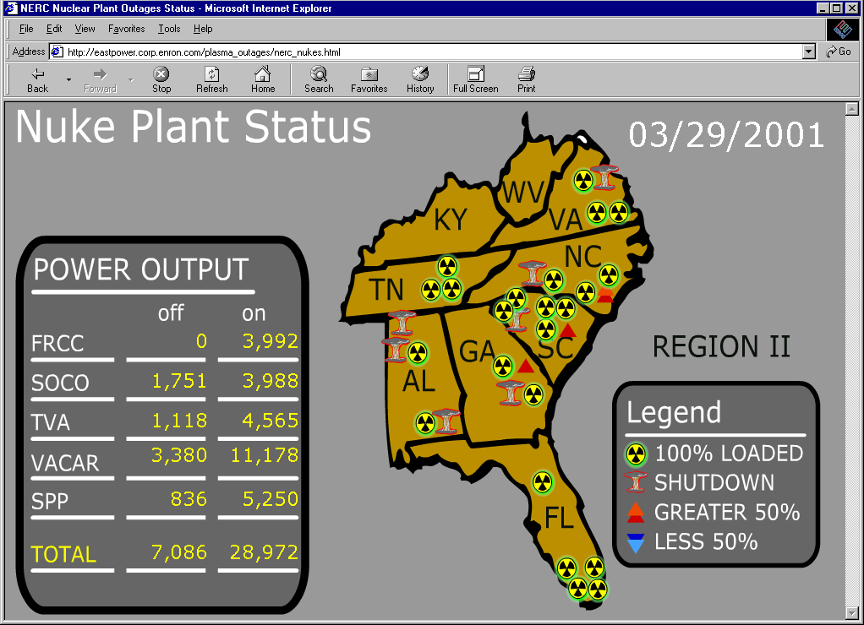
Real Time Market Information

Slide 10
Load Forecasting
Short Term Daily Forecasts
Long Term Forecasts
Temperature Sensitivities

Slide 11
Forward Power Prices

Slide 12
Northeast Power ISO’s
PJM – Pennsylvania, New Jersey and Maryland
NEPOOL – New England Power Pool
NYISO – New York Independent System Operator

Slide 13
What is an “Independent System Operator?”
A concept developed by the Federal Energy Regulatory Commission (FERC) as part of the $320 billion electric industry in the U.S.
Key principles:
> non-discriminatory governance structure.
> facilitating market based wholesale electric rates.
> ensuring for the efficient management and reliable operation of the bulk power system.

Slide 14
PJM

Slide 15
NEPOOL

Slide 16
NYPP

Slide 17
Northeast Peak Loads
PJM
  Summer 2000 – 49,417 MW
  Winter 2000 – 42,395 MW
  All Time Peak Load – 51,700 MW
NEPOOL
  Summer 2000 – 21,992 MW
  Winter 2000 – 20,193 MW
  All Time Peak Load – 22,609 MW
NYISO
  Summer 2000 – 28,138 MW
  Winter 2000 – 24,118 MW
  All Time Peak Load – 28,138 MW

Slide 18
Major Players in the Northeast
PJM
  Public Service Electric and Gas (PSEG)
  PECO/Exelon
  Pennsylvania Power and Light (PPL)
NYISO
  Consolodated Edison (New York and Long Island
  PECO/Exelon
  NRG Energy
NEPOOL
  Pacific Gas and Electric (PG&E)
  Northeast Utilities
  Sithe

Slide 19
Northeast Capacity by Region

Slide 20
PJM Statistics
Complexity:
540 Generation Sources with Diverse Fuel Types
8000 Miles of Transmission
Manage Assets with a Cost in Excess of $5.5 Billion
Over 22 Million People Served
Uniqueness:
Six jurisdictions ( PA, NJ, MD, VA, DEL, DC )
Single Control Area in NERC Region
Energy Transaction Volumes:
Transmission Service Requests: Over 150 Million MWh
Energy Transacted: Over 8 Million MWh/Month
Energy Market Schedules: Over 8,000 Monthly
Tariff & Operating Agreement Billings: In excess of $800 Million Annually
Participants Trained: Approximately 3000
Customer Service Phone Calls: Over 15,000
Membership:
140+ Participants
80 Transmission Service Customers

Slide 21
PJM Market Design
Supports many options for energy traders
  Balanced bilateral transactions (i.e. scheduling coordinator) with no spot market backup
  Bilateral transactions with implicit spot market backup
  Submit flexible generation offers and demand bids
Two Settlement System
  Suppliers offer & customers bid day-ahead prices and quantities into PJM market (first settlement)
  Suppliers offer in real-time market to supply incremental requirements (second settlement)
<date/time>

Slide 22
PJM Market Mechanisms
Supports a variety of financial contracts that are separate from the physical spot market
Forward Energy Market
  PJM Trading Hubs & NYMEX Contract
  Day-ahead Market (Two-Settlement system)
  Financial Transmission Rights
Financial Energy Contracts
  PJM eSchedules

Slide 23
PJM Spot Market
Voluntary offer-based market
  Unit specific (start-up, no-load and energy bids)
  Slice of system (energy only)
  Offers “locked in” by noon day before
Internal units market-based or may be cost-capped
Energy pricing based on Locational Marginal Pricing (nodal pricing) with overlying zones & trading hubs
Central unit commitment & security constrained dispatch
Network customers are not required to schedule expected use (free flowing ties); must bid in designated resources
Non-Network Customers must schedule expected use of spot market (voluntary)

Slide 24
Transmission System Congestion
Transmission system congestion occurs when available, low cost supply cannot be delivered to the demand location due to transmission limitations
As Market Participants compete to utilize the scarce transmission resource, the ISO needs an efficient, non-discriminatory mechanism to deal the congestion problem

Slide 25
Options for Energy Supply
Self-schedule
their own resources
PJM
Spot Market
Load Serving
Entities obtain
energy to serve
customers
Bilateral
Transactions
CUSTOMERS
Industrial Commercial Residential

Slide 26
Transmission System Congestion
The PJM Market uses Locational Marginal Pricing (Nodal Pricing) to manage transmission congestion
The PJM Market also includes overlying trading hubs and zones to provide standard energy products for the commercial markets
The PJM Market includes FTRs (Financial Transmission Rights) to allow participants to manage congestion risk

Slide 27
Locational Marginal Price
LMP =
Generation
Marginal
Cost
Transmission
Congestion
Cost
Cost of
Marginal
Losses
+
+
Cost to serve the next MW of load at a specific location,
using the lowest production cost of all available generation,
while observing all transmission limits

Slide 28
What is LMP?
Pricing method PJM uses to …
  price energy purchases and sales in PJM Market
  prices transmission congestion costs to move energy within PJM Control Area
Physical, flow-based pricing system
  how energy actually flows,
  NOT contract paths

Slide 29
Economic Dispatch
Highest Cost Generator Not Dispatched
I need MWs.
MW
Sale goes to the
300
MWs
@ $10
lowest bidder with capacity.
$10
Going once....
Load
Capacity
300 MWs
499
MWs
MW
199
MWs
@ $15
$15
Capacity
200 MWs
PJM
$15
Market Clearing Price
MW
Not Dispatched
$20
Capacity
200 MWs

Slide 30
Economic Dispatch
Highest Cost Generator Sets Price
MW
I need MWs.
$10
300
MWs
@ $10
Sale goes to the
lowest bidder with capacity.
Capacity
Going once....
300 MWs
Load
599
MWs
MW
$15
200
MWs
@ $15
Capacity
200 MWs
PJM
$20
MW
Market Clearing Price
$20
99
MWs
@ $20
Capacity
200 MWs

Slide 31
Power Transfer Limits
Thermal Limits
Voltage Limits
Stability Limits

Slide 32
Control Actions
240 MW
E
Thermal Limit
D
Sundance
Brighton
A
Solitude
Alta
B
C
Park City
System Reconfiguration
Transaction Curtailments
Re-dispatch Generation

Slide 33
LMP Characteristics
Based on …
  actual flow of energy
  actual system operating conditions
LMPs …
  are equal when transmission system is unconstrained
  vary by location when transmission system is constrained

Slide 34
Factors That Affect LMP
Energy Demand
Economic Dispatch
Available Flexible Generating Units
Network Topology
Binding Transmission Limits

Slide 35
How Does PJM use LMP?
Generators get paid at generation bus LMP
Loads pay at load bus LMP
Transactions pay congestion charges equal to difference between source and sink LMPs

Slide 36
What Are FTRs?
Fixed Transmission Rights are …
a financial contract that entitles holder to a stream of revenues (or charges) based on the hourly energy price differences across the path

Slide 37
Why Do We Need FTRs?
Challenge:
  LMP exposes PJM Market Participants to price uncertainty for congestion cost charges
  During constrained conditions, PJM Market collects more from loads than it pays generators
Solution:
  Provides ability to have price certainty
  FTRs provide hedging mechanism that can be traded separately from transmission service

Slide 38
Why Use FTRs?
To create a financial hedge that provides price certainty to Market Participants when delivering energy across the PJM system
To provide firm transmission service without congestion cost
To provide methodology to allocate congestion charges to those who pay the fixed cost of the PJM transmission system

Slide 39
Characteristics of FTRs
Defined from source to sink
MW level based on transmission reservation
Financially binding
Financial entitlement, not physical right
Independent of energy delivery

Slide 40
What are FTRs Worth?
Economic value determined by hourly LMPs
Benefit (Credit)
  same direction as congested flow
Liability (Charge)
  opposite direction as
  congested flow

Slide 41
Energy Delivery Consistent with FTR
Thermal Limit
FTR = 100 MW
Bus A
Energy Delivery = 100 MWh
Bus B
Source
(Sending End)
Sink
(Receiving End)
LMP = $15
LMP = $30
Congestion Charge = 100 MWh * ($30-$15) = $1500
FTR Credit = 100 MW * ($30-$15) = $1500

Slide 42
Energy Delivery
Not Consistent with FTR (I)
Bus A
FTR = 100 MW
LMP = $10
Bus B
LMP = $30
Bus C
Energy Delivery = 100 MWh
LMP = $15
Congestion Charge = 100 MWh * ($30-$15) = $1500
FTR Credit = 100 MW * ($30-$10) = $2000

Slide 43
Energy Delivery
Not Consistent with FTR (II)
Bus A
FTR = 100 MW
LMP = $20
Bus B
Bus C
LMP = $30
Energy Delivery = 100 MWh
LMP = $15
Congestion Charge = 100 MWh * ($30-$15) = $1500
FTR Credit = 100 MW * ($30-$20) = $1000

Slide 44
Obtaining FTRs
Network service
  based on annual peak load
  designated from resources to aggregate loads
Firm point-to-point service
  may be requested with transmission reservation
  designated from source to sink
Secondary market -- bilateral trading
  FTRs that exist are bought or sold
FTR Auction -- centralized market
  purchase “left over” capability

Slide 45
PJM FTR Auction Summary:
May 1999-June 2000
Total Bids Submitted - 17,956
Total Bids Cleared - 3,360
Total FTR MW Cleared - 50,724
Total Auction Revenue - $2,450,958
Percent of Congestion Charges Allocated Through FTRs
  1998 - 78%
  1999 - 90%
  2000 - 100%

Slide 46
Trading Hubs
Cross section of representative buses
Price less volatile than a single point
Common point for Commercial Trading
Three Hubs:
  - Western (111 Buses)
  - Eastern (237 Buses)
  - Interface (3 Buses)
Weighted Average Price based
on fixed, equal weights at each bus

Slide 47
Delivery Options for Trading Hubs
Bilateral Transactions from External System (Energy or load outside of PJM)
  - Firm, Non-firm paying Congestion, or Non-firm transmission service with the Trading Hubs designated as the Sink or Source
Internal Bilateral Transactions (energy stays within PJM)
  - eSchedules (Internet based scheduling system for internal deals)
  - Source/Sink of Transaction uses trading Hub
Spot Market Purchase/Sale
  - PJM matches generator/load requirements (balancing); accounted for through the PJM Spot Market
  - Source or Sink of Spot Market can be designated at Trading Hubs

Slide 48
External Systems Available for Delivery
NYPP-W NYPP-E
NEPEX
CEI (FE)
PA
NJ
APS
MD
DC
VA
DE
9.
VaPwr

Slide 49
NORTHEAST TRANSFERS
* TTC’s in MWh
1370
Hydro Quebec
940
400
New Brunswick
670
Ontario
2200
700
1800
1575
175
2400
1275
1500
NEPOOL
New York
1800
2800
ECAR-Vacar
MAAC
2850
6500
6500
6500
6500
ECAR-Vacar

Slide 50
Experience with Trading Hubs
The Western Hub is by far the most actively traded location
The majority of deals that are intended to be booked out are at the Western Hub
  The published indices are for Western Hub
  The “broker market” trade the PJM Western Hub almost exclusively
The day ahead market, which is predominately Western Hub, is considered by many to be the the most liquid market in country

Slide 51
PJM Spot Market
Average Monthly Clearing Prices

Slide 52
PJM Transmission Congestion
Number of Constrained Hours by Month
Number of Hours with Congestion

Slide 53
PJM Energy Market
Spot Market Sales
Millions of $

Slide 54
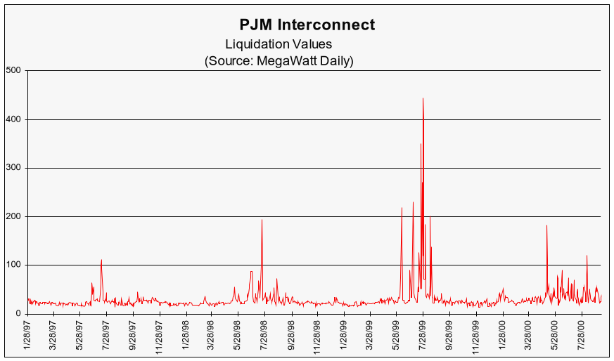
Power Markets: Fundamentals
1997-2000 Liquidation PJM Price Chart

Slide 55
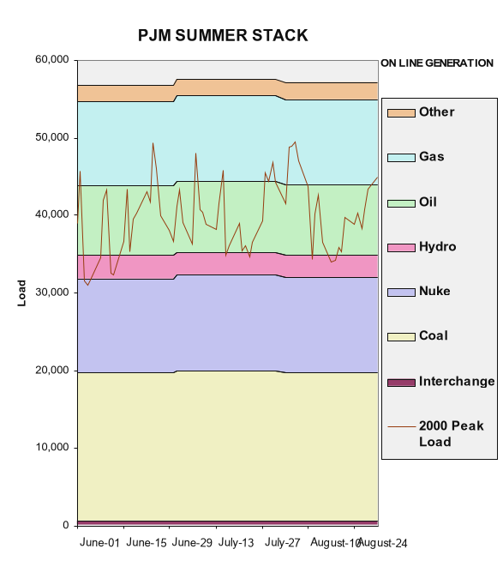
Power Markets: Fundamentals
PJM 2000 Peak Load and Average 1998-2000 Stack

Slide 56
New York ISO
New York’s ISO started operations in November 1999
The NYISO has 11 pricing zones where 3 are traded financially.
The NYISO has Location based pricing with 2 settlements: Day-Ahead and Real Time

Slide 57
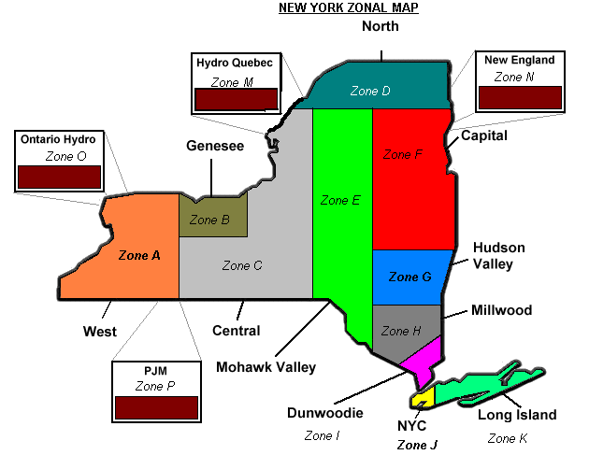
NYISO Trading Hubs
- New York ISO has 3 Active Trading Zones
Zone A
Zone G
Zone J

Slide 58
New York – Constrained?
Most of New York’s generation is in Up-State and most of the load is in New York City (Zone J)
The 3 zones are separated by two major capacity constraints or bottlenecks in New York
  One is Central-East that separates Zone A from G, and the second is the in city Bottleneck (New York City)

Slide 59
New York ISO – Constrained?
HQ
IMO
Central East
ISO-NE
3,100 MW
Zone A
Up-State
New York
5,100 MW
Zone G
Hudson Valley
UPNY/
Coned
4,700 MW
Sprainbrook/Dunwoodie South
Zone J
NYC
PJM

Slide 60
New York TCCs
Transmission Congestion Contracts
  - a financial contract that entitles holder to a stream of revenues (or charges) based on the hourly congestion price differences across the path

Slide 61
Why Use TCCs?
To create a financial hedge that provides price certainty to Market Participants when delivering energy across the New York system
New York TCCs provide the same hedge against congestion as PJM FTRs
Difference between TCCs and FTRs
  - TCCs can be bought for longer terms (1 month to 5 years)
  - TCCs are fully funded where FTRs are not

Slide 62
Supply
What is the condition of NYISO current Supply Portfolio?
  The NYISO reports over 700 generation units for a total of 34,000 megawatts of summer capacity
  Environmental concerns of existing supply
  How many units will be forced into retirement?
  What will replace Indian Point 1 & 2?
  Largest & most immediate concern is NYC & Long Island
    NYC metropolitan area including Long Island make up 45% of NYISO
  New York Queue reports 83 for some 26,500 megawatts
    9,000 megawatts in NYC
    3,000 megawatts on Long Island

Slide 63
Supply
Is the Queue strong enough to support the increased demand for generation?
  New York City metropolitan area (Est. 45% of NYISO load)
    2001 Estimated 700 MWs short going into the summer
        An estimated 480 new MWs will be on line
        This leaves an estimated net short of 220 MWs for this summer
        This does not include any planned outages
    2002 At previous increase rate of 300 MWs per year, NYC is predicted to be 520 MWs short.
        Unclear view of estimated MW on line.
    2003 At previous increased rate of 300 MWs, NYC predicted to be 820 MWs short
        First plant to go through Article X is estimated to be the Athens Plant.
        Average estimated construction time to be 24 months (summer ’03)

Slide 64
Supply
Is the Queue strong enough to support the increased demand for generation?
  New York City metropolitan area (Est. 45% of NYISO load)
    2004 Estimated ranges of demand – 820 to 2000 MWs short
        The year of determination / Will units scheduled come on line?
        Potential expansion of existing facilities on line
        Will environmentalist demand early retirement of some plants?
    2005 Estimated ranges of demand – 300 to 1000 MWs short
        Potential expansion of existing facilities 500 to 100 MWs
        Demand / political environment / public opinion unknown
    2006 First strong indication that supply could exceed 18% capacity reserves

Slide 65
Supply
Is the Queue strong enough to support the increased demand for generation?
  Generation development process extremely slow
    Permitting
      Article X
      Below 80 MWhrs
    Permitting Risk
    Major cost concerns
      Labor
      Land
    Environmental Risk
    Availability of fuel?

Slide 66
NEPOOL
NEPOOL, formed in 1971, is a voluntary association of traditional electric utiltities and competitive wholesale energy companies.

Slide 67
NEPOOL is a “Residual” Electricity Market.
“Residual” means that a participant in the marketplace produces in excess if the demand of its customers, it can sell the excess into the wholesale market to other participants.
NEPOOL has one clearing price; unlike New York and PJM which have 2 market clearing prices.
NEPOOL market has only a real time clearing price, known as the Energy Clearing Price (ECP).
NEPOOL ECP 1998-2000
On Peak Average
NEPOOL ECP 1998-2000
Off Peak Average

Slide 68
How Does NEPOOL operate?
Wholesale electricity suppliers and generators bid resources into the market the day before and submit bids for each resource for each hour of the day.
ISO New England operates in the same fashion as PJM and NYISO by matching bid stacks with hourly demand forecast for that hour and each hour in the next day.

Slide 69
Transmission Uplift
How does NEPOOL deal with a constrained Transmission grid? Through Transmission uplift…
> Participants can receive payments for out of economic Merit Order operation if:
1) Unit is dispatched for a transmission constraint.
2) The resource must pass market power screening tests.

Slide 70
New England ISO Uplift Payment

Slide 71
Coming SOON to NEPOOL - Congestion Management System
Will provide Locational Pricing
  Prices calculated for approximately 300-600 locations.
Financial Congestion Rights
Auction Revenue Rights
External Transactions

Slide 72
Nodal/Zonal Pricing
Network Model defines locations where prices are calculated.
Each location is a set of electrical nodes that is stable over time. This is needed for consistency among FCRs, Day Ahead and Real Time, and Settlement prices.
All generators are priced at nodal price.
All loads are prices at zonal prices.

Slide 73
Financial Congestion Rights (FCRs)
Right/obligation to receive/pay the difference in locational prices between two locations on the grid
This allows hedging for differences in locational prices.
Auction software assures that all FCRs are physically feasible – allocates scarce FCRs to those willing to pay the most.

Slide 74
New York ISO
Regulatory trends/changes for 2001:
  State faces a capacity shortage, especially in the NYC and Long Island regions during 2001 peaking
  This combined with price volatility due, in part, to wholesale market design problems has led to increased pressure from the PSC and some utilities for lower price caps (currently $1,000 per mwh) and other market intervention mechanisms such as a circuit breaker prior to the summer of 2001
NEPOOL
  Regulatory trends/changes for 2001:
  Congestion Management System rules, Uplift, In-Service, Vermont Open access, Connecticut environmental regulations, Utility credit issues, ISO management, Natural gas supply, RTO formation, NEPOOL governance, and CMS/MMS.
PJM
  Regulatory trends/changes for 2001:
  -PJM currently utilizes as what as seen as the premier market operating system. It is the most efficient market in the nation today and as seen as a model for other markets.
  -Currently NEPOOL is in the process of implementing PJMs 2 settlement software system.

Slide 75
Ontario Business & Market Overview

Slide 76
Eastern Canada – Commercial Initiatives
Sector | Opportunities
Industrials (> 25 MW) | Covering top 55 industrials (approximately 8 to 10 completed transactions or near execution representing nearly 500MW of load) Leveraging electricity into new gas business
NUGs | Won OEFC (government) RFP to manage 1,600 MW of non-OPGI generation Providing portfolio management and wholesale electricity services
G6 Retail Initiative (< 25 MW; Not Yet Public) | Proposed new retail business in association with 4 major municipally-owned utility affiliates, to supply electricity: Industrial / Commercial Residential
Services | ENERconnect is a services transaction to provide wholesale and retail settlements to approximately 45 MEUs ENERconnect relationship used as platform for providing similar services to industrials and others.
Generation | Looking at: Industrial Power-by-the-hour Back-up generators OPGI Divestiture Moore Project
Trading | Pending Deals: NUGs: Management of electricity sales in both the forward and spot markets At Market Opening: Long and Short Term Trading in the IMO Physical Markets: Energy and Operating Reserves Management of customers Dispatchability using shared savings structure

Slide 77
Ontario – Key Players
IMO
Ontario Power Generation
Hydro One
Ontario Electricity Finance Corporation / Non-Utility Generators
British Energy
Independent Electricity Market Operator. Responsible for overseeing the reliability of the Ontario power system. In the open market, the IMO will be in charge of amending the markets rules, as well as collecting and publishing market information.
Generation division of former regulated utility, Ontario Hydro
Currently own 93.5% of the generation available in the Ontario Province (25,650 MW)
Must divest down to 35% of total market capacity within 10 years
Planning to sell Lambton (1975 MW) coal units and Lennox (2130 MW) natural gas/oil units in 2002. Also agreed to sell Bruce (3140 MW on line) to British Energy.
The owner and operator of the transmission and distribution operations formerly provided by the provincially owned utility.
Ontario Electricity Finance Corporation is the holding company established to manage Ontario Hydro’s stranded debt
OEFC holds PPAs with Ontario’s 94 NUG units (1768 MW capacity)
OEFC with assistance of contract administrator (Enron Canada Corp) will actively manage the power sales from its portfolio of NUG power
Completed 18 year lease (with an option for another 25 years) on Bruce Nuclear Station (3140 MW on-line and 3076 MW laid up)
As a result, British Energy controls approximately 11% of generation in Ontario

Slide 78
Ontario Supply and Demand
Load:
    All time 20-minute peak demand reached 24,007 MW in January 1994.
    The highest summer peak was 23,435 MW in 1999.
    Load is very weather dependent
    Average Load (1999-2000):
        Jan-Feb On Peak = 19,677 MW
        Jul-Aug On Peak = 18,791 MW
        1999-2000 = 18,443 MW
    Average Year-over-Year Load Growth (1999-2000):
        1999 On Peak = 2.3%
        2000 On Peak = 1.8%
        1995-2000 On Peak = 1.4%
Supply:
    Average Generation:
        In 1999, OPG generated an average of *18,928 MWh during all On Peak hours.
        In 1999, OPG generated an average of *20,215 MWh during Jan-Feb On Peak hours.
        In 1999, OPG generated an average of *20,766 MWh during Jul-Aug On Peak hours.
    Installed Capacity Mix:
        31.7% Nuclear (8728 MW)
        27.5% Coal (7560 MW)
        26.5% Hydro (7230 MW)
        7.9% Oil/Gas (2162 MW)
        6.4% NUGs (1766 MW)
* Taken from a table on the IMO website, representing weekly generation by type of fuel. No data is available for 2000.

Slide 79
Winter Installed Capacity Reserve Margin
*Installed Capacity From The IMO 18-Month Outlook, November 2000

Slide 80
Summer Installed Capacity Reserve Margin
*Installed Capacity From The IMO 18-Month Outlook, November 2000

Slide 81
Ontario - Imports/Exports
*Major Intertie Capability:
        IN OUT
  Manitoba Interface
      Summer 163 163
      Winter 190 190
  Hydro Quebec Interface
      Summer 1,394 530
      Winter 1,408 530
  New York Interface
      Summer 1,850 2,350
      Winter 2,150 2,450
  Michigan Interface
      Summer 1,500 2,350
      Winter 1,600 2,400
  Minnesota 100 150
  Total Capability
  Summer 5,007 5,543
  Winter 5,448 5,720
*From the IMO 18-Month Outlook (November 2000)

Slide 82
Standard Offers
Since the official restructuring of the electricity markets in Maine on March 1, 2000, electricity consumers have had the opportunity to select a competitive energy supplier
The Standard offer is the electricity supply service available to any consumer who does not select a supplier.

Slide 83
Standard Offers
There are 5 services that you must provide to your customers under a Standard Offer:
1) Energy
2) Ancillary Services
  Scheduling, System Control and Dispatch
  Voltage Support
  Regulation and Frequency Response
  Energy Imbalance
  Operating Reserve
  Black Start
3) Losses
4) Congestion
5) Installed Capacity (ICAP)

Slide 84

Standard Offers NEPOOL
What are the standard offer service rates?

Slide 85
Serving Load under a Standard Offer
- Solid Line Represents Long against the pool
- Dashed Line Represents Short against the pool

Slide 86


