Slide 1

New Generation in WSCC
Presentation
October 24, 2000
Proprietary and Confidential 5/02

Slide 2
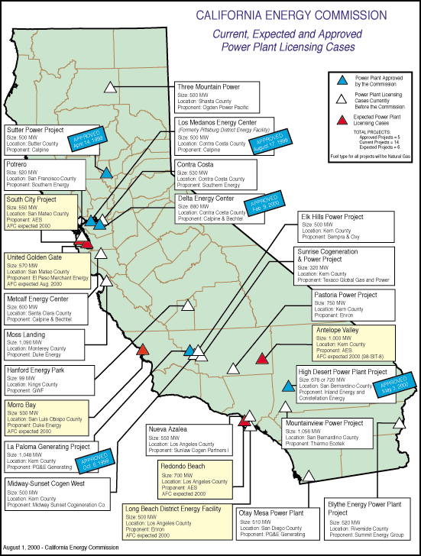
California
High Probability Plants: (UC) Under Construction (AP) Approved by CEC
  Sutter, 500MW, Jun 2001(UC)
  Los Medanos(Pitt), 500 MW, Jul 2001 (UC)
  La Paloma, 1,048 MW, Aug 2001(UC)
  Delta, 880 MW, Jul 2002 (UC)
  Moss Landing, 1,090 MW, Sep 2002, (AP received 10/25)
  High Desert, 720 MW, Jan 2003 (AP)
  Otay Mesa, 510 MW, Nov 2002
Medium Probability Plants
  Elk Hills, 500 MW, Dec 2002
  Metcalf, 600 MW, Feb 2003
  Blythe, 520 MW, Mar 2003
  Midway-Sunset, 500 MW, Mar 2003
  Contra Costa, 530 MW, Apr 2003
  Mountainview, 1,056 MW, Apr 2003
  Rosarito(Tijuana, MX), 255 MW, Apr 2003
  Pastoria, 750 MW, Jun 2003
California

Slide 3
California Electricity Updates
Metcalf, 600 MW, Jan 2003, NP15. CEC approval issued on 10/13/2000. This project still must pass San Jose rezoning but has cleared the biggest stumbling block to issuance of a permit. Consumer advocacy groups have voiced support for this project.
Moss Landing, 1,090 MW, Sep 2002, NP15. Ground break set to Oct 30th.
Mountainview, 1,056 MW, Apr 2003, SP15. CEC decision to be made by January 01.
Calpine sold PG&E 400 MW flat, 3 years for $51.50 starting July 2001. This start date corresponds to the approximate online date of the Sutter power plant (500 MW) coming online in June 2001. See Megawatt Daily Oct 18th.
CISO has suspended power consumers’ chance to opt out of voluntary interruptible programs until March 31, 2000 from Nov. After 18 power cuts this previous summer with some customers experiencing up to 13 curtailments, many customers are rethinking the value of this plan. The PUC estimates there are 2,800 MW enrolled on interruptible programs throughout the state with an estimated annual cost of $220 million.
Chula Vista, 49 MW peaker, Jun 2001, SP15. City council approved construction. Construction set to begin in Jan 2001. Limited to 48,000 annual MW output.
California
Notes:
CISO has reset target pricing mechanism for the real time energy imbalance market. The price of the highest decremental bids is greater than the price for the lowest incremental bid. The new price is to be greater of zero or the lowest incremental bid.

Slide 4
PNW Updates
Washington
  Fredrickson, 249 MW, June 2002. Air permits have been received. The site is 60% complete with a BPA interconnection agreement expected to be signed this month. The major problem with this site is that they have been unable to obtain Frame 7 A or B turbines. Start date has been set, as per developer, to June 2002.
  Chehalis, 550 MW, June 2003. Construction set to begin Spring 2001. EFSEC approval expected Nov 13th.
Oregon
  Klamath Falls, 500 MW, July 2000. SCL has signed a 5 year 100 MW offtake purchase.
Idaho
  Rathdrum, 270 MW, 6,900 HR CC, Construction delays have pushed this online date from June 2001 to August 2001.
  Idaho Power Co has issued an RFP for 250 MW of peaking power installed by June 2004. IPC has short listed a number of companies but has not released that list.
PNW
Notes:
Formerly (stalled) NWPE 220 MW project. FPL bought rights in 1/99. Construction to began 9/1/99 As of 4/25/00 Unit 1 not complete and gas line construction has been stalled.

Slide 5
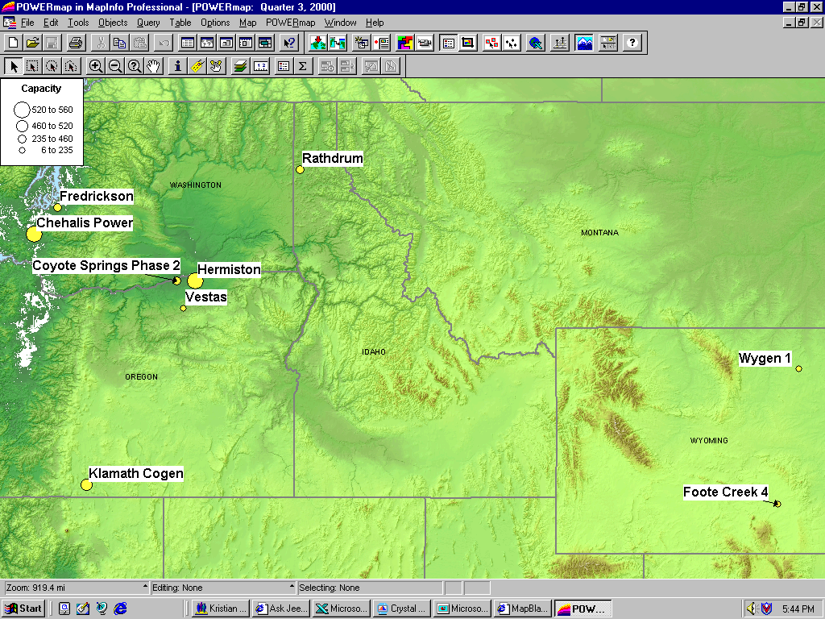
PNW New Generation Map

Slide 6
Rockies Updates
PSCO increased its existing request for plant additions by 100 MW to the 1,500 MW forecast it made in June. PSCO is still in negotiations with several bidders.
Manchief (Brush), 265 MW (UC). Original on-line date June, 2000. Encountered testing delays. On-line date was July 21, 2000.
Ft. St. Vrain, 235 MW (UC), June 2001. Construction has begun on this 3rd unit of existing 2 7FA converted nuke site.
Ray Nixon (Phase 2), 460 MW, May 2001. Not short listed, but will probably be built(80%).
PSCo has issued its “Recommended Plan” which shows 739 MW for 2002, 334 MW for 2003 and 516 MW 2004 for a total of 1,589MW.
PSCo has a $4.5 million DSM Request for Proposal for Bid 2001 which is roughly 362 MW.
Midway, 225 MW, Jul 2001. 6 x LM6000 Peaker. PPA signed for 11 year toll on Oct 15th.
Source: PSCO 1999 Integrated Resource Plan
Rockies

Slide 7
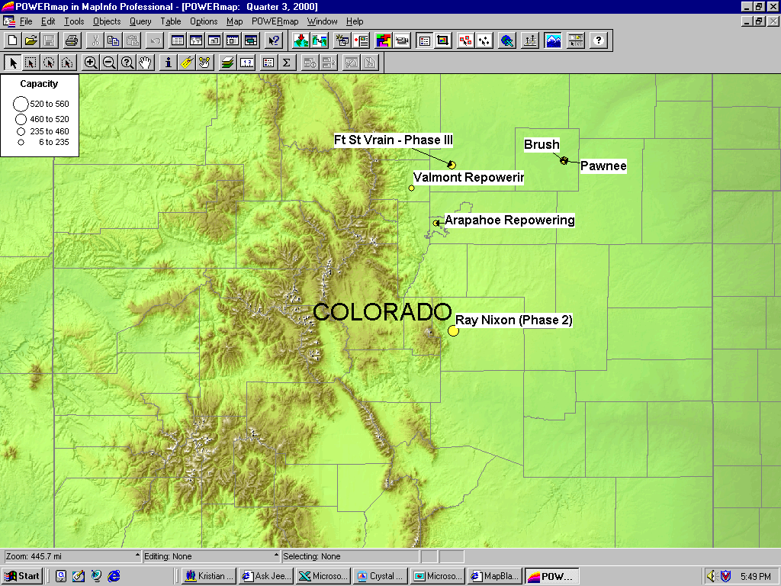
Rockies New Generation Map

Slide 8
DSW Updates
Arizona
  Red Hawk, 530 MW, Pinnacle West(APS), June 2003. EPA review of site license began 10/15/00.
  Mesquite, 1,250 MW, Sempra, Jan 2003. A public hearing is scheduled for Nov 28th. Construction commencement is scheduled for Spring 2001.
The lawsuits with respect to the following plants will be dropped within 30 days. The parties entered a stipulation that would make output available to Arizona customers for 2 years from plant commencement.
    Arlington Valley, 550 MW, Duke, August 2002. Permit to be issued by Nov 15th.
    Panda Gila, 1,000 MW, Oct 2002. According to developer construction scheduled to begin December 2000.
    Harquahala, 1,040 MW, March 2003. The air and water assessment from BLM is due by Dec 2000. The plant had expected to begin construction in January 2001. A public hearing is scheduled for Nov 21st.
DSW

Slide 9
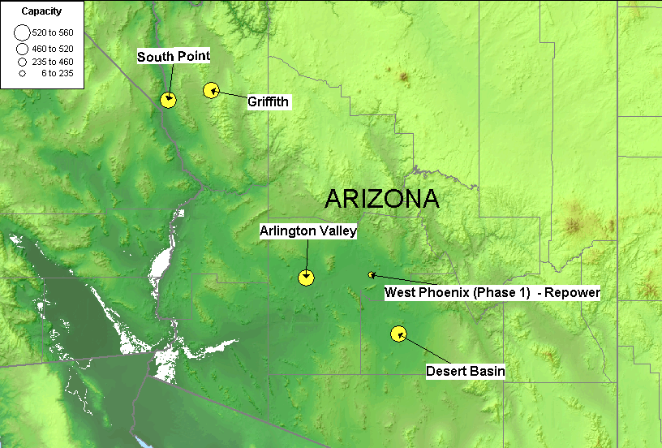
DSW New Generation Map

Slide 10
Summary
RO: Rockies DSW: Desert Southwest
PNW: Pacific Northwest
Summary

Slide 11
Sorted List By Date
Bold items are shown on the preceding graph

Slide 12
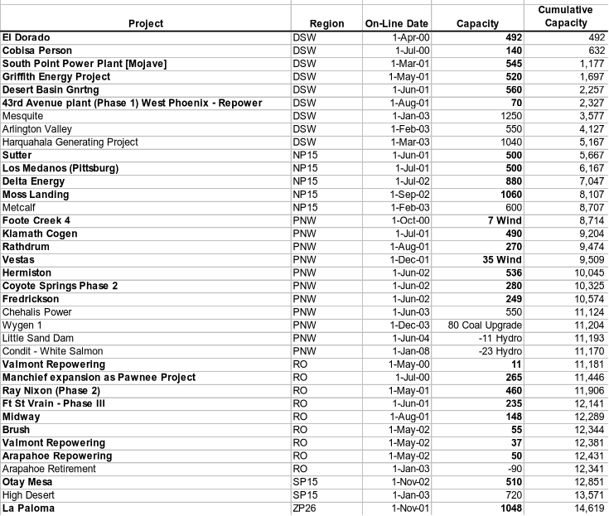
Sorted List By Region

Slide 13
WSCC Capacity Additions
*
**
**
* Foote Creek 4 Wind Project did not begin commercial operations as scheduled and was delayed from August to October.
** Moss Landing has an estimated capacity of 1,060 MW rather than 1,065 MW.
*** Ray Nixon online date May 2003 not May 2001.
Sorted List By Summer

