Slide 1

New Generation in WSCC
Presentation
November 30, 2000
Proprietary and Confidential 5/02

Slide 2
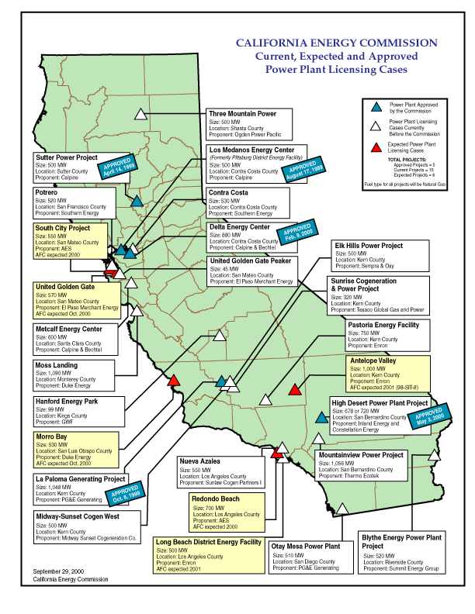
California
High Probability Plants: (UC) Under Construction (AP) Approved by CEC
  Seawest, 16 MW, Mar 2001(UC)
  Sutter, 500MW, Jun 2001(UC)
  Los Medanos, 500 MW, Jul 2001 (UC)
  La Paloma, 1,043 MW, Nov 2001(UC)
  Delta, 880 MW, Jul 2002 (UC)
  Moss Landing, 1,090 MW, Sep 2002(UC)
  High Desert, 720 MW, Jan 2003 (AP)
  Otay Mesa, 510 MW, Jun 2003
Medium Probability Plants
  Metcalf, 600 MW, Feb 2003
  Sunrise, 320 MW, Jan 2003
  Elk Hills, 500 MW, Dec 2002
  Blythe, 520 MW, Mar 2003
  Midway-Sunset, 500 MW, Mar 2003
  Contra Costa, 530 MW, Apr 2003
  Mountainview, 1,056 MW, Apr 2003
  Rosarito(Tijuana, MX), 255 MW, Apr 2003
  Pastoria, 750 MW, Jun 2003
California

Slide 3
California Electricity Updates
Metcalf, 600 MW, Jan 2003, NP15. The San Jose City Council unanimously rejected Calpine’s proposal to build. The mayor of San Jose has called for a task force to study the regions electricity needs. The CEC still has the authority to overrule the city council and may do so in their March meeting.
Sunrise, 320 MW, ZP26, Jan 2003. The CEC has indicated that they have overcome air permit issues Nov 22nd regarding a frame unit. Mission Energy would like to get fast track approval to build the first phase for peaking power next summer. It is unclear whether this will be approved for siting.
Moss Landing, 1,090 MW, Sep 2002, NP15. Ground break for the project occurred on Nov 16th not Oct 30th.
High Desert, 720 MW, Jan 2003, SP15. CEC decision to be made by January 01. Ground break is tentatively set for April 01.
Otay Mesa, 510 MW, June 2003, SP15. A CEC hearing is set for Dec 4th with construction scheduled to commence in late spring 2001.
Midway-Sunset, 500 MW, Mar 2003, SP15. This project was recommended for final approval on Nov 20th. It will use existing facilities and gas pipelines at the Midway substation.
Elk Hills, 500 MW, Dec 2002, ZP26. This project was recommended for final approval on Nov 20th.
Three Mountains, 500 MW, Jan 2003, NP15. Project is nearing final recommendation. The CEC staff has found little to oppose in terms of environmental impacts in their last report.
Blythe, 520 MW, Mar 2003, SP15. This project was recommended for final approval on Nov 20th.
To meet expected gas demand in southern California Williams is expecting to expand Kern capacity by 124,500 dth/d beginning Mar 2002.
California
Notes:
CISO has reset target pricing mechanism for the real time energy imbalance market. The price of the highest decremental bids is greater than the price for the lowest incremental bid. The new price is to be greater of zero or the lowest incremental bid.

Slide 4
California Electricity Updates
PEAKERS
The CISO has issued an RFP for 2,000 MW of peaking power to come online by Summer 2001. They have indicated that only 800 MW has been submitted.
Chula Vista, 49 MW peaker, Jun 2001, SP15. City council approved grading plan Nov 28th. Construction will commence soon. Limited to 48,000 annual MW output.
Golden Gate Power Project, 51 MW, Jul 01, NP15. Located near the SF Intl Airport this facility plans to use infrastructure from existing facility. They are having some difficulty getting approved by the CEC.
Warnerville, 86.4 MW, Oct 01, NP15. Sources indicate that this will not be recommended for the four month siting process which will delay the start date to Oct. This is the last Calpine peaking facility left to be sited in California. Calpine originally submitted 5 peaking projects to address this RFP and has withdrawn four of them.
An additional 350 MWs of peaker P&W turbines have been directed to meeting this RFP by an independent developer. These are sited throughout the state. It is unclear how and when these will be sited but many of these will probably not meet the CISO target date of June 2001.
City of Escondido (SP15) has an RFP offering a site for a peaker to be installed by June 2000.
California
Notes:
CISO has reset target pricing mechanism for the real time energy imbalance market. The price of the highest decremental bids is greater than the price for the lowest incremental bid. The new price is to be greater of zero or the lowest incremental bid.

Slide 5
PNW Updates
Washington
  Fredrickson, 249 MW, June 2002. It is unclear whether Engage has obtained turbines for this site.
  Chehalis, 550 MW, June 2003. Construction set to begin Spring 2001. On November 14th EFSEC approval was received and is now awaiting approval by the Governor. TIC has been chosen as the EPC for this project. Turbines are lined up and construction is ready to begin.
  Puget Sound announced plans to allow 400,000 residential customers to enter into a demand side management program beginning December 2000.
Oregon
  Klamath Falls, 500 MW, July 2000. Because tax-exempt financing was used for the project, 250 MW were set to be sold to tax exempt entities. There is still 100 MW left for sale. The plant developer is currently looking at the possibility of 250 MW expansion.
Idaho
  Rathdrum, 270 MW, 6,900 HR CC, Construction delays have pushed this online date from June 2001 to August 2001.
  Idaho Power Co has issued an RFP for 250 MW of peaking power installed by June 2004.
PNW
Notes:
Formerly (stalled) NWPE 220 MW project. FPL bought rights in 1/99. Construction to began 9/1/99 As of 4/25/00 Unit 1 not complete and gas line construction has been stalled.

Slide 6
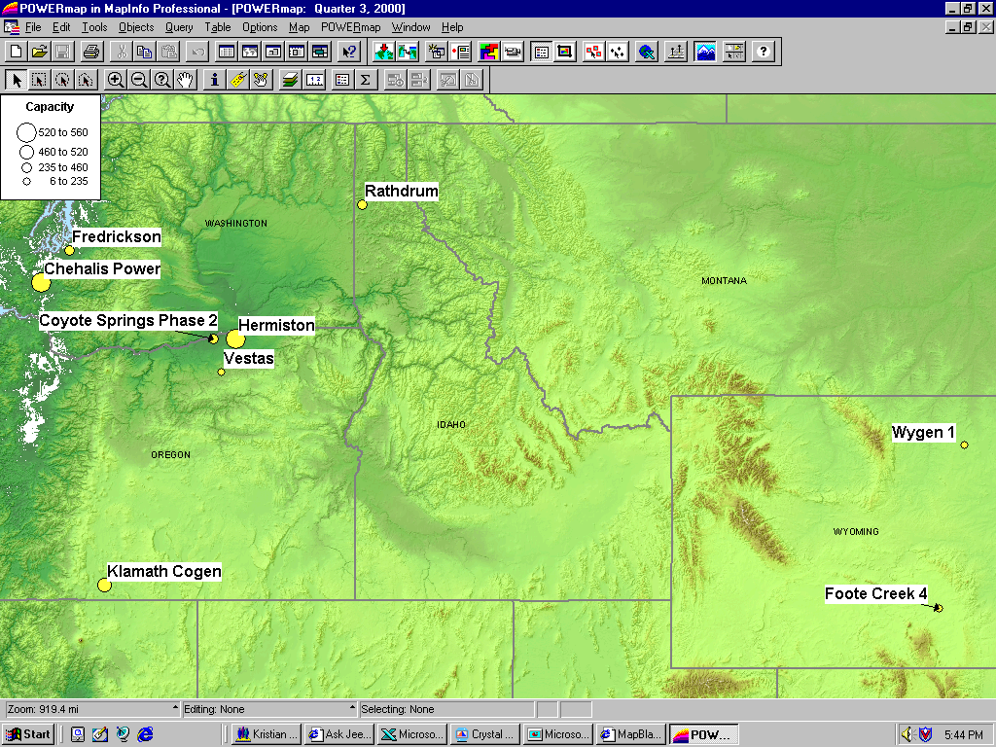
PNW New Generation Map

Slide 7
Rockies Updates
Colorado Office of Consumer Counsel claims that PSCO wasted $567 million by not building generation.(MWD 11/14/00) The generation is now before the PUC, which must approve their purchases.
PSCO increased its existing request for plant additions by 100 MW to 1,600 MW forecast. PSCO is still in negotiations with several bidders.
Manchief (Brush), 265 MW (UC). Original on-line date June, 2000. Encountered testing delays. On-line date was July 21, 2000.
Ft. St. Vrain, 235 MW (UC), June 2001. Construction has begun on this 3rd unit of existing 2 7FA converted nuke site.
Ray Nixon (Phase 2), 460 MW, May 2003. Not short listed, but will probably be built(80%).
PSCo has issued its “Recommended Plan” which shows 739 MW for 2002, 334 MW for 2003 and 516 MW 2004 for a total of 1,589MW.
PSCo has a $4.5 million DSM Request for Proposal for Bid 2001 which is roughly 362 MW.
Midway, 225 MW, Jul 2001. 6 x LM6000 Peaker. PPA signed for 11 year toll on Oct 15th. Air Permits received Oct 31st. County commission approval expected Dec 14th.
Rockies

Slide 8
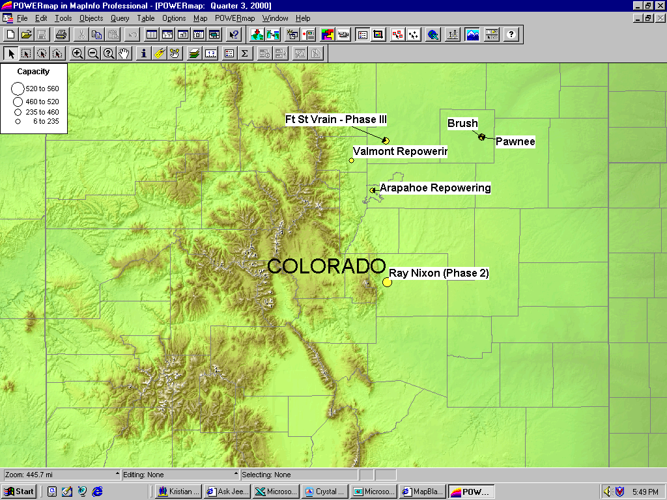
Rockies New Generation Map

Slide 9
DSW Updates
Arizona
  Red Hawk, 530 MW, Pinnacle West(APS), June 2003.
  Mesquite, 1,250 MW, Sempra, Jan 2003. Construction commencement is scheduled for Spring 2001.
  Arlington Valley, 550 MW, Duke, August 2002. Permit to be issued Nov 15th.
  Panda Gila, 1,000 MW, Oct 2002. According to developer construction scheduled to begin December 2000. Project has become a joint venture with Teco.
  Harquahala, 1,040 MW, March 2003. The air and water assessment from BLM is due by Dec 2000. The plant had expected to begin construction in January 2001.
Nevada
  Tahoe-Reno Industrial Center, 350 MW, Sept 2001. Construction to begin Dec 15th. Project is being constructed by Morgan-Stanley and Kansai Electric.
  The Nevada PUC rejected Nevada Power’s 2000 Resource Plan which should lead Nevada to seek 2,150 MW from generators under deals with five to seven-year terms. At present, Nevada has no supply deals with terms beyond March 2003.
DSW

Slide 10
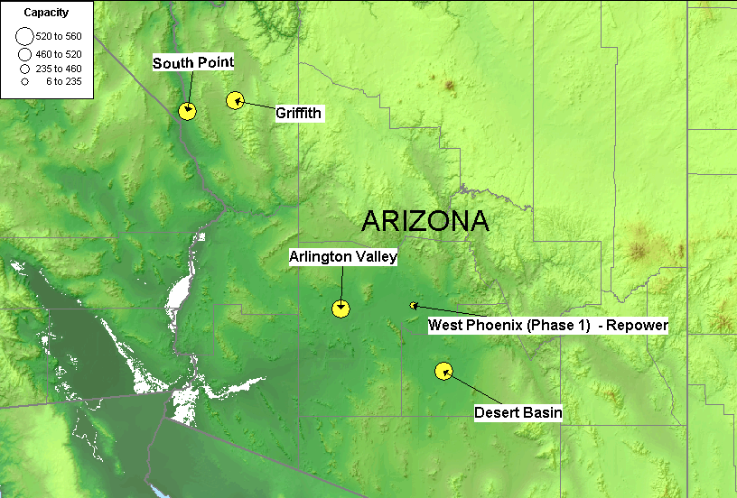
DSW New Generation Map

Slide 11
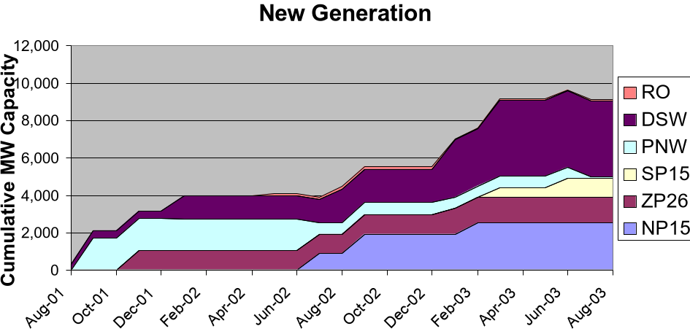
Summary
RO: Rockies DSW: Desert Southwest
PNW: Pacific Northwest
Summary

Slide 12
Sorted List By Date
Bold items are shown on the preceding graph

Slide 13
Sorted List By Region

Slide 14
WSCC Capacity Additions
*
**
* Seawest/PG&E, 16 aMW, Mar 01. Chula Vista, 49 MW, Jun 01. Note: Rosarito(Not included), 450 MW, CFE, Aug 01. Rosarito is not connected to the CFE main grid, but it can export to SP15 during an emergency.
** Tahoe-Reno Industrial Center, 350 MW, Sept 01. Kyrene Generating station, 825 MW, Jan 02. Arlington Valley, 550 MW, Aug 02.
Sorted List By Summer

