Slide 1

New Generation in WSCC
Presentation
May 31, 2001
Proprietary and Confidential 5/02

Slide 2
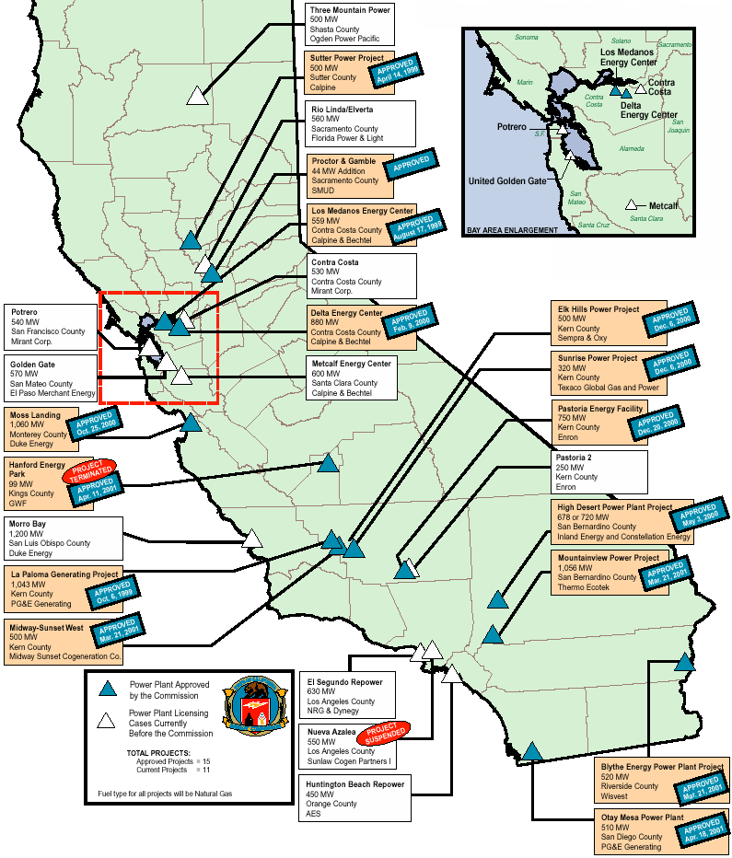
CALIFORNIA
High Probability Plants (UC) Under Construction (AP) Approved by CEC
Harbor Cogen Expansion / 30 MW / Jul-01 (UC)
SMUD McClellan Upgrade / 22 MW / Jul-01 (UC)
Los Medanos / 500 MW / Jun-01 (UC) / 6,950 HR
Sutter / 500MW / Jul-01 (UC) / 6,793 HR
LADWP Harbor V Expansion / 237 MW / Aug-01 (UC)
Sunrise (Phase 1) / 320 MW / Aug-01 (UC) / 10,545 HR
United Golden Gate / 51 MW / Oct-01 (UC)
La Paloma (Phase 1) / 521 MW / Nov-01 (UC) / 6,750 HR
La Paloma (Phase 2) / 522 MW / Mar-02 (UC) / 6,750 HR
Moss Landing / 1,060 MW / Jun-02 (UC) / 6,704 HR
Delta Energy / 880 MW / Jun-02 (UC) / 6,827 HR
Elk Hills / 500 MW / Mar-03 (UC) / 6,760 HR
Blythe / 520 MW / Mar-03 (AP) / 7,100 HR
High Desert / 720 MW / Jul-03 (UC) / 6,827 HR
MEXICO
Hermosillo / 250 MW / Sep-01 (UC)
Bajio (Rosarito 4) / 450 MW / Nov-01 (UC)
Rio Bravo (Phase 1) / 495 MW / Jun-02 (UC)
Monterrey III / 490 MW / May-03 (UC)
Saltillo / 248 MW / Jun-03 (UC)
Tuxpan II / 495 MW / Jun-03 (UC)
La Rosita / 765 MW / Apr-03 (AP)
Medium-High Probability Plants
Madera / 25 MW / Jul-01 (AP)
Three Mountain / 500 MW / Feb-03
Midway-Sunset / 500 MW / Mar-03 (AP) / 6,793 HR
Mountainview / 1,056 MW / May-03 (AP) / 6,704 HR
Otay Mesa / 510 MW / Jun-03 (AP) / 7,100 HR
Pastoria (Phase 1) / 755 MW / Jul-03 (AP) / 6,760 HR
Teayawa Energy Center / 600 MW / Dec-03 (AP) / 6,793 HR
Rio Linda / 560 MW / Apr-04 (AP)
California

Slide 3
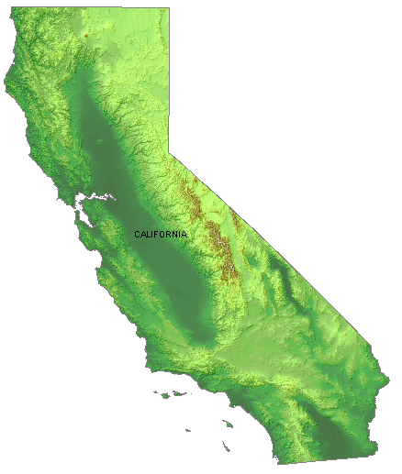
CALIFORNIA
Natural Gas Emergency Peaker Plants
NP15
Fresno / 18 MW / Jun-01
Stockton / 22 MW / Jun-01
Chowchilla / 49 MW / Jul-01
Los Banos / 45 MW / Jul-01
Red Bluff / 49 MW / Aug-01
Gilroy (Phase 1) / 135 MW / Sep-01
King City / 50 MW / Sep-01
Panoche / 49 MW / Sep-01
Susuin City 1 / 49 MW / Sep-01
Susuin City 2 / 49 MW / Sep-01
Susuin City 3 / 49 MW / Sep-01
Vaca-Dixon / 49 MW / Sep-01
SP15
Border 3 / 43 MW / Jul-01
Escondido (Ramco) / 44 MW / Jul-01
Gates / 45 MW / Jul-01
Indigo Energy / 135 MW / Jul-01
Larkspur Energy / 90 MW / Jul-01
Border 2 / 43 MW / Aug-01
Century Project / 40 MW / Aug-01
Drews Project / 40 MW / Aug-01
Escondido (DG Power) / 49 MW / Aug-01
Palm Springs 1 / 43 MW / Aug-01
Palm Springs 2 / 45 MW / Aug-01
Border 1 / 49 MW / Sep-01
El Cajon / 49 MW / Sep-01
La Jolla Baldwin / 53 MW / Sep-01
Midway / 49 MW / Sep-01
Mission / 49 MW / Sep-01
San Ysidro / 43 MW / Sep-01
Pegasus Power Project / 180 MW / Oct-01
Chula Vista / 44 MW / Oct-01
NP15 – 22 Projects
SP15 – 19 Projects
Renewable Projects (NP15)
CEC June Estimate / 43 MW / Jun-01
CEC July Estimate / 12 MW / Jul-01
CEC August Estimate / 17 MW / Aug-01
Biomass Restarts (NP15)
Sierra Forest / 7 MW / May-01
Dinuba / 12 MW / May-01
Soledad / 13 MW / May-01
Madera / 25 MW / May-01
Honey Lake / 30 MW / Jun-01
Jackson Valley / 18 MW / Jul-01
Blue Lake / 10 MW / Jun-01
California

Slide 4
CALIFORNIA UPDATES
(05/01/01 PowerMarketers.com) In the next few weeks, 134,000 residential swimming pool owners in Northern and Central California will receive an offer from Pacific Gas and Electric Company that should make a splash: Agree to run your pool pump only during off-peak hours, and you get $20. The "Keep Your Pool Time in Check" program is expected to reduce demand on the state's electric grid by approximately 15 megawatts - at the time of day when power shortages are most likely to occur. To qualify for the $20 incentive, participants must set their swimming pool timer switch to operate during the off-peak period - between 8 p.m. and 10 a.m. The program is only available to residential electric customers with an in-ground swimming pool. They cannot be on the time-of-use rate or have an operational solar heat pump system.
(05/01/01 MWD) The United States, Canada and Mexico agreed last week to convene a "North American Energy Working Group" to overcome problems caused by three countries' vastly different energy regulatory systems, especially differences between the United States and Mexico. However, the prospect of anything resembling energy policy coordination between Mexico and the United States, as a result of the tripartite Quebec City accord, has led to furious political debate in Mexico because many in Mexico believe any energy pact to strengthen the three-nation North American Free Trade Agreement accord hinges on concessions by Mexico.
(05/01/01 PD) If the rest of the country is to avoid a California-like electricity crisis, the US must over the next 20 years significantly increase spending on transmission and new generation, including coal and nuclear, as well as promote efficiency. Vice President Dick Cheney said the task force would recommend construction of power plants, natural gas transmission lines and oil refineries, and promotion of clean-coal technologies and more nuclear and hydroelectric power. The vice president added that 38,000 miles of gas pipelines must be build to meet demands in the next twenty years. And transmission grids must be expanded and upgraded to meet the projected demand imposed by the 1,300 to 1,900 new power plants that will be needed.
(05/01/01 PD) Boston-based power plant developer InterGen Monday threatened to stop work on three California projects if the Legislature approves a bill that would tax "windfall profits" from electric generators and traders. The warning, however, failed to dissuade the California Senate Appropriations Committee, which yesterday passed legislation (SB 1x) that would set an $80/MWh threshold for electricity sales. The bill would require the Cal ISO, utility distribution companies or any other entity processing electric sales, to withhold payments to the sellers on any amount over the $80. All money over the limit would be refunded to California taxpayers. The bill was amended during the hearing to exclude existing power contracts from the tax.
(05/03/01 CEC) On May 2,2001,the Energy Commission approved the Application for Certification for the King City LM6000 Project (the project)under those limitations presented as conditions contained in this Decision.The proposed project was the subject of a Committee hearing and subsequent analysis by the Energy Commission staff.The proposal meets criteria that the Energy Commission staff developed to implement the Governor ’s Executive Orders expediting the permit process for peaking and renewable energy generating plants.This Decision has been completed in an expedited timeframe,as called out in the Executive Orders.
(05/03/01 CEC) The Committee released the Presiding Member's Proposed Decision (PMPD) for the Contra Costa Unit 8 Project on April 30, 2001. The Committee recommends approval of Mirant Delta's proposed 530 megawatt power plant near Antioch, California with conditions to mitigate potential environmental and community impacts.
(05/03/01 PowerMarketers.com) Faced by ongoing shortages, Californians cut energy use by 9 per cent in March and April compared to the same months a year earlier, according to data released Thursday by the state's energy commission. In April, residential and business consumers reduced electricity demand by 2,866 megawatts and in March the figure was down by 2,967 megawatts. The cutbacks could go far to reduce the likelihood of rolling blackouts in the peaks months of summer demand.
California
Notes:
CISO has reset target pricing mechanism for the real time energy imbalance market. The price of the highest decremental bids is greater than the price for the lowest incremental bid. The new price is to be greater of zero or the lowest incremental bid.

Slide 5
CALIFORNIA UPDATES (cont’d)
(05/03/01 GD) Joining the race to bring new volumes to California, Kinder Morgan Energy Partners and Calpine yesterday said they will jointly develop a new 1,160 mile interstate gas pipeline from the San Juan Basin in northern New Mexico to serve markets in California. The Sonoral Pipeline project will be constructed in two phases, with the first phase running from the San Juan Basin to the California border and the second phase extending from the border to the San Francisco bay area. Phase one will consist of a 460-mile pipeline from the interconnection of TransColorado Gas Transmission and Transwestern Pipeline to various points at the Blanco Hub in San Juan, NM. In addition, the pipeline will continue westward with deliveries into the California/Arizona border. The initial capacity would start with 750,000 dth/d, with capability to expand to 1 million dth/d. Phase two will be a 590-mile pipeline from Needles on the California border to points within California and a termination near Antioch, CA. Once completed, the pipeline will be able to transport 1 million to 1.5 million dth/d. The in-service date for the phase two has yet to be determined. Once completed, the new pipeline could connect with Kern River, Mojave, Elk Hills, PG&E, SoCal Edison and various gas-fired power plants.
(05/03/01 MWD) A unit of El Paso has arranged financing so that a 25-MW plant in California fueled by biomass wastes from vineyards and other sources can be generating power by next month. The plant, called Madera, began operation in 1990, but has been idle for more than five years. Grape byproducts, wood chips and tree trimmings are among the 53 different forms of biomass materials used as fuel.
(05/04/01 MWD) Moving California closer to a more active role in the power business, the state Senate yesterday approved a measure creating a state power authority to finance and build power generation facilities. S.B. 6X passed by a 24-14 margin, and Governor Gray Davis is expected to sign the bill into law. If signed, it would create the California Consumer Power and Conservation Financing Authority. The power authority, according to legislative sources, is modeled after the New York Power Authority, which owns three major hydro facilities and two plants predominantly fueled by natural gas totaling 5,200 MW, plus several small hydro units.
(05/04/01 PowerMarketers.com) The Mexican government agreed to sell the state of California surplus power at the border and cooperate in augmenting electrical connections between the countries. Alfredo Elias Ayub, director of Mexico's Federal Electricity Commission, announced Thursday that, on instructions from President Vicente Fox, "Mexico will continue to help the state of California deal with the energy crisis it has been experiencing for several months." Ayub met with California state Senate majority leader Richard G. Polanco, who expressed gratitude for Mexico's support in addressing the state's energy crisis. Because only the surplus power generated in the Mexican state of Baja California will be sold, Ayub said, domestic demand should not be affected. Baja California is not connected to the rest of the country's electric power system. Ayub stressed the importance of building up electrical connections between the countries beyond their present 400 megawatt capacity, possibly to 2,000 megawatts by next year.
(05/04/01 MWD) President Bush yesterday directed all federal agencies to implement energy conservation measures to reduce their peak consumption in the state of California. Bush also guaranteed that all federally owned power generators will be available to any state in case of a power emergency. Energy Secretary Spencer Abraham is in California today to meet privately with Governor Gray Davis and local federal officials responsible for implementing the presidential directive and to provide details of the program. The federal government accounts for about 1.5% of all energy use in both California and the county at large. Deputy Secretary of Defense Paul Wolfowitz said the Defense Department, which accounts for about 1% of California's peak load, plans to reduce power demand by 10% compared to last year's usage. By next summer, the department expects to cut demand 15% of last year's summer levels.
(05/04/01 PD) Projecting that only 2,600 MW of generation and not the 5,000 MW target set by the governor will be added to the state's supply this summer, California energy officials Thursday called on a congressional panel to urge the FERC to "do its job" and place limits on how high wholesale power prices can rise. Only 800 to 900m MW of capacity is expected by June, 2,600 MW by July and 4,500 MW by mid- to late September.
California
Notes:
CISO has reset target pricing mechanism for the real time energy imbalance market. The price of the highest decremental bids is greater than the price for the lowest incremental bid. The new price is to be greater of zero or the lowest incremental bid.

Slide 6
CALIFORNIA UPDATES (cont’d)
(05/07/01 EIS) Sempra Energy Resources, the wholesale power-generation subsidiary of Sempra Energy, today signed a 10-year agreement with the California Department of Water Resources (CDWR) to supply up to 1,900 megawatts (MW) of electricity to the state. The potential size of the agreement is $7 billion. Sempra Energy Resources will begin providing 250 MW of summer capacity to the state on June 1, 2001. By the end of the 10-year agreement, which extends to 2011, the company will supply the CDWR with up to 1,900 MW during peak-usage periods. One megawatt provides enough electricity for roughly 1,000 homes.
(05/07/01 PD) California Governor Gray Davis Friday announced the state had signed a 10-year, $7-billion deal with Sempra Energy Resources for 1,900 MW of peak power. Under the terms of the deal, the state will being receiving 250 MW of capacity in June. The state said in a statement that the deal will run through September 2011 and that it would receive 1,900 MW during peak-demand hours over the length of the deal.Financial details of the deal were no released, but the state said it would buy power from Sempra this summer at roughly one-third to one-half of the current average spot-market price. The state also said the deal would provide power over the duration of the contract at a price lower than average price the CDWR would pay under long-term contracts.
(05/08/01 PowerMarketers.com) Los Angeles-based Real Energy, a new energy company for the commercial real estate industry, has received equity commitments for $50 million to bring on-site energy generation technologies to commercial properties in urban and suburban markets. The company will install on-site energy systems in 20 class A office buildings in Southern California. The company owns and operates the systems, requiring no capital investment by the property owner. The systems provide energy cost reductions, and in certain applications, increased power reliability, according to the company. The investment round was led by Los Angeles-based GFI Energy Ventures and Global Innovation Partners and includes the California Public Employees Retirement System (CalPERS), Los Angeles-based Arden Realty, San Jose, Calif.-based Divco West Properties, Detroit Edison and CS First Boston, among others. The first of the new power plants is expected to begin producing electricity within four to six weeks while the remaining plants are slated to be operating within the next few months.
(05/09/01 GD) Making good on a promise to expedite the addition of gas pipeline capacity, FERC on Monday issued certificate approval for El Paso Natural Gas' Line 2000 project. Once in service, Line 2000 will boost deliverability into California by as much as 230 million cfd. El Paso originally conceived Line 2000 as a compression replacement project, but as FERC's behest, the company altered the project proposal to turn it into a system expansion. Within two months of El Paso filing an amended application, the commission delivered.
(05/09/01 EIS) The Magnolia Power Project (MPP) today announced plans to submit an application for certification to the California Energy Commission on May 14 to begin the state licensing process for a 240-megawatt (MW) electric generating unit to be constructed at Burbank Water and Power's (BWP) existing generating station complex in Burbank. Municipal utilities serving the cities of Anaheim, Colton, Glendale and Pasadena already have joined Burbank in proposing an accelerated six-month licensing process being sponsored by the Southern California Public Power Authority (SCPPA), said Ronald E. Davis, BWP general manager and MPP coordinating committee chair.
(05/09/01 PowerMarketers.com) San Francisco and Palo Alto plan a groundbreaking partnership that could build power plants or transmission lines or use joint buying clout to seek lower long-term electricity rates. The two cities, which own power-generating utilities, have been in talks with a third public power outpost, the city of Santa Clara, about joining a deal designed to provide long-term solutions to the state's power crisis. Other public agencies, such as BART, could be invited to join the arrangement later, which could lead to a regional power authority. As outlined yesterday to the city PUC, one suggestion for the partnership is improving transmission lines to make electricity delivery more reliable. Currently, the only transmission lines into San Francisco come up the Peninsula from Southern California and the notorious Path 15 bottleneck near Bakersfield. The city would like to develop a transbay transmission line, perhaps using the BART tunnel from Oakland to San Francisco. That would give the Peninsula access to electricity from the Central Valley. Such a line, which would cost more than $100 million, would finally help bring power from San Francisco's hydroelectric dams in the Sierra to the city. Currently, the city's power lines end near Newark, where they join PG&E's grid.
California
Notes:
CISO has reset target pricing mechanism for the real time energy imbalance market. The price of the highest decremental bids is greater than the price for the lowest incremental bid. The new price is to be greater of zero or the lowest incremental bid.

Slide 7
CALIFORNIA UPDATES (cont’d)
(05/10/01 EIS) Calpine Corporation announced today a long-term energy program that will help meet San Francisco's energy requirements. Late yesterday, the San Francisco Board of Supervisors approved Calpine's emergency energy proposal to the San Francisco Public Utilities Commission (SFPUC). Under the terms of this $176 million contract, Calpine will provide San Francisco with 50 megawatts of electricity 24 hours-a-day for five years starting July 1, 2001.Calpine Senior Vice President James Macias commented, ``It is gratifying for Calpine to be able to provide real-time, affordable energy solutions for San Francisco. We recognize electricity is vital to sustaining our quality of life and economy. We are pleased to be helping San Francisco through this energy crisis.'' Calpine's pricing structure conveys substantial up-front benefits to the City. By minimizing the need for high cost short-term purchases, Hetch Hetchy will reduce its power purchase costs in the first year by about $37 million.
(05/10/01 EIS) Pacific Gas and Electric Company announced today that nearly all of the Qualifying Facilities (QFs) that had shut down earlier this year for financial reasons have returned to service, and are again generating power for PG&E's electric customers. Only eight of the more than 300 QFs under contract to PG&E are still shut down for payment-related reasons. These eight remaining generators typically deliver about 109 mw of power, out of the roughly 2,500 mw total typically delivered by all PG&E-contracted QF generators combined. All eight facilities are gas-fired generators.
(05/10/01 CEC) The Energy Commission approves AES’s proposed 450 megawatt Huntington Beach Units 3 &4 Retool Project in Huntington Beach,California.
(05/11/01 PowerMarketers.com) El Paso Corp. said Friday two of its units are to test the market's appetite to expand capacity on two natural gas lines into energy-starved California, where gas prices are the highest in the nation. El Paso unit El Paso Natural Gas Company started taking open bids May 1 and will close its so-called open season on May 25 for new capacity on a proposed two-way line between Daggett, Calif. and Ehrenberg, Ariz., El Paso said in a statement. El Paso unit Mojave Pipeline Co. is also holding an open season from May 10 to May 31 for its Sacramento Valley project, which would add capacity along an expanded Mojave pipeline system from Topock, Ariz., to Antioch and Sacramento in Northern California. No estimates were immediately available as to how much capacity El Paso, the largest supplier of natural gas to California, was considering adding to each system, an El Paso spokeswoman said. El Paso currently delivers more than 3 trillion cubic feet of gas a day, or about 45 percent, to California through four receiving points at the California-Arizona border.
(05/14/01 GD) Mojave Pipeline and El Paso are holding separate open seasons to determine customer interest in new firm transportation service that will serve the increased demand for gas in California. Mojave is considering an expansion of its existing pipeline system from Topock, AZ to Daggett, CA and from its existing system at Daggett to Bakersfield, CA using a portion of the former All American Pipeline facilities. In addition, the plan calls for extending the system from Bakersfield north to the Antioch and Sacramento areas. The project will be called Mojave Sacramento Valley. Possible interconnections would include El Paso Natural Gas, Transwestern Pipeline, Kern River Pipeline, Lodi Gas Storage and local California producers.
(05/14/01 EIS) The AES Corporation announced today that AES Huntington Beach received its certification from the California Energy Commission and is set to commence construction on the refurbishment of two retired gas-fired units that will add an additional 450 megawatts of generation in the electricity-strapped state of California. Units 3 & 4 at the AES' Huntington Beach generation facility were retired in 1995 prior to AES ownership of the facility. The refurbishment project will upgrade and improve the reliability of old boilers, replace obsolete controls, and install state-of-the-art emissions controls.
California
Notes:
CISO has reset target pricing mechanism for the real time energy imbalance market. The price of the highest decremental bids is greater than the price for the lowest incremental bid. The new price is to be greater of zero or the lowest incremental bid.

Slide 8
CALIFORNIA UPDATES (cont’d)
(05/14/01 CEC) On May 14, 2001 the California Energy Commission (Energy Commission) received a request to amend the Energy Commission Decision for the Sunrise Power Project (SPP). SPP is a 320MW simple-cycle natural gas power plant currently under construction and scheduled for commercial operation in late summer 2001. The site is located approximately 35 miles southwest of Bakersfield, and one mile southwest of the intersection of State Route 33 and Shale Road in Kern County, California. The proposed modifications (aka "Sunrise II") will add approximately 265 MW of generating capacity, resulting in a nominal 585 MW combined cycle power plant that is expected to be operational by summer 2003. This 265 MW increase is being processed by the Energy Commission as an amendment, rather than a new application for certification, under the express authority of Executive Order D-25-01 of the Governor of the State of California, dated February 8, 2001. Sunrise II will add several new project features, including two heat recovery steam generators, a steam turbine generator, new equipment for the existing SPP and La Paloma switchyards, a wet cooling tower system, an anhydrous ammonia selective catalytic reduction system, a 15.5 mile water supply line, expanded power plant /construction laydown areas, a one mile recycle water discharge line, a 2.5 mile wastewater discharge line, and six deep injection wells to be used as a wastewater disposal option.
(05/15/01 EIS) In response to unprecedented demand for natural gas for the generation of electricity, Southern California Gas Co. (The Gas Company) today announced plans to further expand the capacity of its backbone gas transmission system by at least 6 percent. This project, combined with an earlier announced expansion, means The Gas Company is adding an additional 11 percent of capacity to its transmission system this year. The Gas Company plans to construct a 32-mile pipeline link to the Kern-Mojave pipeline system that will allow it to deliver an additional 200 million cubic feet of natural gas per day into its pipeline system. This is enough capacity to serve three 500-MW combined-cycle power plants or enough natural gas to serve 1.4 million residential customers per day. Completion of the project, referred to as the Kramer Junction Interconnect, is targeted for the end of the year.
(05/16/01 MWD) Calpine last week signed a five-year, round-the-clock power supply contract with San Francisco's water authority at rates far below current spot market prices. The contract, which goes into effect July 1, will supply Hetch Hetchy with 50 MW at all hours for about $80/MW. Hetch Hetchy has seen prices as high as $440/MW recently.
(05/16/01 MWD) Five municipal utilities in California plan to apply for an expedited permit to build a 240 MW power plant that would supply them with reasonably priced electricity beginning 2004. The municipal utilities of Anaheim, Burbank, Colton, Glendale and Pasadena are jointly developing the Magnolia Power Project, a $200 million facility that will be financed by the Southern California Public Power Authority.
(05/17/01 MWD) California power plant siting officials yesterday gave final approval to a 500 MW plant that have been under their consideration since 1998. Covanta Energy, which proposed the Three Mountain Power project under the name Ogden Energy in September 1998, will build a natural gas-fired, combined-cycle plant in Burney, CA. Construction is expected to being later this year, with commercial operation by late 2003 or early 2004. Development costs are estimated at $300 million.
(05/17/01 GD) FERC yesterday approved the non-environmental portions of North Baja Pipeline's application to build the 80-mile US portion of the pipeline, which is designed to carry about 513 million cfd of gas from Arizona into Mexico, where it would be used primarily by power plants. Final approval of the US portion of the pipeline is contingent on the completion of the commission's environmental review of the project. North Baja, a subsidiary of PG&E National Energy Group, Sempra Energy International and Proxima Gas, would extend a total of 215 miles from an interconnection with El Paso Natural Gas near Ehrenburg, AZ to Mexicali in Baja California. The total cost of the cross-border project is estimated at $230 million. The sponsors hope to place the entire pipeline into service by fall 2002.
California
Notes:
CISO has reset target pricing mechanism for the real time energy imbalance market. The price of the highest decremental bids is greater than the price for the lowest incremental bid. The new price is to be greater of zero or the lowest incremental bid.

Slide 9
CALIFORNIA UPDATES (cont’d)
(05/17/01 PD) Building on a proposal it issued in March, the FERC approved a number of incentive-based rates it hopes will encourage investment in new transmission and generation projects in the Western US. FERC also waded into the ongoing dispute between California utilities and qualifying facilities by extending both an existing waiver on environmental restrictions that have limited the amount of power small generators can produce and allowing the QFs to sell any power in excess of what is needed to satisfy their obligations to the utilities. In addition, FERC issued a separate order directing the state's utilities to provide transmission access to any QF to sell excess power into the market.
(05/17/01 CEC) The California Energy Commission's staff has recommended approval of the Gilroy City LM6000 Project, a summer reliability power plant proposed for Santa Clara County. Not a final decision, the report contains the Energy Commission staff's independent analysis of the Gilroy City LM6000 Project proposed by Calpine Corporation. The 135-megawatt power plant, consisting of three model LM6000 45-megawatt turbine generators, would be constructed and operated next to Calpine's existing co-generation power plant at Gilroy Foods in the City of Gilroy. The plant should be producing electricity no later than September 30, 2001. Calpine Corporation has guaranteed the annual sale of 2,000 hours of generation from the peaker project under contract to the California Department of Water Resources.
(05/17/01 EIS) Governor Gray Davis today signed SB 6x by Senate President Pro Tempore John Burton (D-San Francisco). This bill creates the California Consumer Power and Conservation Financing Authority. The California Power Authority will have broad powers to construct, own and operate electric generation and power facilities and finance energy conservation programs. The California Power Authority will be able to finance natural gas transportation or storage projects; issue up to $5 billion in bonds; have the power of eminent domain; and make loans and grants. No new projects will be funded after January 1, 2007.
(05/18/01 GD) After receiving a recent go-ahead from FERC for an "emergency" capacity addition on the Kern River Gas Transmission system, Williams has amended it certificate application for a related expansion project. The project originally sought to add 124,500 dth/d of firm, long-term service for California-bound shippers. But after the commission in early April gave Kern River the go-ahead to undertake a 135 million cfd expansion of its system, Williams decided to fold that project into the 2002 Expansion. The 2002 Expansion now calls for installation of compression and metering facilities that would expand Kern River's capacity from Wyoming to California by only 10.5 million cfd. The revised project would also reflect the continuation of 21,000 dth/d of service on the emergency expansion, which will eventually be incorporated into a subsequent capacity addition called the 2003 Expansion Project.
(05/22/01 PowerMarketers.com) Gov. Gray Davis announced yesterday the licensing of the eighth power plant -- a 135-megawatt site designed to meet summer demand -- under a 21-day emergency review he ordered three months ago. Calpine Corp. plans to build the plant -- consisting of three 45- megawatt gas-fired turbines -- next to the firm's existing cogeneration power plant in Gilroy. The plant should be producing electricity no later than Sept. 30. Calpine has guaranteed the annual sale of 2,000 hours of generation from the "peaker" project under contract to the California Department of Water Resources.
(05/22/01 EIS) Wisvest, a subsidiary of Wisconsin Energy Corp., today announced it has finalized the sale of the Blythe Energy Project to Caithness Energy for an undisclosed amount. The project is a 520 megawatt (MW) natural gas-fired combined cycle power plant located about three miles west of the city of Blythe in southeastern California. The plant is designed to be a highly efficient and clean burning electric generation system. The gas turbines use state-of-the-art technology to efficiently burn natural gas with reduced nitrogen oxide and carbon monoxide emissions. Wisvest and Caithness entered into a Purchase and Sale Agreement on Nov. 14, 2000, to initiate the Blythe transaction.
California
Notes:
CISO has reset target pricing mechanism for the real time energy imbalance market. The price of the highest decremental bids is greater than the price for the lowest incremental bid. The new price is to be greater of zero or the lowest incremental bid.

Slide 10
CALIFORNIA UPDATES (cont’d)
(05/22/01 Yahoo) Energy company Calpine Corp. expects to open two large new power plants early in July to add more than 1,000 megawatts of electricity to the energy-starved California grid, the company said on Tuesday. Calpine's $350 million, 540-megawatt Sutter plant near Yuba City north of Sacramento, the first large plant licensed for construction since California deregulated its power business in 1996, will connect to the grid in the first week of July, said Potter. The Sutter plant is expected to be followed about one week later around July 7 by a second $350 million, 540-megawatt plant, the Los Medanos Energy Center in Pittsburg, a suburb about 30 miles (50 km) northeast of San Francisco, according to Potter. The two natural gas-fired projects are currently producing power during a test phase before starting commercial operations.
(05/24/01 GD) Calpine and Bechtel Enterprises plan to build a 600 MW, gas-fired power plant in the San Francisco Bay area. The two companies have collaborated on several power plants. The Russel City Energy Center is planned for an industrial site in Hayward, CA, adjacent to the city's wastewater treatment plant, from which the power plant would draw recycled water. An application for certification from the CEC was filed yesterday. If approvals are obtained as expected, Calpine said construction of the new power plant could begin in summer 2002, with commercial operation expected by summer 2004.
(05/24/01 EIS) In an effort to help meet California's critical power needs during the hot summer months, Mirant today announced a 19-month agreement with the California Department of Water Resources (DWR) to provide the state with 500 megawatts of electricity -- enough power for approximately 500,000 homes. Under the terms of the contract, which runs from June 1, 2001, to Dec. 31, 2002, Mirant will provide energy during peak demand directly to DWR from its energy portfolio which includes three power plants in Contra Costa County and San Francisco.
(05/27/01 PowerMarketers.com) Stocker Resources has applied to build a 53-megawatt power plant in the Baldwin Hills in south Los Angeles under the governor's emergency power orders. However, the oil field is located in the middle of the Baldwin Hills Conservancy, part of the urban plain that provides 1,200 acres of green space for the densely packed neighborhoods in the south of the city. Several local legislators have expressed strong support for the park. Assemblyman Herb Wesson (D-Culver City) says this is not "a 'not in my backyard' issue". A public hearing on the proposal is scheduled in Culver City for Thursday. Stocker, which plans to build the plant with Tustin-based La Jolla Energy Development, intends to have the plant up and running by September.
(05/28/01 PowerMarketers.com) A new power plant here is poised to bolster the state's electricity grid this summer. Construction is nearly complete on the first power plant in the city since two wood-burning generators closed several years ago. The new plant, owned by California Neo, is equipped with six generators capable of producing 49 megawatts of electricity by burning natural gas. Contractors hope to finish the plant and begin turning out energy by the end of the week. The power plant will provide enough electricity for nearly 50,000 homes. As a peaker plant, it will run only during times of power shortages.
(05/30/01 EIS) Calpine Corporation, the San Jose, Calif.-based independent power company, and San Francisco based-Bechtel Enterprises Holdings, Inc. announced an agreement with San Jose Mayor Ron Gonzales that would help advance development of the proposed 600-megawatt Metcalf Energy Center (MEC), currently before the California Energy Commission for licensing. Under the terms of the agreement, the City of San Jose would support and provide municipal services for construction and operations of MEC in the Coyote Valley of San Jose. The city would provide all requested municipal services in a timely manner at standard rates and terms applicable to similar users, and it would process annexation of the portion of the site not already within the city limits. The agreement also allows for MEC to provide additional benefits for the community and local businesses. The San Jose City Council will consider the agreement at its regular meeting scheduled June 5.
California
Notes:
CISO has reset target pricing mechanism for the real time energy imbalance market. The price of the highest decremental bids is greater than the price for the lowest incremental bid. The new price is to be greater of zero or the lowest incremental bid.

Slide 11
CALIFORNIA UPDATES (cont’d)
(05/31/01 GD) California will improve its gas supply situation as long as current plans for expanding capacity into the state are realized. The CEC took a look at the state's gas supply fortunes for next winter, concluding that bottlenecks at the state border will be relieved by the intrastate expansion plans of PG&E and SoCal Gas beginning next year. The CEC also intends to monitor storage reservoirs in the state more closely, given the effects of low storage levels on overall gas supply and prices during the past winter.
(05/31/01 GD) PG&E said it would conduct an open season on 1.2 billion cfd of backbone capacity on its intrastate Redwood, Baja and Silverado paths in California. The paths transport gas from Malin, OR, Topock, AZ and California production areas to the company's local distribution system and other pipelines in the state. The open season ends July 31. The open season will include 200 million cfd of capacity from an anticipated expansion of PG&E's Redwood Path from Malin. The expansion is expected to be in service by Jan. 1, 2003. The company said it would explore additional expansions if it receives requests for service that exceed 1.2 billion cfd. Transportation rates for the proposed expansions will be based on tariffs approved by the CPUC.
California
Notes:
CISO has reset target pricing mechanism for the real time energy imbalance market. The price of the highest decremental bids is greater than the price for the lowest incremental bid. The new price is to be greater of zero or the lowest incremental bid.

Slide 12
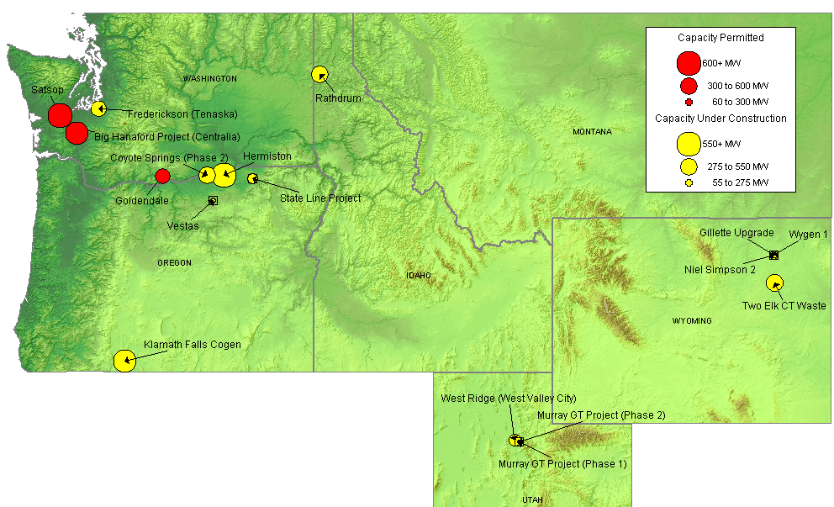
NORTHWEST NEW GENERATION MAP
High Probability Plants
Klamath Falls Cogen / 464 MW / Aug-01 / 6,732 HR
Rathdrum / 270 MW / Aug-01 / 6,760 HR
Blackfeet I Wind / 22 MW / Oct-01
Rock River I Wind Project / 50 MW / Oct-01
State Line Project / 300 MW / Dec-01
Two Elks (Phase 1) / 300 MW / Dec-01
Vestas / 35 MW / Dec-01
Coyote Springs II / 231 MW / Jun-02 / 6,760 HR
Hermiston / 536 MW / Jun-02 / 6,700 HR
Big Hanaford Project (Centralia) / 248 MW / Jul-02 / 7,349 HR
Frederickson (Tenaska) / 248 MW / Jul-02
Goldendale / 288 MW / Sep-02 / 7,200 HR
Wygen 1/ 80 MW / Jul-03
Medium-High Probability Plants
Sumas Energy 2 / 660 MW / Sep-02 / 6,793 HR
NW Regional Power (Creston) / 838 MW / Jun-03
Satsop / 600 MW / Oct-03 / 6,765 HR
Chehalis Power / 520 MW / Nov-03 / 6,704 HR
Gillette Coal / 500 MW / Jun-05

Slide 13
NORTHWEST UPDATES
Washington
(05/01/01 GD) Northwest Natural Gas has signed agreements which enable a utility and an industrial plant to produce electricity using their own generators. Under a one-year agreement, effective July 1, NW Natural will provide about two-thirds of the gas transportation service for temporary generators Clark Public Utilities in Vancouver, WA, is leasing to help meet this summer's power demand. The generators will produce about 50 MW of electricity over the next year and will be significantly cheaper than buying power on the wholesale market.
(05/07/01 EIS) The Bonneville Power Administration and Washington Winds Inc. announced today they are working together to develop and build a 150-megawatt wind farm that will generate enough electricity on average to serve more than 36,000 Northwest homes. The Maiden Wind Farm would be located about 15 miles north of Prosser, Wash., in Benton and Yakima counties. Washington Gov. Gary Locke said of the project, ``The Maiden Wind Farm will help alleviate the current energy crisis and provide clean, renewable energy for Washington. And because a portion of the project is located on state land, it also will help fund our schools. It's a double win for Washington.'' Under a predevelopment agreement, Washington Winds Inc. will secure the necessary permits for the wind farm. BPA will prepare an environmental impact statement. Public involvement is slated to begin this June, when BPA will invite landowners, citizens and governments to suggest issues that should be addressed in the EIS. BPA will purchase 150 megawatts of power from the wind farm for 20 years with an option for up to another 250 MW if siting and environmental reviews prove successful. The first turbines could begin producing power in late 2002. Power would be integrated into the BPA power lines that already cross the project site.
(05/08/01 MWD) Northwest Natural Gas has signed agreements which will enable a utility and an industrial plant to produce electricity using their own generators. Under a one-year agreement, effective July 1, NW Natural will provide about two-thirds of the gas transportation service for temporary generators Clark Public Utilities in Vancouver, WA is leasing to help meet this summer's power demand. The generators will produce
(05/08/01 PD) Washington Governor Gary Locke said Monday he will sign three House and Senate energy bills on Tuesday, many of which resulted from an energy package he presented to the Legislature this spring in an effort to lessen the energy crisis that has nearly paralyzed some power-short utilities in the state. One bill, HB 2247, provides tax incentives to encourage aluminum companies that buy from the BPA to generate their own power providing tax credits on gas they would buy for fuel. The bill requires the smelters to maintain certain employment levels for five years. In addition, the bill creates a tax exemption for developers and utilities to purchase pollution-control equipment for gas-fired power plants, billing discounts for low-income customers, and encourages energy efficiency in public buildings.
(05/14/01 GD) Williams filed an application with FERC Friday for approval to build a 48.9 mile pipeline to deliver gas to a proposed plant near Elma, WA. The proposed Grays Harbor Lateral pipeline would run through Thurston and Grays Harbor Counties in Washington and would deliver up to 161,500 dth/d of gas to the proposed 500 MW, combined-cycle plant, which is being built by Duke Energy. The $75 million pipeline is slated to being service by November 2002, subject to FERC approval. The Grays Harbor line would start an interconnection on Northwest Pipeline near Vail, WA and travel west to the power plant.
(05/17/01 PD) The BPA reinstated a deal it had rescinded earlier in the day to buy back more than 400 MW from Alcoa Inc.'s aluminum smelter in Ferdale, WA. Under the deal, the plant will shut down immediately through September 2003 and the money the smelter gets from the agency will allow 900 affected workers to get full pay and benefits.
PNW
Notes:
Formerly (stalled) NWPE 220 MW project. FPL bought rights in 1/99. Construction to began 9/1/99 As of 4/25/00 Unit 1 not complete and gas line construction has been stalled.

Slide 14
NORTHWEST UPDATES(cont’d)
Washington (cont’d)
(05/22/01 GD) PG&E Gas Transmission - Northwest (PGT - NW) launched an open season to gauge interest in a proposed lateral that would travel westward from the pipeline's mainline near Spokane, WA to serve growing markets in central and eastern Washington state. The open season ends June 22. PGT - NW would consider building a new lateral to central Washington, with a terminus in the mid-Columbia River area. That area is currently served primarily by hydro-electric power but it is expecting a rise in gas-fired power generation. The central Washington project, which would extend about 120 miles could be in service by Nov. 1, 2003; the western Washington project, which would extend about 270 miles, could be in service by Nov. 1, 2004.
(05/26/01 PowerMarketers.com) Avista Utilities announced plans Wednesday to place 21 one- megawatt diesel generators at a switching station north of Reardan. The units, tucked in shipping containers, will supplement the Spokane utility's capacity to generate electricity. Low streamflows have reduced hydrogeneration output at company dams on the Spokane and Clark Fork rivers by 200 megawatts. A megawatt will energize 600 homes. Jason Thackston, manager of wholesale planning, said the units will be leased from Aggreko, a European-based company that will also handle maintenance and operations. Avista will arrange for fuel and tie the units into its Devil's Gap substation, which also routes electricity coming down from the company's Long Lake and Little Falls dams, he said.
(05/29/01 Yahoo) Public officials and company representatives gathered in Frederickson today for Frederickson Power's formal introduction of the power plant it is building to provide electricity for the region's homes and businesses. In mid-2002, the plant is expected to be the first new, combined-cycle power generation facility in Washington to come online in response the power shortage facing the Northwest. Under an expedited timeline for completing the plant, additional power is targeted to begin entering the region's grid by next May, with final completion anticipated for July. Frederickson Power is a partnership between Westcoast Power Inc., a wholly owned subsidiary of Vancouver-based Westcoast Energy Inc., and EPCOR Power Development Corporation, a wholly owned subsidiary of Edmonton-based EPCOR Utilities Inc.
Idaho
(05/14/01 GD) Newport Generation, an independent power producer, is proposing its second 1,300 MW generating facility in Idaho in an attempt to combat dwindling power supply in the Northwest region. The $550 million, gas-fired facility will be located in Rathdrum, ID. The town is located near gas pipelines and major interconnections with the state transmission grid. Newport Generation officials recently met with the Rathdrum City Council, where the company was "very well received.“
(05/14/01 PD) Cogentrix Energy has applied for a water permit to construct an 800 MW gas-fired plant at Rathdrum, ID. Company officials, however, stressed Friday that no firm decision on whether to move ahead with the project has been made, adding that the company applied for the permit because it needs to know if enough water will be available before it proceeds with the project.
(05/29/01 MWD) The supply and reliability outlook for the Pacific Northwest has improved due to emergency capacity addition and load reduction efforts. More than 500 MW of new capacity will be online by August, out of a total of 1,900 MW expected online by the end of this year. That includes a 484 MW cogeneration facility at Klamath Falls, OR and a 270 MW facility at Rathdrum, ID.
PNW
Notes:
Formerly (stalled) NWPE 220 MW project. FPL bought rights in 1/99. Construction to began 9/1/99 As of 4/25/00 Unit 1 not complete and gas line construction has been stalled.

Slide 15
NORTHWEST UPDATES(cont’d)
Montana
(05/08/01 EIS) A vision is taking shape for what could be the first wind farm on tribal land. A 36- to 66-megawatt wind power generation facility is proposed for the Blackfeet Indian Reservation in Glacier County, Mont. If built, it could generate enough power for up to 22,000 homes. The Bonneville Power Administration will prepare an environmental impact statement for the proposed site and will accept public comments through May 25. If approved, the facility will operate between 36 and 88 wind turbines on about 150 acres and could come on line in late 2002.
(05/23/01 PD) The BPA has reached a deal to buy back most of the 171 MW the Montana-based Columbia Falls Aluminum would have purchased over two years starting in October. The Northwest is facing a power shortage due to low water levels in the region, and BPA is encouraging power curtailments. The agency has been forced recently to buy 2,500 MW in the high-priced wholesale market, mostly to serve aluminum loads.
Oregon
(05/02/01 PD) The Oregon PUC Tuesday approved a proposal from PGE to expand its "demand buyback" program under which customers receive market-based rates to shed or reduce load when prices are high or shortages loom. Eight industrial customers now participate in the program, and they have the potential to reduce PGE's load by about 160 MW, said the PUC staff said in a memo. Under the latest plan, 1,500 customers are eligible to participate, and the utility expects about 20, mostly commercial users, to actually sign up, possibly reducing PGE's load by an additional 40 MW. From July to March, PGE saved 57,000 MWhs under the program, which translates to about $7.7-million, the memo added.
(05/03/01 PD) The Oregon PUC asked PacifiCorp to re-work a proposal intended to spur conservation, saying the plan it too ambitious. PacifiCorp proposed a plan that would provide customers with a 20% credit off their monthly summer bills if they reduced their energy consumption by 20% or more. But the PUC thought it would be too difficult to achieve the 20% reduction, and suggested that PacifiCorp consider a plan under which customers who achieve 10% reduction in consumption would ear a 10% credit.
(05/07/01 PD) EWEB last week decided against purchasing 75 MW of wind power from the Stateline project, a 300 MW project under construction on the Oregon-Washington border. A spokeswoman for the EWEB explained that the cost of the wind power at $80 per MWh was too high. The board, which is known for its environmental consciousness, currently offers customers wind power at a rate of about 7 cents per kWh, or $70 per MWh.
PNW
Notes:
Formerly (stalled) NWPE 220 MW project. FPL bought rights in 1/99. Construction to began 9/1/99 As of 4/25/00 Unit 1 not complete and gas line construction has been stalled.

Slide 16
NORTHWEST UPDATES(cont’d)
Oregon (cont’d)
(05/08/01 PD) The Oregon Legislature has passed a bill designed to alleviate electricity shortages by easing plant siting rules to spur construction of 500 MW to 1,000 MW of temporary gas-fired turbines and permanent wind power plants in Oregon. The bill exempts plants as large as 100 MW from the state's centralized siting process in order to speed up review. The plants could operate for 24 months. In addition, the bill is designed to spur development of small wind units and other renewable-resource plants. it raises the threshold for state review of renewable energy plants from 25 MW to 105 MW.
(05/13/01 PowerMarketers.com) The Pacific Northwest's power outlook for the next couple years is like one of those dilemmas in which three men are at sea with a raft that only carries two. Either one goes swimming - in this case, temporarily gives up his claim on the region's cheap hydropower - or everyone drowns. The three "men" here are the Bonneville Power Administration three major customer groups: 135 public utilities, six private utilities and 10 aluminum smelters. Before the present energy crisis hit, Bonneville promised to deliver them a total of 11,000 megawatts through 2006. But the BPA has only 8,000 megawatts of inexpensive power from 19 dams and one nuclear plant. Now that the cost of electricity has risen tenfold on the spot market, it would be ruinously expensive - for the entire region - to fold 3,000 megawatts of grotesquely overpriced power into that 11,000 megawatt base of cheap power. To do so, Bonneville officials estimate, could force a rate increase of 250 percent or more after Oct. 1. That is 250 percent on top of the increases Northwest utilities have already imposed to cover their own spot market purchases. Such an increase would cause immeasurable pain; it could easily plunge the regional economy into recession and leave tens of thousands jobless. As part of a plan to avert this disaster, Bonneville has asked the aluminum companies to shut down their smelters for up to two years- - and has offered to pay their workers for the duration. In other words, the aluminum industry is being asked to give up its seat in the raft for the benefit of the region.
(05/23/01 EIS) In a move that will strengthen the reliability of the Pacific Northwest's natural gas supply, the Federal Energy Regulatory Commission (FERC) has approved an application by NW Natural Gas Co. to provide storage services in the interstate gas market. The FERC decision will allow NW Natural to use its underground storage capacity at Mist, Ore., to help address the region's energy challenges. NW Natural will provide the interstate service using storage capacity that is currently surplus to its core market requirements. NW Natural stores natural gas at the company's own depleted underground fields near Mist, Ore., about 50 miles northwest of the Portland metropolitan area.
(05/23/01 PD) PacifiCorp is seeking approval from Oregon and Utah regulators to build 360 MW of generation. In Oregon, the utility's affiliate, PacifiCorp Power Marketing, is proposing a 100 MW temporary gas-fired plant under the state's new expedited approval process, and in Utah, the utility has proposed installing a temporary 100 MW gas-fired peaker, while the marketer seeks approval to build a 160 MW merchant plant. PacifiCorp wants to build the peaker next to the 484 MW Klamath cogeneration project in Klamath Falls, OR.
(05/24/01 PD) The Oregon PUC approved a revised plan from PacifiCorp under which customers will receive 10% and 20% credits on their bills for cutting monthly energy usage by 20%, saying that goal would be too difficult for most customers to achieve. Under the approved plan, customers save twice by cutting energy consumption, and by earning a credit, said a spokeswoman for PacifiCorp. The company will calculate the credit by comparing customers' usage last summer on a month-to-month basis to this summer's usage, said the spokeswoman. Beginning in June, customers who achieve the 20% goal will receive a 20% credit on their bills, and starting July 1, customers who can't meet the 20% goal will have an option to receive 10% credits if they reduce consumption by 10% to 19%. The program ends September 30.
PNW
Notes:
Formerly (stalled) NWPE 220 MW project. FPL bought rights in 1/99. Construction to began 9/1/99 As of 4/25/00 Unit 1 not complete and gas line construction has been stalled.

Slide 17
NORTHWEST UPDATES(cont’d)
Oregon (cont’d)
(05/25/01 EIS) Efforts to reduce a potential triple-digit increase in BPA's wholesale electricity rates are beginning to pay off. PacifiCorp and the Bonneville Power Administration today announced the first agreement by an investor-owned utility to reduce load (electricity demand) on BPA for the five-year rate period beginning this October. Under the agreement, PacifiCorp has released BPA from its commitment to sell the company 251 average megawatts each year for the next five years. Previously, BPA had agreed to provide 251 average megawatts of firm power for PacifiCorp's residential and small farm customers. Under the new agreement, BPA will instead make a cash payment to PacifiCorp that will maintain benefits to the company's residential and small farm customers. In effect, PacifiCorp has agreed to a cash settlement under BPA's residential exchange program. The arrangement helps BPA avoid power purchases in an expensive market, which would have driven BPA rates up significantly higher.
(05/26/01 PowerMarketers.com) The Bonneville Power Administration said yesterday that Portland-based PacifiCorp has agreed to take less electricity than it had originally signed up for, the latest in a series of agreements BPA hopes will hold in check a rate increase planned for October. BPA hopes to announce other agreements with utilities in the next week for reductions in electricity demand; an agreement is expected today with Clark Public Utilities. Bonneville has also been negotiating with Pacific Northwest aluminum producers to cut the amount of power they'll receive. The power marketing agency is hoping that if it can get its customers to reduce how much power they'll receive under new contracts that take effect Oct. 1, it won't have to buy as much expensive open-market power to fill those contracts. BPA has warned that its wholesale power rates could go up as much as 250 percent if its customers didn't agree to reduce demand. How much consumer rates will rise depends on the size of the BPA increase and how much electricity a particular utility takes from BPA and from other sources.
(05/29/01 PD) PacifiCorp on late Thursday said it would be the first of the energy short BPA's investor-owned utility customers to agree to cut loads and will take cash instead of the 251 MW it would have received annually for five years. During the first year, it will reduce the amount of cash received by about 10%. The energy short BPA is racing to get customers to agree to slash contracted purchases by 10% by June 22 so that it can announce a final rate on June 29 for new five-year contracts that start in October. BPA has asked its five investor-owned utility and 129 public utility customers to reduce loads by 5% to 10% so it can avoid buying power on the market to meet loads to keep its rate hike under 100%. Clack County PUD would reduce purchases for one year by 29.5 MW. BPA is halfway toward meeting its targeted 2,500 MW load cut. BPA has agreed to buy back 400 MW from Alcoa, 167 from Columbia Falls Aluminum and 350 MW from McCook Metals.
PNW
Notes:
Formerly (stalled) NWPE 220 MW project. FPL bought rights in 1/99. Construction to began 9/1/99 As of 4/25/00 Unit 1 not complete and gas line construction has been stalled.

Slide 18
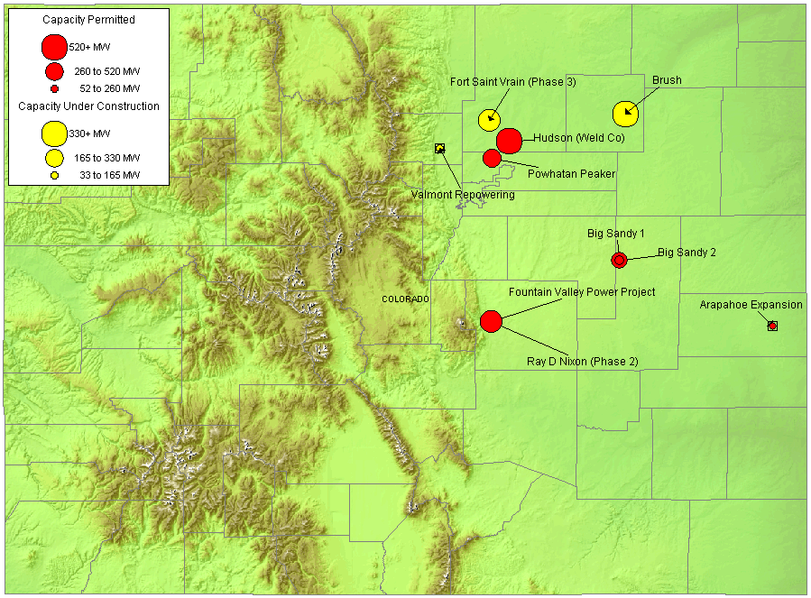
ROCKIES NEW GENERATION MAP
High Probability Plants
Fort Saint Vrain (Phase 3) / 214 MW / Jul-01 / 8,240 HR
Fountain Valley / 240 MW / Jul-01 / 9,086 HR
Valmont Repowering / 40 MW / Jul-01 / 9,169 HR
Rawhide (Phase 1) / 80 MW / Sep-01 / 10,456 HR
Brush / 328 MW / May-02 / 7,500 HR
Arapahoe Expansion / 45 MW / Jun-02 / 9,169 HR
Ray D Nixon (Phase 2) / 480 MW / Dec-02 / 7,100 HR
Medium-High Probability Plants
Big Sandy 1 / 75 MW / Nov-01
Powhatan Peaker / 280 MW / May-02
Barr Lake / 128 MW / Jun-02
Brighton / 140 MW / Jun-02
Limon / 140 MW / Jun-02 / 11,624 HR
Big Sandy 2 / 225 MW / Nov-02 / 10,500 HR
SkyGen / 270 MW / Jun-03
Hudson (Weld Co) / 516 MW / Jun-04 / 7,100 HR
Kiowa Energy Park I / 475 MW / Jul-04

Slide 19
ROCKIES UPDATE
Rockies

Slide 20
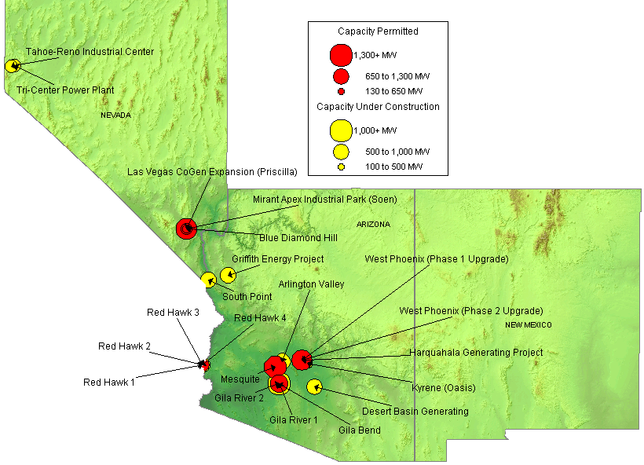
SOUTHWEST NEW GENERATION MAP
High Probability Plants
Murray GT Project (Phase 1) / 15 MW / Jul-01
Tri-Center Power Plant / 360 MW / Jul-01
Desert Basin Generating / 560 MW / Jul-01
Griffith Energy Project / 620 MW / Jul-01
Environmental Oil Project / 30 MW / Sep-01
Tahoe-Reno Industrial Center / 350 MW / Sep-01
West Ridge / 160 MW / Sep-01
Kyrene (Oasis) / 265 MW / Feb-02
Red Hawk (Phase 1) / 580 MW / Jun-02
Red Hawk (Phase 2) / 580 MW / Jun-02
Arlington Valley / 570 MW / Aug-02
Gila River (Phase 1) / 575 MW / Aug-02
Gila River (Phase 2) / 575 MW / Dec-02
Gila River (Phase 3) / 575 MW / Mar-03
Mesquite / 1,250 MW / Mar-03
Mirant Apex Industrial Park (Phase 1) / 550 MW / Mar-03
Gila River (Phase 4) / 575 MW / May-03
West Phoenix (Phase 2 Upgrade) / 440 MW / Jun-03
Harquahala Generating Project / 1,083 MW / Sep-03
Mirant Apex Industrial Park (Phase 2) / 550 MW / Dec-04
Medium-High Probability Plants
Chino Mines Co. / 50 MW / Jul-01
Murray GT Project (Phase 2) / 15 MW / Oct-01
Tortoise Power Plant / 60 MW / Mar-02
Reliant Energy Bighorn (Phase 1) / 310 MW / Jun-02
Steamboat Springs Geothermal / 30 MW / Jun-02
LV CoGen Expansion / 225 MW / Sep-02
Reliant Energy Bighorn (Phase 1) / 575 MW / Jun-03
Blue Diamond Hill / 400 MW / Jun-04
Gila Bend / 845 MW / Jun-04
Santan Expansion Project / 825 MW / Dec-05

Slide 21
SOUTHWEST UPDATES
Arizona
(05/01/01 PD) The US Army is seeking power for Fort Huachuca, AZ, and plans to sign a contract for up to five years. The Army announced the solicitation in the Department of Commerce's Commerce Business Daily. For Huachuca, which houses the US Army Intelligence Center, has a peak load of 16.5 MW, and uses about 97,000 MWh annually. Suppliers must be certified by the Arizona Corporation Commission by the start of deliveries, which could come as early as October. Bids must beat the base's current prices from Tucson Electric Power, which run around 6.5 cents/kWh for generation.
(05/10/01 PD) Maestros Group, an Arizona power plant developer, filed May 7 for federal permission to sell power to northern Mexico, as part of a proposed 600 MW plant it wants to build in southern Arizona. The company hopes to build the 600 MW natural gas-fired Ambos Nogales Generating Station in Nogales and is in negotiations with possible partners, according to the permit application. The group is considering exporting 500 MW to Mexico and dedicating 100 MW for us in the US. The entire project, including a transmission line into Mexico, would cost about $430 million, the company estimated. If approved, Maestros aims to build the first, 500 MW phase by 2004, depending on turbine availability, and will feed power to the northwest Mexico grid.
(05/21/01 EIS) Pinnacle West Energy will commemorate the completion of its new combined-cycle generating unit at the West Phoenix Power Station with a dedication ceremony Tuesday, May 22. Arizona Governor Jane Dee Hull will be among the dignitaries to speak to an invited group of public officials, community leaders and Pinnacle West employees. The ceremony begins at 9 a.m. at the West Phoenix Power Station, located at 4606 W. Hadley, south of Van Buren off of 43rd Avenue. Media are invited. The 120-megawatt combined-cycle Unit 4 is the first new generating unit designed to serve the Valley to come on-line since Palo Verde Unit 3 began operating in 1988. Palo Verde is operated by APS, a sister company of Pinnacle West Energy.
(05/21/01 EIS) PG&E Corporation's National Energy Group today began construction of the Harquahala Generating Plant, a 1,048-megawatt natural gas, combined-cycle electric generating facility, planned for commercial operation in mid-2003. According to the National Energy Group, the facility will meet market demands for new power while achieving improved levels of environmental performance. It will use advanced technology -- combining the use of natural gas with a combined-cycle plant configuration -- making the Harquahala Generating Project one of the cleanest gas-fired generating stations in the country.
(05/23/01 EIS) The Shaw Group Inc. today announced that it has signed a Letter of Intent with PG&E National Energy Group for the construction of an 1,100 megawatt combined-cycle power plant, to be located 60 miles west of Phoenix, Arizona in the town of Tonopah. Shaw will execute the engineering, procurement and construction services for the project. PG&E National Energy Group has ownership or management interests in more than 7,000 megawatts and has more than 10,000 megawatts in new power plant development or construction currently underway. Shaw will assume engineering on the project immediately. The power plant is scheduled to be complete and in commercial operation by June 2003.
DSW

Slide 22
SOUTHWEST UPDATES
Nevada
(05/14/01 PD) Allegheny Energy Supply has signed a tolling agreement with Southwest power for the 222 MW Las Vegas Congeneration II project in Nevada. Southwest is now building the combined-cycle plant and it expects to start operating in the third quarter 2002. Allegheny said the deal is part of its strategy to expand into Western markets, adding that that contract will give the company control of more than 2,300 MW to sell into western states by 2005. Allegheny is already contracted to sell up to 1,000 MW to the CDWR, which has become the power buyer for the state during the energy crisis, and it is developing a 1,080 MW merchant plant in Arizona.
(05/18/01 EIS) Environmental Oil Processing Technology Corporation announced today that Sierra Pacific Power Company has signed a contract to purchase $47,020,640 of the electric power generated from Environmental Oil's 30-megawatt power plant that will be built in Storey County, Nevada. The contract to supply northern Nevada consumers will begin on August 1, 2001 and end on December 31, 2002, at which time the contract is renewable. Environmental Oil's new 30-megawatt power plant will be the first phase of a major new regional waste oil reprocessing plant. The plant is under development and is estimated to be on-line in September 2001. The second phase of the Company's Nevada project will be construction of a major waste fuels reprocessing plant. The reprocessing plant will be constructed over a one-year period. Both facilities will be built and operated on a Company owned 20-acre site at the Tahoe Reno Industrial Center.
(05/20/01 PowerMarketers.com) A Nevada firm proposes building a 30,000-megawatt, diesel-burning power plant in Tuolumne County -- if people don't kick up a big fuss over it. Shelor is a vice president for Far West Energy of Reno, which owns two geothermal power plants in Nevada. Geothermal production involves drilling deep into the earth for hot water and steam to run turbines. Now the company wants to build small plants in several areas on the California side of the Sierra. But the plan here is to create power with diesel, not steam. Shelor told Tuolumne County supervisors last week that "low-sulfur" diesel and catalytic reduction would be used to keep smog down, and that the plant would operate no more than 12 hours a day, five days a week.
(05/25/01 PD) The Nevada Assembly approved Wednesday a bill that would allow large energy users to buy power from competitive suppliers. The Assembly also passed a bill that requires utilities to purchase or generate at least 15% of their power from renewable sources by 2013. The senate had already approved a renewable energy bill but will vote on changes made in the Assembly. AB 661, which allows customers that use more than 1 MW of power to shop competitively, will be heard by the Senate Commerce and Labor Committee today. Another provision in AB 661 requires competitive shoppers in southern Nevada to buy 10% more power than they need and transfer it to Nevada Power Co. to help lower rates for smaller customers.
(05/30/01 PowerMarketers.com) Continental Ridge Resources Inc. announces that the Company has entered into an agreement with a private company, Blue Mountain Power Company Inc. (BMPC), whereby Continental Ridge is granted the exclusive option to acquire a 60% interest in the Blue Mountain Geothermal Project in Humboldt County, Nevada. Continental Ridge plans to complete development work to enable an early production decision. In order to earn a 60% interest, Continental Ridge must (i) pay US$50,000, (ii) incur a total of US$1,700,000 in exploration expenditures and (iii) issue 600,000 shares to BMPC over a three year period. The first year commitments are US$10,000 cash, US$200,000 exploration expenditures and 200,000 shares.
DSW

Slide 23
SUMMARY
Summary

Slide 24
Sorted List By Online Date

Slide 25
Sorted List By Online Date

Slide 26
Sorted List By Region

Slide 27
Sorted List By Region

Slide 28
WSCC CAPACITY ADDITIONS
NOTE: 100% of Capacity Under Construction, 80% of Permitted Capacity
Summer Summary

Slide 29
New Gas Generation Summary

