Slide 1

Gas Supply for New Generation in WSCC
Discussion Items for Weekly Meeting
June 4, 2001
Proprietary and Confidential

Slide 2
Issues Around Gas for New Power Generation
Insufficient physical supply?
Insufficient pipeline capacity?
0.6 BCF/d demand increase in June 01 from new power gen in the west
Mismatch in trading blocks (6x16 vs 3-day weekend)
Day-ahead notification vs same-day
Risk management for daily calls
Does purchasing storage make sense?

Slide 3
Gas for Services Transactions
Daily purchases vs Term Gas
Capacity purchases may not work
Where does Orig come from

Slide 4
Gas Volumes Associated with WSCC Capacity Additions
MWh
NOTE: 100% of Capacity Under Construction, 80% of Permitted Capacity
MMBTu
Summer Summary

Slide 5
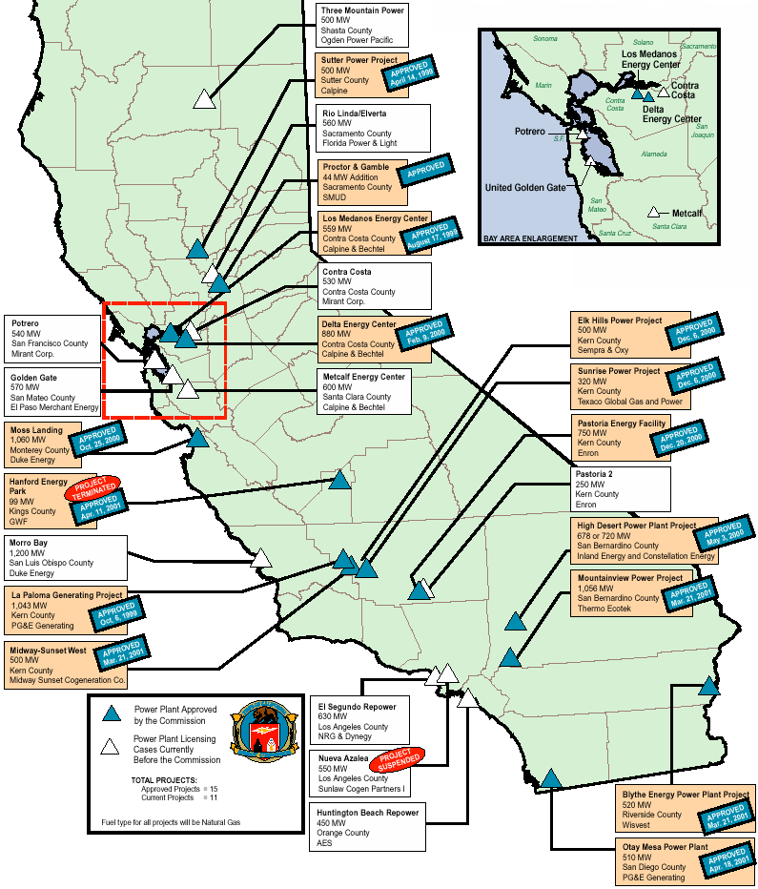
CALIFORNIA
2.5 BCF per day behind SoCal and PG&E
Capacity into state sold out
No in-state capacity available
California

Slide 6
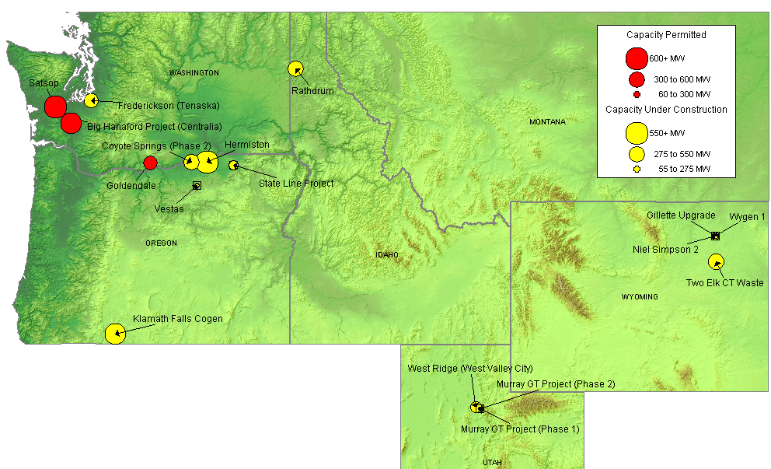
NORTHWEST NEW GENERATION MAP
Grays Harbor/
Franklin
No primary firm on NWPL
Cascade holds some generators hostage

Slide 7
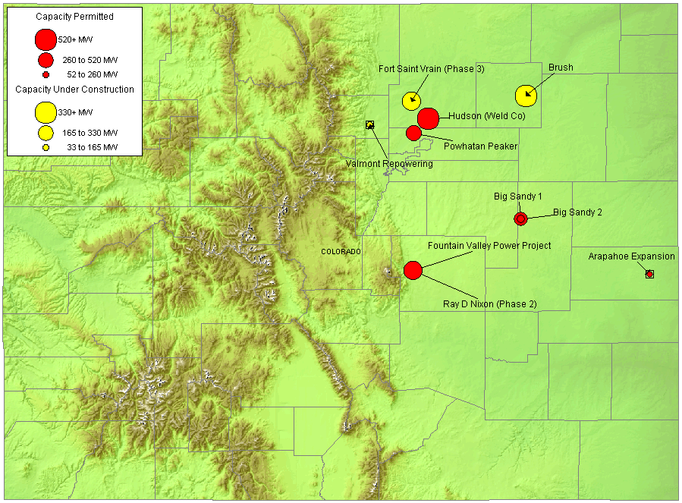
ROCKIES NEW GENERATION MAP

Slide 8
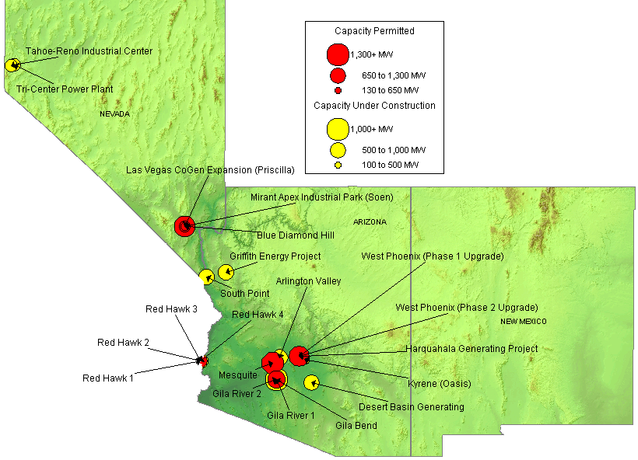
SOUTHWEST NEW GENERATION MAP

Slide 9
SUMMARY
Summary

Slide 10
CALIFORNIA UPDATES
(04/01/01 Yahoo) An affiliate of Baltimore-based Constellation Energy Group, today began construction of the first major power plant to be built in Southern California since the 1980's. Groundbreaking for the approximately $450 million, 750-megawatt facility, known as High Desert Power Project, was held here at the Southern California Logistics Airport. The natural gas-fired power plant will produce enough electricity to serve more than a half a million homes. Last month Constellation Power Source, a top-10 ranked national power marketer, announced the signing of a long-term power sales contract with the California Department of Water Resources.
(04/03/01 PD) The CPUC is today likely to approve a proposal to create several new interruptible load programs and revise rotating outage programs for the state's three investor-owned utilities. The commission is expected to vote on a draft order that would allow the state Treasurer to issue $12-$14 billion in revenue bonds to finance electricity purchases by CDWR. Under the draft, the PUC would set the so-called California Procurement Adjustment between $3 billion and $3.5 billion a year.
(04/04/01 MWD) A top official of the CEC warned that the state will fall short of its declared goal of adding 5,000 MW by this summer in an attempt to avert blackouts. CEC Deputy Director Bob Therkelsen told the state Senate Energy Committee last week that the commission, while inundated with new generation projects, expects 1,931 MW of new capacity to come online this summer, but none before July. The commission in the past two years has approved permits for 13 plants totaling 8,464 MW.
(04/05/01 EIS) The CEC today announced approval of InterGen's Wildflower Energy Project - two natural gas-fired generating plants that together will produce 225 megawatts of power for the California market by July of 2001. The 90-megawatt Larkspur Energy Facility will be located in the San Diego area and the 135-megawatt Indigo Energy Facility will be located in Palm Springs. The Wildflower Energy Project "peaker" plants are the first facilities to be licensed under the CEC's emergency siting process instituted upon Governor Gray Davis' Executive Order to expedite the licensing of electricity plants that can be on line by September 30, 2001.
(04/05/01 MWD) With California's political and regulatory approaches to the state energy situation still unsettled, Mirant is reassessing whether it will proceed with applications to obtain permits for two new power plants. The merchant generator is planning new units of about 500 MW each at the Contra Costa and Potrero sites it acquired from PG&E and is ready to submit applications to the state siting authorities this year. By contrast, Mirant will break ground next week on a 1,000 MW plant in southern Nevada for which permits were sought six months after the company started on the new California facilities.
(04/09/01 GD) Only three weeks after receiving the certificate application, FERC Friday granted Kern River Gas Transmission authority to proceed with a 135 million cfd expansion of its system that will move new gas supplies from Wyoming to California. The unprecedented speed in which FERC completed its review of the $81 million project grew out of the commission's desire to address the energy crisis in California, which is expected to worsen this summer in light of forecasts for continued high gas prices and shortages of power generation capacity. The installation of these new facilities will boost capacity on the system by 19%.
California
Notes:
CISO has reset target pricing mechanism for the real time energy imbalance market. The price of the highest decremental bids is greater than the price for the lowest incremental bid. The new price is to be greater of zero or the lowest incremental bid.

Slide 11
CALIFORNIA UPDATES (cont’d)
(04/11/01 PD) AES Pacific stopped short of telling the CEC that it would abandon the fast track 60-day review process for the 450 MW retooling project at its Huntington Beach generation station if the CEC insists on limiting the license for five years. The five-year limitation is outside the scope of the CEC's decision-making power, AES stressed, referring to a CEC licensing committee recommendation in March that the two retooled units be licensed for five years only because of on-going environmental studies.
(04/12/01 GD) Otay Mesa Generating this week filed an application with FERC for permission to build and operate facilities to import gas from Mexico to serve a proposed electric generating plant that it wants to build near San Diego. The company has proposed to build a pipeline segment to bring gas from the US-Mexico border to an interconnection with San Diego Gas and Electric. The 340-foot pipe would interconnect with Transportation de Gas Natural de Baja California (TGN) at the border. The Otay Mesa plant will be the first one in the US to use "mobile offsets" to comply with the clean air acts. The fleet of 120 converted trucks will be the largest deployment of natural gas-powered trash trucks in the US.
(04/15/01 LATimes.com) Gov. Gray Davis has mobilized state government and invited developers to put dozens of small "peaker" power plants online "at warp speed" to help avert blackouts this summer. But, as California races against time, industry experts say the logistics and uncertainties of power plant construction make it doubtful the state will have as much peaker electricity as it is seeking: Generating turbines--which resemble giant jet engines--are in tight supply. Without knowing how much people will conserve, state officials estimate the summer energy shortage at about 5,000 megawatts--enough to serve 3.7 million homes. They are counting on emergency peaking plants, usually providing 50 to 100 megawatts each, to make up about 40% of that shortfall.
(04/16/01 GD) Bakersfield, CA-based Tri-Valley Oil and Gas believes it could be sitting atop one of the biggest onshore dry gas finds in the state as it begins to explore Sunrise Natural Gas project in the area of the city of Delano. Some 3 trillion cf may await exploitation in the Sunrise/McClure interval of Monterey Shale, which earlier this year saw a wildcat well yield very significant results. The well logs revealed a cut of approximately 300 net feet of diatomaceous formation saturated with 825 to 922 Btu of gas. Estimates are for 72 billion cf of gas per 160 acres.
(04/18/01 CEC) Sacramento -- With a 4 to 0 vote at its Business Meeting on April 18, 2001, the California Energy Commission began a formal review process for construction and operation of the Rio Linda/Elverta Power Plant Project, a nominal 560-megawatt natural gas-fired, combined cycle power generating facility.
(04/18/01 PowerMarketers.com) A state energy panel delayed Tuesday a fast-track proposal to license two units at the Huntington Beach power plant until the owner, AES Corp., signs a contract to keep the power in California. The state Energy Commission planned to vote on the permit request today in Sacramento. Instead, the commission delayed discussion and a final vote until April 25, said Garrett Shean, a commission hearing officer. Ed Blackford, president of AES Huntington Beach, said the commission is requiring the company sign an agreement with the state's Department of Water Resources, which began buying power in lieu of the state's three largest utilities in mid-January. AES has repeatedly promised to sell power to the state from two 40-year-old gas-fired generators, but the company has not signed a formal agreement with the DWR.
California
Notes:
CISO has reset target pricing mechanism for the real time energy imbalance market. The price of the highest decremental bids is greater than the price for the lowest incremental bid. The new price is to be greater of zero or the lowest incremental bid.

Slide 12
CALIFORNIA UPDATES (cont’d)
(04/18/01 Yahoo) PG&E Corporation's National Energy Group (NEG) announced today that the California Energy Commission (CEC) has approved construction of the Otay Mesa Generating Plant in San Diego County, which the NEG has developed. In a regular business session Wednesday, the CEC voted unanimously to approve a license for the 500-megawatt project.
(04/19/01 MWD) California's siting board has given the nod to a 500 MW plant proposed for an industrial site in western San Diego County along the US-Mexico border. PG&E Corp.'s National Energy Group subsidiary developed the Otay Mesa project that will be located 15 miles southeast of San Diego. PG&E NEG will see the project through the remainder of the CEC's permitting process, after which Calpine will take over ownership of the plant. Calpine will being construction of the natural gas-fired, combined-cycle plant in the third quarter of this year. The Otay Mesa facility could enter service by summer 2002. California Governor Gray Davis urged the CEC to also offer it approval to the much disputed Metcalf Energy Center in south San Jose. The plant has run afoul of local giant Cisco Systems and the city's mayor, who say the site is better suited to residences and a planned Cisco corporate campus.
(04/24/01 PowerMarketers.com) Pacific Gas and Electric Company announced today that as scheduled, Unit 2 of Diablo Canyon Nuclear Power Plant will be taken offline to undergo vital refueling and maintenance work beginning April 29. The work will help ensure that the 1,100 megawatt unit will be prepared to operate through the summer months of high electricity demand. The refueling and maintenance outage is scheduled to last 35 days, and has been in the planning stages for more than a year. Unit 1 of Diablo Canyon, also 1,100 megawatts, is scheduled to operate at full power while Unit 2 is shut down.
(04/24/01 PowerMarketers.com) As California tries to build its way out of its energy crisis, the state is deepening its dependence on natural gas, a fuel source that is increasingly expensive and scarce. That reliance could keep costs of wholesale power high for the state and its utilities even when California eventually generates enough electricity to keep the lights on. The state hopes to have at least 13 new power plants generating an additional 8,900 megawatts by 2004. California then will rely on natural gas to generate 60 percent of its electricity, up from 52 percent today, according to the Rand Corp. All the plants now in the works will be fired by natural gas, which has been the cheapest and cleanest way to produce power. On Monday, Gov. Gray Davis and other officials broke ground on the latest, a 500-megawatt plant west of Bakersfield to be online by the middle of next year. Putting the state's energy future almost entirely in the hands of natural gas suppliers concerns some analysts.
(04/26/01 CEC) The Energy Commission staff has performed a fatal flaw analysis of the Calpine King City LM6000 Project and recommends that the project be approved by the Energy Commission with the Conditions of Certification proposed by staff. Staff further recommends that the certification be for the life of the project provided that at the end of the power purchase agreement with either the California Independent System Operator or the California Department of Water Resources the project owner can verify that the project meets certain continuation criteria. These recommendations are based on the Energy Commission staff’s independent assessment of the emergency permit application, independent studies and site evaluation, and consultation with agencies that would normally have permitting authority over the project except for the Energy Commission’s emergency permitting authority provided by the Emergency Executive Orders of the Governor.
California
Notes:
CISO has reset target pricing mechanism for the real time energy imbalance market. The price of the highest decremental bids is greater than the price for the lowest incremental bid. The new price is to be greater of zero or the lowest incremental bid.

Slide 13
CALIFORNIA UPDATES (cont’d)
(04/26/01 MWD) Edison International's utility subsidiary has paid $242 million to small power generators who have supplied it with power since March 27. SoCal Edison paid $211 million to qualifying facilities for "estimated deliveries" during April and would also be making a "stub payment" to those suppliers for power sold from March 27 through the end of the month.
(04/28/01 PowerMarketers.com) Federal energy regulators yesterday agreed to place limited caps on the price of wholesale electricity in California in an effort to help the state through summer when demand for power is at its highest. The temporary initiative, passed by the heavily-divided Federal Energy Regulatory Commission, falls far short of regulations proposed by Gov. Gray Davis and evoked only a cautious response from Californian utilities executives and power producers. Power can no longer be sold for more than $300 per megawatt hour, $200 less than prices expected this summer.
(04/30/01 CEC) Calpine’s proposed King City LM6000 Project ( the project ) was the subject of a Committee hearing and subsequent analysis by the Energy Commission staff. The proposal meets criteria that the Energy Commission staff developed to implement the Governor’s Executive Orders expediting the permit process for peaking and renewable energy generating plants. This Proposed Decision has been completed in an expedited timeframe as called out in the Executive Orders and is submitted for approval by the full Commission. As the Presiding Commissioner assigned to review this proposal, I hereby recommend certification of the project under the limitations presented as proposed conditions contained in this Proposed Decision.
California
Notes:
CISO has reset target pricing mechanism for the real time energy imbalance market. The price of the highest decremental bids is greater than the price for the lowest incremental bid. The new price is to be greater of zero or the lowest incremental bid.

Slide 14
NORTHWEST UPDATES
Washington
(04/03/01 PD) Kaiser Aluminum Corp. has sold to BPA for $130 million the last of the power it had contracted to buy from BPA through September for smelters in Mead and Tacoma, WA. These agreements bring its total re-sale of power to BPA since last November to $395 million. Houston-based Kaisers uses 615 MW in the Northwest, and BPA supplies 80%. Smelters are not sure if they will restart in October. Only three are currently operating, but at reduced capacity. Smelters say they cannot operate profitably if rates hit $40/MWh or higher. Kaiser says new contracts are expected to increase BPA rates to about $48/MWh, which it says is 150% higher than the world average for the aluminum industry.
(04/05/01 PowerMarketers.com) Skyrocketing electricity prices have Snohomish County officials talking garbage. Specifically, managers of the county's dormant dump are reviving a plan to turn rotting apple cores into electrons. The fine print on garbage power. The project would use methane gas produced by decaying trash at the Cathcart Sanitary Landfill to fuel generators, which could make enough power to light 1,800 homes, said Jeff Kelley-Clarke, director of the county's solid waste division. It could also cash in on the high demand for power. High power prices have renewed interest in trash power elsewhere as well. King County officials are considering installing generators at the Cedar Hill dump, which could generate 20 to 25 megawatts, enough electricity for 15,000 homes.
(04/06/01 PowerMarketers.com) This notice announces BPA's intention to prepare a joint National Environmental Policy Act (NEPA) / State Environmental Policy Act (SEPA) EIS in cooperation with the State of Washington Energy Facility Site Evaluation Council (EFSEC) for an electrical interconnection including a new 29-mile 500-kilovolt (kV) transmission line associated with a proposed power plant. BPA is the lead Federal agency under NEPA and EFSEC is the lead Washington State agency under SEPA. The Wallula Power Project is a 1,300-megawatt (MW) generating station proposed by Newport Northwest, LLC (Newport Northwest) that would be located near Wallula in Walla Walla County, Washington. BPA proposes to execute an agreement with Newport Northwest to provide the interconnection and firm power transmission.
(04/06/01 PowerMarketers.com) TransAlta will break ground on the site of its planned $210-million US ($310-million Cdn) 248-megawatt (MW), natural gas-fired combined-cycle power plant near Centralia, Washington on Tuesday, April 10, 2001. Washington Gov. Gary Locke and Murray Nelson, TransAlta's executive vice-president of Generation will attend.
(04/07/01 PowerMarketers.com) A 29-megawatt diesel generator farm is to go up on the site of an unfinished nuclear power plant at Hanford next month, and another may be in the works. Energy Northwest, which operates the nearby Columbia Generating Station nuclear plant, has signed a one-year agreement with Northwest Regional Power of Goldendale to lease land near unfinished Plant No. 1. The consortium of public utilities also is considering setting up its own generator farm of a similar size nearby.
PNW
Notes:
Formerly (stalled) NWPE 220 MW project. FPL bought rights in 1/99. Construction to began 9/1/99 As of 4/25/00 Unit 1 not complete and gas line construction has been stalled.

Slide 15
NORTHWEST UPDATES(cont’d)
Washington (cont’d)
(04/10/01 PD) In a fight for its financial survival, the BPA said Monday it will impose a 250% rate increase, or about $200/MWh, if its utilities and directly served aluminum companies do not cut back on power demand from the agency. BPA said it may even have to triple or quadruple its rates if the 250% rate hike is not enough. BPA wants 10 aluminum smelters operated by Kaiser Aluminum Corp., Alcoa and others to drop off its system for two years in exchange for BPA funds to pay employees. The smelters currently receive 2,200 MW, and this amount would dwindle to 1,500 MW starting in new five-year contracts in October. But BPA is 2,500 MW short and has been buying high-priced power on the market to meet aluminum and other loads. BPA said that without the purchase power, its cost-based power would be $23/MWh.
(04/10/01) TransAlta broke ground today on the site of its $210-million US ($310-million Cdn) 248-megawatt (MW), natural gas-fired combined-cycle power plant near Centralia, Washington. Washington Gov. Gary Locke joined Murray Nelson, TransAlta's executive vice-president Generation, at the plant site to dig the first spade into the ground for the Big Hanaford Project. The new plant will add 248-MW of electricity to the Pacific Northwest energy market and will be on the site of TransAlta's 1,340-MW Centralia coal-fired power plant, pending final approvals. The facility, which will begin operating by July 2002, will use the best available emission-control technology.
(04/16/01 GD) Northwest Pipeline is holding an open season through April 20 on firm, year-round capacity on its proposed 48-mile Grays Harbor Lateral in Thurston County, WA. Based on timing of FERC approval, Northwest expects to place the new capacity into service by November 2002. The Grays Harbor lateral would move gas from an interconnection with Northwest's mainline near Vail, WA, to a proposed power plant near Elma, WA. Duke Energy is building a 500 MW combined-cycle plant at the site. Duke said it plans to have the plant in operation by 2002 or 2003.
(04/16/01 PD) The BPA said its water and power buy-back programs for farm irrigators in Washington have been a huge success, and it expects to get 90 MW to 120 MW of load reduction. In a program offered directly through utilities in southeastern Washington, it is offering $75/MWh and will get 10 MW to 20 MW of load reduction during the spring and summer growing season. In another program offered directly to irrigators in the Banks Lake Irrigation District in northeast Washington, it will pay farmers $330 per acre to participate and will pay out more than $25-million to achieve a savings of 80 MW to 100 MW.
(04/17/01 PD) The Washington State Energy Facility Site Evaluation Council has approved Duke Energy's plans to increase generation from the proposed Satsop, WA plant from 450 MW to 650 MW. Duke will begin construction in late summer and hopes to bring the plant online in 2003. The council also approved the air emission permit for Tractebel's proposed 520 MW plant in Chehalis, WA and construction will being shortly.
PNW
Notes:
Formerly (stalled) NWPE 220 MW project. FPL bought rights in 1/99. Construction to began 9/1/99 As of 4/25/00 Unit 1 not complete and gas line construction has been stalled.

Slide 16
NORTHWEST UPDATES(cont’d)
Washington (cont’d)
(04/18/01 PowerMarketers.com) Westcoast Energy Inc. (Westcoast) and EPCOR Utilities Inc. (EPCOR) today announced that Frederickson Power L.P. has completed a 20-year sale of 125 megawatts (MW) of power to three Washington State Public Utility Districts (PUDs). Based in the Frederickson area of Pierce County, Washington, Frederickson Power L.P. is a partnership between Westcoast Power Inc. and EPCOR Power Development Corporation. The Benton, Franklin, and Grays Harbor PUDs have agreed to purchase power from Frederickson Power L.P. These power purchase agreements begin in mid-2002, when the 249-MW Frederickson Power Project commences commercial operation. Construction is underway by the project's engineering, procurement and construction contractor, KBV-Tacoma, a joint venture between Kiewit Industrial Co. and Black & Veatch Construction Inc.
(04/18/01 Yahoo) Calpine Corporation announced that it has acquired the development rights from Kirkland, WA-based National Energy Systems Company for the 248 MW natural gas-fired Goldendale Energy Center planned for Goldendale, WA. The project has been fully permitted and is expected to begin construction immediately. Energy deliveries are projected to being as soon as July 1, 2002. The facility will feature one General Electric Frame 7FA gas combustion turbine in combined-cycle with a steam turbine, representing 248 megawatts of baseload capacity.
(04/19/01 MWD) Three Washington state public utility districts have agreed to buy about half the output of a new merchant power plant for a 20-year period. The Benton, Franklin and Grays Harbor PUDs have agreed to purchase power from Frederickson Power, a joint venture between Canadian companies Westcoast Energy and EPCOR, beginning in mid-2002 when the 249 MW Frederickson Power project starts, commercial operation. Construction of the power project is currently under way.
(04/25/01 GD) A private developer seeking to put up a power plant in Washington state said this week it has obtained gas supply and turbines for the facility. Newport Generation is working on a 1,300 MW, gas-fired project in Walla Walla County, WA, named the Wallula Power Project. Newport said yesterday that it had secured delivery of 175,000 dth/d of gas on PG&E Gas Transmission - Northwest, operated by PG&E National Energy Group. The PG&E unit has sought FERC approval to expand capacity on the pipeline next year.
(04/26/01 MWD) Utility regulators in Washington state yesterday approved a proposal to being a five-month pilot program that will charge residential utility customers for power depending on the time of day of their consumption. The Washington Utilities and Transportation Commission gave Puget Sound Energy the go ahead to introduce its "Personal Energy Management pricing" program for 300,000 residential customers effective May 1. The utility's time-of-use billing plan will have only a limited effect on Puget Sound customers, utility representative Grant Ringel said. The plan is designed so that average customers who do not change their consumption patterns will see little or no change in their monthly bills.
PNW
Notes:
Formerly (stalled) NWPE 220 MW project. FPL bought rights in 1/99. Construction to began 9/1/99 As of 4/25/00 Unit 1 not complete and gas line construction has been stalled.

Slide 17
NORTHWEST UPDATES(cont’d)
Washington (cont’d)
(04/26/01 PD) The Washington Utilities and Transportation Commission Wednesday approved plans by three utilities to buy back from customers all additional power they are able to conserve after having achieved reductions ranging from 5-20% of last year's baseline. The incentive program will run from May 1 through December 31. The WUTC approved similar plans for Avista Corp., which will pay 5 cents/kWh to all customers after they have achieved a 5% cut and PacifiCorp, which will pay 20 cents/kWh for all power saved after a 20% reduction has been reached. All customers who do not have other curtailment agreements with the utilities are eligible for the program. The commission also approved the Bellevue-based Puget's controversial time-of-day rate plan that will allow 300,000 customers with special meters will pay different rates based on when they use power.
Idaho
(04/06/01 PD) The Idaho PUC okayed three power buy-back programs proposed by Idaho Power and PacifiCorp that involve irrigation customers and industrial companies. The PUC approved an irrigation program proposed by PacifiCorp that will likely have up to 500 participants after the utility agreed to increase the amount it would pay irrigators to 15 cents/kWh. PacifiCorp initially offered 8.5 cents, which it later increased to 12 cents. Irrigators had balked at participating at the lower price because Idaho Power was paying its customers 15 cents. Commission Dennis Hansen said the higher price is "a definite improvement. Irrigators in southeast Idaho seem a lot more comfortable with it." The PUC also said Idaho Power's industrial and commercial customers could voluntarily reduce electrical loads by 1,000 kW in exchange for credit against their accounts. The program will expire March 14, 2002, unless Idaho Power extends it.
(04/16/01 Yahoo) Newport Generation, Inc. today announced plans to build a 1,300 megawatt (MW) power plant in Rathdrum, Idaho, 32 miles northeast of Spokane, Wash. Upon completion in 2004, the $550 million natural gas-fired combined cycle plant will generate electricity equivalent to that required to meet the needs of a city the size of Seattle. Newport Northwest, LLC, the Pacific Northwest affiliate of Newport Generation, will manage the development activities on the proposed project. The Kootenai Power Project is planned for a portion of a 320-acre site adjacent to a new 250 MW power plant currently under construction and owned by Avista Energy, Inc. and Cogentrix. Both a Bonneville Power Administration (BPA) electric transmission line and a PG&E Gas Transmission Northwest natural gas pipeline intersect the site. The proposed Kootenai Power Project is in the early stages of development.
Wyoming
(04/16/01 MWD) North American Power Group has announced it is seeking permitting for a second 500 MW, coal-fired generating project in Wyoming. Earlier this month, the Colorado-based company filed permit applications for a 500 MW minemouth plant to be build at Kennecott Energy's Cordero Rojo complex in Campbell County. NAPG said last Thursday that it filed an application with the Wyoming Department of Environmental Quality for a construction permit on the second Two Elk Unit. The facility can be in production as early as 2005.
PNW
Notes:
Formerly (stalled) NWPE 220 MW project. FPL bought rights in 1/99. Construction to began 9/1/99 As of 4/25/00 Unit 1 not complete and gas line construction has been stalled.

Slide 18
NORTHWEST UPDATES(cont’d)
Oregon
(04/10/01 PD) Delaying or stopping implementation of SB 1149, Oregon's restructuring law, would stifle innovation and harm efforts to build more renewable energy plants in Oregon, according to the Renewable Northwest Project, a nonprofit group that promotes the development of renewable energy. The Renewable Northwest Project is urging Oregon legislators to keep SB 1149 intact. Two Oregon legislators have filed bills aimed at delaying or stopping implementation of the law, which would grant small commercial and industrial customers open access beginning October 1. SB 1149 establishes a 3% systems benefit charge under which utilities will collect an amount equal to 3% of revenues and invest it in renewable energy and conservation. In addition, small commercial and residential customers will remain with their utilities and choose from a "portfolio" of options, including green power and time-of-use energy.
PNW
Notes:
Formerly (stalled) NWPE 220 MW project. FPL bought rights in 1/99. Construction to began 9/1/99 As of 4/25/00 Unit 1 not complete and gas line construction has been stalled.

Slide 19
ROCKIES UPDATE
(04/06/01) In an effort to acquire new generation in a timely manner to meet the ever-increasing demand from consumers, Tri-State will add approximately 280 megawatts to the region's generation resource pool with four natural gas-fired combustion turbines. The units will be installed over the next 14 months near Colorado's Front Range - two in the Limon area and two near Brighton.
(04/24/01 GD) Colorado Interstate Gas is holding an open season through May 31 to evaluate whether it should add capacity from the Rockies to Nevada and northern California markets. The project, called the Ruby Pipeline, would total up to 750 million cfd of incremental capacity and would begin service in late 2003. Bid sheets can be obtained from CIG's Web site at www.cigco.com/business/colorado/index.html. The Ruby project will consist of approximately 850 miles of 30-inch and 36-inch pipeline running from western Wyoming through Utah to Elko, NV, to points of delivery near Reno, NV, Yuba City, CA and Sacramento, CA. CIG said it anticipates interconnecting with the northern California gas storage facility of Wild Goose Storage, which is currently holding its own open season to evaluate expanding its facility.
(04/25/01 GD) Colorado Natural Gas can move forward with plans to bring gas service into Pueblo County, CO after an administrative law judge granted the company a certificate of public convenience and necessity to operate and maintain facilities in the area. The gas system will be the utility's second distribution system in the state.
(04/30/01 PowerMarketers.com) New Mexico's rural electric cooperatives will get a new source of power if Tri-State goes ahead with plans for a huge new plant in Colorado. Tri-State Generation and Transmission has proposed a 1,200-megawatt, $1.3 billion coal-fired plant to be built in Bent County in southeastern Colorado. Tri-State, based in Denver, is talking to several other utilities, including Xcel Energy in Colorado and Missouri-based Utilicorp about sharing costs to build the plant.
Rockies

Slide 20
SOUTHWEST UPDATES
Arizona
(04/02/01 GD) El Paso Natural Gas is winning kudos for its plans to expand the capacity of its interstate transmission system. El Paso recently amended its proposal for the conversion of a crude oil pipeline to natural gas service, saying it would keep six existing mainline compressors online. The amendment would change the project, called Line 2000, to a capacity upgrade rather than a capacity replacement. The proposal calls for expanding the pipeline's capacity by approximately 230 million cfd. Citizens suggested that cost allocations for the project, which is expected to run $75 million could be rolled into the next rate case.
(04/06/01 GD) Arizona regulators required the developer of a power plant to meet the highest possible emissions control standards on a new facility. The Arizona Corporation Commission approved the application of Gila Bend Power Partners for an 845 MW, gas-fired, combined-cycle unit in Gila Bend, AZ. Among the conditions imposed on the plant is that the developers must use best available control technology, the tightest standard. The plant is expected to coat about $375-million and come online in mid-2004. The equipment to meet the cleaner air standards will cost about $6-million. The developers are considering partners to market the power reach a tolling arrangement.
(04/06/01 PowerMarketers.com) Tucson's Electric Power Company's two-unit, 760 MW Springerville coal-fired power plant located in northeastern Arizona will add the second two 380 MW units initially planned for the plant, doubling the plant's capacity to 1,520 MW by 2005. The Springerville plant was originally designed by Bechtel to have four 380 MW coal-fired units. Despite the overwhelming use of natural gas for new generating capacity in Arizona in the years since the first two units were built, Springerville's two new units will also be coal fired.
(04/07/01 PowerMarketers.com) Pima County Zoning Examiner Peter Gavin withheld a recommendation Thursday on whether to rezone the 220-acre site of Tucson Electric Power Co.'s proposed gas-fueled power plant for industrial construction. TEP's rezoning request will go before the examiner again on April 26. TEP is planning to build two 75-megawatt turbines, south of Interstate 10 and east of Harrison Road, about 2.6 miles form the Rita Ranch subdivision.
(04/25/01 PD) A staff report from the Arizona Corporation Commission predicts that existing and planned system upgrades will likely fall short of what is needed to keep up with the rising demand and the number of new power plants coming online, threatening system reliability. Although, Phoenix-based Arizona Public Service Co. disputed the ACC staff's findings. According to the report, Phoenix faces a "small possibility" of blackouts this summer, with an increasing likelihood in 2002. Overall, Arizona's transmission system faces several limitations, which are hampering reliability, the report states. For example, there is little long-term firm regional transmission capacity available to export or import energy over Arizona's transmission system, the report finds. With a boom in merchant power plant construction underway, the report finds that the transmission system won't be able to handle all the new capacity. Arizona currently has 21 power plants with 15,935 MW of capacity, and 17 plants are being build or have been proposed adding up to 17,000 MW of capacity, the report states.
DSW

Slide 21
SOUTHWEST UPDATES
Arizona (cont’d)
(04/25/01 PD) On the eve of a key regulatory hearing, a new survey has found that most Phoenix-area residents support the Salt River Project's 825 MW expansion of the Santan electric generating station. The Arizona Corporation Commission may today decide whether to approve the utility's plans to build the unit, which it promises would be completed by 2005. Ninety-percent of respondents who have an opinion on the Santan project favor it. The survey of 403 heads of household in Maricopa County was commissioned by a coalition of Arizona power users, including the East Valley Partnership, Westmarc, the Arizona Association of Industries and the East Valley Chamber Alliance. The poll found that Arizonans are concerned that California's energy crisis may spill over into their state. Sixty-eight percent of the people polled said they believe California's problems would drive up electric bills in Arizona.
(04/30/01 MWD) Salt River Project might have to retrofit a power plant now under development every five years to keep up with improvements in environmental control technology, according to a permit that allows the Arizona power provider to build the facility. The ACC on Thursday added numerous stringent conditions to a permit granted to SRP to build an 825 NMW, gas-fired plant adjacent to its Santan facility in the Phoenix suburb of Gilbert, AZ.
Nevada
(04/05/01 EIS) Reliant Energy plans to build two facilities that will comprise a new power generation complex -- Reliant Energy Bighorn -- to serve power markets in Nevada and the West. These two facilities will include a 310 MW peaking facility to provide power during the summer months and a separate 575 MW, combined-cycle facility for year-round power generation. Reliant Energy anticipates timely receipt of all approvals and expects to start construction on both facilities in September 2001, with a projected commercial operation date of June 1, 2002, for the peaking facility and June 1, 2003, for the combined-cycle plant. A 30-mile transmission interconnection will be needed to link the units to the regional grid, and has applied to the federal Bureau of Land Management for permits to locate new transmission facilities following or adjacent to an existing Nevada Power right of way.
(04/05/01 PowerMarketers.com) A St. George, Utah, company is on the last leg of a decade-long project that could put a hydroelectric power plant on Blue Diamond Hill on the western outskirts of Las Vegas. Terry Hickman, manager for the $320 million project by Blue Diamond Power Partners, said he hopes construction of two reservoirs and a power-generation plant will begin in April 2002, four months after financial backing has been secured and the last in a string of permits is issued.
DSW

Slide 22
SOUTHWEST UPDATES
Nevada (cont’d)
(04/06/01 PowerMarketers.com) Two power companies have signed tentative agreements with the Las Vegas Valley Water District to build power plants in the Apex area and sell at least 25 percent of the electricity they produce to Nevada customers, Gov. Kenny Guinn announced Thursday. Duke Energy and Mirant Americas Inc. will construct separate 1,150-megawatt power plants north of Las Vegas and use water supplied for free by the water district. The state has approved permits for use of the water. Mirant will break ground on its plant Wednesday and Duke later in the year. Their power will be transmitted into Las Vegas and throughout the West on new transmission lines and facilities that will be constructed by Nevada Power Co for $300 million.
(04/09/01 PD) Clearing the way for Mirant and Duke Energy to build two power plants in Nevada, the companies agreed last week to devote at least 25% of the output from the plants to the southern Nevada market in exchange for water rights. The 1,200-MW Duke Energy plant and the 1,000-MW Mirant project, to be built in the Apex Industrial Park area near Las Vegas, are expected to be on-line by 2003. The power plants will be air-cooled, using about 10 times less water than a water-cooled plant. Under the agreement reached between Duke and Mirant and the Las Vegas Water District, the generators will sell power to qualified wholesale customers in southern Nevada, a water district spokesman said.
(04/10/01 EIS) Mirant Corp. and Apex Industrial Park joined forces today to dedicate and break ground for the Apex Generating Station located on 90 acres in the Apex Industrial Park. The generating station, a state-of-the-art 1,100 megawatt natural gas- fired power plant, will provide enough electricity to keep the lights on for more than 1 million area customers.
(04/11/01 PD) Adding to the list of Nevada power plants moving toward construction, a county planning board approved late last week a 400 MW hydroelectric project slated to come online by 2005. St. George, the parent of Blue Diamond Power Developers LLC, still needs approval for air quality, and dam safety permits for the $320-million project. The project, located west of Las Vegas, would include two reservoirs with about 1,500 feet of elevation between them. The Clark County Planning Commission on April 5 approved the project and a 230-kV transmission line to connect the project to the grid.
(04/18/01 PD) Public hearings are set to start this week on Calpine Corp.'s plans to build a 760 MW baseload plant near Las Vegas. If the plant is approved, Calpine aims to start construction this year and bring the plant online by 2003. Calpine is building the plant, expected to cost about $500-million, for the Moapa Paiute Indian tribe. Under the deal, Calpine will lease the plant and water rights from the tribe for at least 25 years and sell power into the fast-growing southern Nevada market.
(04/29/01 PG&E) PG&E Corporation announced Monday that its National Energy Group will pursue the Corporation's first project in Nevada through development of a 1,000-megawatt generating plant 45 miles northeast Las Vegas. The plant is designed primarily to serve the rapidly growing Nevada market. The proposed Meadow Valley Generating Project will be located on a 160-acre site in northeastern Clark County near Moapa, Nevada. The PG&E National Energy Group hopes to begin construction of the project during the fourth quarter of 2001, with completion expected by first quarter 2004.
DSW

Slide 23
SOUTHWEST UPDATES
New Mexico
(04/10/01 PowerMarketers.com) Tri-State Generation and Transmission is looking at building a gas-fired power plant near Lordsburg in southwestern New Mexico. Denver-based Tri-State is just one of several utility companies that have shown interest in the Lordsburg area. The proposed plant would cost an estimated $110 million to $115 million to build. When operational it would be capable of generating 160 megawatts of electricity, or enough to supply 160,000 homes. Tri-State plans to use power from the plant to supply its own customers, but any surplus would be sold on the wholesale market, Van Someren said. Tri-State has not yet applied for the state regulatory permits required to site a power plant, but Van Someren estimated it would be at least two years before the plant would be finished. He said the utility is talking to local ranchers about water rights.
(04/10/01 PowerMarketers.com) Water concerns recently drew local opposition for another proposed power plant project. Valencia County Commission voted April 3 against a zoning change request to allow Houston-based Cobisa Corp. to build a 145 megawatt gas-fired plant near Belen.
DSW

Slide 24
Sorted List By Online Date

Slide 25
Sorted List By Online Date

Slide 26
Sorted List By Region

Slide 27
Sorted List By Region

