Slide 1

New Generation in WSCC
Presentation
June 30, 2001
Proprietary and Confidential 5/02

Slide 2
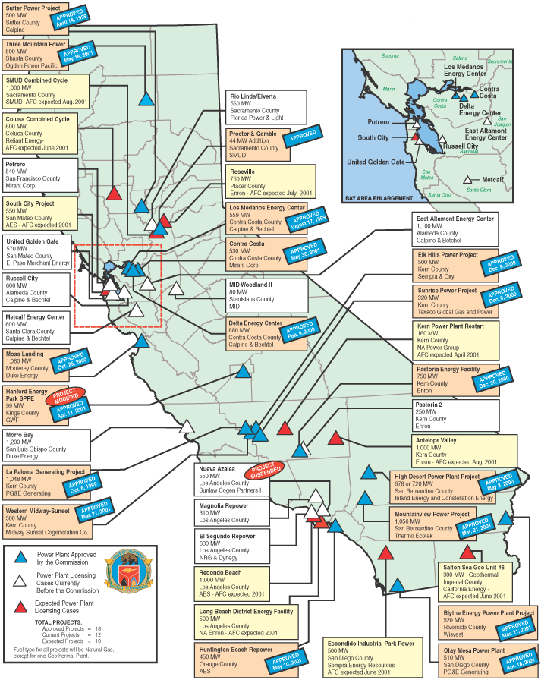
CALIFORNIA
High Probability Plants (UC) Under Construction (AP) Approved by CEC
Harbor Cogen Expansion / 30 MW / Jul-01 (UC)
Los Medanos / 500 MW / Jul-01 (UC) / 7,067 HR
Sunrise Power (Phase 1) / 320 MW / Jul-01 (UC) / 11,021 HR
Sutter / 500MW / Jul-01 (UC) / 7,160 HR
LADWP Harbor V Expansion / 237 MW / Aug-01 (UC)
United Golden Gate / 51 MW / Oct-01 (UC) / 9,664 HR
La Paloma (Phase 1) / 521 MW / Dec-01 (UC) / 6,870 HR
La Paloma (Phase 2) / 522 MW / Mar-02 (UC) / 6,870 HR
Delta Energy / 880 MW / Jun-02 (UC) / 7,178 HR
Moss Landing / 1,060 MW / Jun-02 (UC) / 7,067 HR
Blythe / 520 MW / Mar-03 (AP) / 7,100 HR
Elk Hills / 500 MW / Mar-03 (UC) / 7,067 HR
High Desert / 720 MW / Jun-03 (UC) / 7,178 HR
Sunrise Power (Phase 2) / 320 MW / Aug-03 (UC)
Medium-High Probability Plants
(UC) Under Construction (AP) Approved by CEC
Midway-Sunset / 500 MW / Oct-02 (AP) / 6,793 HR
Otay Mesa / 510 MW / Jun-03 (AP) / 7,100 HR
Mountainview / 1,056 MW / Jul-03 (AP) / 6,704 HR
Pastoria (Phase 1) / 755 MW / Jul-03 (AP) / 6,760 HR
Three Mountain / 500 MW / Mar-04
Rio Linda / 560 MW / Apr-04 (AP)
California

Slide 3
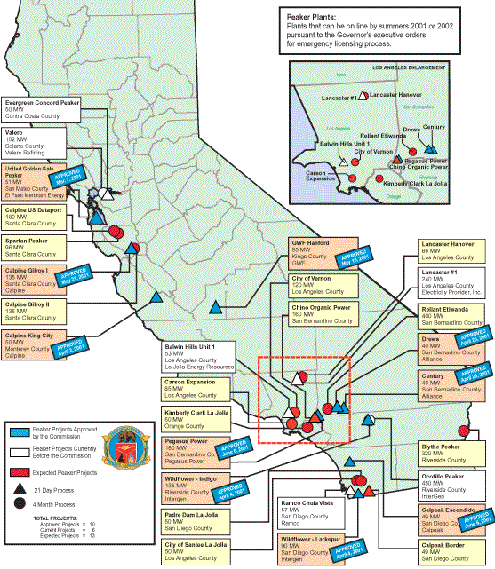
CALIFORNIA
Natural Gas Emergency Peaker Plants
NP15
Fresno / 18 MW / Jun-01
Stockton / 22 MW / Jun-01
Chowchilla / 49 MW / Jul-01
Los Banos / 45 MW / Jul-01
Red Bluff / 49 MW / Aug-01
Gilroy (Phase 1) / 135 MW / Sep-01
King City / 50 MW / Sep-01
Panoche / 49 MW / Sep-01
Susuin City 1 / 49 MW / Sep-01
Susuin City 2 / 49 MW / Sep-01
Susuin City 3 / 49 MW / Sep-01
Vaca-Dixon / 49 MW / Sep-01
SP15
Border 3 / 43 MW / Jul-01
Escondido (Ramco) / 44 MW / Jul-01
Gates / 45 MW / Jul-01
Indigo Energy / 135 MW / Jul-01
Larkspur Energy / 90 MW / Jul-01
Border 2 / 43 MW / Aug-01
Century Project / 40 MW / Aug-01
Drews Project / 40 MW / Aug-01
Escondido (DG Power) / 49 MW / Aug-01
Palm Springs 1 / 43 MW / Aug-01
Palm Springs 2 / 45 MW / Aug-01
Border 1 / 49 MW / Sep-01
El Cajon / 49 MW / Sep-01
La Jolla Baldwin / 53 MW / Sep-01
Midway / 49 MW / Sep-01
Mission / 49 MW / Sep-01
San Ysidro / 43 MW / Sep-01
CENCO Electric Company / 50 MW / Oct-01
Chula Vista / 44 MW / Oct-01
Evergreen Concord / 50 MW / Oct-01
Pegasus Power Project / 180 MW / Oct-01
Biomass Restarts (NP15)
Sierra Forest / 7 MW / May-01
Dinuba / 12 MW / May-01
Soledad / 13 MW / May-01
Madera / 25 MW / May-01
Honey Lake / 30 MW / Jun-01
Jackson Valley / 18 MW / Jul-01
Blue Lake / 10 MW / Jun-01
Renewable Projects (NP15)
CEC July Estimate / 12 MW / Jul-01
CEC August Estimate / 17 MW / Aug-01
California

Slide 4
CALIFORNIA UPDATES
(06/01/01 PowerMarketers.com) California-based GWF Power Systems Company, Inc., broke ground today on the Hanford Energy Park Peaker plant -- a natural gas-fired, simple-cycle power plant that will generate 90 megawatts of electricity for California. Designed to operate as a "peaker," the new plant is designed to help California meet its current energy needs by providing 90 megawatts of electricity when the state needs it most -- during those "peak use" times when there isn't enough supply to meet demand. GWF also expects to build and operate two additional plants in California by 2002. Using the governor's new "fast track" permitting process, GWF submitted its application in April, received CEC approval on May 10 and began construction on June 1.
(06/01/01 PowerMarketers.com) Power generator Mirant Corp. says it will not start building a 530-megawatt power plant, blaming the state's "hostile business climate." It won a state license for the plant Wednesday from the California Energy Commission. The license is good indefinitely. Talk of power plant seizures, a windfall-profits tax, accusations of market manipulation and litigation make unfavorable conditions for investing up to $300 million in expanding the Contra Costa Power Plant outside Antioch, said Chuck Griffin, the Mirant spokesman.
(06/01/01 PowerMarketers.com) GWF Energy LLC has won a 10 year electricity supply contract with the state of California to supply 430 Megawatts of power starting from Sept 1, according to a statement from the office of California Governor Gray Davis. GWF Energy is owned by PSEG Global of New Jersey and Harbert Cogen of Alabama. Electricity supplies to fulfill the contract will be provided from GWL's Hanford plant which was approved for construction in early May.
(06/05/01 EIS) Calpine Corporation, the San Jose, Calif.-based independent power company, today announced that initial construction of 135 megawatts (mw) of peaking generation capacity will begin during this week adjacent to its existing Gilroy Power Plant in Gilroy, Calif. Through an Application for Certification (AFC) filed with the California Energy Commission (CEC) on April 25, 2001, Calpine proposed to add three 45-mw simple-cycle gas turbine peaking units in the first of a two-phase process. The California Energy Commission approved the project on May 21, 2001. Upon completion the two-phase build out, the Gilroy Energy Center will be a 270-mw, natural gas-fired, simple-cycle peaking generation facility located on approximately 9.5 acres at 1400 Pacheco Pass Highway in Gilroy. Commercial operation of Phase One is scheduled for September 2001. An additional three 45-mw gas turbine generators will be installed in Phase Two with full build-out estimated for May 2002. Phase Two requires the filing of an additional application with the CEC and is subject to a four-month review process. Initial construction will begin this week with site and civil engineering activities occurring for approximately six weeks at which time the site will be cleared and leveled. Foundation work and the installation of generation equipment will follow shortly thereafter, and commissioning and testing will take place for a two to three week period prior to commercial operation in September 2001.
(06/05/01 MWD) In a surprise move, Mirant said it would not start construction of its 530 MW Contra Costa plant expansion in light of the state's talk of the plant seizures and windfall profits taxes. Until the company is more assured of the plant's potential profitability, officials said the plant would not be build. Mirant is the first company with CEC-approved expansion to say it will put off construction.
California
Notes:
CISO has reset target pricing mechanism for the real time energy imbalance market. The price of the highest decremental bids is greater than the price for the lowest incremental bid. The new price is to be greater of zero or the lowest incremental bid.

Slide 5
CALIFORNIA UPDATES (cont’d)
(06/07/01 EIS) Calpine Corporation, the nation's leading independent power company, announced its new 540-megawatt South Point Energy Center in Arizona is generating and selling electricity into the Tri-state wholesale power market. The facility successfully completed start up and final testing and is available to help meet peak summer power demand in Arizona, California and Nevada. Located at the Fort Mojave Indian Reservation in Mohave County, Ariz., South Point represents the first merchant power plant to enter operations in Arizona and the first facility of its kind to be developed on Native American tribal land. South Point is also Calpine's first major new energy center to enter operations in the Western region power market, significantly expanding the company's regional portfolio of natural gas-fired combined-cycle generating capacity.
(06/08/01 MWD) A new 540 MW, natural gas-fired, combined-cycle, merchant plant in Mahave County, AZ, came online June 1 and is selling power into the wholesale markets of Arizona, California and Nevada.The South Point Energy Center is Calpine's first major new energy center to being operations in the West.
(06/08/01 EIS) Calpine Corporation, a leading independent power producer, announced plans to build, own, and operate a 600-megawatt electric generating facility to be located in southwestern Riverside County, California. The proposed Inland Empire Energy Center will feed directly into Southern California Edison's power grid and is intended to serve the rapidly growing counties of Riverside and San Bernardino. Construction of the $325 million facility is scheduled to begin in mid-2002, with commercial operation targeted for late 2004. The facility will use two advanced technology General Electric combustion turbines in combined-cycle with a single steam turbine and will be fueled by natural gas. With its advanced emissions control system and configuration, the Inland Empire Energy Center will be significantly cleaner and more fuel efficient than the typical natural gas-fired power plant operating today.
(06/11/01 GD) Calpine plans to invest $325 million to build a 600 MW, gas-fired plant in southwestern Riverside County, CA. The proposed Inland Empire Energy Center will interconnect with Southern California Edison's grid through existing transmission lines adjacent to the site and will help met growing demand in Riverside and San Bernardino counties. An existing major gas line will provide the plant's fuel. The facility will use two advanced technology General Electric combustion turbines in combined-cycle with a single steam engine and will have an advanced emissions control system and configuration. Calpine expects construction of the plant to begin by the middle of next year, with commercial operation scheduled by the end of 2004.
(06/13/01 EIS) FPL Energy, LLC, a subsidiary of FPL Group, Inc., today announced that it will construct, operate and own a 517-megawatt, natural gas-fired power plant in Blythe, California. Located midway between Los Angeles and Phoenix, the new plant will be one of the largest independent power generation projects in California. Electricity generated at the Blythe plant will have the capacity to power more than 500,000 homes in the state, and its output will be sold in the state's wholesale market. Given the plant's proximity to Arizona and Nevada, its power could be sold into those adjacent markets as conditions warrant. Construction of the advanced technology, combined-cycle facility began in May 2001. The plant, 200 miles east of Los Angeles, is expected to begin commercial operation in early 2003.
(06/13/01 CEC) On June 13, 2001, the Energy Commission approved the Application for Certification for the Chula Vista Peaker Generating Station proposed by RAMCO, Inc. under the limitations presented as conditions contained in this Decision, the Staff Assessment and Staff Supplemental Assessment, which are incorporated herein by reference.
California
Notes:
CISO has reset target pricing mechanism for the real time energy imbalance market. The price of the highest decremental bids is greater than the price for the lowest incremental bid. The new price is to be greater of zero or the lowest incremental bid.

Slide 6
CALIFORNIA UPDATES (cont’d)
(06/13/01 EIS) In a deal which could help stave off bankruptcy for California's second largest utility, Southern California Edison announced on Tuesday it had reached agreement with key Qualifying Facilities over payment, pricing and future litigation. Edison spokesman Gil Alexander said the agreement announced on Tuesday was the result of months of negotiation between utility executives, trade group representatives, and representatives of several of the largest QFs, who together are owed an estimated $1.3 billion by the utility and have filed a total of 33 lawsuits against it. Alexander said the proposed QF deal was being submitted immediately to the California Public Utilities Commission (CPUC), which had scheduled a meeting Wednesday to address the QF issue. While Southern California Edison officials declined to say how much the utility would pay under the proposed deal, it was believed to be a somewhat higher percentage than that under consideration by the CPUC, which said they must pay 15% of the amount owed. The deal, if approved and joined by the remaining QFs, was also expected to set a roadmap for an end to litigation over the payment issue -- a move which could effectively remove one major threat of involuntary bankruptcy for the utility.
(06/14/01 EIS) NRG Energy, Inc. today announced the opening, by its subsidiary NEO Corporation, of the Chowchilla II Power Plant. The 49 megawatt (MW) plant can generate enough power to meet the electricity needs of approximately 50,000 homes. Designed with environmental sensitivities, the new electric generation plant is a state-of-the-art facility powered by efficient natural gas-fired internal combustion engines. With the Chowchilla II plant, generation facilities owned by NRG and its subsidiaries now contribute more than 1,600 MW to California's power supply. NRG operates major plants near San Diego, Los Angeles and in northern California that supply 3,200 MW of electricity.
(06/14/01 PD) FPL Energy plans to build a 517 MW natural gas-fired plant at Blythe, CA, that will sell power into California, Arizona and Nevada. Construction of the combined-cycle plant began in May, and the facility, which will be located between Los Angeles and Phoenix, is expected to go into commercial operation in early 2003.
(06/15/01 EIS) The City of San Diego's Point Loma Wastewater treatment plant and Pump Energy Recovery Project (PERP) has been brought on-line in time for the peak summer season and will begin selling power to the San Diego grid through a contract with San Diego Gas and Electric (SDG&E). The $1.2 million project, completed by Henwood Energy Services, Inc. (Henwood), included a $360k grant from the California Energy Commission in addition to $420k renewable energy incentives from the state of California to get the wastewater treatment facility back up and running in time for Summer 2001, and will supply an additional 1.35 megawatts of green energy to San Diego area power grid. The Point Loma hydroelectric turbine was originally installed in the mid-1980's, but operated for less than 24 hours before being shut down in 1989 and partially disassembled due to the inability to properly regulate the effluent flow. However, changes to the plant's piping system in concordance with the ocean outfall's hydraulic characteristics and rising energy costs created the interest in bringing the project back on-line. Henwood, a leading energy technology and consulting company, was chosen for the major maintenance overhaul including the installation of a new control system and wiring it into the GUF (gas utilization facility) which can in turn produce over 4.5 MW of power. Henwood met the deadline of June 1, 2001 after bringing the generator online with successful testing starting May 23.
(06/15/01 GD) Kern River Gas Transmission is considering building a new meter station at a proposed Kramer Junction interconnection with Southern California Gas. In May, SoCal Gas announced plans for a 200 million cfd system expansion, called the Kramer Junction Interconnect project, including a 32-mile pipe that would link with Kern River and Mojave Pipeline. The project is slated for completion at the end of December. Kern River is proposing to construct a meter station at Kramer Junction, with primary firm delivery of up to 500 million cfd. Kern River will allow existing 2002 and 2003 expansion project shippers to acquire capacity at the Kramer Junction in return for relinquishing equivalent firm delivery entitlements at the Wheeler Ridge, which interconnects with SoCal gas. In addition, capacity at Kramer Junction delivery point that is committed to the Kern River 2002 or 2003 expansion projects in this request process will also be available on a first-come, first-served basis.
California
Notes:
CISO has reset target pricing mechanism for the real time energy imbalance market. The price of the highest decremental bids is greater than the price for the lowest incremental bid. The new price is to be greater of zero or the lowest incremental bid.

Slide 7
CALIFORNIA UPDATES (cont’d)
(06/15/01 PD) ALCOA Inc. said it will shut down its Wenatchee, WA, aluminum smelter on July 1 for 15 months in return for a 35-year supply of power once it ramps the smelter back up. ALCOA made the agreement with one of its primary power suppliers, the Chelan Public Utility District. Under the agreement, the smelter would idle for 15 months and return to the PUD the 23% of Chelan's Rocky Reach dam output on the Columbia River it is entitled through to 2011. It would also return the 25 MW it gets from the PUD through a couple of small power purchase contracts. The PUD would take that capacity, which totals about 150 MW a year (depending on how much the dam produces each year) and sell it into the market. After the 15 months, the PUD would supply ALCOA with all its power needs, about 300 to 400 MW, through 2036.
(06/19/01 PowerMarketers.com) EP Power Finance L.L.C., an indirect subsidiary of El Paso Corporation (NYSE: EPG), announced today that the biomass-fueled Madera power generation facility located near Fresno, California has begun operations two weeks ahead of schedule and is supplying up to 25 megawatts of electricity to the energy-short California market. EP Power Finance provided funding to Madera Power, a subsidiary of Energy Products of Idaho, enabling the company to acquire and refurbish this previously dormant power plant. This facility, which makes use of 53 different forms of nearby biomass materials as environmentally friendly fuel sources, is one of two power plants to come online in California since the state has been in a power crisis. Madera uses biomass materials that typically include grape by-products, wood chips, and tree trimmings that would otherwise be disposed of in local landfills or burned in open fields.
(06/19/01 Yahoo) El Paso Natural Gas Company, a subsidiary of El Paso Corporation, today announced two binding open seasons for capacity on a bi-directional lateral within California. The lateral, which El Paso obtained as part of its purchase of the All American oil pipeline in February 2000, runs from the area of Daggett, California southeast to the area of Blythe, California and Ehrenberg, Arizona on the Colorado River. The project will facilitate the movement of natural gas within California and provide service to power plants in California and Arizona. The open seasons, which begin today, close on July 10, 2001. These open seasons are in response to the non-binding open season for this lateral that was held from May 1 through May 25, 2001. In that open season, El Paso received requests for more than 2.1 billion cubic feet per day (Bcf/d) of natural gas on the Daggett-to-Ehrenberg path and more than 0.9 Bcf/d on the Ehrenberg-to-Daggett path.
(06/20/01 PowerMarketers.com) Edison International unit Southern California Edison said yesterday that it has reached an agreement with most of its renewable Qualifying Facilities (QF) power producers to provide power at a fixed price -- 5.37 cents/kWh -- over the next five years. The agreement eliminates some of the price volatility that has plagued California's energy markets during the current crisis, the company said. The plan stays all existing legal action, and assures that no new legal action will be initiated unless the terms of the agreement are not met, it said. Representatives for approximately 95 pct of Southern California Edison's renewable energy capacity have signed the agreement.
(06/20/01 Yahoo) Calpine Corporation, the San Jose, Calif.-based independent power company, and San Francisco based -- Bechtel Enterprises Holdings, Inc. announced that the Presiding Members' Proposed Decision (PMPD), released by the California Energy Commission (CEC) on June 18th, recommends approval of the 600-megawatt, gas-fired Metcalf Energy Center (MEC). The CEC Commissioners stated that in reaching their recommendation, ``we have concluded that the Metcalf Energy Center will result in no significant adverse impacts.'' It recommends that the full five-member CEC Commission exercise its authority to override the current non-compliances with San Jose's local land use ordinances.
California
Notes:
CISO has reset target pricing mechanism for the real time energy imbalance market. The price of the highest decremental bids is greater than the price for the lowest incremental bid. The new price is to be greater of zero or the lowest incremental bid.

Slide 8
CALIFORNIA UPDATES (cont’d)
(06/21/01 CEC) The South Coast Air Quality Management District performed an analysis of the air quality implications of the project, including compliance with air emission requirements, and concluded that a Permit to Construct cannot be issued for the project as configured in Phase I but can be issued for the project as configured in Phase II. Based on information provided by the Applicant, the project as configured in Phase II cannot be operational until after September 30, 2001. Unless an expedited project proposal has the expectation of being operational by September 30, 2001, it cannot be licensed under Public Resources Section 25705 and the Executive Orders. Therefore, as Presiding Commissioner, I cannot recommend approval of the project as currently proposed.
(06/21/01 PowerMarketers.com) Two separate lawsuits were filed yesterday in the U.S. District Court against Mirant Corp by the City of San Francisco and environmental and community groups, demanding that the Potrero Hill power plant operator stop operating the plant's six turbines beyond the stipulated limit of 877 hours a year until more stringent pollution controls are introduced for its so-called peaker plants. The Bay Area Air Quality Management District, which regulates air pollution in the region, allowed Mirant to expand its operations to meet energy demand, but has asked the group to pay $20,000 per ton of extra nitrogen oxides, a smog-causing contaminant, emitted by the plants. The plaintiffs, which include the groups Our Children's Earth, Communities for a Better Environment and Bayview-Hunters Point Community Advocates, claim that the people in the plants' surrounding neighborhood are being exposed to significant health risks at the hands of the increased power generation.
(06/21/01 MWD) SoCal Edison has signed a debt-payment agreement with most of the QFs supplying the utility with renewable energy. In addition to agreeing to pay its debts, the utility reached agreement on pricing for future supplies. The agreement will suspend all legal action that the QFs initiated to get payment for their energy supplies. Tuesday's agreement covered about 95% of SoCal Edison's renewable QF contracts or about 3,000 MW of power. The utility has yet to reach agreement on the supply of power of about 150 MW of wind power. The agreement calls for SoCal Edison to pay a fixed price of 5.37 cents/kWh for QF Supplies for the next five years. The CPUC is expected to take up the matter at a meeting at the end of the month.
(06/21/01 CEC) Letter to Commissioner Pernell from Steve Wilburn on withdrawing Baldwin Peaker Project from 21-day process and stating they will not purse the project in the future.
(06/22/02 GD) PG&E Gas Transmission - Northwest yesterday said it received binding precedent agreements with 25-year terms for about 250,000 dth/d of capacity associated with its 2003 expansion project. In March, the company successfully auctioned off all of the capacity associated with its 2002 expansion. The open season on the 200,000 dth/d of capacity associated with its 2002 expansion project, which was held in January, was awarded to Newport Northwest, a Walla Walla, WA-based power plant developer, and Calpine. In April, FERC said it would process PG&E GT-NW's 2002 Expansion project application on an expedited basis because of the need for new energy capacity in the West. The pipeline expects to have its first mainline expansion in service by the summer of 2002 with expedited FERC review. Additionally, PG&E GT-NW said it also seeks expedited approval for its 2003 project and plans to file the project application with the commission by November.
(06/25/01 GD) Continuing FERC's campaign to drum up goodwill in California, FERC Chairman Curt Hebert Friday sent a letter to the CEC detailing the recent findings of a staff technical conference on California gas transportation infrastructure. The commission's conclusion -- that the lack of adequate takeaway capacity within the state is a major culprit in the state's record gas prices -- should also cheer interstate pipeline companies, which have absorbed a fair amount of blame for the state's energy woes.
(06/26/01 MWD) The United Native Depository Corp., on behalf of the Navajo Nation, plans to spend about $125 million to build a 250 MW geothermal power plant on the Elem Pomo Indian Tribal Site in California, the company said yesterday. In return for providing the initial construction capital, UNDC will receive 85% of the plant's net profits for a period of 50 years. To develop the plant, UNDC will pay 25% of its share of the plant's net profits over the 50-year period to subsidiary Focal Corp. After repayment of the construction financing, the Elem Pomo Tribe will own 51% of the plant and UNDC will own 49%.
California
Notes:
CISO has reset target pricing mechanism for the real time energy imbalance market. The price of the highest decremental bids is greater than the price for the lowest incremental bid. The new price is to be greater of zero or the lowest incremental bid.

Slide 9
CALIFORNIA UPDATES (cont’d)
(06/27/01 MWD) Reliant Energy Wholesale Group has completed a $13 million emissions control upgrade to two 1960s-era units at its Etiwanda plant in Southern California, ensuring that the units will be able to run during the summer without the need for expensive emissions credits. Untis 3 and 4, with capacity of 320 MW each, were due to be taken offline for other maintenance work; Unit 3 was taken down in march to address mechanical problems. During that time, selective catalytic reduction control systems, which will cut nitrogen oxide emissions by 90%, were installed on the two units, the company said. Reliant is also proceeding with a NOx emissions control upgrade at its Madalay 3 unit, which is overseen by the Ventura County Air Pollutant Control District.
(06/27/01 Yahoo) Gov. Gray Davis today ``switched on'' California's newest power plant in a bid to help ease the state's energy crisis. Edison Mission Energy, an Edison International company, and Texaco Power & Gasification, a division of Texaco Inc., announced that their Sunrise Power Project is providing reasonably priced electricity to the people of California more than one month ahead of schedule -- just in time for the long, hot summer. Gov. Gray Davis; John Bryson, EIX chairman, CEO and president; and James Houck, president of Texaco Power & Gasification today celebrated the plant's achieving full commercial operation at a ribbon-cutting ceremony held at the plant site in western Kern County.
(06/27/01 PowerMarketers.com) The San Jose City Council gave final approval last night to plans for a controversial power plant that was mired in debate for the past year. The council voted 10 to 1 to approve the Metcalf Energy Center, a $400 million, 600-megawatt plant that will be built this year for Calpine Corp. by Bechtel Enterprises. Last night's proposal is essentially the same plan the council unanimously rejected in November, before California's energy crisis had taken hold. Mayor Ron Gonzales originally argued that the power plant was too close to a neighborhood and to workers at a huge office park that Cisco Systems is planning to build. But the city took a nationwide public-relations beating for its opposition, and the proposal was appealed to the California Energy Commission.
(06/28/01 EIS) AES Huntington Beach L.L.C., a subsidiary of the AES Corporation, announced today that the California Department of Water Resources (``DWR'') has terminated negotiations with AES Huntington Beach for a long-term power purchase contract. AES Huntington Beach is redirecting its marketing effort for the output of two gas-fired units that is expected to bring 450 MWs of power to supply-limited California by late summer 2001.
(06/28/01 CEC) Sacramento The California Energy Commission began a formal review today of plans to build the East Altamont Energy Center. Commissioners voted 3-0 to begin the review process for the proposed 1,100-megawatt, natural gas-fired, combined-cycle, power generating facility.
California
Notes:
CISO has reset target pricing mechanism for the real time energy imbalance market. The price of the highest decremental bids is greater than the price for the lowest incremental bid. The new price is to be greater of zero or the lowest incremental bid.

Slide 10
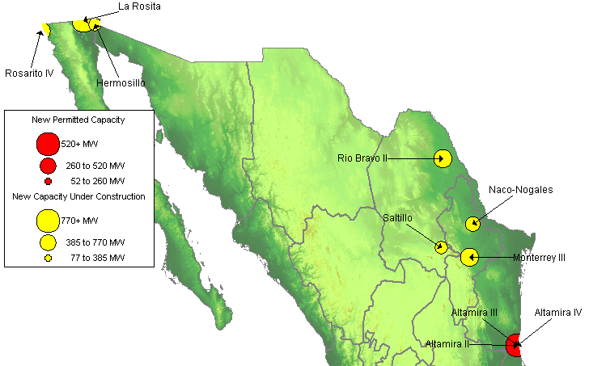
MEXICO NEW GENERATION MAP
High Probability Plants
Rio Bravo 2 / 495 MW / Jul-01
Rosarito IV / 541 MW / Jul-01 / 6,870 HR
Baja California 2000 / 61 MW / Sep-01
Altamira II / 495 MW / May-02
Naco-Nogales / 339 MW / Jun-02
Hermosillo / 250 MW / Sep-02
La Rosita / 765 MW / Apr-03
Monterrey III / 490 MW / May-03
Bajio / 495 MW / Jun-03
Saltillo / 248 MW / Jun-03
Tuxpan II / 495 MW / Jun-03
Medium-High Probability Plants
Altamira III / 518 MW / May-03
Altamira IV / 518 MW / May-03
Termoelectrica de Mexicali / 600 MW / Aug-03

Slide 11
MEXICO UPDATES
(06/04/01 PowerMarketers.com) Mexico has a generating capacity of 35,869 megawatts and is capable of serving some 18.9 million customers, according to Federal Electricity Commission (CFE) Chairman Alfredo Elias. Elias said Sunday that Mexico planned to build 10 new power plants in 2001, boosting generating capacity by 3,256 megawatts. Elias said nine other power plants were under development, noting that the total cost of the expansion would be $4.28 billion. The CFE operates more than 108,000 substations and close to 35,625 kilometers (22,136 miles) of transmission lines.
(06/26/01 PowerMarketers.com) Mexico's adoption of daylight saving time has averted an energy crisis by reducing the amount of electricity used for lighting and ensuring peak industrial use does not coincide with peak domestic demand, deputy energy secretary Niceforo Guerrero said, quoted in local paper Reforma. However, demand spikes over recent days due to a cold wave has made it necessary for power authorities to increase generation to "maintain adequate reserves," Guerrero warned, commenting the risk of short supply still exists. To keep ahead of rising demand, 13 new power plants across the nation are scheduled to come into production by end-2002, he added. The plants will have a combined generating capacity of 1,536MW, representing a 12.4% increase over existing capacity.
(06/26/01 MWD) ICA Fluor Daniel, the Mexico-based joint venture company of Fluor Corp., and Empresas ICA, was selected by Sempra Energy and awarded $158.5 million to provide engineering, procurement and construction services for a proposed 600 MW, natural gas-fired facility in Mexicali, Baja California, Mexico, the companies said yesterday. The Thermoelectrica de Mexicali plant will be connected to the US electric grid via a 230-kV transmission line, and will help to ensure that the border region has adequate infrastructure to meet its future energy needs. The project is expected to take 26 months to complete.
(06/28/01 PowerMarketers.com) Mexicans have to face the fact that, unless its electricity sector receives optional sources of financing for its development, blackouts will start occurring in various parts of the country, President Vicente Fox said Thursday on Engineers Day. Responding to the accusation made against him by Congress about his wanting to change the Electric Energy Public Service Law, he said that it¦s not a controversy against Fox, but a discussion about if the country wants to have enough electric energy or a drop in electric service.
PNW
Notes:
Formerly (stalled) NWPE 220 MW project. FPL bought rights in 1/99. Construction to began 9/1/99 As of 4/25/00 Unit 1 not complete and gas line construction has been stalled.

Slide 12
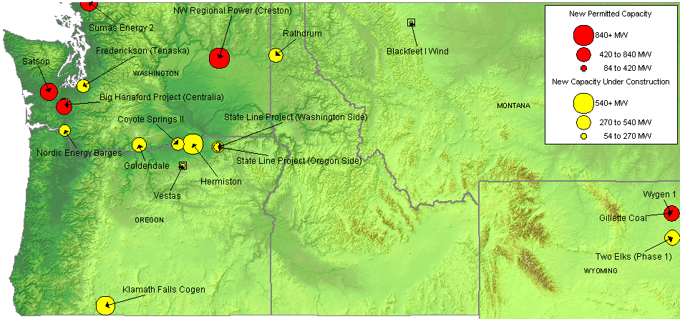
NORTHWEST NEW GENERATION MAP
High Probability Plants
Klamath Falls Cogen / 464 MW / Aug-01 / 6,732 HR
Rathdrum / 270 MW / Aug-01 / 6,760 HR
Blackfeet I Wind / 22 MW / Oct-01
Rock River I Wind Project / 50 MW / Oct-01
State Line Project / 300 MW / Dec-01
Two Elks (Phase 1) / 300 MW / Dec-01
Vestas / 35 MW / Dec-01
Nordic Energy Barges / 200 MW / Jan-02 / 11,800 HR
Coyote Springs II / 231 MW / Jun-02 / 6,760 HR
Frederickson (Tenaska) / 248 MW / Jun-02
Big Hanaford Project (Centralia) / 248 MW / Jul-02 / 7,349 HR
High Probability Plants (cont’d)
Hermiston / 536 MW / Aug-02 / 6,700 HR
Goldendale / 288 MW / Sep-02 / 7,200 HR
Wygen 1/ 80 MW / Jul-03
Medium-High Probability Plants
Sumas Energy 2 / 660 MW / Sep-02 / 6,793 HR
NW Regional Power (Creston) / 838 MW / Jun-03
Satsop / 600 MW / Oct-03 / 6,765 HR
Chehalis Power / 520 MW / Nov-03 / 6,704 HR
Gillette Coal / 500 MW / Jun-05

Slide 13
NORTHWEST UPDATES
Washington
(06/04/01 EIS) The U.S. Federal Energy Regulatory Commission said on Monday it approved a temporary increase in hydropower generation at the Priest Rapids Hydroelectric Project in Washington state to help California and other Western states avoid power shortages this summer. The statement from the FERC said the commission's move to suspend rules on the spilling of dam waters during fish migration season this summer would allow Priest Rapids to produce an additional 219,600 megawatt hours of electricity. California is under direct threat of rolling blackouts this summer. Industry experts expect as many as 260 hours of shortages, due to a lack of generation to meet demand during the air conditioning months from June through September. In addition to Monday's order, the commission said it was seeking comment on a FERC staff alternative plan that would suspend spill for an additional eight hours per day, boosting generation to the region by an added 109,800 megawatt hours.
(06/08/01 EIS) Morgan Stanley Capital Group has purchased 17.31 acres of land south of Tacoma and plans to build a 324-megawatt, gas-fired electrical generation plant on the site. The sale was approved by the Port of Tacoma Commission on Thursday, June 7. The property is located at the Port's Frederickson Industrial Area. Morgan Stanley's offer of $2.83 million was one of six bids the Port received. The project entails an investment of $90-100 million and will create about 100 construction-related jobs. Once fully operational, the plant will employ about 10 people. The plant will use jet turbines, fueled by natural gas, to generate power. Frederickson's industrial zoning and industrial capacity utilities helped attract Morgan Stanley to the site. A natural gas main runs through the Port's Frederickson property.
(06/05/01 PD) The FERC has approved a plan to temporarily increase hydroelectric generation by 219,600 MWh at the Priest Rapids project in Washington. Under the plan, approved Friday, Priest Rapids will be allowed to reduce spill to aid fish migration through the end of the year. In exchange, the BPA will increase its spill at some of its dams. The so-called "spill exchange," should increase power generation without harming fish listed under the Endangered Species Act. The Priest Rapids project includes a 900 MW development at Wanapum and an 855 MW development at Priest Rapids, both on the Columbia River. Its annual average output is 9.5 million MWh.
(06/15/01 PD) Puget Sound Energy will reduce the amount of power it plans to buy from the BPA by 368 MW under an agreement announced Thursday. The power from Puget is expected to help BPA significantly reduce a general rate increase planned for October. BPA last week said the price of wholesale electricity it sells to Northwest utilities and industrials could rise 150% or more October 1 unless BPA customers agree to reduce their demands on the agency by 10%. Customers have until June 22 to sign load reduction agreements.
(06/15/01 GD) Williams plans to feed new electric generators in Washington with 276 million cfd of gas from an expansion of its Northwest Pipeline system. The company's third expansion project in a year for the Pacific Northwest is geared specifically toward supplying new electric plants under construction in the western portion of the state. The $200 million Evergreen Expansion Project would include 26 miles of new pipe and 90,000 HP of new compression. The pipeline would be build along Northwest Pipeline's existing rights of way, and compression would be added through eight new compressor stations along the pipeline system. Williams held an open season last December, which resulted in five electric generators signing 15-year contracts for all of the capacity. Construction of the pipeline expansion is slated to begin in the summer of 2002, with installation fo the additional compression in fall and winter of 2002-2003. Evergreen is expected to come online in June 2003.
PNW
Notes:
Formerly (stalled) NWPE 220 MW project. FPL bought rights in 1/99. Construction to began 9/1/99 As of 4/25/00 Unit 1 not complete and gas line construction has been stalled.

Slide 14
NORTHWEST UPDATES(cont’d)
Washington (cont’d)
(06/19/01 PD) Williams unit Northwest Pipeline Monday announced plans to add within the next two years 276,000 Mcf/day of capacity to feed gas to five power plant developers. The Northwest's so-called Evergreen Expansion Project is already fully subscribed and has a target in-service date of June 2003. Northwest held an open season last December to add capacity between its border point at Sumas, WA, where it receives gas from Westcoast Energy, and Chehalis,WA, in the Interstate-5 corridor.
(06/22/01 PD) The Snohomish County PUD of Everett, WA, said Thursday that it has agreed to reduce its demand on the BPA by 70 MW for one year starting October 1, in keeping with BPA's plea that its customers cut their purchases by 10% for a year or two. Under the agreement BPA will pay the PUD $12/MWh for the energy. A BPA spokesman said it appears that the federal agency will be able to meet its target of reducing its load by 2,400 MW from its utility and aluminum customers in new five-year contracts that being in October. Its goal is to avoid buying power on the market to meet loads. BPA has said hitting the target would allow it to keep its rate hike to about 75% of lower, and that without load reductions, it would face having to institute 250% rate hike. The Snohomish PUD said that starting in October, the PUD will buy 630 MW from BPA, about 77% of its 823 MW load.
(06/25/01 GD) Following a strong response from shippers for its 2002 expansion project, PG&E Gas Transmission - Northwest has received more good news. On Friday, FERC released a favorable environmental assessment of the project, which would add about 200,000 dth/d of new capacity. The pipeline has already received a clear signal of support from the market. Recently, the company awarded capacity associated with the project to Calpine and Newport Northwest. Subsequent expansions are in the works. By November 2003, PG&E GT-NW plans to have capacity in excess of 3.1 billion cfd.
(06/26/01 EIS) The Bonneville Power Administration (BPA) and Golden Northwest Aluminum Inc. (Golden Northwest) have agreed to delay restart of BPA power deliveries to the company's smelters in The Dalles, Ore., and Goldendale, Wash., for an additional six months. Under the pact, BPA will also support development of a wind energy project by an affiliate of Golden Northwest. The curtailment agreement covers the full 236 megawatts of power Golden Northwest otherwise would have received from BPA from Oct. 1, 2001, through March 31, 2002.
Montana
(06/04/01 EIS) PacifiCorp and SeaWest WindPower Inc., (San Diego, Calif.) today announced a 20-year agreement for PacifiCorp to purchase the entire output of SeaWest's new 50-megawatt Rock River I wind project located near Arlington, Wyoming. Construction has begun and the facility is anticipated to be online in fall 2001. The project will produce enough clean energy for nearly 27,000 average homes in the region, while offsetting approximately 164,000 tons of greenhouse gases per year. PacifiCorp provides energy services to 1.5 million customers in six western states. It operates as Pacific Power in Oregon, Wyoming, Washington and California; and as Utah Power in Utah and Idaho. Steady winds made Wyoming an ideal location for developing wind power and the state has been a supporter of the renewable power industry.
PNW
Notes:
Formerly (stalled) NWPE 220 MW project. FPL bought rights in 1/99. Construction to began 9/1/99 As of 4/25/00 Unit 1 not complete and gas line construction has been stalled.

Slide 15
NORTHWEST UPDATES(cont’d)
Montana (cont’d)
(06/14/01 EIS) NorthWestern Corporation and Montana Governor Judy Martz today announced that the company plans to construct a 240-megawatt electricity generating facility near Great Falls, Mont., that will create a pool of reasonably priced, reliable electricity for Montana industrial customers. The proposed generation facility will be located about one mile north of Great Falls, adjacent to and east of Highway 87 (Havre Highway) in Cascade County. The project involves the construction of three 80-megawatt combined cycle, natural gas-fired generating units, with the first unit projected to come on line in the fall of 2001, the second phase in the summer of 2002 and the third unit in the fall of 2002. Hanson said that generating turbines have been secured for the project and that air quality permits are being filed with the Montana Division of Environmental Quality. Securing the necessary permits for the plant and meeting other considerations are required before construction can begin.
Oregon
(06/07/01 PD) The BPA said it has received about 1,200 MW of load-reduction commitments, of half of its target, and based on this amount alone, its rates would rise 150% to $50/MWh for new five-year contracts that being in October. If BPA is able to reach its goal of reducing load by 2,400 MW from aluminum companies and utility customers, rates would go up less than 75%. But if BPA does not achieve its total target, some of the deals the agency already cut with companies that have agreed to reduce power will evaporate because they were contingent upon BPA achieving a 2,400 MW reduction. While aluminum companies have reduce their loads by 900 MW, or 75% of the target, public and private utilities so far have contributed 11% and 25%, respectively, of their share. BPA must have all commitments in hand by June 22, and it will announce final rates June 29. BPA has worked out deals with all of its aluminum customers except Golden Northwest and Kaiser Aluminum, which operate four smelters.
(06/18/01 PD) The BPA said last week that it has hammered out a plan for exchanging energy with CDWR and the California ISO this summer if the state is in imminent danger of rolling blackouts. BPA will now receive power at an unfixed exchange ration that will be determined by the event and based on market conditions and the shape of BPA's system. In all cases, however, through the exchange the agency will get back more power that is supplied.
(06/14/01 PD) PacifiCorp Power Marketing, one of only a few companies trying to sell wind power to the general wholesale market, is facing transmission-related challenges in its efforts to sell from the 300 MW Stateline Wind Project in Oregon and Washington to the power-hungry West. Transmission costs now are based on the assumption that a plant runs at 90% to 95% capacity but wind plants operate at 35% of their capacity. EWEB recently decided not to buy 75 MW from the Stateline project, because transmission costs, which included pancaking, were too high.
PNW
Notes:
Formerly (stalled) NWPE 220 MW project. FPL bought rights in 1/99. Construction to began 9/1/99 As of 4/25/00 Unit 1 not complete and gas line construction has been stalled.

Slide 16
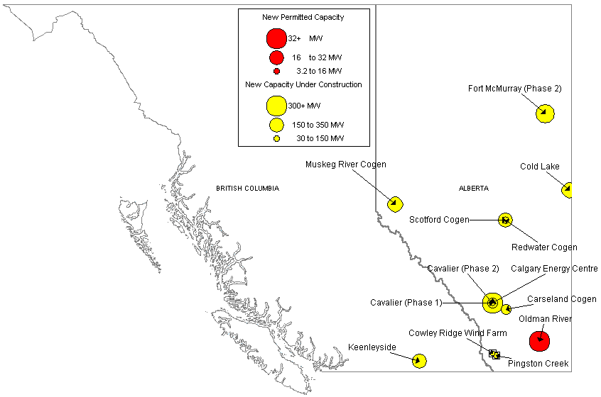
CANADA NEW GENERATION MAP
High Probability Plants
Cavalier (Phase 1) / 80 MW / Aug-01
Cowley Ridge Wind Farm / 20 MW / Oct-01
Balzac Cogen / 106 MW / Nov-01
Carseland Cogen / 80 MW / Nov-01
Redwater Cogen / 40 MW / Nov-01
Cavalier (Phase 2) / 26 MW / Dec-01
Pingston Creek / 30 MW / Jun-02
Cold Lake / 170 MW / Oct-02
Muskeg River Cogen / 170 MW / Nov-02
Scotford Cogen / 150 MW / Dec-02
Keenleyside / 150 MW / Jan-03
Calgary Energy Centre / 300 MW / May-03
Fort McMurray (Phase 2) / 238 MW / Aug-04
Medium-High Probability Plants
Oldman River / 32 MW / May-02

Slide 17
CANADA UPDATES
(06/11/01 PD) Montreal-based Alcan Friday said it will cut aluminum production by 50% at its Kitimat, BC, smelter and sell up to 115 MW of unneeded power at market prices to BC Hydro's export marketing subsidiary Powerex for about a year. Alcan generates 780 MW at its Kemano Hydro Plant on the Kitimat River but a drought has reduced its power output to the point it cannot produce enough power to keep its smelter operating at 100%. Alcan has legal obligation to sell BC Hydro 165 MW and has determined it can make enough money on additional power sales to Powerex to pay employees and produce aluminum at half of its smelter's capacity.
PNW
Notes:
Formerly (stalled) NWPE 220 MW project. FPL bought rights in 1/99. Construction to began 9/1/99 As of 4/25/00 Unit 1 not complete and gas line construction has been stalled.

Slide 18
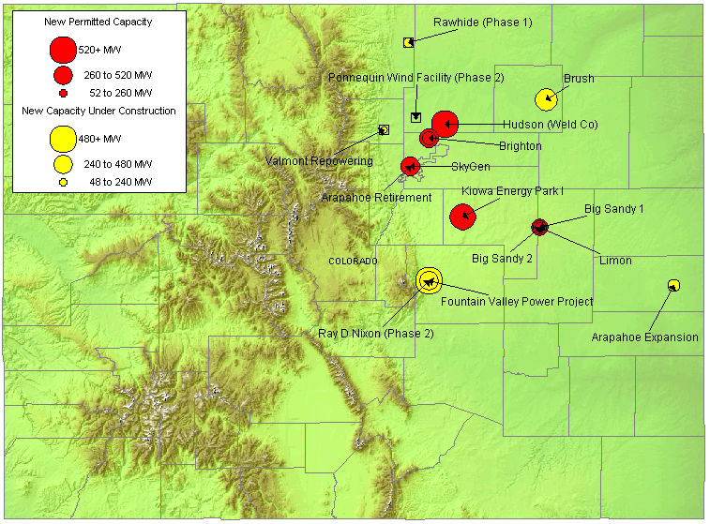
ROCKIES NEW GENERATION MAP
High Probability Plants
Fountain Valley / 240 MW / Jul-01 / 9,800 HR
Valmont Repowering / 40 MW / Jul-01 / 9,800 HR
Rawhide (Phase 1) / 80 MW / Sep-01 / 11,400 HR
Brush / 328 MW / May-02 / 7,500 HR
Arapahoe Expansion / 45 MW / Jun-02 / 9,500 HR
Ray D Nixon (Phase 2) / 480 MW / Dec-02 / 7,067 HR
Medium-High Probability Plants
Big Sandy 1 / 75 MW / Nov-01
Powhatan Peaker / 280 MW / May-02
Barr Lake / 128 MW / Jun-02
Brighton / 140 MW / Jun-02
Limon / 140 MW / Jun-02 / 11,873 HR
Big Sandy 2 / 225 MW / Nov-02 / 10,500 HR
SkyGen / 270 MW / Jun-03
Hudson (Weld Co) / 516 MW / Jun-04 / 7,100 HR
Kiowa Energy Park I / 475 MW / Jul-04 / 7,160 HR

Slide 19
ROCKIES UPDATE
(06/12/01 Yahoo) Xcel Energy, Colorado's major electric utility, said on Tuesday a $283 million ``repowering'' of a former nuclear power plant to a natural-gas fired plant can produce enough energy for 750,000 customers, just in time for the high-demand summer season. The reopening of the Fort-St. Vrain power station, about 35 miles north of Denver, comes at a time when consumers are keeping an eye on California where an energy crisis has subjected consumers to rolling blackouts. Fort St. Vrain is expected to provide about 12 percent of Xcel's demand in Colorado, David Wilks, president of energy supply for Xcel, told reporters. But instead of just mothballing it, the company decided to ``repower'' it with three combined-cycle turbine generators of about 140 megawatts, powered by natural gas. Waste heat from the turbines is captured for steam production in the plant's original 300 megawatt generator, giving the plant a 720 total megawatt production capacity. The plant will be the biggest of Xcel's 12 facilities in Colorado.
(06/19/01 PowerMarketers.com) A unit of Williams Cos. said late Monday it is holding a binding open season from June 15-29, 2001, for shippers interested in annual incremental firm natural gas transportation service on the proposed Western Frontier Pipeline. Western Frontier Pipeline, L.L.C., a unit of Williams Gas Pipeline, proposes to construct 400 miles of 30-inch diameter pipeline and 15,000 horsepower of compression designed to transport up to 540 million cubic feet per day of gas from the Cheyenne Hub in northeastern Colorado to Williams' Central pipeline system in southwest Kansas, the Oklahoma panhandle, and various markets along the newly proposed pipeline.
(06/29/01 EIS) Colorado Interstate Gas, a subsidiary of El Paso Corporation, announced today an open season that began at 5:00 p.m. Mountain Time on June 26, 2001 and will continue until 5:00 p.m. Mountain Time on July 20, 2001 for a pipeline project to transport gas from the Cheyenne Hub in northeastern Colorado to mid-continent pipeline markets near Greensburg, Kansas. Colorado Interstate Gas proposes to construct 380 miles of 30-inch diameter pipeline and 17,000 horsepower of compression, designed to transport up to 540,000 dekatherms per day.
Rockies

Slide 20
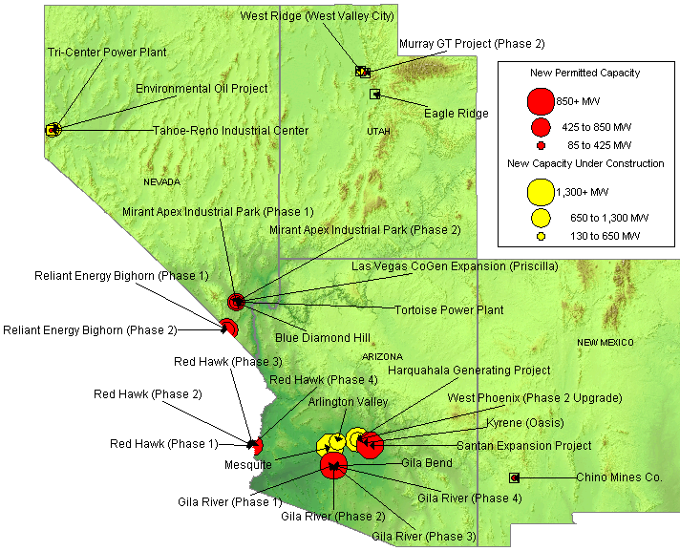
SOUTHWEST NEW GENERATION MAP
High Probability Plants
Tri-Center Power Plant / 360 MW / Jul-01 / 10,911 HR
Environmental Oil Project / 30 MW / Sep-01
Tahoe-Reno Industrial Center / 350 MW / Sep-01 / 7,000 HR
West Ridge / 160 MW / Sep-01 / 9,518 HR
Kyrene (Oasis) / 265 MW / Feb-02 / 7,125 HR
Red Hawk (Phase 1) / 580 MW / Jun-02 / 7,067 HR
Red Hawk (Phase 2) / 580 MW / Jun-02 / 7,067 HR
Arlington Valley / 570 MW / Aug-02 / 7,067 HR
Gila River (Phase 1) / 575 MW / Aug-02 / 7,067 HR
Gila River (Phase 2) / 575 MW / Dec-02 / 7,067 HR
Mesquite / 1,250 MW / Mar-03 / 7,067 HR
Gila River (Phase 3) / 575 MW / Mar-03 / 7,067 HR
Mirant Apex Industrial Park (Phase 1) / 550 MW / Mar-03 / 7,067 HR
Gila River (Phase 4) / 575 MW / May-03 / 7,067 HR
West Phoenix (Phase 2 Upgrade) / 440 MW / Jun-03 / 7,196 HR
Harquahala Generating Project / 1,083 MW / Sep-03 / 6,880 HR
Mirant Apex Industrial Park (Phase 2) / 550 MW / Dec-04 / 7,067 HR
Medium-High Probability Plants
Chino Mines Co. / 50 MW / Jul-01
Murray GT Project (Phase 2) / 15 MW / Oct-01
Tortoise Power Plant / 60 MW / Mar-02
Reliant Energy Bighorn (Phase 1) / 310 MW / Jun-02
Steamboat Springs Geothermal / 30 MW / Jun-02
LV CoGen Expansion / 225 MW / Sep-02
Reliant Energy Bighorn (Phase 1) / 575 MW / Jun-03
Blue Diamond Hill / 400 MW / Jun-04
Gila Bend / 845 MW / Jun-04
Santan Expansion Project / 825 MW / Dec-05
Red Hawk (Phase 3) / 580 MW / Jun-02 / 7,067 HR

Slide 21
SOUTHWEST UPDATES
Arizona
(06/14/01 Yahoo) TECO Power Services and Panda Energy today announced that they have closed on a five-year bank financing for the two largest independent power projects in the nation. The landmark $2.2-billion transaction, which includes $1.7 billion in non- recourse debt and a $500-million equity bridge loan, will cover construction costs for the TPS/Panda joint venture's Union Power Station (also known as El Dorado) and Gila River Power Station. The two plants represent more than 4,500 megawatts of new, highly efficient generating capacity.
(06/15/01 EIS) UniSource Energy Corp. Friday announced that its electric utility subsidiary, Tucson Electric Power Co. (TEP), has put into service two new gas-fired generators. TEP will use the combined 96 megawatts of generation to meet summer peak demand from its retail customers in southern Arizona. The first unit, a 75 MW gas turbine, is in service at TEP's DeMoss Petrie substation and the second unit, a 21 MW generator powered by an aircraft-derived jet engine, is in service at TEP's North Loop substation. The generators, both equipped with state-of-the-art emission-controls technology, have the capability to be started remotely from TEP's control center, providing power to the electrical grid within minutes.
(06/20/01 PowerMarketers.com) Reliant Energy Wholesale Group, a unit of Reliant Resources, Inc., today announced a long-term agreement under which Salt River Project (SRP) of Phoenix will buy all of the power to be produced by Reliant's 560-megawatt Desert Basin plant.
(06/26/01 GD) California is not the only state worried about the adequacy of its gas pipeline infrastructure. In recent correspondence with FERC, the Arizona Corporation Commission urged the federal regulators to put California's capacity shortage in a broader regional context; failure to do so, the ACC warned, might cause California's gas supply problems to spread to other states. As part of its effort to tackle California's energy woes, FERC staff has been studying the state's pipeline infrastructure to see if there are ways to improve the delivery of gas. In May, the commission hosted a conference devoted entirely to gas transportation issues in California; representatives from neighboring states also got involved. In particular, the ACC said that it was alarmed about the continued reliance of Arizona shippers on the El Paso Natural Gas system. At present, two interstate pipelines, El Paso and Transwestern Pipeline, serve the state, but the bulk of Arizona shippers only have access to the El Paso system. El Paso recently won approval for Line 2000, which will boost deliverability into California by as much as 230 million cfd. But despite its efforts to add capacity, the pipeline has been dogged by complaints about access to its system.
(06/28/01 PowerMarketers.com) An overwhelming majority of Arizonans are taking steps to conserve energy this summer, but they remain unsure whether conservation will prevent California-style electricity blackouts. Most see a need to build new power plants, and they favor nuclear plants over natural gas or coal units, according to 404 registered Arizona voters polled by KAET-TV (Channel 8) and the Walter Cronkite School of Journalism and Telecommunication at Arizona State University.
(06/28/01 PowerMarketers.com) Albertson's, Inc., today announced it will expand its energy conservation measures to Arizona. The effort, which currently calls for power use reductions in more than 1100 Albertson's stores, will affect all 50 Arizona Albertson's food and drug stores and the Company's 85 Sav-on and Osco Drug stores. The company will implement the plan immediately and expects all stores to be in compliance with the efforts within the next seven to ten days.
DSW

Slide 22
SOUTHWEST UPDATES
Nevada
(06/25/01 MWD) The owners of the 1,580 MW Mohave power plant in Nevada gained the support of the Nevada Public Service Commission last week for the owners' effort to loosen emissions restrictions will allow the plant to produce as much as 200 MW of additional power during limited periods under emergency conditions. A Nevada Power official likened the variance to an insurance policy. Mohave would kick into high gear only if an emergency power situation were imminent. Nevada Power owns a 14% interest in the plant.
New Mexico
(06/27/01 PD) WAPA, the arm of the DOE that markets power from federal hydroelectric projects in the West, has issued a solicitation for 60 to 70 MW. Samuel Loftin, a WAPA electrical engineer, explained the power would be used to supply one of WAPA's wholesale customers, a federal agency, in New Mexico. Deliveries will begin "on or about" September 1, and run for five or possible ten years, according to WAPA. Suppliers may offer as little as 10 MW, and power may be delivered to any of several locations in New Mexico.
DSW

Slide 23
SUMMARY
Summary

Slide 24
Sorted List By Online Date

Slide 25
Sorted List By Online Date

Slide 26
Sorted List By Region

Slide 27
Sorted List By Region

Slide 28
Sorted List By Region

Slide 29
WSCC CAPACITY ADDITIONS
NOTE: 100% of Capacity Under Construction, 80% of Permitted Capacity
Summer Summary

Slide 30
New Gas Generation Summary

