Slide 1

New Generation in WSCC
Presentation
July 31, 2001
Proprietary and Confidential 5/02

Slide 2
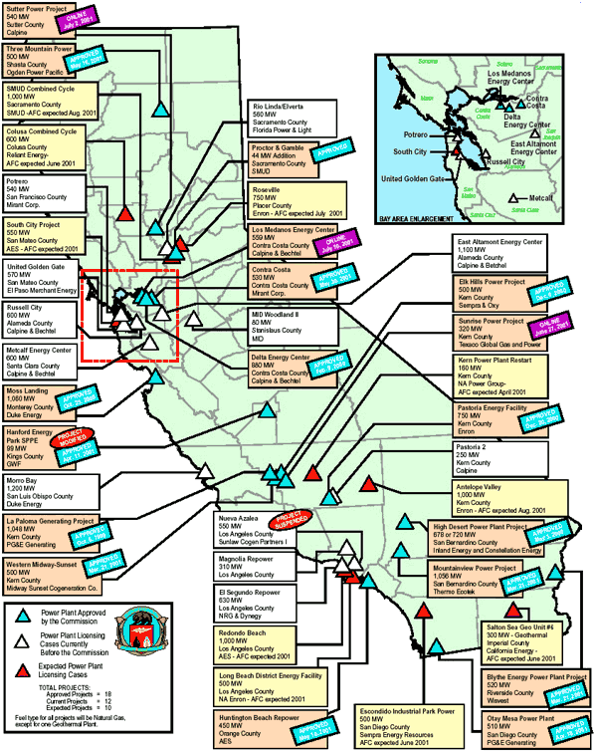
CALIFORNIA
High Probability Plants (UC) Under Construction (AP) Approved by CEC
LADWP Harbor V Expansion / 237 MW / Aug-01 (UC)
Elk Hills (Phase 1) / 350 MW / Mar-02 (UC) / 7,067 HR
La Paloma (Phase 1) / 521 MW / Mar-02 (UC) / 6,870 HR
Delta Energy / 880 MW / Jun-02 (UC) / 7,178 HR
La Paloma (Phase 2) / 522 MW / Jun-02 (UC) / 6,870 HR
Moss Landing / 1,060 MW / Jun-02 (UC) / 7,067 HR
Blythe (Phase 1) / 520 MW / Mar-03 (UC) / 7,100 HR
Elk Hills (Phase 2) / 220 MW / Mar-02 (UC) / 7,067 HR
High Desert / 720 MW / Jun-03 (UC) / 7,178 HR
Sunrise Power (Phase 2) / 320 MW / Aug-03 (UC) / 11,021 HR
Medium-High Probability Plants
(UC) Under Construction (AP) Approved by CEC
Midway-Sunset / 500 MW / Oct-02 (AP) / 6,793 HR
Otay Mesa / 510 MW / Jun-03 (AP) / 7,100 HR
Mountainview / 1,056 MW / Jul-03 (AP) / 6,704 HR
Pastoria (Phase 1) / 755 MW / Jul-03 (AP) / 6,760 HR
Four Mile Hill Project / 50 MW / Dec-03 (AP)
Three Mountain Power / 500 MW / Mar-04 (AP)
Rio Linda / 560 MW / May-04 (AP)
California

Slide 3
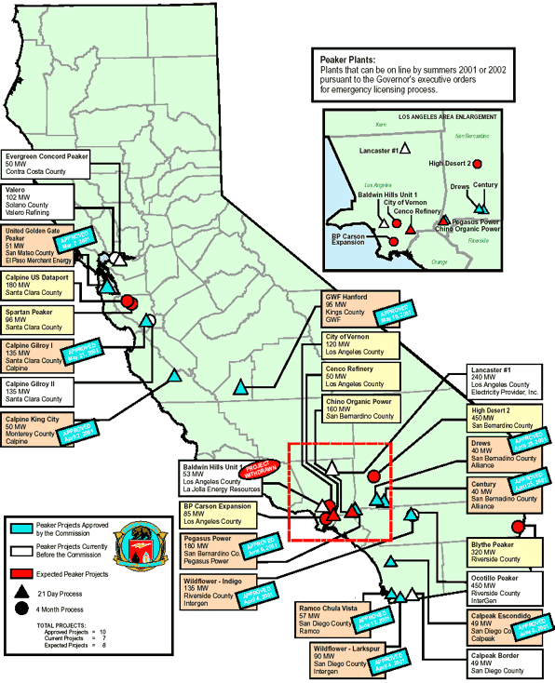
CALIFORNIA
Natural Gas Emergency Peaker Plants
NP15
Red Bluff / 49 MW / Aug-01
Gilroy (Phase 1) / 135 MW / Sep-01
King City / 50 MW / Sep-01
SP15
Century Project / 40 MW / Sep-01
Drews Project / 40 MW / Sep-01
CalPeak Border / 49 MW / Sep-01
Escondido (CalPeak) / 49 MW / Sep-01
Pegasus Power Project / 180 MW / Nov-01
California

Slide 4
CALIFORNIA UPDATES
(07/02/01 MWD) California officials have added three, long-term power purchase contracts to their portfolio of some 40 other deals that will provide power to the state's three IOUs over the next 10 years. The first deal began deliveries of 325 MW to the grid last week at an average cost to the state of $72/MWh based on expected usage. The contract with an unregulated power generation subsidiary of Edison International will last for 10 years, through December 2011. In a second deal, Calpine Energy Services will provide the state with 180 MW from its North San Jose Project beginning May 1, 2002. Output under the three-year contract will increase to 225 MW within one year of the deal's start. The state will pay on average $158/MWh for peak power from the facility. The third deal entered into by the state is a 10-year contract for the delivery of 25 MW of baseload power from a geothermal unit. The Clearwood Electric Co. will provide power at $67.40/MWh starting May 2002 through April 2012.
(07/02/01 Yahoo) California struck two blows on Monday in its fight to keep the lights on, opening a second major power plant in less than a week and citing new gains in consumers' efforts to save energy. San Jose-based independent power producer Calpine Corp. said early Monday that its 540-megawatt natural gas-fired Sutter Energy Center in northern California was up and running. The plant will be officially opened by California Gov. Gray Davis later Monday.
(07/03/01 EIS) A unit of Williams completed construction of expansion facilities on its Kern River natural gas transmission system on July 1. Williams filed an application with the Federal Energy Regulatory Commission on March 15 for a certificate of approval to proceed with the expansion project, adding 135,000 dekatherms per day of firm transportation service from Wyoming to California. The emergency expansion project added two new compressor stations in Utah and one in California, as well as upgraded compressor units at three existing compressor stations in Wyoming, Utah and Nevada. The installation of these facilities increased the transportation capacity on Kern River by approximately 19 percent. Williams completed the multimillion dollar project more than three weeks ahead of schedule.
(07/05/01 GD) In another test of FERC's willingness to resolve pipeline capacity issues, the commission on Monday ruled that Kern River Gas Transmission had properly allocate capacity on a key system expansion. SoCal Gas claimed it was entitled to the capacity in question, but FERC disagreed, saying that SoCal Gas had tried to "engage in a collateral attack" on the capacity bidding process. Kern River has an ambitious series of capacity additions on tap to serve the electric generation market in California. But in April, FERC raised eyebrows when it gave Kern River permission to proceed with an "emergency" 135 million cfd expansion of its system that will move new supplies from Wyoming to California.
(07/06/01 EIS) Calpine Corporation, the San Jose, Calif.-based independent power company, announced today that it has entered into a binding agreement with Pacific Gas and Electric Company (PG&E) to modify and assume all of Calpine's Qualifying Facility (QF) contracts with PG&E. Calpine and PG&E today filed a stipulation with the U.S. Bankruptcy Court for the Northern District of California (Bankruptcy Court) seeking authorization for PG&E to assume the modified Calpine QF contracts. The Bankruptcy Court is scheduled to approve the agreement on July 12, 2001. Under the terms of the agreement, Calpine will continue to receive its contractual capacity payments plus a five-year fixed energy price component of approximately 5.37 cents per kilowatt-hour, which is consistent with the recent California Public Utilities Commission Decision No. 01-06-015. In addition, all past due receivables under the QF contracts will be elevated to administrative priority status and paid to Calpine, with interest, upon the effective date of a confirmed plan of reorganization. Administrative claims enjoy priority over payments made to the general unsecured creditors. As of April 6, 2001, Calpine had recorded approximately $267 million in accounts receivable with PG&E under its QF contracts. QF facilities are an integral part of California's energy market, representing more than 20 percent of the state's power supply. Calpine's 11 QF projects provide close to 600 megawatts of electricity to Northern California customers.
California
Notes:
CISO has reset target pricing mechanism for the real time energy imbalance market. The price of the highest decremental bids is greater than the price for the lowest incremental bid. The new price is to be greater of zero or the lowest incremental bid.

Slide 5
CALIFORNIA UPDATES (cont’d)
(07/09/01 EIS) Customers of Southern California Gas Co. (The Gas Company) who install on-site power-generation systems to supply all or a portion of their own energy needs may now qualify for monetary incentives under a new $13.6 million-a-year rebate program launched today. The new ``self-generation'' rebate program is aimed at businesses and large residential complexes. Electricity-generation systems covered by the program include microturbines, small gas turbines, non-diesel internal combustion engines, solar power (photovoltaics), wind turbines and fuel cells, all of which must be interconnected with the utility grid to qualify for the program.
(07/09/01 MWD) Calpine and PG&E have entered into a binding agreement for the control of Calpine's 13 qualifying facility contracts with PG&E, totaling roughly 450 MW, the companies said Friday. Calpine owns a total of 11 QFs, which can generate about 600 MW. On Friday, Calpine and PG&E filed a stipulation with the US Bankruptcy Court for the Northern District of California seeking authorization for the bankrupt utility to assume the modified Calpine QF contracts. The court is scheduled to approve the transaction July 12, the companies said. Under terms of the agreement, PG&E will pay for power from July 13 onward, once the court approves the agreement. The company will pay about 5.37 cents/kWh for the amount of energy bought and will do so for at least five years.
(07/09/01 Yahoo) San Jose, Calif.-based Calpine Corporation announced today that its 555-megawatt Los Medanos Energy Center in Pittsburg, Calif. is providing needed electricity to California's strained power grid. Los Medanos is the second major combined-cycle facility to be licensed and built in California in over a decade. Fueled by natural gas, the facility is designed to add up to 555-megawatts of clean, reliable electricity to California on a 24 hours a day, seven days a week availability. As a cogeneration facility, the project also delivers electricity and steam to USS POSCO for use in industrial processing.
(07/10/01 EIS) The California State University (CSU) Chancellor's Office has purchased Electric City's EnergySaver(TM) and has verified that the EnergySaver reduced electrical consumption for lighting by more than 20 percent with no visible reduction in lighting levels. Due to the strong positive results, the EnergySaver will be presented to CSU energy managers at the Energy Managers Meeting on July 20 for possible implementation across CSU facilities. As a result of this initial system, Electric City is evaluating other CSU campuses regarding additional installations. The EnergySaver was installed at the newly constructed six-story 173,000 sq. ft. Chancellor's Building in Long Beach to provide variable voltage lighting control for the facility's 277-volt fluorescent lighting systems. During the May 24th test procedure witnessed by CSU facility engineers and energy engineers, the EnergySaver delivered more than a 20 percent power reduction using the building's existing energy-efficient bulbs and fixtures without any visible reduction in lighting levels. CSU anticipates saving 113,984 kWh per year for a total savings of $14,984 from just one EnergySaver unit used on lighting in the open office areas of the Chancellor's Building. CSU's return on investment in energy savings alone is well under 24 months.
(07/10/01 MWD) BPA violated its open access transmission tariff when it did not grant Idaho Power's request for short-term transmission service, FERC determined. In an order issued Friday, FERC said its decision was the first time it had explicitly stated that its pro forma tariff required that a transmission provider make remaining capacity available for both short-term and long-term firm service. Also, FERC said BPA must immediately apply such partial interim service to all figure requests for short-term firm transmission service. BPA, which has a tariff similar to FERC's pro forma tariff, had asked to wait until October 1, when its new tariff takes effect, to being applying the short-term firm service provisions.
California
Notes:
CISO has reset target pricing mechanism for the real time energy imbalance market. The price of the highest decremental bids is greater than the price for the lowest incremental bid. The new price is to be greater of zero or the lowest incremental bid.

Slide 6
CALIFORNIA UPDATES (cont’d)
(07/10/01 Yahoo) Independent power producer Calpine Corp (NYSE:CPN - news) said Tuesday it had completed the acquisition of the 500-megawatt Otay Mesa Generating power project in southern California. The project was developed by PG&E Corp.'s National Energy Group. Construction, which has been approved by the California Energy Commission, is expected to begin later this summer, with commercial start-up targeted for July 2003. Under the terms of the sale, Calpine will build, own and operate the natural gas-fired combined cycle facility and PG&E's National Energy Group will contract for up to 250 megawatts of output under a 10-year fuel tolling agreement. Under tolling agreements, gas is delivered to the plant and returned for a fee as electricity.
(07/11/01 EIS) San Jose-based Calpine Corporation and San Francisco-based Bechtel Enterprises Holdings, Inc. today announced that the Application for Certification (AFC) for their joint development project, the Russell City Energy Center, has met the California Energy Commission's (CEC) data adequacy requirements. The project was also approved for expedited review-making the Russell City Energy Center the first combined-cycle California energy project to meet the CEC's stringent qualifications for a six-month review. The proposed Russell City Energy Center will be a 600-megawatt, natural gas-fired, combined-cycle electric generating facility. The site is adjacent to the city of Hayward's wastewater treatment plant, which would supply recycled water to the facility. The Russell City Energy Center will provide enough electricity for approximately 600,000 homes and will serve Hayward, western Alameda County and the San Francisco Peninsula.
(07/11/01 GD) A little over two months after receiving certificate approval for its Line 2000 project, El Paso Natural Gas is planning to boost capacity on the California-bound line. The company said yesterday it would seek binding offers for an additional 320 million cfd on the pipeline, which runs from the Permian Basin to the California border. The open season announcement follows signals from El Paso that it would boost Line 2000 with additional compression. That marks the second enhancement of the Line 2000 project, which was originally conceived as a capacity replacement project. According to El Paso, the expansion would help meet burgeoning demand for gas to fuel generation both in California as well as in New Mexico and Arizona.
(07/11/01 MWD) Calpine completed the acquisition of the 500 MW, natural gas-fired Otay Mesa facility under development by PG&E Corp. The Otay Mesa facility, which will be the first new plant build in San Diego in more than 30 years, was originally developed by PG&E Nation Energy Group and was licensed by the California Energy Commission in April. Construction of the facility is slated to start later this summer, which completion expected in 2003. Under terms of the acquisition, Calpine will build, own and operate the facility. In addition, PG&E National Energy Group has agreed to enter into a 10-year tolling contract, under which it will purchase up to 250 MW.
(07/12/01 EIS) Calpine Corporation, one of the nation's leading independent power producers, today announced plans for the 180-megawatt Los Esteros Critical Energy Facility. Located in San Jose, California, Calpine's c*Power program will supply U.S. Data Port's planned San Jose Internet Campus with highly reliable critical power and ancillary services. c*Power's critical energy supply will allow U.S. Data Port to offer the type of energy infrastructure necessary for tomorrow's data management needs with environmentally preferred technology. Calpine has agreed to accelerate construction of the $250 million energy facility and enter into a near-term power contract with the California Department of Water Resources (DWR). Under the agreement, Calpine will provide 180 megawatts of peaking capacity and energy to the State beginning the summer of 2002 and continuing through April 30, 2005.
(07/12/01 MWD) Calpine and Bechtel Enterprises Holdings said yesterday that the California Energy Commission had approved an application for certification for their joint development project, the Russell City Energy Center. The project was also approved for expedited review. Calpine and Bechtel said that this project is the first combined-cycle California energy project to meet the qualifications for a six-month review. The companies said that they plan on having 600 MW at the facility, with power generated by natural gas-fired, combined-cycle turbines. The electricity produced will be used to supply Hayward, western Alameda County and the San Francisco Peninsula. If the plant is successfully licensed, construction is expected to begin in summer 2002. Commercial operation is planned for summer 2004.
California
Notes:
CISO has reset target pricing mechanism for the real time energy imbalance market. The price of the highest decremental bids is greater than the price for the lowest incremental bid. The new price is to be greater of zero or the lowest incremental bid.

Slide 7
CALIFORNIA UPDATES (cont’d)
(07/13/01 PD) The CEC Wednesday approved with strict conditions AES's request to change a certification agreement for 450 MW of its Huntington Beach generating station now that it no longer has a power sales contract with the CDWR. The contract had been a requirement when the CEC certified the project in May. The CDWR broke off negotiations with AES over the contract June 15.
(07/17/01 EIS) A unit of Williams, Tuesday filed an application with the Federal Energy Regulatory Commission (FERC) to construct and operate a delivery lateral pipeline in San Bernardino County, Calif. (High Desert Lateral). Kern River Gas Transmission Co. (Kern River) is proposing to build approximately 32 miles of 24-inch diameter pipeline in southern California. Extending from the Kern River/Mojave Common Facilities and the Pacific Gas & Electric Co. (PG&E) system interconnects, the High Desert Lateral will supply natural gas to the gas-fired electric generating power plant currently being constructed by High Desert Power Project, LLC near Victorville, Calif. When completed, the lateral pipeline will have a delivery capacity of 282,000 dekatherms per day. Completion of the pipeline is scheduled for Sept. 1, 2002.
(07/17/01 Yahoo) Heeding pleas to save energy, nearly one in three Californians have slashed their power use by 20 percent or more from a year ago, qualifying for a state-backed 20 percent refund on their electricity bills. San Diego Gas & Electric spokeswoman Jennifer Andrews said 39.4 percent of customers it has so far billed are entitled to a refund. Because they were hit hard with high prices earlier than the rest of the state and had already taken steps to save power before the refund program took effect, San Diegans need to cut their power use by just 15 percent to secure the discount. The state's other investor-owned utilities, Pacific Gas & Electric and Southern California Edison, are seeing around 29 percent hit their 20 percent savings target, according to company spokesmen.
(07/18/01 EIS) The 30 MW combined-cycle upgrade of the Harbor facility near Long Beach, Calif. is also operational. Its output currently is available on a merchant basis as the Company pursues contractual arrangements for the power. The upgrade boosts the total rating of the power plant to approximately 110 MW. Recently, the Company acquired additional ownership interests in this plant, resulting in a net capacity ownership approximating 50 MW.
(07/18/01 PowerMarketers.com) Pacific Gas & Electric has sued the state of California seeking compensation for millions of dollars in energy contracts the state seized in January amid a spiraling energy crisis, officials said Wednesday. Pacific Gas & Electric, a unit of San Francisco-based PG&E Corp., is currently in bankruptcy proceedings after racking up billions of dollars in debt as wholesale power prices spun out of control in the past year. The utility's suit, filed Tuesday in San Francisco Superior Court, seeks what could be millions of dollars in compensation for contracts Gov. Gray Davis seized on Jan. 31. as the state stepped in to buy power its utilities could no longer afford.
(07/19/01 GD) Williams' Kern River Gas Transmission this week asked FERC for permission to build a 32-mile delivery lateral in Southern California to deliver gas to a power plant under construction. The High Desert Lateral would extend the Kern River/Mojave Common Facilities and the PG&E system interconnects. The proposed line would deliver up to 282 million cfd of gas to the 720 MW combined-cycle power plant being constructed near Victorville, CA, by the High Desert Power Project. Construction is expected to be completed by September 1, 2002. The High Desert Lateral marks Kern River's third expansion into California in the past year. The pipeline recently placed into California in the past year. The pipe recently placed its California Action Project in service, which expanded system capacity by 135 million cfd, most of which will go to power generators. In addition, Kern River has filed an application with FERC to further expand its system capacity by May 2002. The pipeline also plans to expand its capacity by 906 million cf by May 2003.
California
Notes:
CISO has reset target pricing mechanism for the real time energy imbalance market. The price of the highest decremental bids is greater than the price for the lowest incremental bid. The new price is to be greater of zero or the lowest incremental bid.

Slide 8
CALIFORNIA UPDATES (cont’d)
(07/20/01 MWD) Berry Petroleum has agreed to sell power to SoCal Edison under terms of an agreement whereby SoCal Edison will buy all of the output from Berry's 42 MW Placerita cogeneration facility in northern Los Angeles County, CA, the company said yesterday. The plant produces both power for residential consumption and steam for Berry's heavy oil production operations on the site. Both of the plant's 21 MW units have been shut down since April because SoCal Edison had not paid for the power it had purchased from the company. Berry restarted the units on June 27, when the company entered into the agreement with the utility. The state PUC, however, did not approve the deal until late last week, and it did not become final until July 18, when Berry received SoCal Edison's notice.
(07/23/01 PD) A handful of peaking power projects under construction in southern California may never come on-line because the developers have been unable to reach contracts to sell the power to CDWR. Negotiations over the contracts have faltered, and the developers are accusing CDWR, which began buying power for the state's investor-owned utilities in January, of walking away from the table. Some developers already have pulled out of projects, claiming CDWR isn't interested in buying the power as demand in the state continues to fall in response to increased conservation and cool weather.
(07/24/01 PD) Energy Secretary Spencer Abraham Monday said the federal government's proposal to expand Path 15, a key transmission line between northern and southern California, has attracted 13 proposals from private industry. The administration called for expanding Path 15 as part of its national energy strategy, and Abraham in May ordered the Western Area Power Administration to determine investor interest and complete expansion plans for the line. The project, which entails building a third, 500-kV transmission line and other improvements between Los Banos and Gates substations in California, is estimated to cost roughly $300-million and take up to four years to complete. A third line along Path 15 would boost capacity by 1,500 MW.
(07/25/01 Yahoo) Energy company Mirant Corp. is appealing for help from California's grid manager to keep four old power turbines running near San Francisco beyond a January 1 air pollution deadline that threatens to shut them down. The suburban Pittsburg plant, which Mirant bought from PG&E Corp.'s troubled Pacific Gas & Electric utility unit in 1998, is an example of the conflicts between California's urgent need for electricity and strict standards on emissions of smog-forming nitrogen oxides from power plants. The 47-year-old, natural gas-fired units, which can generate more than 600 megawatts -- power for 600,000 homes -- at Mirant's 2,022-megawatt plant, may be yanked from California's grid if the Bay Area Air Quality Management District cancels their clearance to run. The company is not ready, however, to install costly new equipment on the turbines to cut emissions, said Dorinson. ``If we get variances, we could continue to run them, but clearly they face retirement in the next couple of years,'' he said. Air quality officials appear sympathetic to the state's need for all the power it can tap during emergencies.
(07/25/01 Yahoo) The Federal Energy Regulatory Commission approved on Wednesday a plan by the Kern River Gas Transmission Co. to increase capacity on an existing pipeline to ship an extra 10.5 million cubic feet of natural gas from Wyoming to California. Kern River, a unit of Williams Cos., plans to have the pipeline project finished by May. The pipeline project, which will cost around $31 million, includes adding several compressor stations to move the additional gas. The company said the expansion was needed because of increasing natural gas production in the Rocky Mountain Basin and growing demand for gas-fired electric generation plants. Kern River operates a 922-mile system delivering Rocky Mountain and Canadian natural gas to markets in California, Nevada and Utah. In addition to the 10.5 mmcf per day pipeline expansion, Kern River has separately asked FERC for permission to spend $1 billion to add another 900 mmcf per day to the line. That project to move even more gas from Wyoming to California would be completed by mid-2003.
California
Notes:
CISO has reset target pricing mechanism for the real time energy imbalance market. The price of the highest decremental bids is greater than the price for the lowest incremental bid. The new price is to be greater of zero or the lowest incremental bid.

Slide 9
CALIFORNIA UPDATES (cont’d)
(07/26/01 GD) Kern River Gas Transmission yesterday got the green light from FERC to add an additional 10.5 million cfd of capacity from Wyoming to California as part of 2002 Expansion Project. The project is set to come online in May 2002. The project is part of Kern River's California Action Project, and the amended facilities will cost about $31.4 million to construct.
(07/26/01 PowerMarketers.com) A proposal to build a 50-megawatt power plant in Martinez is drawing heat from residents who fear it would increase pollution in a region already burdened with large refineries and industrial plants. A local developer and a Southern California power firm want to team up to build build a natural gas-fired "peaker" plant on city- owned land near the former Shell Oil refinery now operated by Equilon Enterprises. Some residents fear that such a plant would reduce air quality by releasing thousands of pounds of carbon dioxide, nitrogen and sulfur dioxide. Critics complain that the county already has more than its fair share of power plants and other heavy industry. Some question the need for so many new plants, considering that the state seems to have turned a corner in its battle to stave off rolling blackouts and keep energy prices down.
(07/30/01 PowerMarketers.com) The 40-year-old AES Huntington Beach power plant, which was to nearly double its capacity this month when it finishes refurbishing two idle generators, is still running into roadblocks in the approval process. AES Corp. representatives will appear Wednesday before the South Coast Air Quality Management District to seek an operating permit. The permit was to be contingent on the company reaching an agreement to sell power to the state. But that agreement fell through earlier this month because the state refused to pay AES's asking price. Now the city of Huntington Beach is contesting the plant's permit request.
(07/30/01 PowerMarketers.com) It's a race against time and so far California's winning -- so far. Heading into the summer, the state's electricity situation looked dire. Experts projected that on peak-demand days, the state would fall 5,000 megawatts short of supply -- enough to supply nearly 3.8 million homes. But an unusually mild summer and stepped-up conservation by consumers has bought the state time -- time it's used for a pull-out-all- the-stops effort to get new power plants approved and built. The effort is slowly beginning to pay off: Three major new plants are already online, producing 1,415 megawatts. By the end of the month, two so-called peaker facilities will start coming online, providing another 225 megawatts. Next month, the refurbishment of two mothballed units at the AES Huntington Beach plant will be completed, adding another 450 megawatts to the power grid. Also, two more peaker plants totaling 80 megawatts will begin coming online. If all goes according to schedule, four full-time plants and 10 peaker facilities capable of producing a total of 2,729 megawatts are expected to be online by Sept. 30. State energy officials say other renewable energy projects like wind, geothermal and biomass will bring the total available to about 3,000 megawatts by the end of September. La Paloma, a 1,048-megawatt plant in Kern County, was to have its first units up by December. Construction delays have pushed that back to next March. The Pegasus Chino plant, a 180-megawatt facility, was delayed this week by the South Coast Air Quality Management District, making it unlikely that it will make the Sept. 30 completion deadline for plants approved under an emergency order issued by the governor.
California
Notes:
CISO has reset target pricing mechanism for the real time energy imbalance market. The price of the highest decremental bids is greater than the price for the lowest incremental bid. The new price is to be greater of zero or the lowest incremental bid.

Slide 10
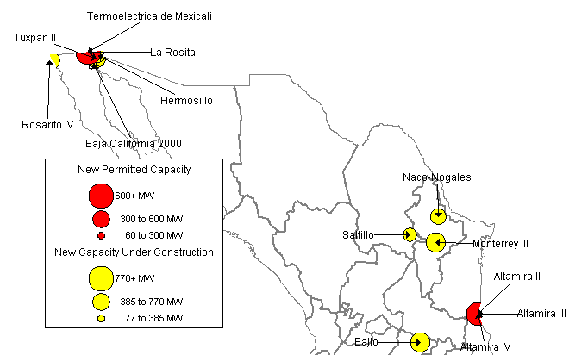
MEXICO NEW GENERATION MAP
High Probability Plants
Rosarito IV / 541 MW / Aug-01 / 6,870 HR
Baja California 2000 / 61 MW / Sep-01
Altamira II / 495 MW / May-02
Naco-Nogales / 339 MW / Jun-02
Hermosillo / 250 MW / Sep-02
La Rosita / 765 MW / Apr-03
Monterrey III / 490 MW / May-03
Bajio / 495 MW / Jun-03
Saltillo / 248 MW / Jun-03
Tuxpan II / 495 MW / Jun-03 / 7,160 HR
Medium-High Probability Plants
Altamira III / 518 MW / May-03
Altamira IV / 518 MW / May-03
Termoelectrica de Mexicali / 600 MW / Aug-03
Mexico

Slide 11
MEXICO UPDATES
(07/18/01 PowerMarketers.com) Banco Mexicano de Obras y Servicios Publicos (Banobras) will grant $55 million in loans from now through the end of the year to be channeled for energy investment and savings programs by the Federal Electricity Commission (CFE). The two entities penned their agreement Tuesday to implement the Energy Savings and Efficient Use Program for states and municipalities, according to a joint Banobras-CFE press release.
(07/18/01 PowerMarketers.com) The United States is looking for new energy sources not only within the country, but also in Mexico, Canada and other countries in the region, U.S. Energy Secretary Spencer Abraham confirmed on Tuesday, at a meeting of Hispanic leaders. The energy secretary explained that the U.S. government is currently involved in bilateral negotiations with countries in Central and South America to increase energy production and improve energy transmission. Bush is committed to working with Mexican President Vicente Fox and other leaders to "enhance North American trade and energy connections," the energy secretary said.
Mexico
Notes:
Formerly (stalled) NWPE 220 MW project. FPL bought rights in 1/99. Construction to began 9/1/99 As of 4/25/00 Unit 1 not complete and gas line construction has been stalled.

Slide 12
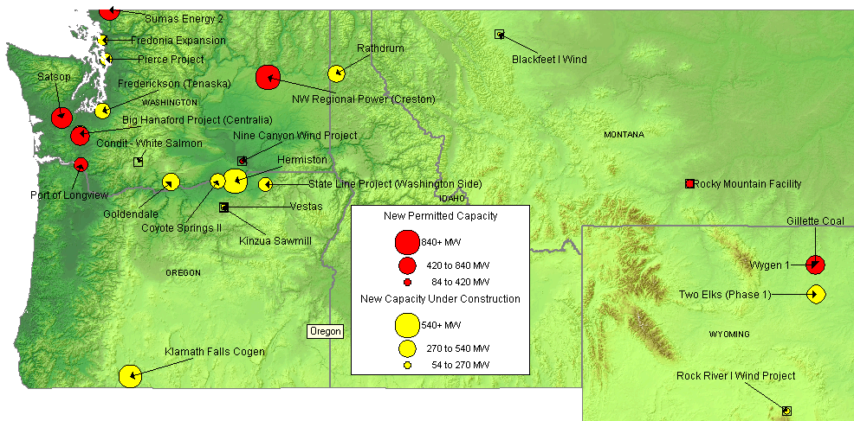
NORTHWEST NEW GENERATION MAP
High Probability Plants
Fredonia Expansion / 110 MW / Aug-01
Klamath Falls Cogen / 464 MW / Aug-01 / 6,732 HR
Rathdrum / 270 MW / Aug-01 / 6,760 HR
Kinzua Sawmill / 10 MW / Sep-01
Pierce Project / 154 MW / Sep-01
Blackfeet I Wind / 22 MW / Oct-01
Rock River I Wind Project / 50 MW / Oct-01
State Line Project / 200 MW / Dec-01
Two Elks (Phase 1) / 300 MW / Dec-01
Vestas / 35 MW / Dec-01
Coyote Springs II / 231 MW / Jun-02 / 6,760 HR
Frederickson (Tenaska) / 248 MW / Jun-02
High Probability Plants (cont’d)
Big Hanaford Project (Centralia) / 248 MW / Jul-02 / 7,349 HR
Hermiston / 536 MW / Aug-02 / 6,700 HR
Goldendale / 288 MW / Sep-02 / 7,200 HR
Wygen 1/ 80 MW / Jul-03
Medium-High Probability Plants
Rocky Mountain Facility / 110 MW / Jul-02
Sumas Energy 2 / 660 MW / Sep-02 / 6,793 HR
NW Regional Power (Creston) / 838 MW / Jun-03
Port of Longview / 290 MW / Jul-03 / 7,800 HR
Satsop / 600 MW / Oct-03 / 6,765 HR
Chehalis Power / 520 MW / Nov-03 / 6,704 HR
Gillette Coal / 500 MW / Jun-05
PNW

Slide 13
NORTHWEST UPDATES
Washington
(07/02/01 GD) PG&E Gas Transmission - Northwest has concluded a successful open season on its Washington Lateral Project, with three times more capacity requested than the project will provide. The open season ended June 22, with non-binding interest primarily from gas utilities and generators. PG&E GT-NW has proposed the lateral begin at an interconnection with PG&E GT-NW's mainline system south of Spokane, WA., travel west to the central Washington in the mid-Columbia area and then extend to the I-5 corridor in western Washington. The pipeline will be capable of transporting 300,000 to 400,000 dth/d.
(07/12/01 PowerMarketers.com) Plans are still bubbling below the surface for two power plants that could be built along the Snohomish River, but a decision is still a long time away. This week, a new form of the plan surfaced in a petition to the state's Energy Facilities Site Evaluation Council that details two plants operated by separate companies with shared facilities such as the steam turbine, control room and administrative building. Carol Clawson, spokeswoman for FPL Energy -- the primary owner of the planned Everett Delta I plant -- said the project remains in various stages of internal review. She said she did not know when the review would be completed. Previously, the company said it planned to start construction in early 2000.
(07/17/01 PD) National Energy Systems, which hopes to build a $398-million, 600 MW plant near the Canadian border, Friday submitted plans to Washington's EFSEC for a revised and cleaner unit. Concerns that the proposed plant would degrade air quality in British Columbia became an issue in the province's elections this spring, and Washington's siting council in February said it would recommend that the company's application be denied because of fears that emissions from the Sumas Energy-2 gas-fired facility would increase pollution in Canada.
(07/19/01 MWD) Avista Corp. has asked state regulators in Washington and Idaho for permission to add a surcharge to retail rates for its utility customers in those states from September 15, through 2003, the company said yesterday. The Spokane, Washington-based utility has proposed a 36.9% retail rate surcharge in Washington and a 14.7% surcharge for retail customers in Idaho. All customer classes in each state would see the uniform percentage increase on their bills. The rate increase would boost the company's annual income by $105 million to help it pay down debts it incurred buying power in Western wholesale markets, Avista said. The Washington surcharge will increase the company's annual revenues by $87.4 million, and the Idaho surcharge will bring in $17.9 million. Without the rate increase, Avista predicts those deferred costs could rise to $267 million by year's end.
(07/19/01 MWD) TransAlta subsidiary Pierce Power has received all necessary regulatory approvals to build a simple-cycle, gas-fired plant in Frederickson, WA, the company said yesterday. The Pierce project will add 154 MW to the Pacific Northwest energy market for a period of 14 months. The plant will comprise seven portable gas-fired turbines and will be located on a leased site.
(07/26/01 GD) FERC yesterday approved PG&E Gas Transmission-Northwest's application to construct a 21-mile pipeline parallel to its existing mainline that would bring an additional 200 million cfd of firm service to the Pacific Northwest and California. The expansion would also add 20 million cfd of winter-only capacity. The 42-inch looping will begin at the British Columbia border and will go through Idaho, Oregon and Washington before terminating at the California border. The project will also involve installing an additional 97,500 HP of compression at five existing compressor stations located in Washington, Oregon and Idaho. The proposed facilities include looping to PG&E's existing A and B mainlines between Compressor Station 5 in Idaho and the mainline valve 5-2 near East Farms, WA. PG&E also will add a pig launcher and valving at Compressor Station 5 to accommodate a proposed C line loop, to be located 20 feet from the existing mainline.
PNW
Notes:
Formerly (stalled) NWPE 220 MW project. FPL bought rights in 1/99. Construction to began 9/1/99 As of 4/25/00 Unit 1 not complete and gas line construction has been stalled.

Slide 14
NORTHWEST UPDATES (cont’d)
Washington (cont’d)
(07/31/01 EIS) In its first foray into power plant development in the Pacific Northwest, Mirant announced today that it plans to build a 286-megawatt power plant in cooperation with Avista Power LLC. Construction is expected to begin shortly and Mirant will market 100 percent of the output. The project is located in the Mint Farm Industrial Park in Longview, Wash., and will help supply the growing demand for electricity in Washington and throughout the West. Avista has developed the project for the last two years and is now selling its interest to Mirant. Avista will continue to assist with completion of licensing and other development activities. The power plant will be a natural gas-fired combined cycle facility -- combining gas turbine generation with a steam turbine that employs heat captured from the gas turbine -- and is anticipated to come on-line by summer 2003. The gas turbine part of the project could begin generating electricity by summer 2002. In keeping with its commitment to use the cleanest and most efficient methods of producing power, the plant will use state-of-the-art environmental technology.
Montana
(07/05/01 PD) Montana Power said it has received 23 proposals from 15 developers for 1,650 MW in response to its solicitation to buy 150 MW of wind power to serve its default supply customers starting in July 2002. Since wind power is dependable about one third of the time, the utility said, the 1,650 MW would result in a total of 550 MW of actual generation if the utility decided to buy power from all of the projects proposed.
(07/23/01 EIS) Shell Renewables' U.S. wind energy operation, Shell WindEnergy Inc., has signed an agreement to acquire its first project with the purchase of the 50 megawatt (MW) Rock River I wind farm in Wyoming. The project, developed by wind farm developer SeaWest WindPower Inc., is the first major step in achieving Shell Renewables' wind energy strategy by moving from experimental to commercial scale in this business. The project is made up of 50 one-MW Mitsubishi wind turbines. The wind farm will be constructed over the summer and is scheduled to begin generating electricity in October 2001. All energy produced, and the emissions reduction credits, will be sold to PacifiCorp under a single 20 year Power Purchase Agreement (PPA).
(07/25/01 MWD) Montana Power has signed a contract with independent provider Rocky Mountain Power to receive 100 MW from Rocky Mountain's coal gasification facility, to be constructed southeast of Billings. Rocky Mountain Power expects to break ground on the 110 MW facility as early as next wekk, following the Montana Public Service Commission's review of the contract. The plant is expected to come online by July 1, 2002, when Montana's customer choice program begins. A Rocky Mountain Power representative said that the additional 10 MW produced at the plant would most likely be consumed internally.
PNW
Notes:
Formerly (stalled) NWPE 220 MW project. FPL bought rights in 1/99. Construction to began 9/1/99 As of 4/25/00 Unit 1 not complete and gas line construction has been stalled.

Slide 15
NORTHWEST UPDATES (cont’d)
Oregon
(07/02/01 EIS) With this year's Columbia River flows perilously close to the lowest year on record, the Bonneville Power Administration, in consultation with other federal agencies, has decided it cannot provide summer spill for migrating salmon. Spill means diverting water through a spillway so that more fish can traverse a dam without going through its turbines. Spilled water cannot be used to generate electricity. On June 28, the Northwest River Forecast Center of the National Weather Service issued its July early-bird forecast of Columbia River runoff for January-July. It dropped by 2 million acre-feet (maf) from the June mid-month forecast to 53.9 maf at The Dalles. This is a mere 0.1 maf above the all-time record low of 53.8 maf set in 1977.
(07/13/01 PD) Environmentalists and industry groups have asked Oregon's two investor-owned utilities to withdraw requests for proposals they issued for wholesale green power and reissue the RFPs for green power that can be sold in the retail market. PGE and PacifiCorp issued the RFPs, for about 5 MW each, in mid-May under the direction of the Oregon PUC staff. The staff was told to follow the Portfolio Advisory Committee's recommendations, which included requiring the RFPs to seek power for the retail market.
(07/19/01 PowerMarketers.com) Coburg Power LLC has filed notice with the Oregon Office of Energy that it would like to build a 605-megawatt power plant, and Enron Corp. (ENE) has expressed interest in becoming involved with the project, a spokesperson for the Office of Energy said Thursday. The plant, which would be built in Coburg near Eugene, Ore., would comprise two natural-gas-fired turbines and one steam turbine. The approval process could take up to two years, with another two years needed to build the plant, said Samuel R. Sadler, an analyst in the Office of Energy. The estimated cost of building the project is $350 million, he added. The plant may have difficulty getting permitted, however, due to local opposition. That's because it would be located in the backyard of Eugene, Ore., which is known for environmental activism and has recently seen a degradation of its air quality, a source close to the issue said, requesting anonymity.
(07/26/01 PowerMarketers.com) On an appropriately windswept hill above Wallula Junction, row upon row of windmills face the breeze. Their massive three-bladed fans spin in the wind, converting wind energy into power to be distributed across the Northwest. By Monday, 26 windmills were energized and putting power on the Northwest grid through a connection with PacificCorp. FPL Energy, owner and developer of the Stateline Wind Power Project, started installing the windmills in February at the site about halfway between Pasco and Walla Walla. The first megawatts were sold July 15 on the real-time market to municipal utilities in the Northwest, said Barrett Stambler, director of renewable business development for PacifiCorp Power Marketing.
Idaho
(07/13/01 PD) Idaho Power said Wednesday that it will release through August a third of the Brownlee Reservoir's water at the 1,167 MW Hells Canyon dam complex in Idaho to benefit fish at federal dams downstream in Washington. The decision resolves a conflict between Idaho and the federal government. Under the agreement, the utility will generate power instead of spilling water for fish as it has during past summers, and will in turn allow it to buy less power on the market to meet loads. Even though the water released will be used to generate power it should help mitigate fish migration problems cause by low water levels downstream in Washington.
PNW
Notes:
Formerly (stalled) NWPE 220 MW project. FPL bought rights in 1/99. Construction to began 9/1/99 As of 4/25/00 Unit 1 not complete and gas line construction has been stalled.

Slide 16
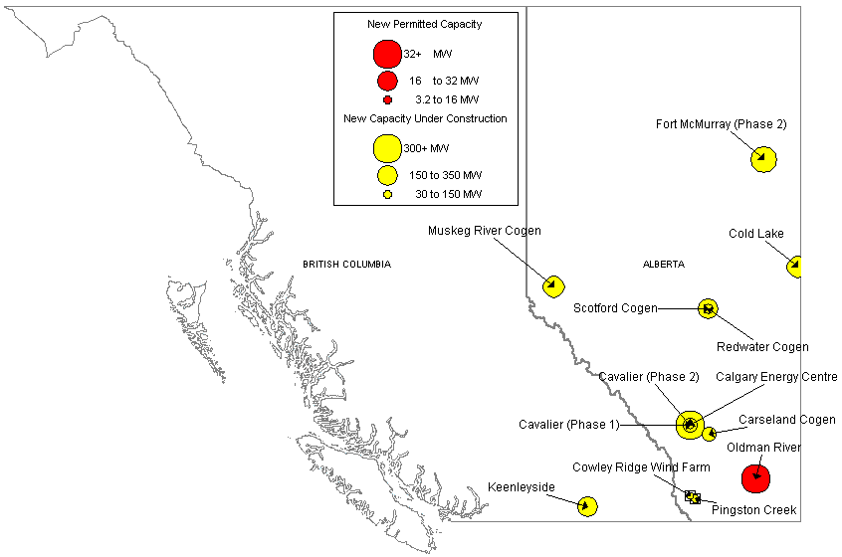
CANADA NEW GENERATION MAP
High Probability Plants
Cavalier (Phase 1) / 80 MW / Aug-01
Cowley Ridge Wind Farm / 20 MW / Oct-01
Balzac Cogen / 106 MW / Nov-01
Carseland Cogen / 80 MW / Nov-01
Redwater Cogen / 40 MW / Nov-01
Cavalier (Phase 2) / 26 MW / Dec-01
Valleyview / 46 MW / Dec-01
Pingston Creek / 30 MW / Jun-02
Cold Lake / 170 MW / Oct-02
Muskeg River Cogen / 170 MW / Nov-02
Scotford Cogen / 150 MW / Dec-02
Keenleyside / 150 MW / Jan-03
Calgary Energy Centre / 300 MW / May-03
Fort McMurray (Phase 2) / 238 MW / Aug-04
Medium-High Probability Plants
Rainbow Lake / 46 MW / Feb-02
Oldman River / 32 MW / May-02
Canada

Slide 17
CANADA UPDATES
(07/05/01 EIS) Canadian Gas & Electric Inc., a wholly owned subsidiary of Canadian Hydro Developers, Inc., and Canadian Forest Products Ltd. have entered into a definitive agreement to construct a 25 megawatt wood residue fueled power facility adjacent to Canfor's Grande Prairie, Alberta lumber mill. The facility will produce electrical and steam energy from wood waste that is currently being incinerated. Canfor will utilize approximately 40% of the produced energy at their Alberta operations, with the balance being available for sale to other customers and the spot market. CG&E is currently applying for permits, ordering equipment and starting some preliminary construction work. Subject to financing, the major construction activity will take place during 2002 with an anticipated completion date late in 2002..
Canada
Notes:
Formerly (stalled) NWPE 220 MW project. FPL bought rights in 1/99. Construction to began 9/1/99 As of 4/25/00 Unit 1 not complete and gas line construction has been stalled.

Slide 18
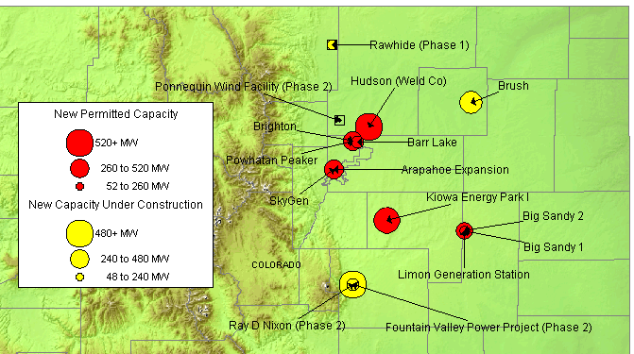
ROCKIES NEW GENERATION MAP
High Probability Plants
Ponnequin Wind Facility (Phase 2) / 10 MW / Aug-01
Fountain Valley / 240 MW / Sep-01 / 9,800 HR
Rawhide (Phase 1) / 80 MW / Sep-01 / 11,400 HR
Limon Generating Station / 140 MW / Jun-02 / 11,873 HR
Brighton / 140 MW / Apr-02
Brush / 328 MW / May-02 / 7,500 HR
Arapahoe Expansion / 45 MW / Jun-02 / 9,500 HR
Ray D Nixon (Phase 2) / 480 MW / Dec-02 / 7,067 HR
Medium-High Probability Plants
Big Sandy 1 / 75 MW / Nov-01
Powhatan Peaker / 280 MW / May-02
Barr Lake / 128 MW / Jun-02
Big Sandy 2 / 225 MW / Nov-02 / 10,500 HR
SkyGen / 270 MW / Jun-03
Hudson (Weld Co) / 516 MW / Jun-04 / 7,100 HR
Kiowa Energy Park I / 475 MW / Jul-04 / 7,160 HR
Rockies

Slide 19
ROCKIES UPDATE
(07/02/01 GD) CIG is holding an open season through July 20 on 540,000 dth/d of capacity from the Cheyenne Hub in northeastern Colorado to Midcontinent markets near Greenburg, Kansas. CIG has completed environmental, archeological and right-of-way survey work and plans to file for FERC approval in October. The company has an in-service date of late 2003. The project will access all Rocky Mountain supply basins via El Paso pipeline affiliates CIG and Wyoming Interstate at the Cheyenne Hub. The project also planned interconnection near Greensburg with ANR Pipeline, Panhandle Eastern Pipe Line, Northern Natural Gas, Natural Gas Pipeline of America and Williams, with an estimated takeaway capacity of 6.8 billion cfd.
(07/23/01 MWD) Colorado regulators last week approved Xcel Energy's plans to build a 345-kV transmission line originating in Texas, running through Kansas and ending in Colorado, and allowed the company to charge retail customers in the state $46 million to pay for construction costs, a company representative said. Xcel Energy had initially asked the state PUC for permission to recover $65.7 from customers to pay for the portion of the line running through Colorado. The charge for the line's construction will result in an average increase of 28 cents on customers' monthly bills. The increase will likely go into effect when the line enters in 2005. The company plans to build the Colorado section of the line between 2003 and 2004.
Rockies

Slide 20
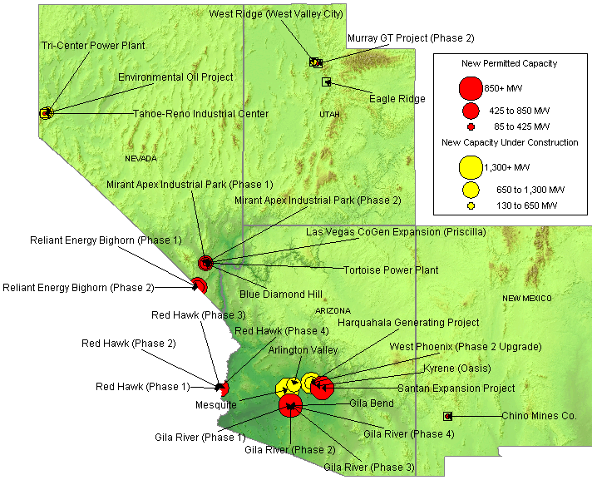
SOUTHWEST NEW GENERATION MAP
High Probability Plants
Tri-Center Power Plant (Phase 2) / 240 MW / Aug-01 / 10,911 HR
Environmental Oil Project / 30 MW / Sep-01
Tahoe-Reno Industrial Center / 350 MW / Sep-01 / 7,000 HR
West Ridge / 160 MW / Sep-01 / 9,518 HR
Kyrene (Oasis) / 265 MW / Feb-02 / 7,125 HR
Red Hawk (Phase 1) / 580 MW / Jun-02 / 7,067 HR
Red Hawk (Phase 2) / 580 MW / Jun-02 / 7,067 HR
Arlington Valley / 570 MW / Aug-02 / 7,067 HR
Gila River (Phase 1) / 575 MW / Aug-02 / 7,067 HR
Gila River (Phase 2) / 575 MW / Dec-02 / 7,067 HR
Mesquite / 1,250 MW / Jan-03 / 7,067 HR
Gila River (Phase 3) / 575 MW / Mar-03 / 7,067 HR
Mirant Apex Industrial Park (Phase 1) / 550 MW / Mar-03 / 7,067 HR
Gila River (Phase 4) / 575 MW / May-03 / 7,067 HR
West Phoenix (Phase 2 Upgrade) / 440 MW / Jun-03 / 7,196 HR
Harquahala Generating Project / 1,083 MW / Sep-03 / 6,880 HR
Mirant Apex Industrial Park (Phase 2) / 550 MW / Mar-04 / 7,067 HR
Medium-High Probability Plants
Chino Mines Co. / 50 MW / Sep-01
Murray GT Project (Phase 2) / 15 MW / Oct-01
Tortoise Power Plant / 60 MW / Mar-02
Steamboat Springs Geothermal / 30 MW / Jun-02
LV CoGen Expansion / 225 MW / Sep-02
Reliant Energy Bighorn (Phase 2) / 575 MW / Jun-03
Blue Diamond Hill / 400 MW / Jun-04
Gila Bend / 845 MW / Jun-04
Santan Expansion Project / 825 MW / Dec-05
DSW

Slide 21
SOUTHWEST UPDATES
Arizona
(07/10/01 EIS) El Paso Natural Gas Company, a subsidiary of El Paso Corporation, announced today a binding open season for 320 million cubic feet per day (MMcf/d) of pipeline capacity from the Keystone and Waha areas of the Permian Basin in West Texas to the California border near Ehrenberg, Arizona. The binding open season, which began July 5, 2001 and closes on August 2, 2001, is in response to the interest expressed during El Paso's non-binding open season in March 2001 soliciting shippers for potential system expansions. The expansion capacity will be made available by adding compression to El Paso's Line 2000 from McCamey, Texas to the California border near Ehrenberg, Arizona. The expansion capacity will be sold at El Paso's existing maximum California tariff rate, and the fuel charge is estimated to be 5 percent. The projected in-service date of the expansion facilities is mid-2003 subject to the receipt of all necessary regulatory, environmental, and right-of-way authorizations. The receipt points on El Paso's system for this capacity will be the Waha and Keystone pools in the Permian Basin area of West Texas. The delivery points will be Southern California Gas Company (SoCal) and PG&E's proposed North Baja Pipeline, El Paso's bi-directional lateral (Line 1903), any future incremental capacity on the SoCal system from Ehrenberg, Arizona into the State of California, and any upstream points on El Paso's south mainline system where capacity exists.
(07/24/01 PD) Arizona's transmission system is falling behind rising electricity demand and new power project, putting the system on the verge of unreliability, according to a report approved Monday by state regulators. In approving the "Revised Biennial Transmission Assessment," the Arizona Corporation Commission, however, scraped a staff recommendation that there should be enough transmission import capacity to reliably serve all load in a utility's service area and allow access to more economical and less polluting remote generation. Overall, Arizona's transmission system faces several limitations, which are hampering reliability, the report states. For example, there is little long-term firm regional transmission capacity available to export or import energy over the state's system. With a boom in power plant construction underway, the report predicted that the transmission system won't be able to handle all the new capacity. Arizona currently has 21 power plants with 15,951 MW of capacity and 17 plants are being build or have been proposed adding up to 17,000 MW of capacity.
(07/25/01 NWD) Tucson Electric Power filed an application today with the Arizona Corporation Commission to schedule a hearing to address the need for a fourth electric generating unit at its Springerville Generating Station. Two 380 MW, coal-fired generating units are installed at the site. Tucson Electric hopes to install a previously approved third unit as well as the fourth unit to meet growing demand. Expansion plans call for total emissions from all four units to be much less than the emissions from the two units now operating, a Tucson Electric representative said.
DSW

Slide 22
SOUTHWEST UPDATES (cont’d)
Arizona (cont’d)
(07/30/01 PD) Arizona regulators will soon decide on two new proposed power projects -- a 600 MW plant by Duke Energy and a 520 MW unit by Wellton-Mohawk Irrigation & Drainage District. Duke Energy North America filed an application with state regulators July 13 to build a 600 MW gas-fired plant next to its 570 MW Arlington Valley Energy Facility, a $250 million merchant plant that is set to start supplying power by next summer. Once Duke has the necessary permits in hand, the company will evaluate its position before making a final decision on the proposed facility. Despite the market and political uncertainty in California, Duke is moving ahead with plans to add generation in the Western region. Meanwhile, the state Power Plant & Transmission Line Siting Committee will hold its first hearing August 10 on the Wellton-Mohawk Irrigation & Drainage District's proposed 520 MW gas-fired project, which would be used to meet local demand and sell power into the wholesale market.
Nevada
(07/19/01 PD) Nevada's large energy users will be able to shop for power beginning next spring under a bill signed Tuesday by Governor Kenny Guinn. Guinn signed the legislation (AB 661) hours after the Nevada Supreme Court ruled that the bill must be forwarded to the governor. The bill passed the Legislature shortly after midnight June 5 minutes after the legislative session ostensibly ended. The state's legislative counsel declined to send the bill to the governor, saying time had run out on the session. The bill allows commercial and industrial customers and governmental agencies with an annual average demand of more than 1 MW to shop for power. Competitive shopping begins April 1, 2002, in northern Nevada and June 1, 2002, in southern Nevada.
(07/23/01 PD) The Northwest Planning Council Friday said between 500-750 MW of planned capacity additions in the four-state region are unlikely to come online this year because the decline in wholesale power prices since federal regulators imposed soft price caps across the West last month has made the project uneconomic. A systems analyst with the council said the majority of postponed or cancelled capacity is part of 1,000 MW reciprocating diesel and simple-cycle gas turbines that were expected to come on-line to help the region get through anticipated supply emergencies. In a related development, Houston-based Reliant Energy Friday said it has halted plants to build a 310 MW peaking plant in Nevada and blamed the FERC's June 19 mitigation plan. Reliant cancelled the peaking portion of the Bighorn project.(07/25/01 NWD) Tucson Electric Power filed an application today with the Arizona Corporation Commission to schedule a hearing to address the need for a fourth electric generating unit at its Springerville Generating Station. Two 380 MW, coal-fired generating units are installed at the site. Tucson Electric hopes to install a previously approved third unit as well as the fourth unit to meet growing demand. Expansion plans call for total emissions from all four units to be much less than the emissions from the two units now operating, a Tucson Electric representative said.
DSW

Slide 23
SOUTHWEST UPDATES (cont’d)
Nevada (cont’d)
(07/24/01 EIS) Black Hills Energy Capital, Inc., the independent power subsidiary of Black Hills Corporation (NYSE: BKH), today announced the signing of a definitive agreement to purchase a 273 MW gas-fired power generation complex located in North Las Vegas, Nev. from Enron North America, a wholly-owned subsidiary of Enron Corp. (NYSE: ENE - news). The transaction is expected to close in the third quarter of 2001. Expansion of the present 51 MW co-generation site near Las Vegas is now under way. Construction of a new combined cycle generation facility adjacent to the existing plant will add approximately 222 MW of capacity to the existing plant site. The new generation is expected to phase in operations in the third quarter of 2002. The facility will feature LM-6000 gas-fired turbine technology comparable to Company facilities in Colorado and Wyoming. The Company has initiated discussions with several banks and expects to finance the project primarily with non-recourse debt. As part of the transaction, the Company also has secured long-term contracts for the output of the facility. Nearly all of the capacity and energy produced by the existing 51 MW plant is under contract through 2024 with the remainder being merchant power. The power of the planned 222 MW combined-cycle plant is sold under a 15-year contract. The contract requires the purchaser to provide fuel to the power plant when the plant is dispatched.
DSW

Slide 24
SUMMARY
Summary

Slide 25
Sorted List By Online Date

Slide 26
Sorted List By Online Date

Slide 27
Sorted List By Region

Slide 28
Sorted List By Region

Slide 29
Sorted List By Region

Slide 30
WSCC CAPACITY ADDITIONS
NOTE: 100% of Capacity Under Construction, 50% of Permitted Capacity
Summer Summary

Slide 31
New Gas Generation Summary

