Slide 1

New Generation in WSCC
Presentation
February 28, 2000
Proprietary and Confidential 5/02

Slide 2
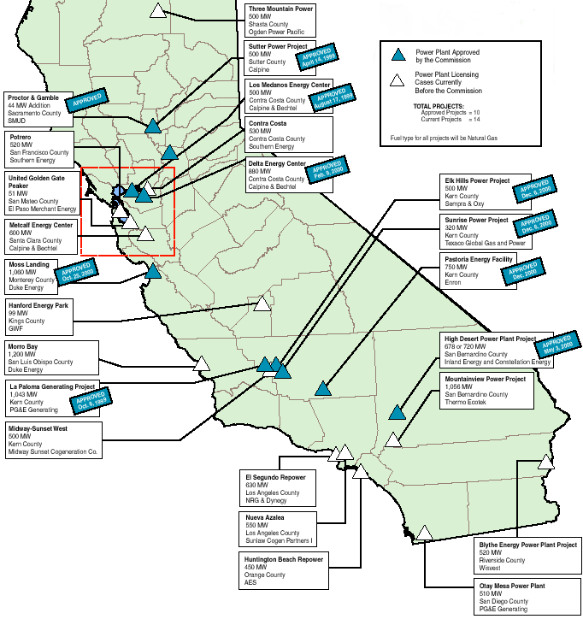
California
High Probability Plants (UC) Under Construction (AP) Approved by CEC
  Seawest, 16 MW, Mar-01(UC)
  Sutter, 500MW, Jun-01 (UC)
  Los Medanos, 500 MW, Jul-01 (UC)
  La Paloma Phase I, 521 MW, Dec-01 (UC)
  La Paloma Phase II, 522 MW, Mar-02 (UC)
  Delta, 880 MW, Jul-02 (UC)
  Moss Landing, 1060 MW, Jun-02 (UC)
  Elk Hills, 500 MW, Sep-02
  High Desert, 720 MW, Jan-03 (AP)
  Sunrise, 320 MW, Jan-03
  Otay Mesa, 510 MW, Jun-03
  Pastoria, 750 MW, Jan-03
  Mountainview, 1056 MW, May-03
Medium Probability Plants
  Metcalf, 600 MW, Mar-03
  Blythe, 520 MW, Apr-03
  Midway-Sunset, 500 MW, Mar-03
  Contra Costa, 530 MW, May-03
  Rosarito (Tijuana, Mexico), 255 MW, Apr-03
California

Slide 3
California Updates
After San Jose, California officials rejected Calpine’s plans for its controversial Metcalf Energy Center, officials in Hayward 20 miles north of that city are rolling out the red carpet for Calpine and Bechtel’s proposed 600-MW combined-cycle power plant.The Hayward City Council authorized the city to begin negotiations with Calpine for the $400-million project. If approved by the CEC, the plant could be operational by 2004.
In response to an executive order by Governor Gray Davis aimed at bringing more generation capacity online for this summer, the CEC has identified 33 sites across the state that could be potentially available for the installment of peaking power plants. The CEC predicted the facilities could generate between 1,700 MW and 3,400 MW.
Sempra Energy has plans to build a $350 million, 600 MW power plant near Mexicali, Baja California, in Mexico. The Termoelectrica de Mexicali facility will be connected to the US transmission grid via a new 230-kV transmission line.
Dynegy and AES told a federal judge that they will not be able to supply power from their in-state power plans as called on by the California ISO without exceeding their permitted air quality emissions and incurring stiff fines. Dynegy has long-term contracts to supply peak power next summer from its Encina power plant but “if the ISO continues to demand power from us at the same level we’ll run out of [NOx] emissions credits before summer,” warned Robert Mittelstued, Dynegy’s attorney. But an ISO attorney, Norma Formanek, said that Dynegy’s Encina plant would not meet the ISO’s requirements for RMR contracts, which can only be used to solve local reliability problems. SCAQMD’s executive director issued an order exempting AES from emissions limits for 10 days because of the statewide power emergency.
The Air Force has issued an RFP for non-hydro green power at Edwards Air Force bas. Edwards has used about 133,000 MWh annually in recent years, and it pays about 10 cents/kWh for firm power from SoCal Edison. The Air Force is seeking green power because recent executive orders require government agencies to use renewable power whenever possible.
California
Notes:
CISO has reset target pricing mechanism for the real time energy imbalance market. The price of the highest decremental bids is greater than the price for the lowest incremental bid. The new price is to be greater of zero or the lowest incremental bid.

Slide 4
California Updates (cont’d)
The CEC recommended Thermo Ecotek’s proposed 1,056 MW Mountainview facility to receive a license. The CEC accepted two other projects, both repowerings of exiting facilities, for the 12-month review. AES Corp. has proposed adding 450 MW to its Huntington Beach facility, and Dynegy and NRG Energy have proposed replacing two old units at their jointly owned El Segundo facility with a new, 630-MW unit, increasing overall output by 280 MW.
Calpine Corp. of San Jose, California, said Thursday that combining Canadian natural gas and oil Company Encal Energy Limited of Calgary, Alberta, which it just bought for $1.2 billion, with its other acquisitions, the company will now control gas production to fuel 2,300 MW of its power plant portfolio. Calpine will also receive access to firm gas transportation capacity from western Canada to California and the eastern US.
California
Notes:
CISO has reset target pricing mechanism for the real time energy imbalance market. The price of the highest decremental bids is greater than the price for the lowest incremental bid. The new price is to be greater of zero or the lowest incremental bid.

Slide 5
PNW Updates
Washington
  Washington state's power siting council said Tuesday it has recommended that Governor Gary Locke approve permit changes that would hike the capacity from 460 MW to 520 MW on Tractebel's proposed merchant gas-fired Chehalis project located in Chehalis, WA. Tractebel would like to start construction in June and bring the plant online in 2002. Tractabel would be able to increase the capacity by 60 MW by using more advanced turbines that would use air for cooling rather than water. EFSEC said it would eliminate the requirement that the developer sell 60% of the capacity through long-term contracts.
  A Washington state siting council said it would recommend that Governor Gary Locke deny the application of developer National Energy Systems Co. of Kirkland, WA, to construct the 660 MW Sumas Energy 2 because of concerns about potential impacts to air quality in Canada. The merchant power plant would dump three tons a day of pollutants into the air.
  Avista Corp. and air quality officials in Spokane, WA, have struck an agreement under which a power plant will be granted extended operating hours. Avista sought to extend the operating hours of its 60 MW Northeast Combustion Turbine, a reserve unit limited to use during peak demand periods and restricted by air emissions. The Spokane County Air Pollution Control Authority is allowing Avista to operate the turbine for extended hours during the 90-day period beginning February 21, 2001.
Oregon
  The BPA said it will spend $35-million to modernize a key line running from Dalles, OR to Los Angeles, CA. The “direct current intertie” handles 3,100 MW and is the only high-voltage direct-current transmission line on the West Coast. The line can supply three cities the size of Seattle. BPA said it will offer utilities long-term contracts for capacity on the DC Intertie through October 1, 2006. The upgrade should be completed by November 2003. Without the project, the agency said the interties’ capacity would have declined.
PNW
Notes:
Formerly (stalled) NWPE 220 MW project. FPL bought rights in 1/99. Construction to began 9/1/99 As of 4/25/00 Unit 1 not complete and gas line construction has been stalled.

Slide 6
PNW Updates (cont’d)
Oregon (cont’d)
  To alleviate the Northwest's 3,000 MW power shortage, the BPA on Thursday issued an RFP for more than 1,000 MW of new wind resources in large-scale projects that would come online rapidly, or at latest by 2003.
  The BPA said it will launch a $200 million, five-year energy conservation program immediately instead of next fall as originally planned because the region is short of power and market power prices are soaring. BPA's wholesale customers who participate will receive a discount on their power bill if they agree to invest in conservation or renewable resources, including distributed generation. BPA will cap its investment at $200 million.
Idaho
  Idaho Power said Wednesday that it asked the Idaho Public Utilities Commission on Monday to approve a one-year energy buy back program for large power users who voluntarily reduce their load by 1,000 kW at times of peak demand through March 15, 2002. Idaho Power had asked the PUC to approve a power buyback program for its 1,700 farm irrigation customers.
PNW
Notes:
Formerly (stalled) NWPE 220 MW project. FPL bought rights in 1/99. Construction to began 9/1/99 As of 4/25/00 Unit 1 not complete and gas line construction has been stalled.

Slide 7
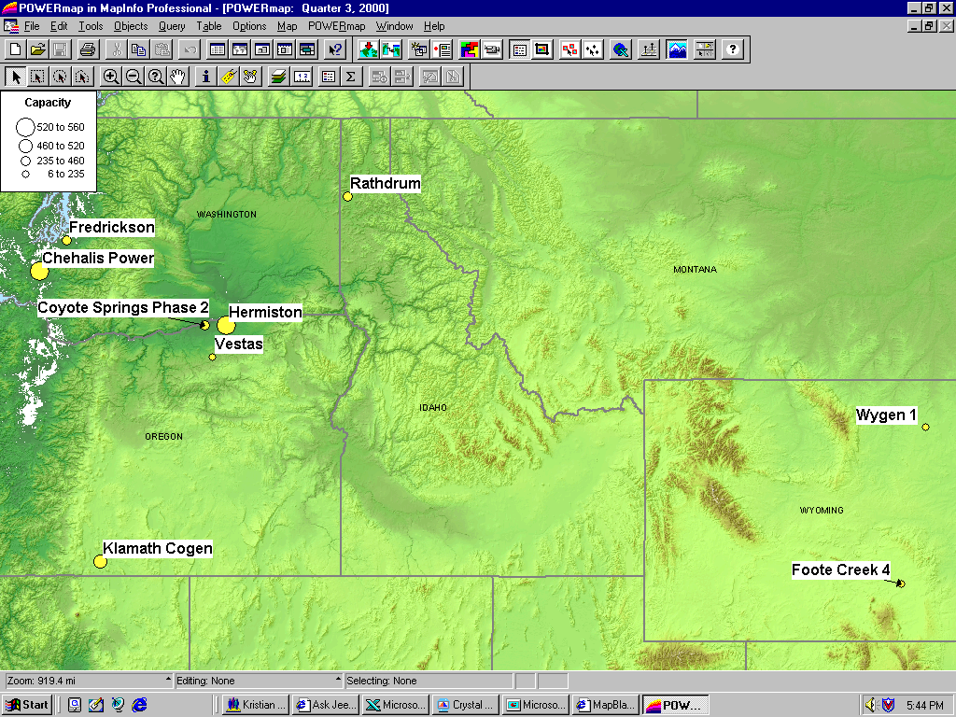
PNW New Generation Map

Slide 8
Rockies Updates
Colorado Office of Consumer Counsel claims that PSCO wasted $567 million by not building generation. (MWD 11/14/00) This did not stop the PUC from approving these purchases on Dec 14th.
North American Power Group has announced plans to invest $175 million in a new power line that would connect Colorado's Front Range with coal-fired generation resources in Wyoming and northern Colorado. If approved, the plans call for the project to be completed in 2004 and predict that 30% more power could be delivered to electricity markets in Colorado. The lines would run from northeast of Douglas, Wyoming into Colorado near Ault and south into metro Denver, according to WAPA.
Ft. St. Vrain, 235 MW (UC), June 2001. Construction has begun on this 3rd unit of existing 2 7FA converted nuke site.
PSCo has issued its “Recommended Plan” which shows 739 MW for 2002, 334 MW for 2003 and 516 MW 2004 for a total of 1,589MW.
Ray Nixon (Phase 2), 460 MW, May 2003. Not short listed, but will probably be built(80%).
PSCo has a $4.5 million DSM Request for Proposal for Bid 2001 which is roughly 362 MW.
Midway, 225 MW, Jul 2001. 6 LM6000 Peaker. PPA signed for 11 year toll on Oct 15th. Air Permits received Oct 31st. County commission approval received Dec 14th.
Rockies

Slide 9
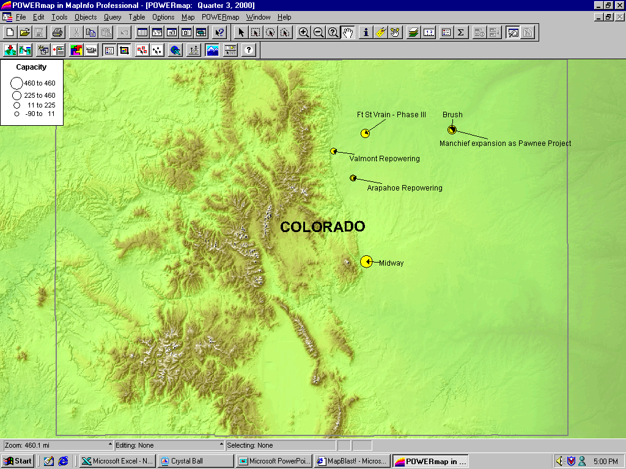
Rockies New Generation Map

Slide 10
DSW Updates
Nevada
  Williams plans to construct a 125 MW peaking plant at a site near Las Vegas, Nevada, with capabilities to be expanded to 300 MW. Williams expects 62 MW to be in service in the fourth quarter of 2001 and an additional 63 MW to be available in second-quarter 2002. The power plant will provide generation for the Las Vegas area and to points that transfer power to other regions, including California. Natural gas supplies will be obtained from Williams Kern River Pipeline System.
  Sierra Pacific Power and Nevada Power have asked the state Public Utilities Commission to approve a voluntary load-curtailment program that would pay market-based rates to large users that are willing to cut demand during peak hours. The one-year pilot would target 400 customers that have at least 1 MW of load and can curtail at least 500 kW. The utilities said they are hoping the program will free up 300 MW when demand soars, reducing their need to purchase power in the expensive spot market.
Arizona
  Duke Energy broke ground on a new $250 million generation facility in Arlington Valley, AZ. The 570 MW merchant plant will supply power to the market by summer 2002. The facility acquired all the necessary permitting and received approval from Arizona regulators and local officials in Maricopa County.
DSW

Slide 11
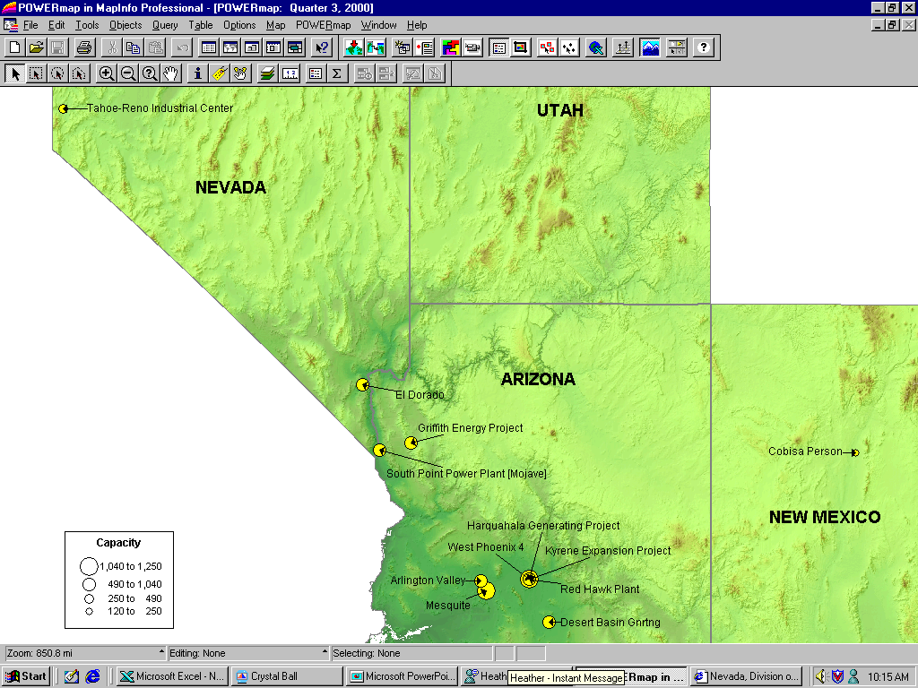
DSW New Generation Map

Slide 12
Summary
RO: Rockies PNW: Pacific Northwest DSW: Desert Southwest
Summary

Slide 13
Sorted List By Online Date
Items in bold are shown on the preceding graph

Slide 14
Sorted List By Region

Slide 15
WSCC Capacity Additions
I
II
I. Rosarito, CFE, 450 MW, Aug-01 not included. Rosarito is not connected to the CFE main grid, but it can export to SP15 during an emergency.
II. Mountainview, SP15, 1056 MW, May-03
Summer Summary

